Slide 1

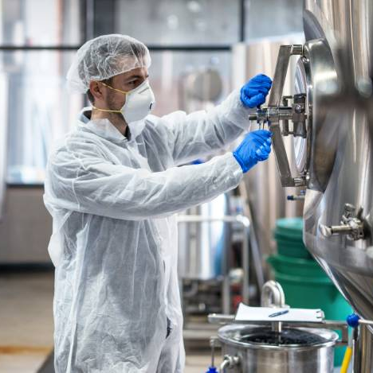
Inventys –
Corporate Overview
Inventys Service Offerings
Key Statistics
Mission & Values
Marquee Client Base
Safety &
Sustainability
Manufacturing Facilities
Deep Domain Expertise
New Capacity Timeline
Wide Chemistry Range
Sustainable & Reliable Inventys
Notes:
When we speak about Inventys, we cannot underemphasize our demonstrated decade long commitment to circularity. We have walked our talk. Another important defining feature of Inventys is its deep domain expertise and its wide chemistry capabilities. And finally, I would like to explain in some detail - our manufacturing capabilities – both current and in the near future.

Slide 2


Exclusive Synthesis & CDMO Services
Exclusive Synthesis
CDMO Services
Manufacturing Services
Discovery & Development Support
Butibori MIDC, Nagpur
Mumbai
Mfg Site
Corporate HQ
Inventys Mission
Be the most reliable & trustworthy Exclusive Synthesis & CDMO partner
to Global Innovator Supply Chains in Lifesciences domain
Product Development
  Discovery (gm to Kg scale)
  Regulatory Trials for
  Ph I to Ph III
  (few kgs to 100s kgs)
Regulatory support (2024 onwards)
Up to 100s MT /yr
Crop Protection
Healthcare
Other Specialty Chemicals
Notes:
Inventys provides Exclusive Synthesis and CDMO services to life science & specialty chemicals innovator companies. We also support innovator in their discovery, product development, & commercialization efforts. We can supply material from few grams up to several hundreds of tons of material. Inventys Manufacturing Sites are located near Nagpur in Central India and the Corporate Office is situated in Mumbai.

Slide 3

Inventys Values
Reliability & Trustworthiness
the core guiding principles
Deep Domain Expertise
Responsive &
Transparent
ZERO Critical Dependence on Unreliable Entities
Responsible Behavior
Society
Employees
IPR
Backward Integration driven by Research & Engineering Skills
Environment
Suppliers
Safety
Compliance
Quality
Sound Financials
Notes:
Our values are guided by our mission. Inventys has developed deep domain expertise in a relatively short time of 15 years. The culture we have built at Inventys is that of flexibility, responsiveness, & transparency. We focus on backward integration to ensure absolutely ZERO critical dependence on the unreliable entities. It needs to be stated emphatically that Inventys does not compromise on the principles of Intellectual Property Rights. We are RESPONSIBLE. Safety is ingrained in our culture. Our people are constantly trained and reminded regularly of our obligation to safe operations.

Slide 4


Safety & Sustainability
Culture
Systems
Hardware
Training
Safe
Manufacturing
Decade+ long demonstrated commitment excellence in Safe Manufacturing & Sustainable Practices
> 51%
of the total energy
from renewable resources
Since 2012
89
Notes:
We are an also established practitioner of Circularity. Inventys has converted more than 50% of its energy - to be derived from non-depletable resources, since as early as 2012. We have also enthusiastically adopted of the principles of Green Chemistry.

Slide 5
Inventys – Process Safety Systems
Hazard Identification & Characterization
  Literature
  TSU / DSC - ALL steps, ALL RMs/Intermediates, ALL Products, ALL Waste
  RC – when required
Process Safety Analysis
  Identify Onset Temperatures, Rate, Profile of Temperature and Pressure Increase
  Evaluation of MTSR, Onset Temperatures vs. MTT
  Peak Gas Formation Rate + Vent Sizing
  HAZOP – Three times
Hazards Addressal
  Process Improvements / Modifications
  PID Changes & Equipment Selection
  ALL HAZOP & Safety mandated process interlocks FULLY AUTOMATED with necessary instrumentation & sensors
  SOP and Education
  Continuous Training (1,400 training sessions in 2023 - 450 on safety)

Slide 6
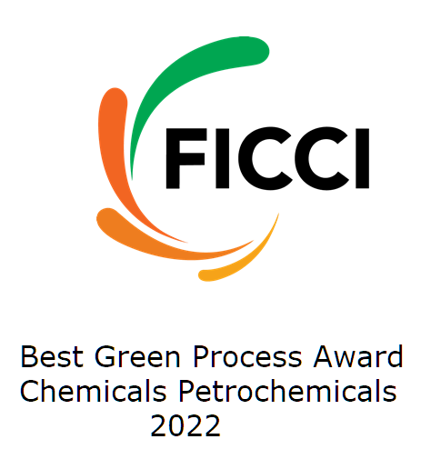
Green Chemistry at Inventys
2
3
1
Atom
Economy
Flow Chemistry
4
Holy grail of green chemistry
Design Safer Chemical Processes
Pollution
Prevention
One major product (3,000 MTs/yr) generates(!) ZERO effluent
Inventys received in 2022 BEST GREEN PROCESS award by Federation of Indian Chamber of Commerce & Industry
12
Inherently Safer Chemistry
for Accident Prevention
Safer
Solvents & Auxiliaries
5
THE
12
Principles
Green
Chemistry
OF
Real-time Analysis for Pollution Prevention
Design for Energy Efficiency
11
6
~30%+ revenue derived from processes SIGNIFICANTLY adhering to the principles of Green Chemistry
Design for Degradation
Use Renewable Feedstocks
10
Reduce
Derivatives
7
Catalysis
Inventys expertise in Flow Chemistry will make your Supply Chain more sustainable
9
8
Notes:
We today can proudly boast of Approximately 25 percent of our revenue from completely green chemistry-based products, with some generating ZERO effluent. Our commitment to circularity was recognized by the Federation of Indian Chamber of Commerce and Industries - with Best Green Process award in 2022.
Over the last few years, we have developed good expertise in continuous and flow chemistry. One product has been commercially implemented at the scale of 10 Tons per day and two more products – using the flow chemistry technology – at about 5 tons per month. Currently six more products under development will use flow chemistry substantially with quantities in the range of 10-500 metric tons per year.

Slide 7





Exclusive Synthesis & CDMO Services
Concept to Manufacturing
Commercial Production
(3 – 24 months)
Laboratory Feasibility
(1 – 3 months)
Pilotation
(1 – 3 months)
10-500+ MT scale
Plant retrofit / New Plant Design & Construction
Full process automation
Grams scale
RoS Finalization
Develop Analytical Methods
Kilogram scale
Stabilizing process
Basic engineering package
Paper Chemistry
(1 – 2 weeks)
Laboratory Process Optimization
(1 – 3 months)
Trial Production
(1 – 3 months)
Shortlisting 2-3 candidates
Estimation of material cost
Estimate cost, hazards, hurdles, etc.
100 grams scale
Achieving quality and yields
Optimize lab process package
10-20 MT scale
Minimum process automation
Training & Plant modification
Supported by a team of 360+ professionals (110+ for New Products Development)
~45 strong management team
Notes:
Inventys has built a strong multi-disciplinary team of over 300 professionals. Our middle management team, with about 45 professionals, having 15-30 years of experience is stable - with less than 5% attrition rate. Over the last 6 years, Inventys has scaled up more than 30 molecules. As a result, Inventys has gained an excellent experience in developing commercially competitive manufacturing technologies. Inventys team consists of over 110 dedicated scientists & engineers to new product development Inventys has succeeded in building a large tool box of chemistry & engineering capabilities.

Slide 8

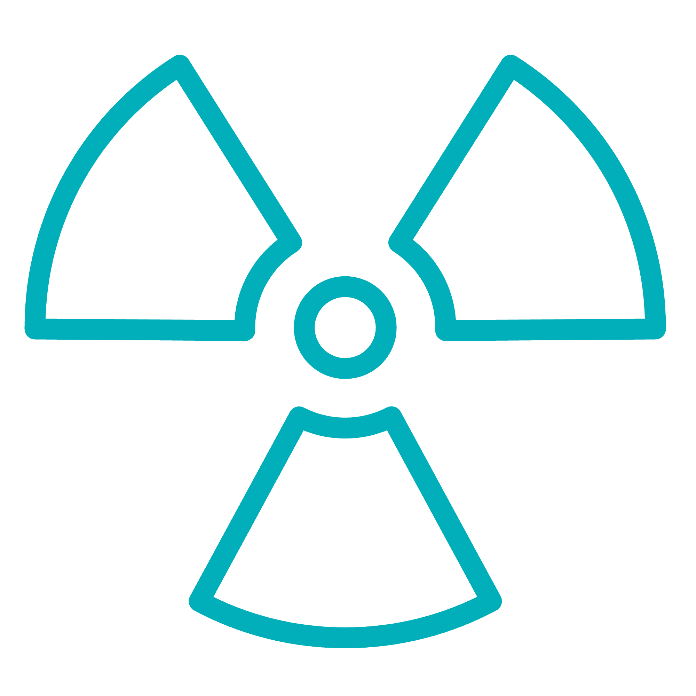
Wide range of Chemistry / Hazardous Materials
Wide range of plant scale implemented chemistry
Defragment your supply chain & hence more robust
Notes:
Today, we can handle many hazardous chemicals at commercial scale. For example, we have been consuming one ton per day Sodium Cyanide & Hydrazine Hydrate for many years. In our new upcoming production plants, we will use HF gas for continuous fluorination. We have already commercialized several products that use KF and fluoroborate salts. Our mastery of numerous complex chemistries and our ability to handle multiple hazardous chemicals – safely in a consistent manner – enables us to help you defragment your supply chain using our backward integration capabilities.

Slide 9



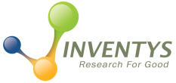
Inventys – Key Statistics
Inventys Revenue Segment
Inventys Customers
Raw Material Sources
Inventys revenue & customer segmentation is a testimony to its superior Exclusive Synthesis services.
Inventys RM sourcing pattern is one of the factors contributing to high reliability
Notes:
Inventys groups total revenue currently exceeds rupees 5 billion (or $70 million) Majority of Inventys revenues are derived from Crop Protection segment. with more than 75% of Inventys revenue from Japan and USA. About 25% of Inventys revenue is derived in India selling chemicals to pharma companies that helps them reduce critical dependency on China. A small percentage of revenue comes from electronics industry segment. It is important to note that around 87% of our raw materials are sourced within India. The data above is an average, over last three years, hence fairly representative.

Slide 10

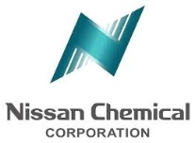

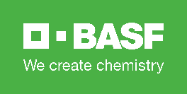




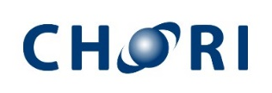






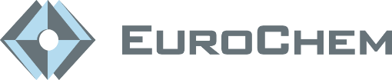




Customers - Exclusive Synthesis
Inventys Customer Base
is a testament to Inventys Reliability & Services Superiority
Notes:
Inventys is fortunate to have served, over the years – many reputed Companies across various continents. Inventys has consistently met /exceeded the stringent criteria of vendor selection by these global companies for over a decade.

Slide 11

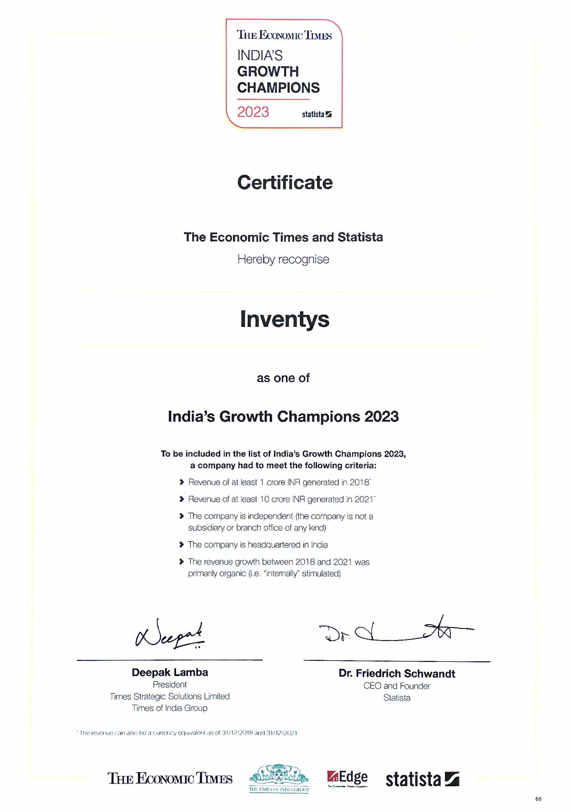
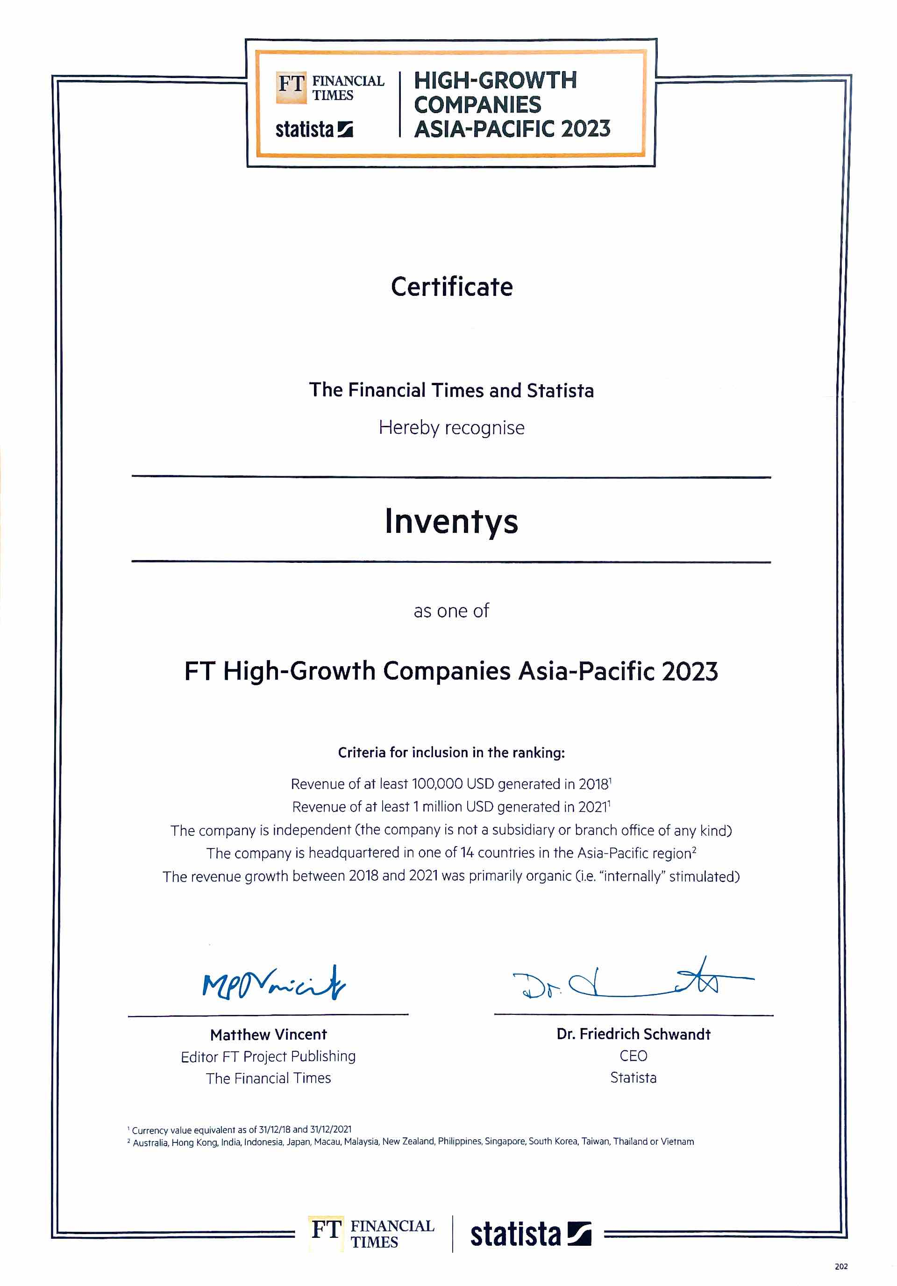
High-Growth Companies Asia-Pacific 2023 – Top250
Ranked 248th – by Financial Times (London)
India’s Growth Champions 2023 – Top100
Ranked 58th – by Economic Times (Mumbai)
Best Green Process
Federation of Indian Chamber of Commerce & Industries) 2022
Titans of Indian Business
Fortune India Exchange Special Edition in February 2022
Inventys - Awards
Business Across Borders
dun & bradstreet (India) in annual publication 2021
Top 10 Dynamic Business leaders of 2022
The Week magazine
Leaders of Tomorrow award
ET NOW (Economic Times)” 2012
Notes:
Inventys has received many awards and accolades over the last decade. Some notable ones are listed here. Inventys was listed by Financial Times of London – to be among the top 250 fastest growing companies in the Asia Pacific region. Less than 5% of these 250 are chemicals manufacturing companies Inventys was also listed by Economic Times of India to be among the 100 Growth champions of India These two surveys were conducted by Statista of Germany.

Slide 12
Inventys Manufacturing Infrastructure
SITE I
SITE II
SITE III
SITE IV
7 Acres
12 Acres
5 Acres
Healthcare & Specialty Integrated Manufacturing
Healthcare Manufacturing Site
Crop Protection Manufacturing Site
Pharma KSMs, Advanced Intermediates, Specialties
Crop Protection Actives, RSMs, Advanced Intermediates, Specialties
Crop Protection Herbicides
Healthcare CDMO CRO
50+ Batch Reactors (& 45 in future) + Cfg. /Dryers/Dist. etc & Utilities – 5 Prod Blocks
250+ Batch & Flow Reactors Other Supporting Equipment & Utilities
In 16 Production Blocks
60 Batch & Flow Reactors
Other Supporting Equipment Utilities
R&D/ADL/QC/Safety/Microbiology/EffTreat Labs
45 Products
To be Decided
Pilot Plant for Scale Up studies – 12 reactors
Small Lot Manufacturing – 29 reactors
(30 lit / 300 lit / 1000 lit)
~11 Production Blocks
Quality Control
Various Utilities
5 Production Blocks
Quality Control
Various Utilities
3 Production Blocks,
Microbiology / ADL / QC Laboratories
Various Utilities
300+ KL Reaction Capacity
1200+ KL Reaction Capacity
500+ KL Reaction Capacity
To be Decided
Operating Since 2008
Early 2024
Early 2024
2026
Necessary Permissions in Place
Necessary Permissions in Place
Necessary Permissions in Place
Inventys manufacturing capacity will increase 6x in next 5 years
Notes:
In order to serve our customers better, Inventys manufacturing capacity is poised to grow significantly. Site 2, is dedicated to specialty chemicals, advanced intermediates, and crop protection actives. This site will have a up to 14 production blocks, Whereas the site 3, is dedicated to herbicides production. This site will contain 5 independently operating production blocks. First phase of expansion will be commissioned in early 2024.
From the current capacity of about 45 batch reactors at the Integrated Manufacturing Site 1, Inventys will add more than 300 batch and flow reactors at these 3 new sites

Slide 13
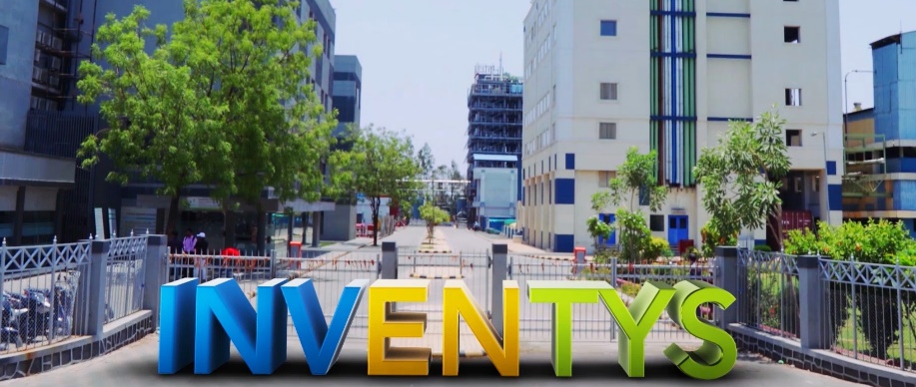



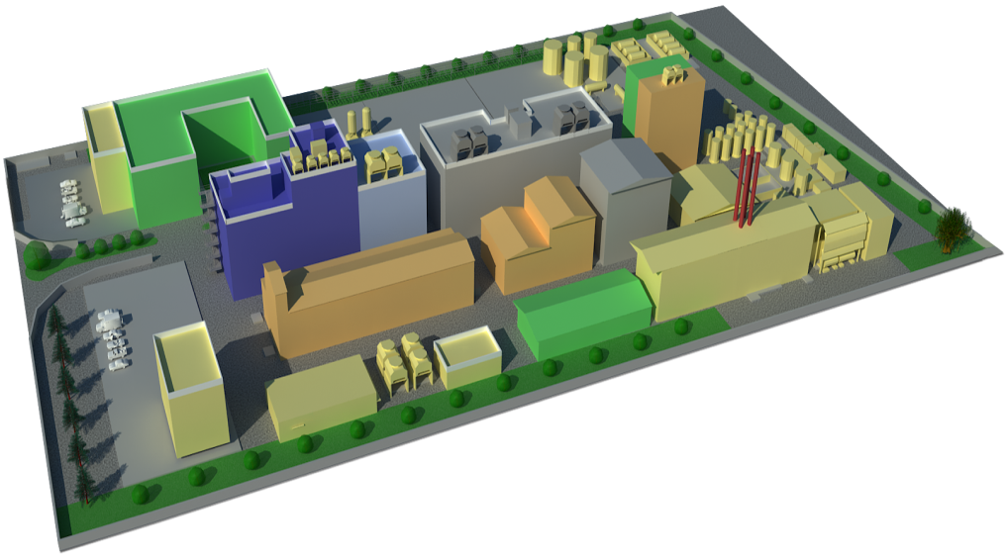


Integrated Manufacturing Site 1 –
Pharma & Specialty Chemicals
WHO GMP
ISO 9001, ISO 14001, ISO 45000
Concept
Manufacturing
Synthesis Strategy to Process Development
Scale up to Commercial Production
Continuous Improvement
Quality Assurance & Quality Control
Laboratories
Manufacturing Facilities
R&D (Batch/Flow) & ADL
Process Safety & Hazards, Effluent Treatment,
QC, QA, & Microbiology
APIs & RSMs
Specialties
Advanced Intermediates (GMP & non-GMP)
Bulk Intermediates
Kilo Labs & Pilot Plants
Scale up Studies (12 reactors)
Small Lot Mfg (29 reactors)
Total 41 reactors
30 – 300 – 1000 lit
Effluent Treatment Facilities
500 KL/Day Discharge Permission
5 min Virtual Tour
https://youtu.be/9rcNlSdsyX8
Notes:
Inventys integrated manufacturing site number 1 has been operating since 2008. It houses more than 45 reactors up to 15,000 liters in size, another 45 reactors will be added. Additionally, our new pilot plant has more than 40 reactors. 30 liters, 200 liters, and 500 liters. Scaling up a product from laboratory stage to Metric Ton scale production, is a complex task. This happens to be one of the core strengths of Inventys. Inventys is WHO GMP, ISO 9001, ISO 14001, and ISO 45000 certified.
The Knowledge Center houses quality, safety, analytical, flow chemistry, as well as research & product development laboratories as well as Process Design & Engineering, and the Projects department. You may virtually visit this site for 5 short minutes on YouTube, using the link provided.

Slide 14
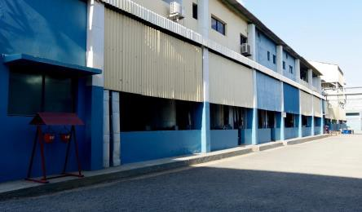
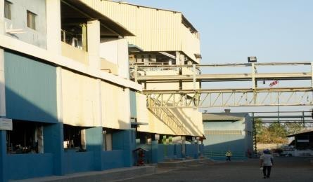
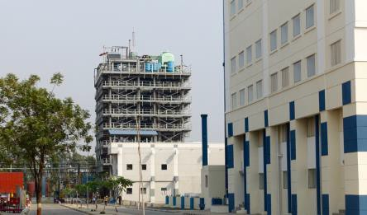
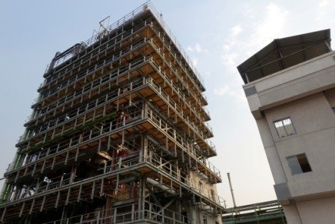
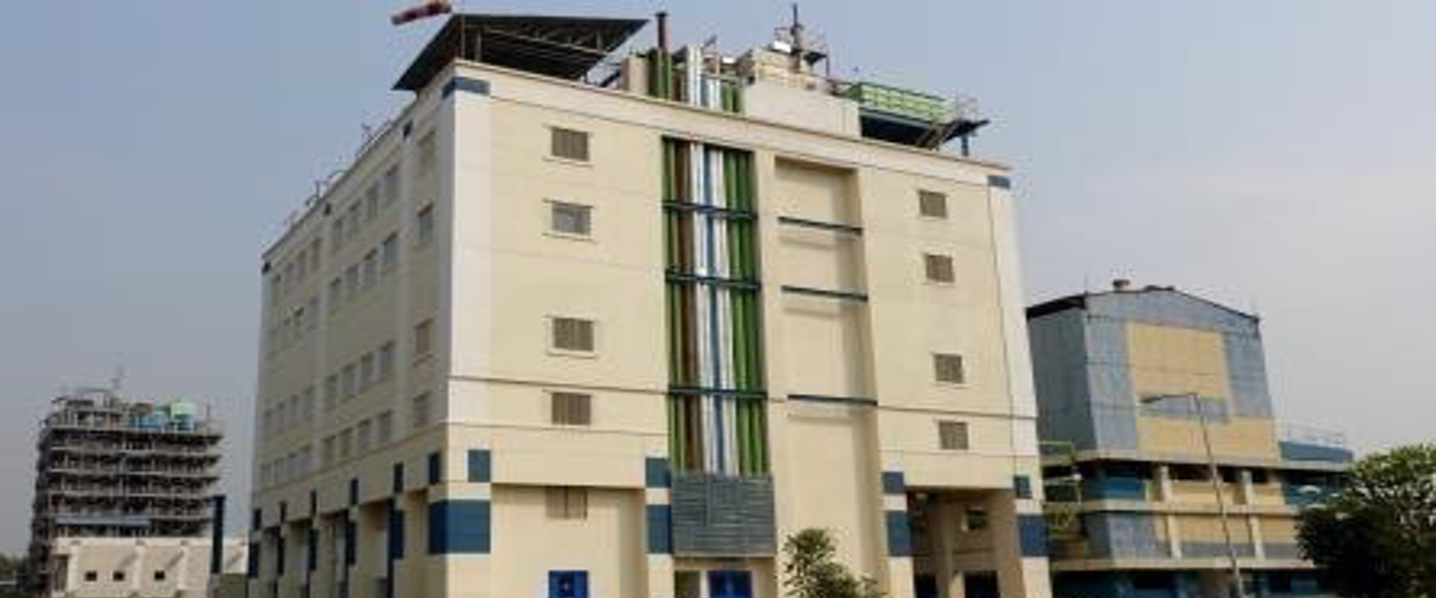

Integrated Manufacturing Site 1
1
Knowledge Centre – R&D, Process Engg
2
Plant 1 – Advance Intermediates
3
Plant 2A/2B – Cyanation & Multi-Purpose Plants
4a
Plant 2C1 & 2C2 – Advanced Intermediates
Inventys production plants are highly automated.
BMRs can be generated automatically
4b
Plant 2C3, 2C4 & 2C5 – Advanced Intermediates
5
Plant 3AB – API
6
Plant 6 –
Hydrogenation Plant
Notes:
Pictures of various production blocks are shown here. The YouTube virtual tour will give you a better idea of our site facilities and its operational standards

Slide 15
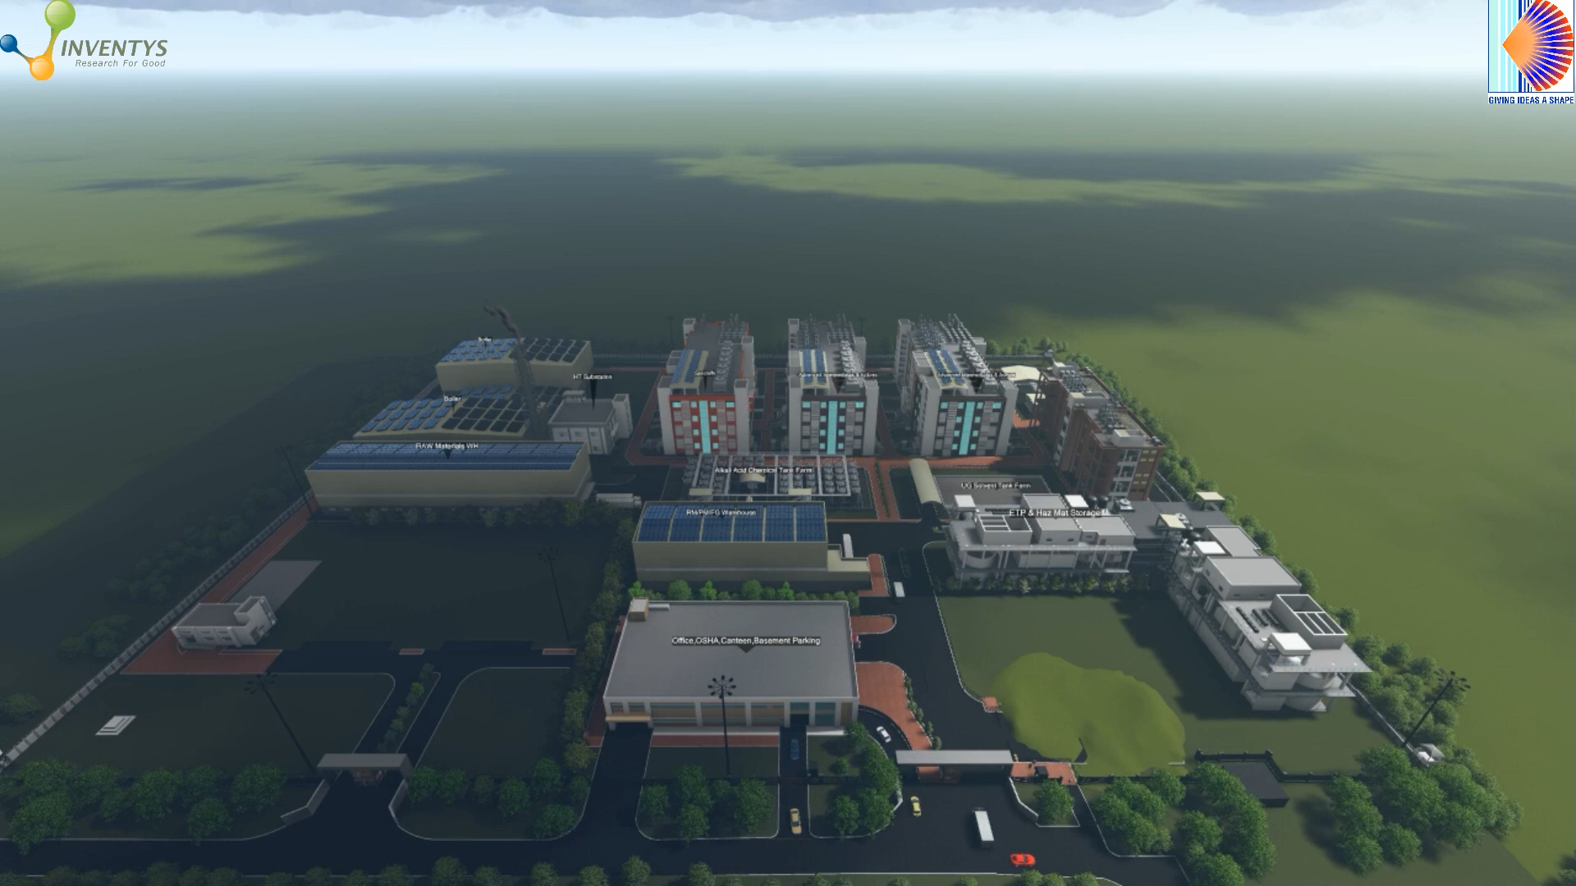
New Site 2 – Production Capacities
Actives (Fungicides & Insecticides)
3 Production Blocks (6 Production Lines)
36 Reactors (Batch/Flow) – 200+ KL
Plus other supporting equipment
Registered Starting Materials / Adv Intermediates / Specialty Chemicals
6 Production Blocks
150 Reactors (Batch/Flow) – 900+ KL
Plus other supporting equipment
Hydrogenation
1 Production Block
6 Reactors (Batch/Flow) – 50+ KL
Halogenation (HF/KF/etc)
1 Production Block
10 Reactors (Batch/Flow) – 50+ KL
Fermentation Products
1 Production Block
To be decided
Notes:
The greenfield Site - two is designed for the production of various advanced intermediates, specialty chemicals, and actives. This manufacturing site will also have dedicated production blocks for hydrogenation, halogenation, and fermentation. Fluorination by HF gas and by KF as well as by Fluoroborate salts will be implemented on this site. Hydrogenation as well as Fluorination will be conducted in batch as well as in flow manufacturing mode.

Slide 16
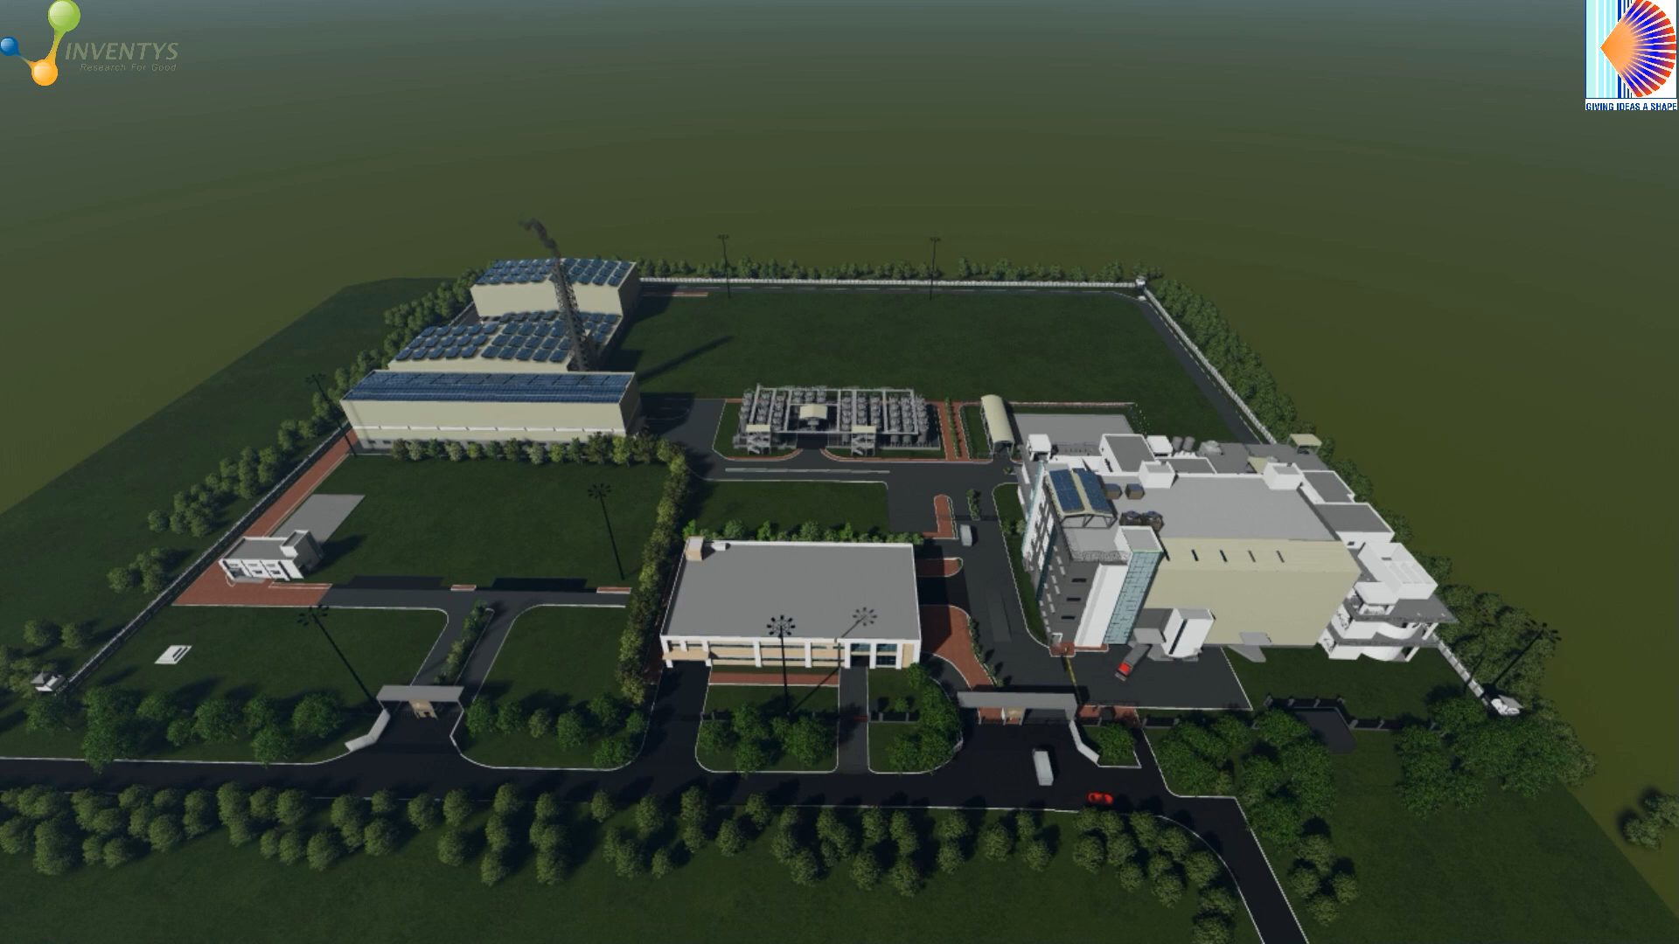
New Site 3 – Production Capacities
Herbicides
5 Production Blocks
50 Reactors (Batch/Flow) – 500+ KL
Plus, other supporting equipment
Quality Control
Quality Assurance
Warehouses
Primary Effluent Treatment
Byproduct Recovery
Parking
Notes:
Inventys Site three is designed for herbicides production. This site will contain five independent production blocks. To ensure adequate containment, all the support facilities – including the final product warehouses will be located within this Site three.

Slide 17



Inventys New Capacity Timeline
New Crop Protection Facility
4th Facility for Healthcare Chemicals
~30 more flow reactors (plus other supporting equipment) will be commissioned
Second Herbicides Block
Expansion of the CRO facilities
Kilo and few MT scale production facilities
Early 2024
End 2024
2026
2027
New Crop Protection Facility
Expansion of the Crop Protection Facility
Production Block PB1 – for advanced intermediates
One Herbicides Block
One Actives Block (2 independent lines)
Production Block PBHY for Hydrogenation & Fluorination by HF gas
  Up to 36 atm batch Hydrogenation
  Up to 50 atm continuous Hydrogenation
  Batch and continuous fluorination
Permissions in place
Production Block PB2 & 3 – for advanced intermediates
Three more Herbicides Block
Two Actives Block (Four independent lines)
Doubling of reaction capacity in the Production Block PBHY for Hydrogenation & Fluorination
Inventys will serve your manufacturing requirements competently
Notes:
To summarize Inventys provides reliable & state of the art Exclusive Synthesis & CDMO services. Our demonstrated track record of backward integration would help you defragment your supply chain & make it more robust. With our flexible and responsive culture – we have what it takes – to be your trustworthy partner through changing times.
Because of our deep domain expertise, we will hit the ground running. We will require less handholding and we will deliver the results faster.
And finally, in our industry segment, we probably have THE most superior demonstrated track record of practicing sustainable behaviour.
Today – we can confidently state without exaggeration – that we have implemented & consistently demonstrated – all the qualities and the capabilities that are necessary as well as sufficient – to become your MOST reliable and trustworthy manufacturing & discovery partner.

Slide 18
Inventys – IP Protection
Culture
  Sensitization
  Discipline
  Training
IT infrastructure
  Thin Clients -- USB x
  eMails & Printing Regulation
  Modified Cellphones on site
Protection of Key Identifiers
  Encoding without Safety Compromises
  Strictly Limited Exposure
  SDS SOPs etc. – Recreated
Legal Measures
  Strong Confidentiality Agreements
  Project & Product Specific Agreements
  Ready for aggressive pursuit

Slide 19
Inventys – Quality
Accreditations
  WHO GMP
  ISO 9001
  ISO 14001
  ISO 45001
Audits
  Facility audited and approved by Govt Authorities, as well as by major Pharma / Crop Protection / Specialty Chemical innovator multinationals
Quality by design
  Robust processes to ensure fail proof systems
  Focus on complete life cycle from R&D to production
  Testing and release of ALL batches including intermediates as well as in-process monitoring
Automation
  All key process (Heat & Mass Transfer related) parameters including controlled additions - DCS controlled
Cross Contamination Prevented by Design
  All liquid handling in closed loop, with isolation at entry point
  All solid handling in dedicated rooms / areas

Slide 20
Inventys – Environmental Care
On-site Effluent Treatment Plant
  EACH Production plant has dedicated a preliminary effluent treatment section
  Neutralization & Aeration Ponds (COD/BOD reduced to <250) & MEEs
  Site 1 Discharge Permission = 300 kL /day
  Sites 2 & 3 Discharge Permission = 700 kL /day
Solvent Recovery
  COMPLETELY performed internally -- No external agency is involved
  EACH Production plant buildings has dedicated a solvent recovery section
    14 distillation columns on site 1
Butibori MIDC - Effluent Treatment Infrastructure
  Common Effluent Treatment Plant (CETP) -- Well-operated – 20+ years unblemished record
  Common Incinerator
  Common Landfill(s)
Effluent Treatment – Process Development
  Dedicated laboratory for effluent treatment technology development
  Focus of continuous improvement and adoption of new technologies

Slide 21
Demonstrated Track Record of Sustainable Reliable and Safe Practices
11+ years of highly sustainable practices
15+ years of consistently high-quality reliable supply & safe practices
Debt Free
Large State-of-the-Art automated production capacity
~3,000,000 Lit of reaction capacity (2024-2027)
Top 10 in India
Ready capacity availability
Exclusive Synthesis / CMO / CDMO for large Innovator Supply Chains
Professional Management Team with well funded 5-year business plan
Sustainable
& Reliable
Complex Broad Range Chemistry + Superior Engineering
Stable reliable backward-integrated supply chain for our customers
Flow Chemistry Experts
Financial Times (London) & STATISTA (Germany) rated Inventys Top 250 fastest growing company in Asia Pacific
Notes:
To summarize Inventys provides reliable & state of the art Exclusive Synthesis & CDMO services. Our demonstrated track record of backward integration would help you defragment your supply chain & make it more robust. With our flexible and responsive culture – we have what it takes – to be your trustworthy partner through changing times.
Because of our deep domain expertise, we will hit the ground running. We will require less handholding and we will deliver the results faster.
And finally, in our industry segment, we probably have THE most superior demonstrated track record of practicing sustainable behaviour.
Today – we can confidently state without exaggeration – that we have implemented & consistently demonstrated – all the qualities and the capabilities that are necessary as well as sufficient – to become your MOST reliable and trustworthy manufacturing & discovery partner.

