Slide 1
Quality Management System at Inventys
Quality Management System
Policy
Organization
Processes
Quality standards
Quality elements and Principles
Audit Process
Problem Detection
CAPA
Virtual tour

Slide 2
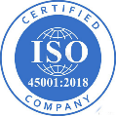
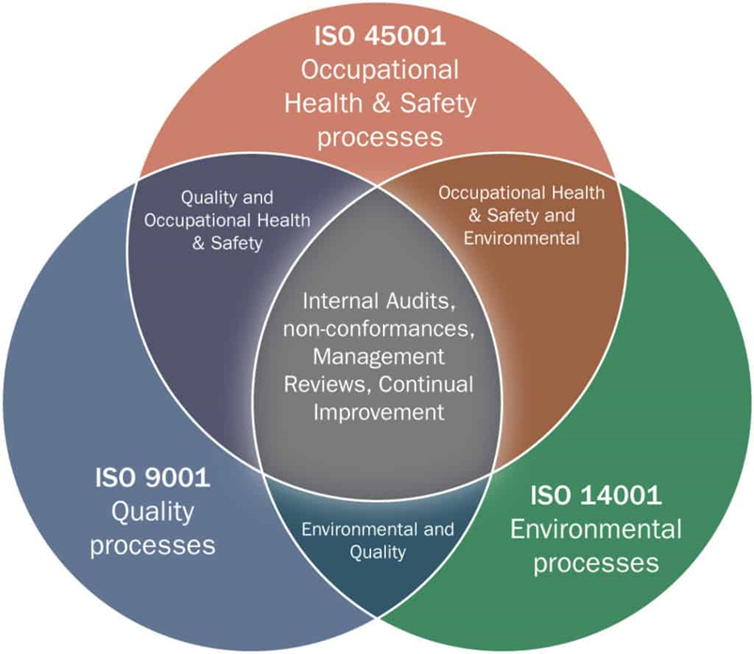
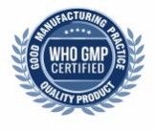
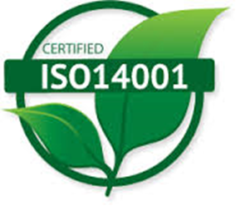
Quality Management System
Policy
Requirement
Standards
Guideline
Standard operating procedure
Inventys is committed to achieve customer satisfaction and meet changing expectations through:
Health & Safety
Continual quality improvement
Adhere up to GMP requirements
Meeting the national and international regulatory requirements
Qualified and fast response to the customers and authorities

Slide 3
Quality, Health, Safety and Environment Policy 1/3
“Safety of a person is the top priority other than any target” is the Quality, Health, Safety and Environment policy of InventyS Research Company.
InventyS believes that due to continual improvement in safe working environment through regular learnings, trainings and practicing Quality, Health, Safety and Environment procedures, all incidents, accidents, and environmental incidents brings to near zero.

Slide 4
Quality, Health, Safety and Environment Policy 2/3
Inventys is committed to
Carry out all its activities in such a way that it avoids any harm to employees, contractors and to the environment.
Encourage employees and contractors to take care of their occupational health and personal safety.
Enhance continually its environmental practices and performance.
Reduce adverse impact on environment and minimize the risk to the peoples which may arise from its operational activities and transportations.
Manage all energy resources in a responsible way to minimize emissions and reduce waste generation.
Comply all statutory requirements related with Quality, Safety, Health and Environment.
Develop safe working environment through regular learnings, trainings and practicing Quality, Health, Safety and Environment Systems and Procedures among all its employees and contractors.

Slide 5
Quality, Health, Safety and Environment Policy 3/3
Inventys strives to achieve these objectives by
Operating the plant with provisions of adequate safeguards to establish effective process safety. | Investigating all incidents relating to Quality, Health, Safety and Environment and implementation of corrective action on all incidents.
Continuous process development with well defined systems to improve process and operational criterion and stringent applications of the same. | Providing trainings to employees about outcome of investigations of incidents occurred internally or externally and steps to be taken to avoid such incidents in future.
Applying Standard Operating Procedures for operations, maintenance, and emergency situations | Identifying and evaluating a factual base to define the likelihood of adverse health effects of workplace- associated injuries and exposures and carrying out pre- employment and periodic health check up of its employees
Inspecting and updating existing systems and procedures on regular basis. | Implementing programs and appropriate protective measures to control such risks
Providing Trainings to employees and contractors on quality, health, safety, and environmental practices followed by company. | Regular monitoring of work environment and plant waste generations and taking measures to achieve better environmental performance.
Providing safe & healthy working conditions for the prevention of work-related injury and ill health by using adequate personal protective equipment, tools, and tackles. | Communicating with local authorities on operations, likely hazards, and emergency response systems
Regular auditing of external and internal work practices and procedures | Keeping abreast of latest international codes, standards and practices and adopting the same where applicable.
Eliminating hazards and reduce OH & S risks and to ensure integrity of assets, through consultation & participation of workers and other stake holders
Legends
Quality
Environment & Waste Disposal
Operations

Slide 6
Management System & Quality Excellence
Management System compliant with international standards
INVENTYS Integrated Management System ensures alignment of management core processes
Directives on key elements provide the underlying framework
Focus are all core processes during the product life cycle
Production
Scaleup
R&D

Slide 7
Management System & Quality Excellence
Document Type | Orientation | Content | Binding nature | Approver
Policy | Strategic | Vision, mission, values | Binding | Managing Director INVENTYS
Directive | Methodological | Key elements | Binding | Responsible Member of the INVENTYS Management Board
Procedure | Operational | Instructions | Binding | Head of INVENTYS function
Work instruction | Operational | Detailed instructions | Binding | Unit Manager
Guideline / Best Practice | Operational | Advice, Recommendations | Non-binding (advisory) | Unit Manager
Other documents | Operational | Not specified | Document specific | Document specific

Slide 8
Management Organization Quality
Chairman & Managing Director
Director Manufacturing
Head Accounts (F& A)
R&D, Operations, Technology, ADL
GM Manufacturing
Sales, Marketing Strategy, Portfolio Management
Director Compliance
ADL
Supply Chain
GM Engineering
GM Works
QC
QA
Stores
HSE
HR & Admin
Joint Managing Director

Slide 9
Inventys QA Organization
QA Department
DGM
Executive
QA Officer
QA Officer
QA Officer
QA Officer
QA Officer
Asst. Manager
&
Sr. Executive

Slide 10
Inventys QC Organization
QC
Department
Sr. Manager ADL
Asst. Manager
Chemist
Chemist
DGM
R&D &ADL
Asst. Manager
Microbiologist

Slide 11
5 Key Components of Good Manufacturing Practices
Material and Product
Premises
People
Procedure
Process
RM, Regent, solvents, Product contact
Facility control
Ware house; Production; Utilities; Quality control/QA/QC; HR and HSE
All associate with Product : site Organogram QMS
Site Master file : Policy and QMS Maintain complete records : Regulatory
SOP,
Qualification and validation

Slide 12
10 Principles of GMP 1/2
Standard Operating Procedures (SOP) for processes and design specifications for facilities and equipment
1. Create
4.Document
Thoroughly
The SOP and specifications
2.Follow
5.Monitor
The facilities and equipment
The SOP and specifications
3.Validate

Slide 13
10 Principles of GMP 2/2
Competent and qualified personnel
6. Employee
9. Ensure
Quality in operations, manufacturing, logistics, and distribution
Products against contamination
7.Protect
10. Perform
Periodic audits with certified auditors
components and processes that are related to the product
8.Control

Slide 14
Certifications
State License for Manufacturing Healthcare Products 2018
Renewal 2023 April valid up to April 2028
Central WHO certification GMP :- 2020
ISO 9001:2015 IRQS/210100486 Valid 23/03/2024
ISO 14001:2015 IRQS/210300487 Valid 23/03/2024
ISO-45001:2018 IRQS/210400488 Valid 23/03/2024
Validity 5 Years
Manufacturing of Speciality Chemicals, Agro Actives, APIs, & Advanced Intermediates for Pharma & Agro
LICENSE No : 25-MH/102571
State FDA approval 2019
Certificate number 6116113
Validity Yearly
Valid 5/11/2024
Certificate No.: NEW-WHO-GMP/CERT/ND/126239/2023/11/46894
Validity 3 years 2020
Renewal June 2023 Valid Aug 2026
Dosage Form(s) Active Pharmaceutical Ingredients (Bulk Drugs)
Activity(ies) Synthesis, Purification, Packing, Labelling, Quality Control, Quality Assurance
Integrated ISO Certification 2012

Slide 15
Continuous Education
Inventys places significant importance to continuously upgrading skills of Inventys team
Trainings conducted in 2023
~1400
Training Categories
Safety
Quality
Environment
Health
Maintenance
Production Practices
Organic Chemistry
Analytical Chemistry
Chemical Engineering
etc

Slide 16
Quality INVENTYS Standards
Cross contamination prevention technical measures
Separation of Product Groups
Dedicated buildings
Dedicated equipment or Line with CIP System
No interconnections / common lines (purge / ventilation lines, utility piping (steam, compressed air etc.)
Cross contamination prevention organizational measures
Organizational measures
Product Change Over
Standard Procedures in place Clean up / Set up Start up
Defined Roles and Responsibilities for approval of release and sign-off
Defined up-to-date cleaning levels / cleaning matrix with (ACL)
Analytical capabilities available to determine residual impurities as requested
Standard Documents
Equipment usage Log
Equipment cleaning record
Line clearance
Validation Process
Equipment
Software
Process
Qualification Process
Design Qualification (DQ)
Installation Qualification (IQ)
Operational Qualification (OQ)
Performance Qualification (PQ)
Documentation
System
Established System to monitor and record “Quality” for all aspects of Good manufacturing practices (GMP) and other Quality System pertaining
Document Types
Standard operating procedures
Protocols
Specification and method of analysis
Record

Slide 17
Quality Assurance Responsibilities
QA Department is responsible to ensure QMS implementation & maintenance
Ensuring product quality and adherence to SOPs
In process checks and record verification
Supplier Qualification
Internal audits and compliance
Documentation Control
Change Control and Deviation Management
Stability Evaluation of Products.
Equipment qualifications, Validations & Calibrations.
Batch Release.
Complaint handling and CAPA implementation
Review & approval of out of Specification and out of Calibration
Annual Product Quality Review
GMP Training & Implementation

Slide 18
Quality Control & ADL Infrastructure
Quality Control Instruments
HPLC (High Performance Liquid Chromatography)
GC (Gas Chromatography)
UV Spectrometer
Stability Chamber
IR
KF Titrator
Combi flash
Microbiology Instruments
Biological Incubator
Autoclave
Microscope
Colony counter
Hot Air Oven
LAF
Analytical Development Lab
NMR
TSU
etc

Slide 19
Quality Element INVENTYS Audit process
Audit planning
Long term audit plan
Annual audit program
Approval and distribution of the audit program
Detail audit program
Prepare an audit
Approval and distribution of the audit program
Prepare audit
Audit conduction
Conduct audit opening meeting
Review existing documents
Conduct audit
Determine audit results
Audit reporting and communication
Action item tracking
Track actions
Plan audit
review
Update annual audit plan
Update detail audit plan

Slide 20
Quality & CAPA INVENTYS Process
Quality enabling
Q-awareness
Q-coaching
Auditor coaching
CAPA
preventive action
lessons learned
Q-objective
Quality planning
Q-Strategy
Audit planning
Plan
Do
Quality processes
Q-process development
standardization
Quality during development
Risk management
customer orientation
Quality adjustment
Reporting
KPI measurement
Quality cost
Audit conduction
General system audit
Compliance Audit
Process Audit
Subject-specific Audits
Expert Audits
Operational Audits
Act
Check
CAPA
correction action
Complaint management
customer complaints
internal complaints
Q-Process
QHSE-Process
Expert advise
Audit Experts
Quality measurement
current to objective deviation

Slide 21
Standard Operating Procedures
EHS
22 nos.
Production
126 nos.
QA
38 nos.
QC + Microbiology +QCD
138 nos.
Warehouse
33 nos.
Engineering (Electrical + Instrumentation + Maintenance)
63 nos.
16 nos.
HR & Admin
R&D +ADL
73 nos.

Slide 22
Plant Walk-Through

Slide 23
Material Movement
Raw material entry
Raw Material Sampling
Raw Material Analysis
Raw Material Approval & Storage
Raw Material Approval
Intermediate and API Storage

Slide 24
Production flow
Store issue & dispensed the material
Reaction Process
Physical Isolation
Co milling
Sifter
Final analysis
IPC
Approved Material
Intermediate and API Storage warehouse
Operations
RCVD
Tray dryer

Slide 25
Quality control Instrumentation
Wet analysis
UV Spectrometer -1
HPLC - 2
Micro analysis
BOD Incubator 600L*2 400L*1
KF Titrator - 1
Autoclave – 175L
Stability chambers 3Nos 400L*2 800*1
IR - 1
GC (Gas Chromatography) 1

Slide 26
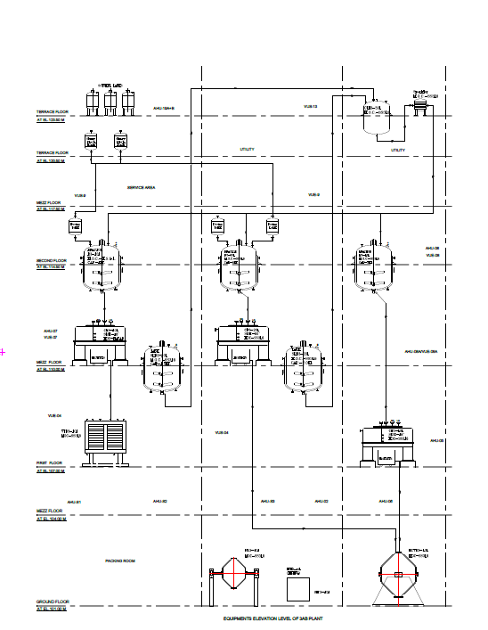
Process Flow by Gravity
Utilities
About the facilities
ISO Class 8 area for reaction, filtration and powder processing. (0.3µ Air supply)
Separate Cubicles provided to avoid cross contamination.
HVAC system provided to maintained pressure,
temperature and humidity.
Atomization for less material exposure.
Purified water 2 KL/hr
Equipment's
Stainless steel Reactor-02
Glass lined Reactor-01
Centrifuge-03
Vacuum Tray Dryer-01
Rota cone Vacuum Dryer-01
Sifter-01
Blender-01
Multimill-01
Dust Collector-03
Separate utilities
Nitrogen
Compressed Air Jacket flushing and instrumentation
Brine -20°C
Cooling water ~29 °C
Chilled water <7°C
Hot water to Reactors and dryer
Standard Documents
Batch Manufacturing Records
Line clearance
Equipment cleaning Records
Equipment usage Log
Temperature, Humidity and Pressure differential Records
House keeping Records
Dispensing area
SSR
Charcoal Treatment
GLR
SSR
SSR
Reaction
SSR
SSR
Isolation
and
purification
Final
isolation
Final
Filling,
packing
and
Sampling
Blender

Slide 27
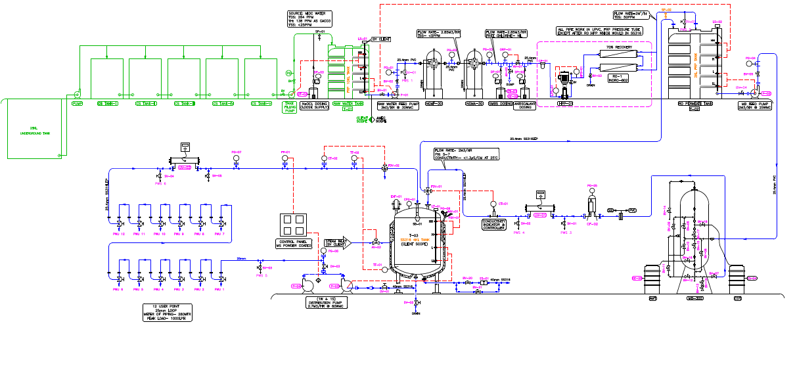
Purified Water System: 2 KL /hr
PW5 After distribution tank – 2nd Floor
Storage and Circulation
Sr. No | Input Municipal Water Quality | Purified Water Quality
1 | pH : 6.5-8.5 | pH : 5-7
2 | Total Hardness (as CaCO3) : NMT 300 ppm | Heavy Metals : NMT 0.1 ppm
3 | Total Dissolved Solids : NMT 500 ppm | Nitrates : NMT 0.2 ppm
4 |  | Conductivity : NMT 1.3 µS/cm
4 KL
12 No’s of User points Twice in a month
6PWS monitoring points Daily
Microbial Analysis of Purified & Potable Water Twice in a month
TAMC (Total Aerobic Microbial Count)
TYMC (Total Yeast & Mold Count)
Specific Pathogen Test (Seven pathogen)

Slide 28
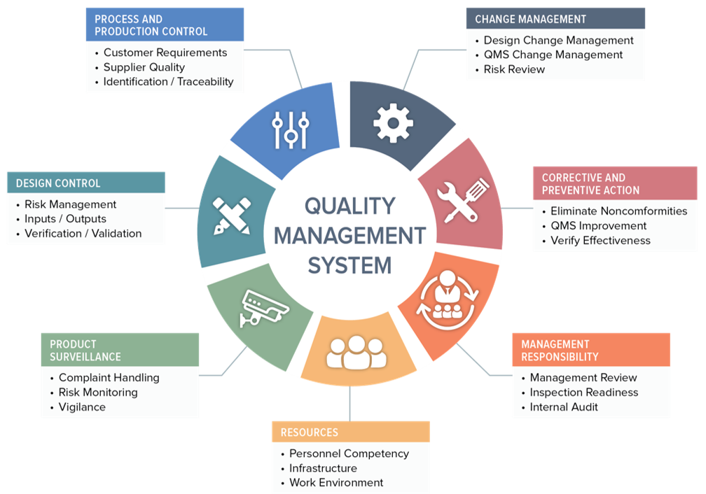
Summary Quality management System

