Slide 1
Inventys HSE Practices
2023 Q4

Slide 2
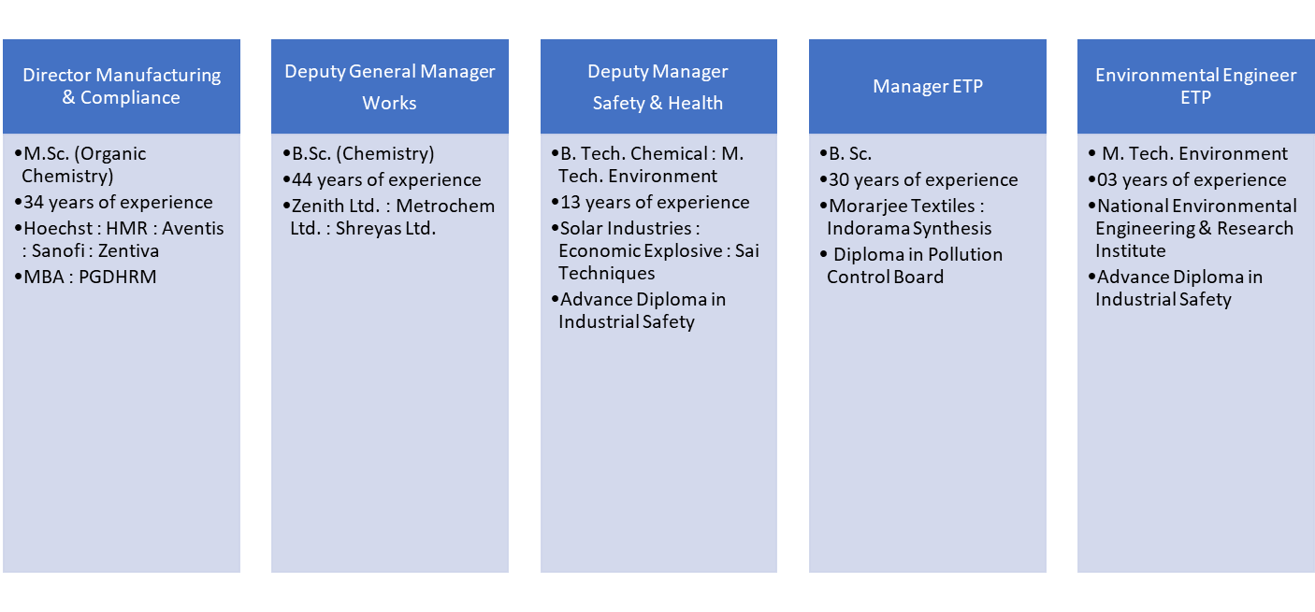
HSE TEAM PROFILE

Slide 3





Health, Safety, Environment and Quality (HSEQ)
Management System compliant with
international standards
ISO 9001:2015, ISO 14001:2015,
ISO-45001:2018
WHO GMP & FDA (Maharashtra)
Professional EHS team
Compliance with local & international EHS regulations

Slide 4


Policy and standard procedure
Policy
Requirement
Standards
Guideline
Standard Operating Procedures

Slide 5
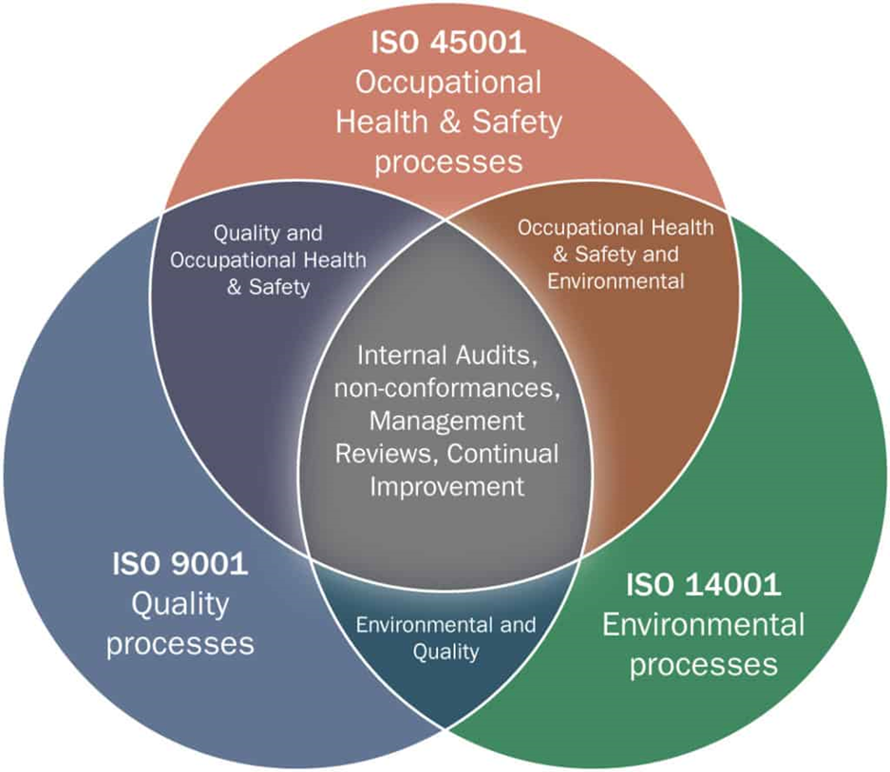
Integrated Management System

Slide 6
ISO Audit Scope
Manufacture of Specialty Chemicals
  Agro and pharma intermediates
  Active pharmaceuticals ingredients (API)
  Agro Ingredients (AI)
Products for ISO Audit (2023)
  API
    Plant 2A,2B,Hydrogenation & 3AB
  Specialty Chemical, Agro and Pharma Intermediates-
    Plant 1A, 2A & 2B
  Agro Intermediate
    Plant 1A/Hydrogenation,2C,1A & 2A
  Specialty Chemical
    Plant 2C
ISO 9001:2015, ISO 14001:2015 and ISO 45001:2018

Slide 7
Quality, Health, Safety and Environment Policy 1/3
Safety of a person is the top priority other than any target” is the Quality, Health, Safety and Environment policy of InventyS Research Company.
InventyS believes that due to continual improvement in safe working environment through regular learnings, trainings and practicing Quality, Health, Safety and Environment procedures, all incidents, accidents, and environmental incidents brings to near zero.

Slide 8
Quality, Health, Safety and Environment Policy 2/3
InventyS is committed to
Carry out all its activities in such a way that it avoids any harm to employees, contractors and to the environment.
Encourage employees and contractors to take care of their occupational health and personal safety.
Enhance continually its environmental practices and performance.
Reduce adverse impact on environment and minimize the risk to the peoples which may arise from its operational activities and transportations.
Manage all energy resources in a responsible way to minimize emissions and reduce waste generation.
Comply all statutory requirements related with Quality, Safety, Health and Environment.
Develop safe working environment through regular learnings, trainings and practicing Quality, Health, Safety and Environment Systems and Procedures among all its employees and contractors.

Slide 9
Quality, Health, Safety and Environment Policy 3/3
InventyS strives to achieve these objectives by :
Operating the plant with provisions of adequate safeguards to establish effective process safety. | Investigating all incidents relating to Quality, Health, Safety and Environment and implementation of corrective action on all incidents.
Continuous process development with well defined systems to improve process and operational criterion and stringent applications of the same. | Providing trainings to employees about outcome of investigations of incidents occurred internally or externally and steps to be taken to avoid such incidents in future.
Applying Standard Operating Procedures for operations, maintenance, and emergency situations | Identifying and evaluating a factual base to define the likelihood of adverse health effects of workplace- associated injuries and exposures and carrying out pre- employment and periodic health check up of its employees
Inspecting and updating existing systems and procedures on regular basis. | Implementing programs and appropriate protective measures to control such risks
Providing Trainings to employees and contractors on quality, health, safety, and environmental practices followed by company. | Regular monitoring of work environment and plant waste generations and taking measures to achieve better environmental performance.
Providing safe & healthy working conditions for the prevention of work-related injury and ill health by using adequate personal protective equipment, tools, and tackles. | Communicating with local authorities on operations, likely hazards, and emergency response systems
Regular auditing of external and internal work practices and procedures | Keeping abreast of latest international codes, standards and practices and adopting the same where applicable.
Eliminating hazards and reduce OH & S risks and to ensure integrity of assets, through consultation & participation of workers and other stake holders

Slide 10
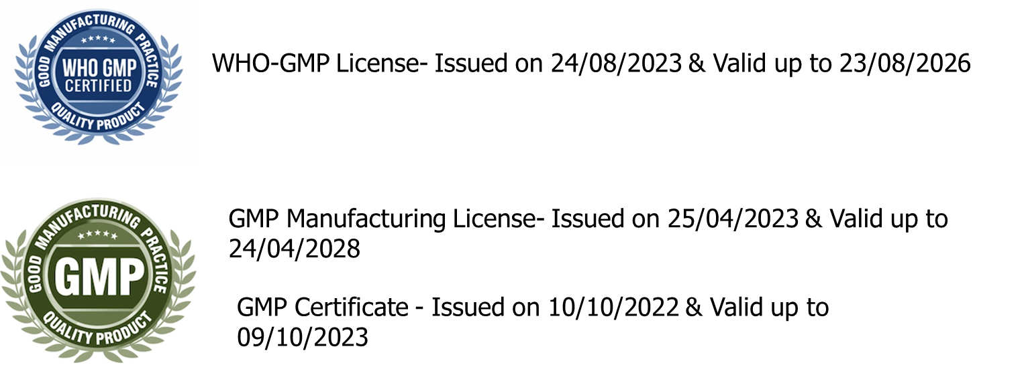
GMP Manufacturing License details
Quality

Slide 11
Standard Operating Procedures
EHS
22 nos.
Production
126 nos.
QA
38 nos.
QC + Microbiology +QCD
138 nos.
Warehouse
33 nos.
Engineering (Electrical + Instrumentation + Maintenance)
63 nos.
16 nos.
HR & Admin
R&D +ADL
73 nos.

Slide 12
Objectives and EMP
The departments covered under IMS objectives
  6 Production Blocks (1A, 2A & 2B, 2C, HYD & 3AB)
  HR, EHS, WH, INST, Maintenance & Utility, QC, Electrical
    List of IMS_ Objective 2023.docx
The departments covered under EMPS
  6 Production Blocks 1A, 2A & 2B, 2C, HYD & 3AB)
  HR, EHS, WH, INST, Maintenance & Utility, QC, Electrical.
  List of IMS_EMP 2023.docx

Slide 13
PSM Elements
Material Hazard Identification
Process Hazard Information
Design Documentation
Inventory Management
Operating Procedures
Skill development & evaluation
Safe work practices
Work Permit system
Emergency planning & response
Passive protection
Preventive Maintenance
PSSR
MOC
Process Incident Investigation
Contractor worker Training program
Management Review ( twice in year)

Slide 14
Safety Management system
Plan
Establish Safety management frame work
Do
Implement planned safety program
Check
Monitor safety performance
Act
Safety awareness
Safety communication
CAPA

Slide 15
HSE practices

Slide 16
Lab feasibility to Production
Lab Feasibility
Process Optimization
Scale up studies
Pilot trials
Trial Production
Commercial production
Route Scouting
Evaluation of selected routes
Hazards identification & listing
Isolation of characterization of intermediates
Screening of reaction parameters
Process sensitivity studies
Process hold up studies and stability studies
DSC studies for reaction mass, intermediates, distillation residue
Reporting of reaction exothermicity – dose dependency
Critical process parameter identifications
Reaction profile at kilo scale
Reaction & impurity profiling
Calculation of dimensionless numbers
Listing of process requirements – Equipments & utilities
Stability studies
Finalization of cleaning protocol
Solvent recovery & reuse; if required
Reaction profile at scale
Throughput calculation
Utility requirement
Selection of reactor and downstream equipment
Finalization of RM, Intermediate and FG handling and storage protocol
Validation of cleaning protocol
Process validation
Finalization of reactor and equipment for commercial scale
Stability studies
Analytical method development
Production planning
Basic engineering package preparation
Production efficiency improvement
Energy conservation
Quality monitoring
Quality monitoring
HAZOP studies
HAZOP studies
Finalization of Engineering & administrative controls
Defining LoP

Slide 17
New Initiative Process Safety
Powder (Intermediate & FG) :
  MIE
  Dust layer Ignition test
  Gas evolution test
  Fall Hammer test (Those steps we used ANFD for drying)
Distillation Process (excluding solvent re-distillations) :
  DSC High pressure (as such sample of mass after solvent distillation & mass after product distillation i.e. final residue)
  ARC only in case of prolong distillation or not unloading bottom residual mass for number of batches.
  RC1 for critical reactions

Slide 18
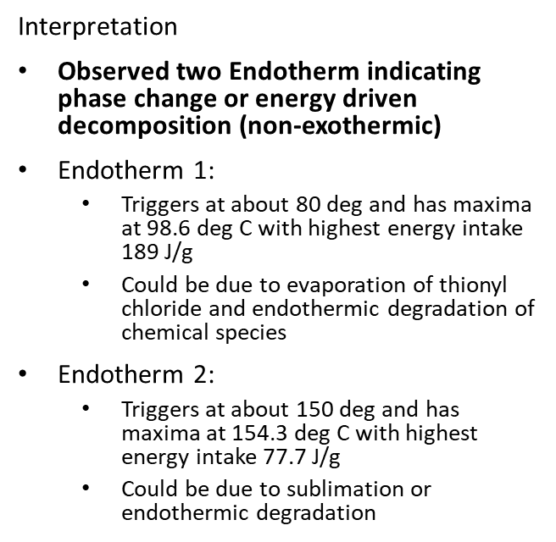
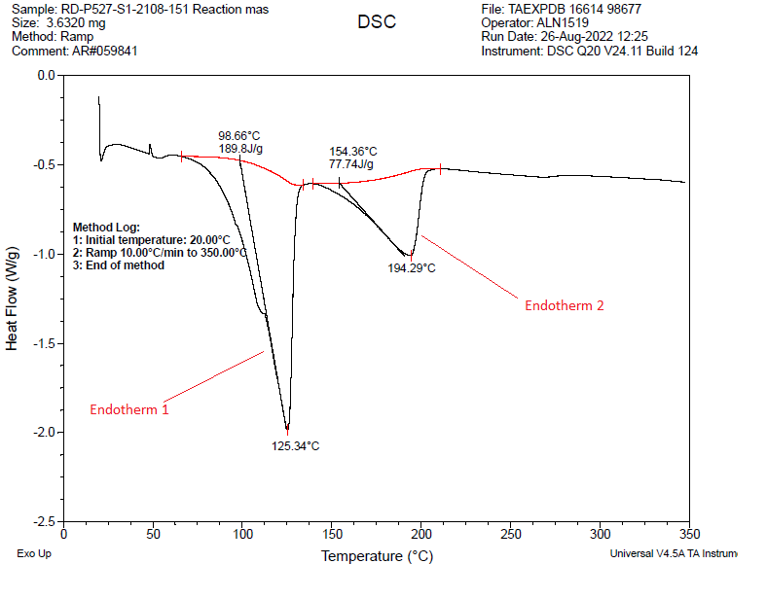
DSC chromatogram – Reaction mass

Slide 19
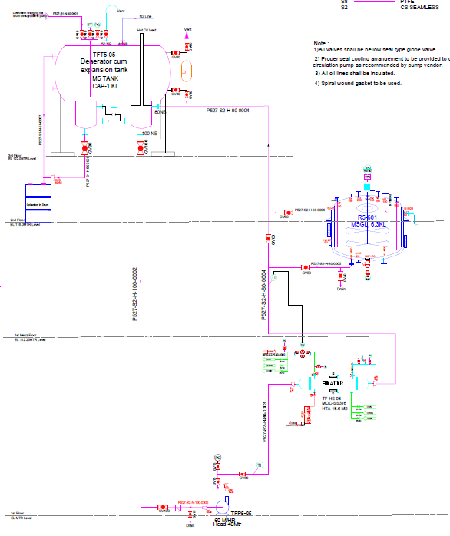
Secondary Heating System

Slide 20
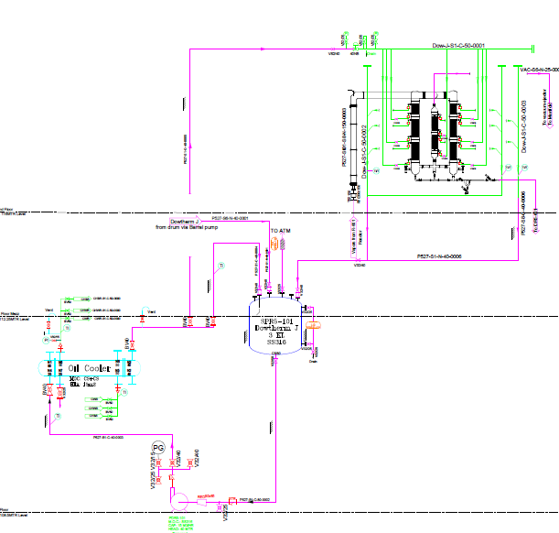
Secondary Cooling System

Slide 21
Safety

Slide 22
Workplace Safety Goal
Lagging : Our Goal is ZERO
  LTIFR (Lost time injury frequency rate)
  Ill Health cases
  MTIFR (Medically treated injury frequency rate)
  Environmental Impact
Leading :
  Unsafe Act, Unsafe Condition reporting
  Near-miss reporting
  Internal Safety Audit & Inspection
  Critical safety interlock test plan
  Refresher training (24 man hrs./employee/year)
  Follow Permit System
  Follow PPE Matrix
  HAZOP, PHA, PSI, PSSR

Slide 23
LTIFR , MTIFR & First Aid Injury

Slide 24
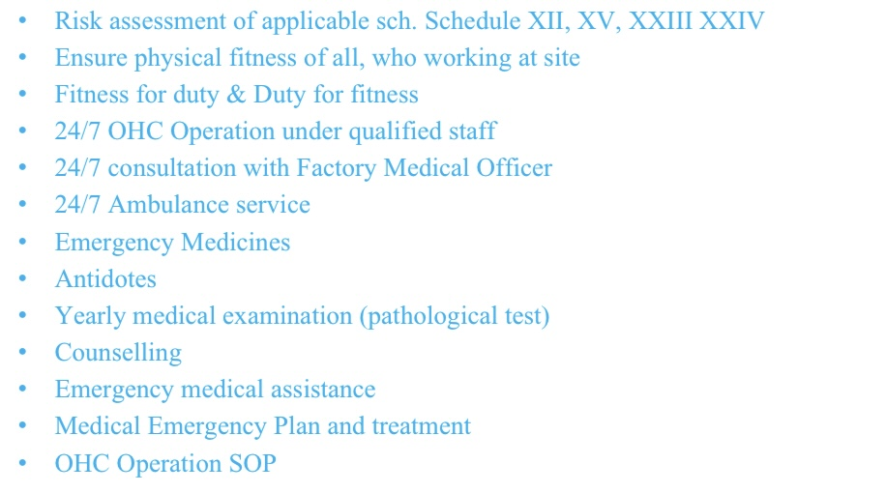
OHC Management

Slide 25
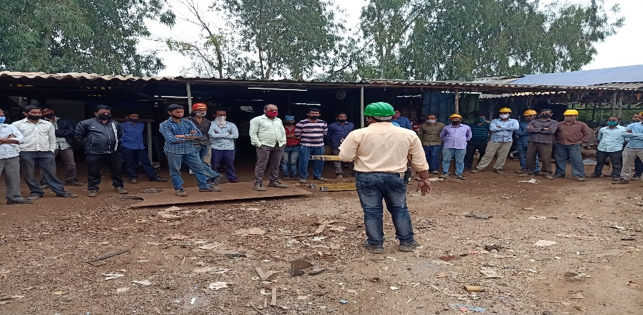
Safety Training Tracking
Total Trainings of Employees :
344 Number
  1st Quarter : 68 Nos.
  2nd Quarter : 156 Nos.
  3rd Quarter : 120 Nos.
Total Trainings of Contractors :
534 Number
  1st Quarter : 152 Nos.
  2nd Quarter : 139 Nos.
  3rd Quarter : 243 Nos

Slide 26
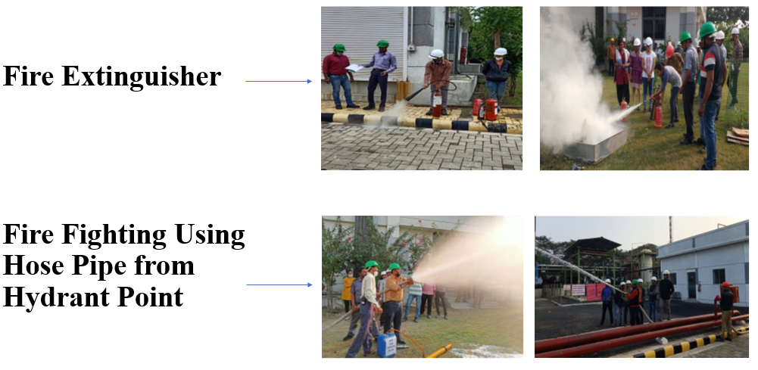
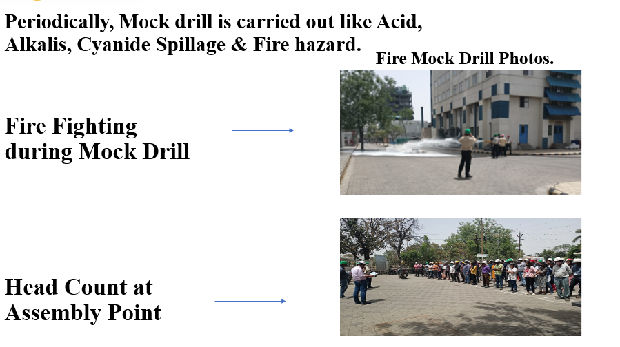
Fire Fighting Training & Mock Drill

Slide 27
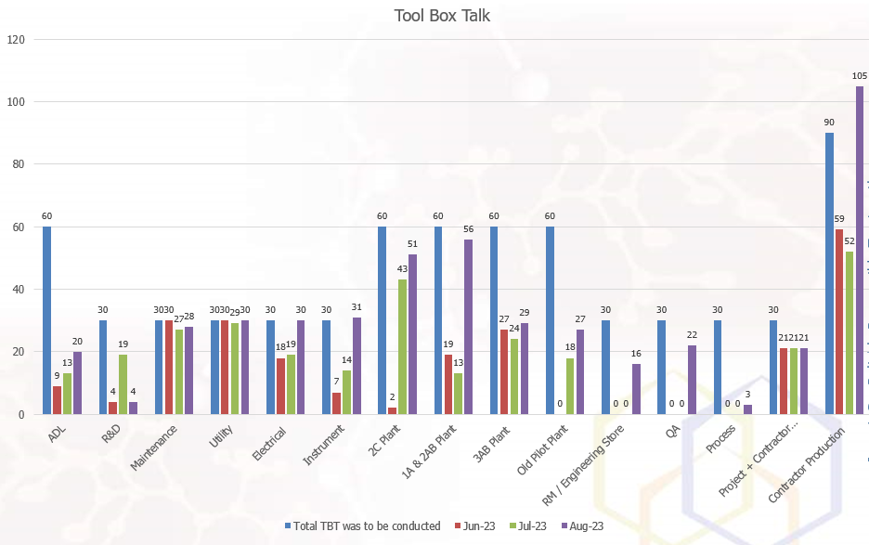
Tool box talk trend

Slide 28
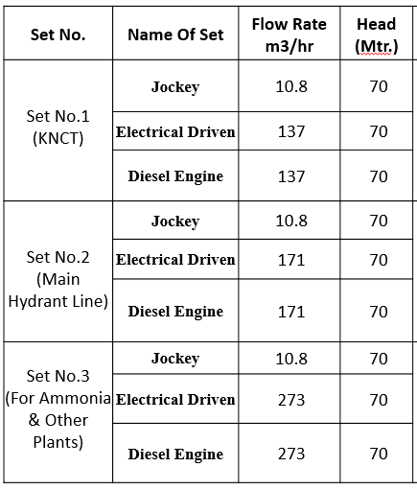
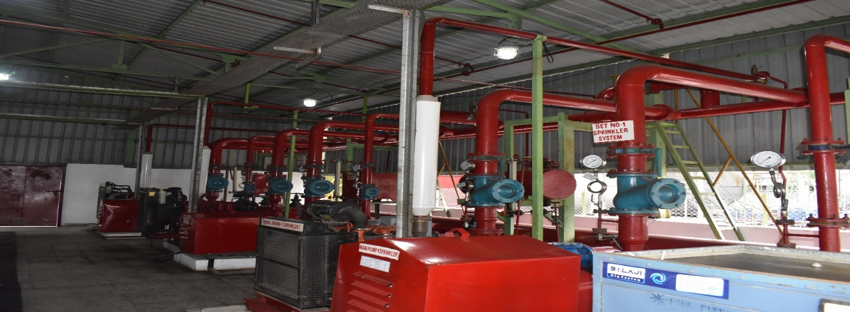
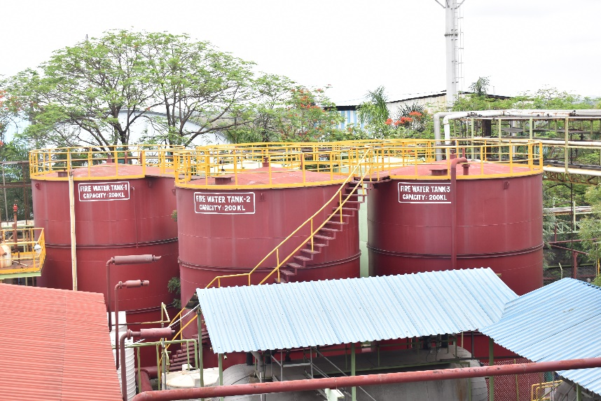
Fire & Safety Provisions
Total Sets = 3 Nos.
1. Sprinkler System
2. Hydrant System
3. Ammonia Storage
Fire Water Storage Tanks (Capacity- 600000 Lit.)

Slide 29
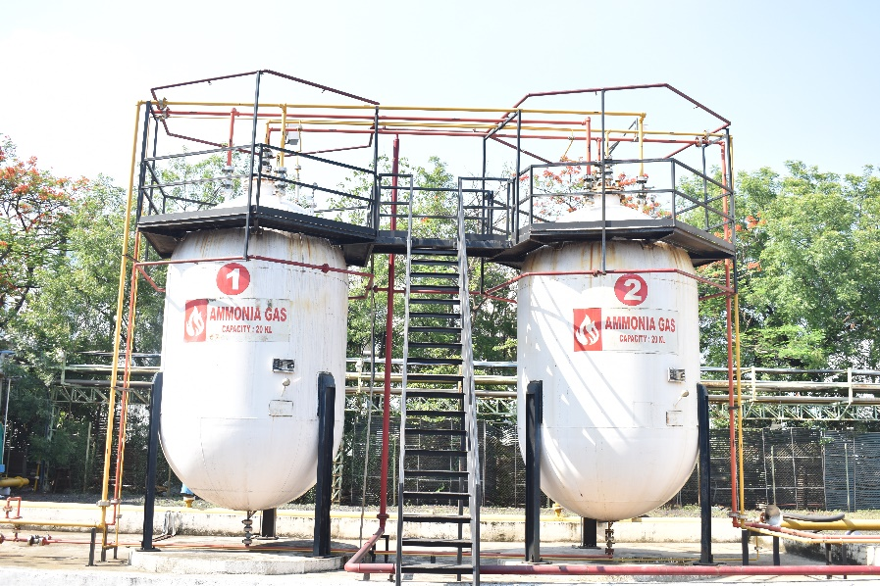

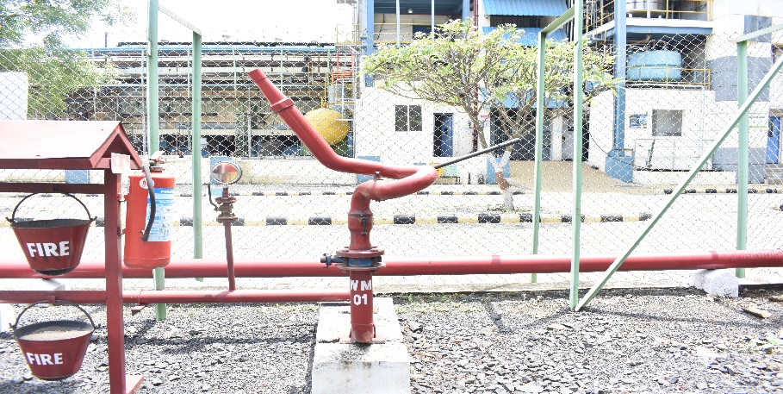
AMMONIA STORAGE AREA
MVWS System above Storage
Sprinkler Storage above Unloading Storage
Water Monitor at Ammonia Storage Area

Slide 30
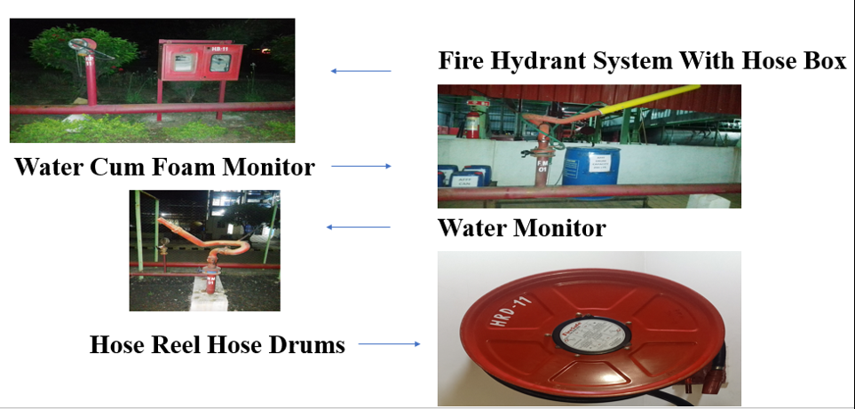
Fire & Safety Provisions

Slide 31
Detection System
Hydrogen Detector Sensor.
We have Automatic as well as manual operated Deluge System with high velocity water spray sprinkler For Hydrogenation Plant.
For Hydrogen Cascade, Pendent type-bulb Sprinkler with alarm System provided.
Medium velocity water spray Sprinkler & Water Monitor for Ammonia Storage tank & Unloading Point.
Smoke detector, Pendent type sprinkler system & manual alarm System provided in KNCT Building.

Slide 32
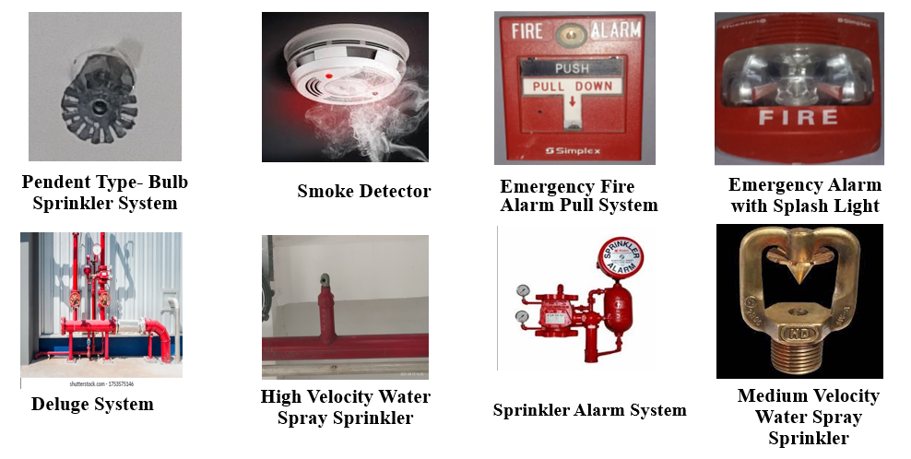
Fire & Safety Provisions

Slide 33
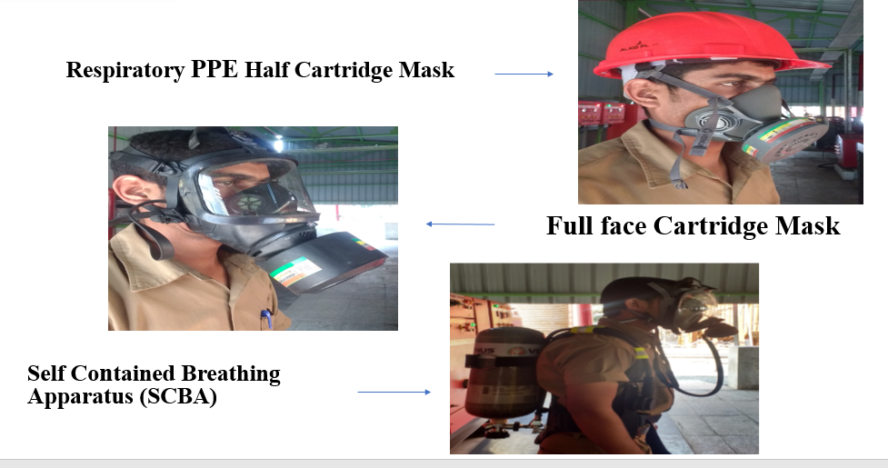
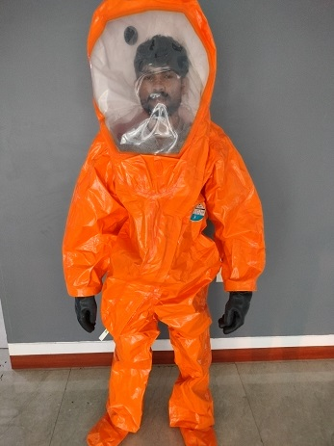
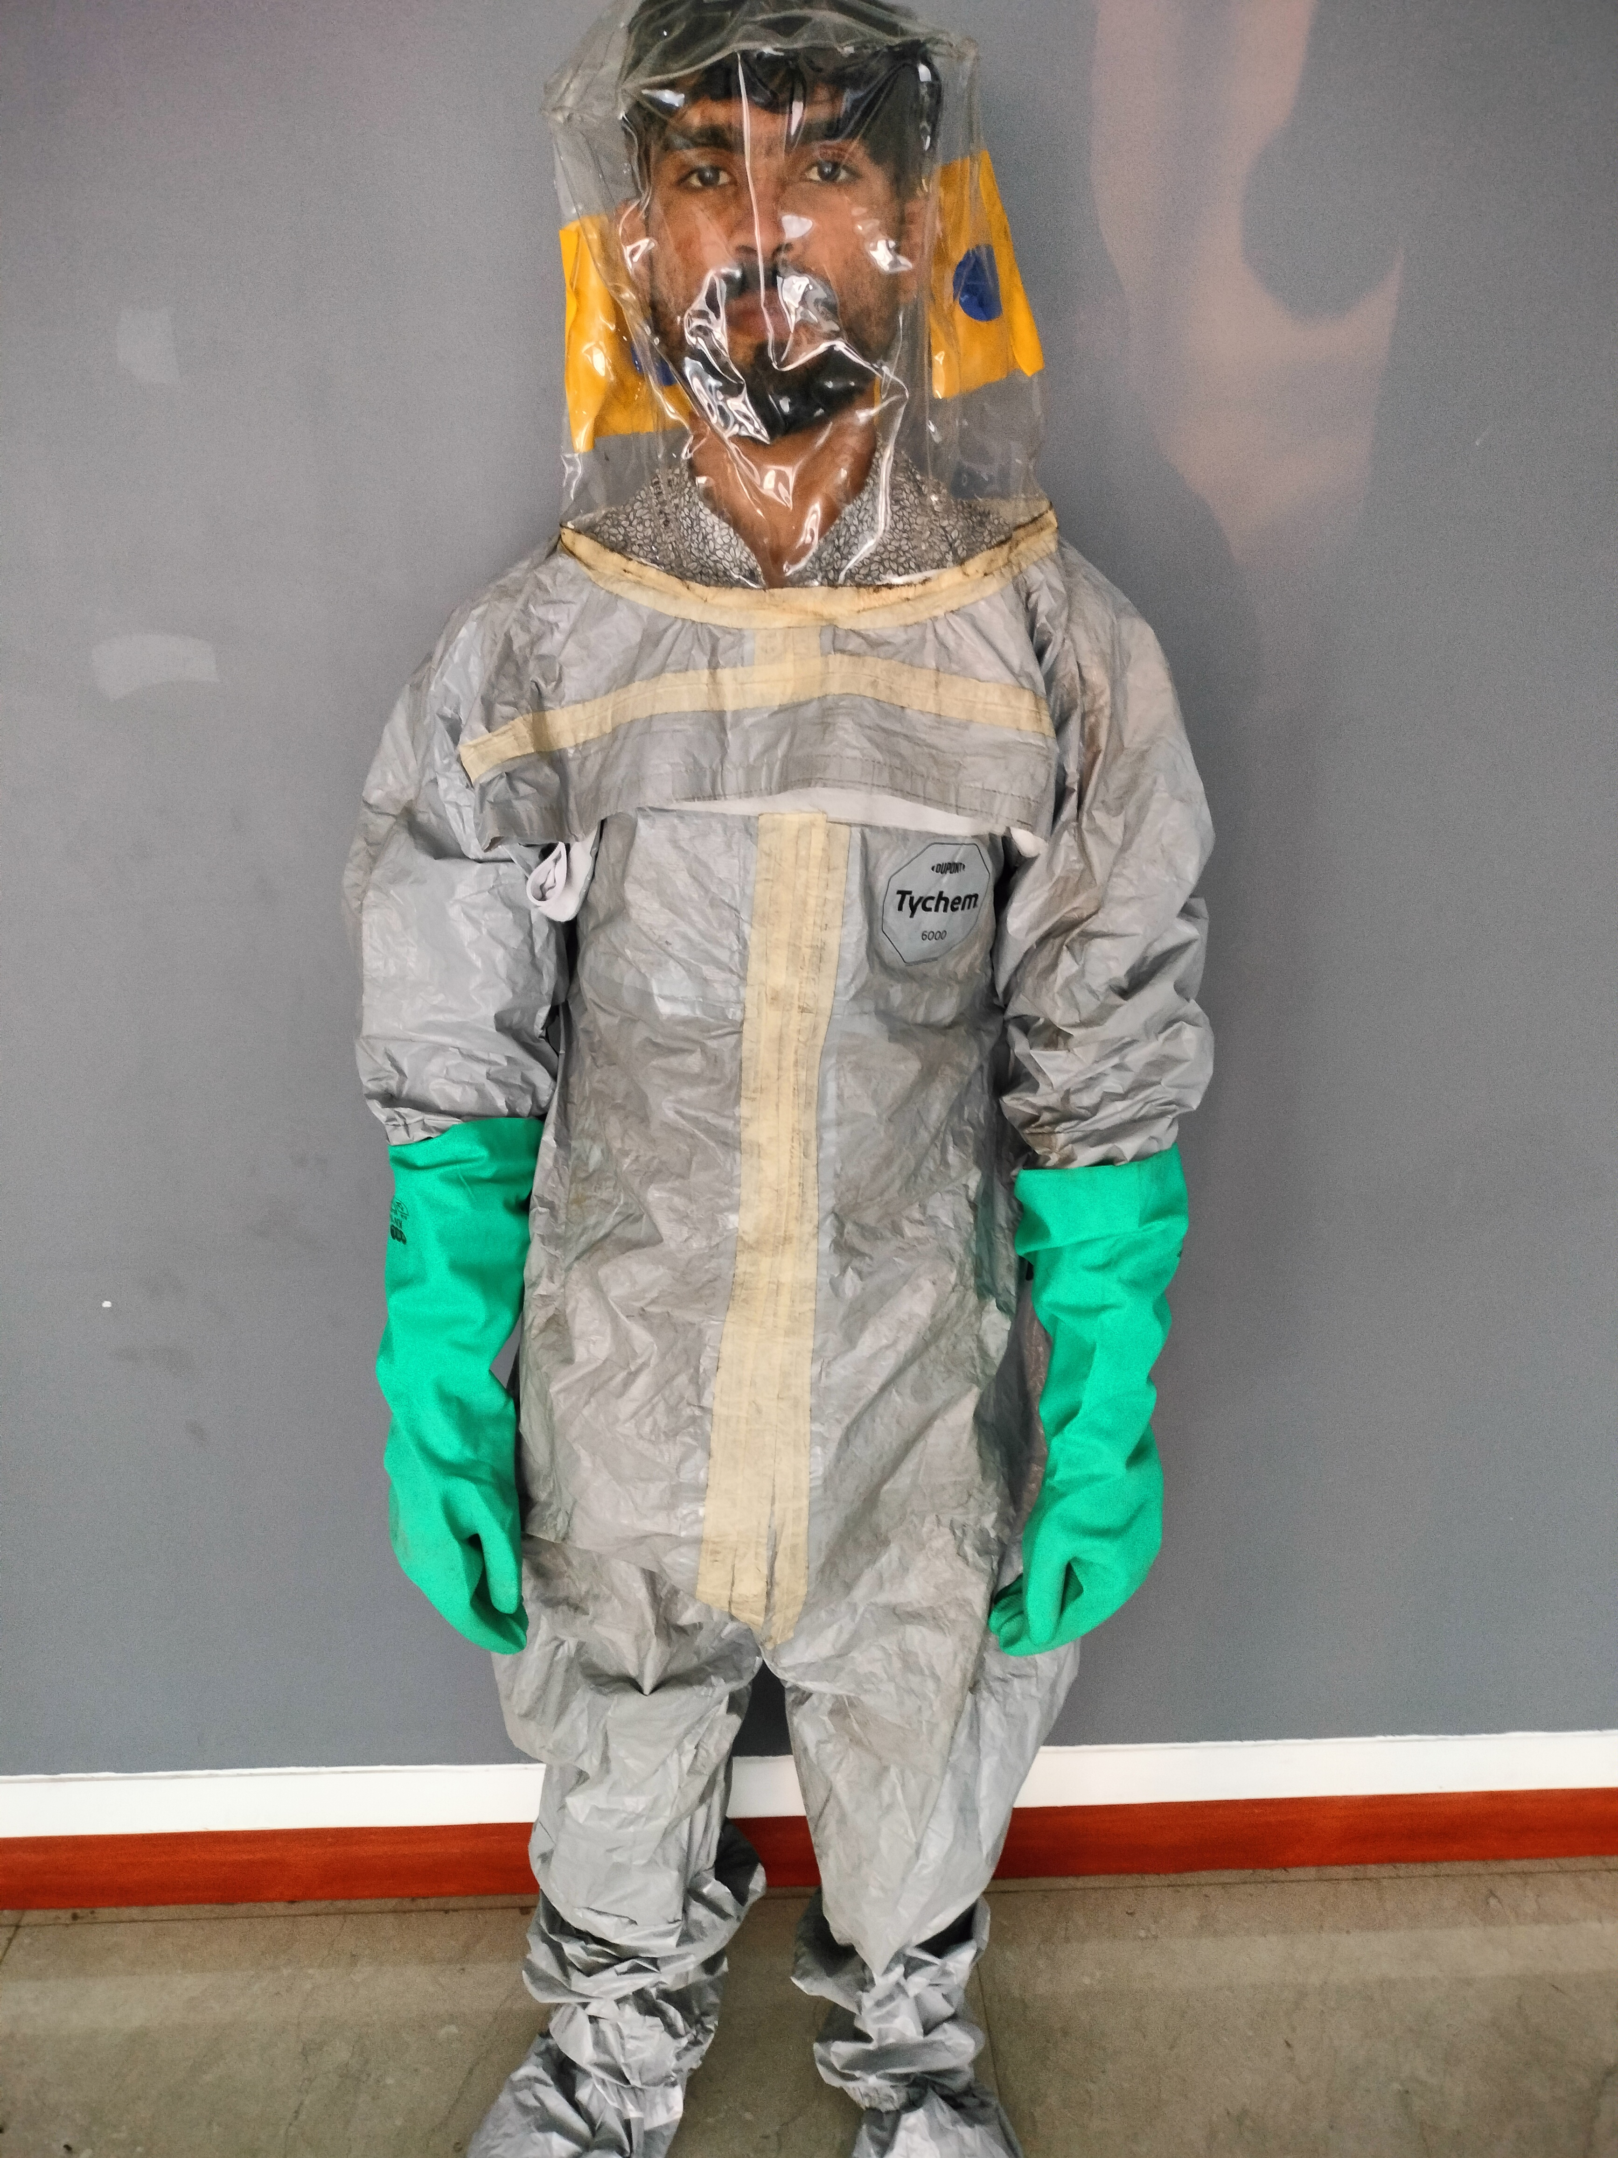
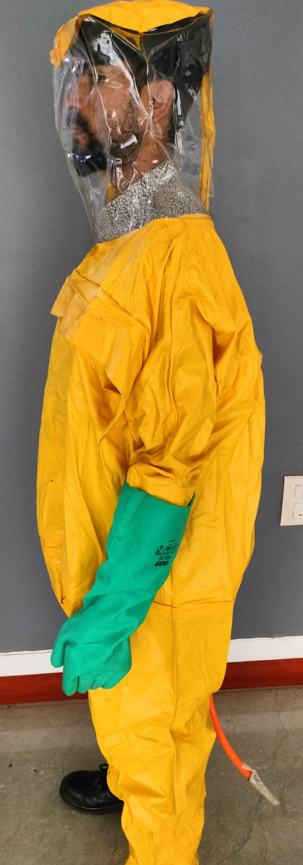
PPE Matrix is defined
Chemical Protection Suit
Positive Air Pressure Suit for
Bromine (Dupont:Tychem “F”
Positive Air Pressure Suit for
Cyanide (Dupont:Tychem “C”

Slide 34
Emergency Response Plan
Step-1.First Observer shall Call the main security gate on emergency intercom no. 888 & also inform to fire pump house intercom no. 555 (Safety Dept.)
Step-2. Security Supervisor shall inform to Site controller.
Step-3. Site Controller give instruction to Incident Controller.
Step-4. Incident Controller along with safety officer immediately rush to the incident site & Site Controller rush to control room.
Step-5. Incident Controller along with available team shall douse off the fire, If fire do not control, he inform to site controller regarding uncontrolled fire.
Step-6. Site controller shall declare emergency and instruct to blow the emergency siren to declare emergency (Siren blow 3 times for 30 second (with 05 sec. gap in each siren).
Step-7. On hearing the emergency siren each employee shall stop their activity, keep the operation in safe mode & start to gather at assembly point.
Step-8. As per demand by Incident Controller, Site Controller shall send Combat team for Fire Fighting, Rescue Team.
Step-9. Rescue Team shall shift injured Person to first aid centre & First aid team will give first aid to injured person & if Require, send to Hospital for further Treatment.
Step-10. Meanwhile communication team shall inform the Fire station, Police station, Hospital, neighboring industries for Help.
Step-11. Security Supervisor shall take head count.
Step-12. Once the Incident is under control, the Incident Controller informs to Site Controller.
Step-13. Site Controller declares the emergency over, and instruct all clear siren for 1 Minute. (Siren blow 1 minute continuous).

Slide 35
Environment

Slide 36
Statutory Compliances
No. | Particulars | Frequency
1 | Hazardous Waste Manifest (Form 10) | As and when Required
2 | Hazardous Waste Annual Returns (Form 4) | Yearly
3 | E-Waste Manifest (Form 6) | As and When Required
4 | E-Waste Annual Returns | Yearly
5 | Environment Statement (Form V) | Yearly
6 | Half Yearly EC Compliance | Twice in a Year
7 | Environment Monitoring | Quarterly
8 | PWM rules – EPR Annual Returns | Yearly

Slide 37
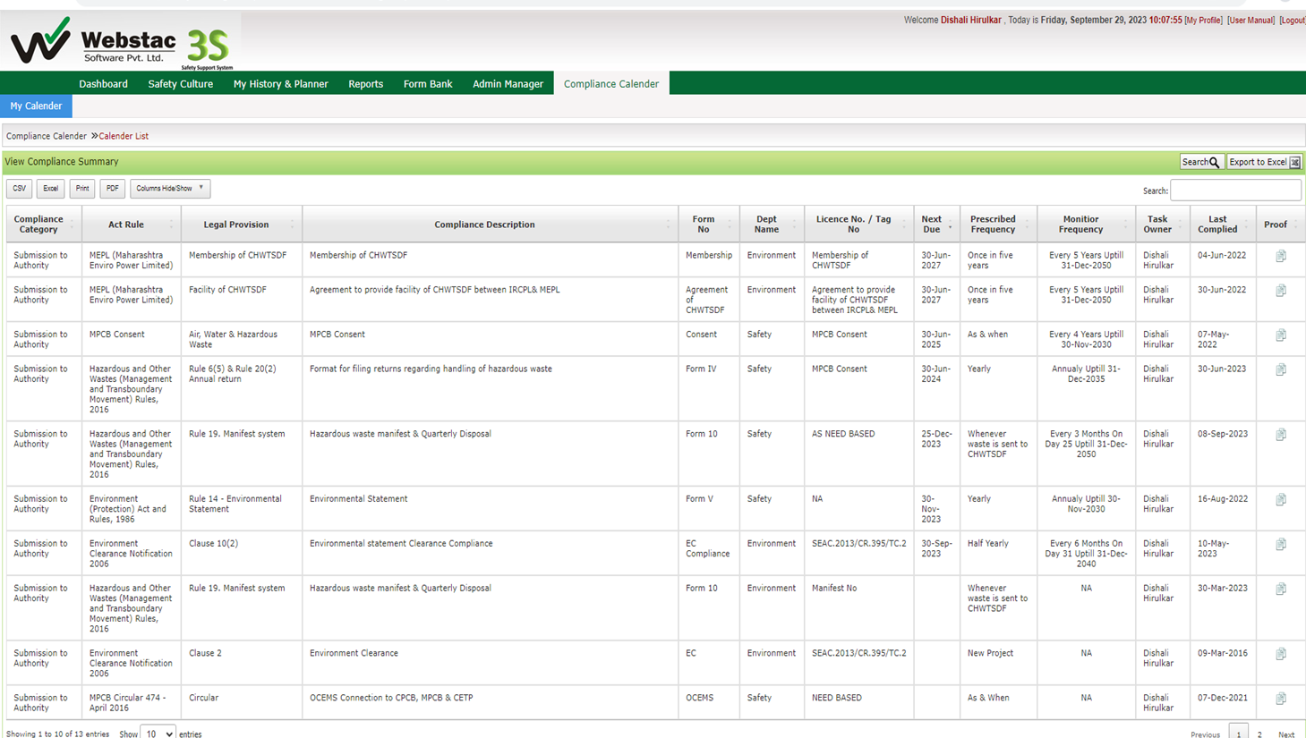
Webstac Compliance

Slide 38
Environment Monitoring Details
Drinking Water Quality
ETP Treated Effluent Quality
STP Treated Effluent Quality
Soil Quality
Ambient Air Quality
Stack Emission Quality
Ambient Noise Quality
Workplace Noise Quality
DG Set Insertion Loss
Chemical Exposure Quality
Illumination Level

Slide 39
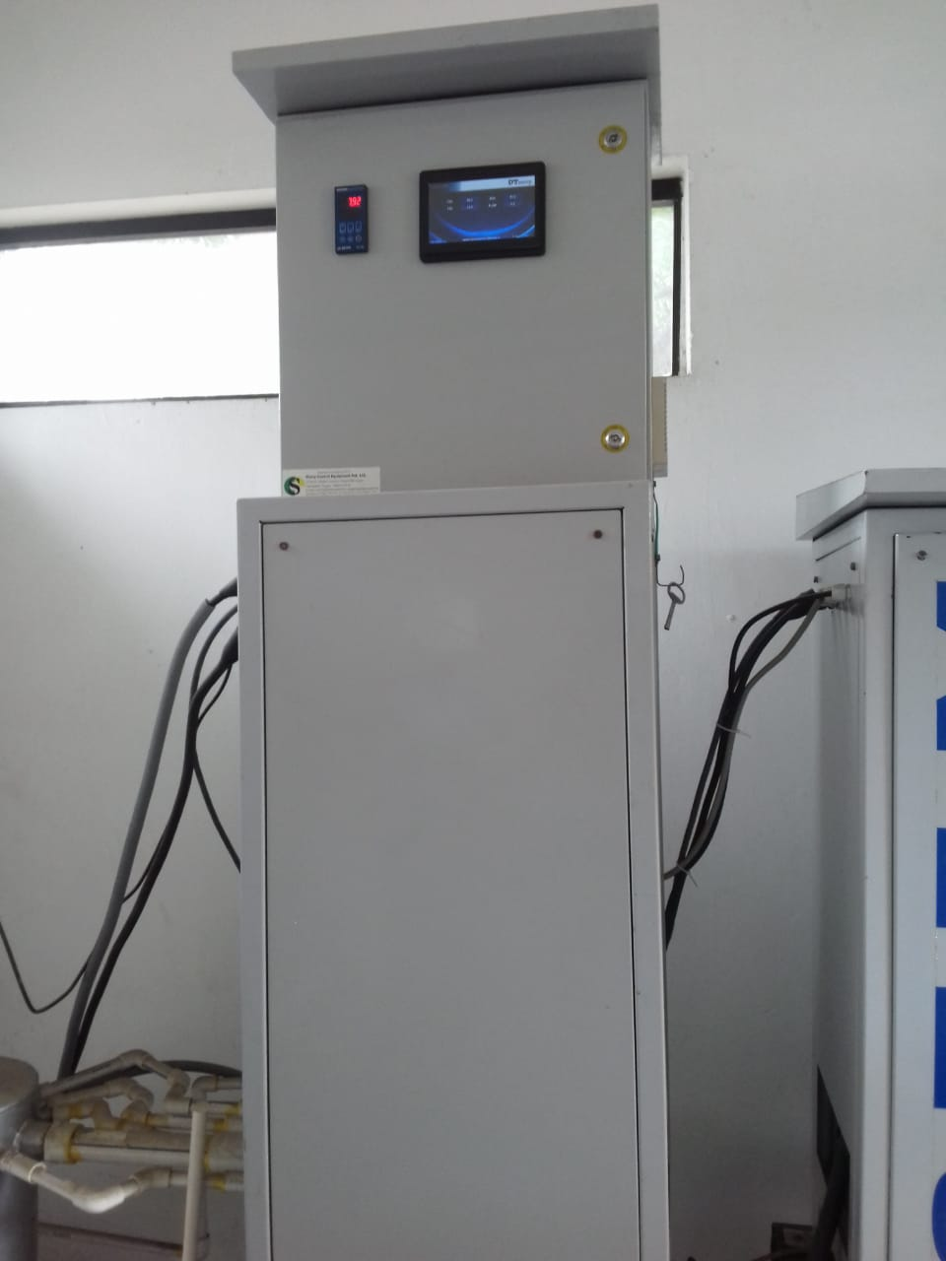
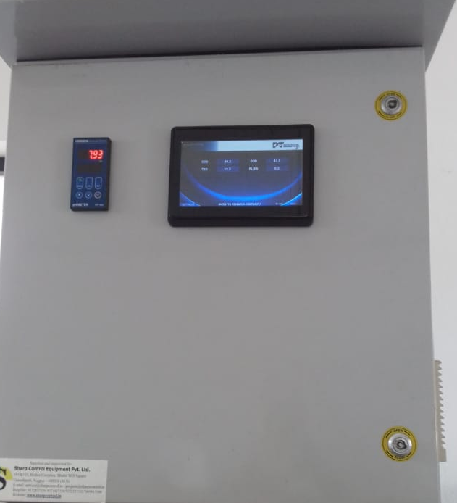
OCEMS and its Connectivity
Installation of Online continuous monitoring system and its connectivity to CETP, CPCB and MPCB
OCEMS Panel Room

Slide 40
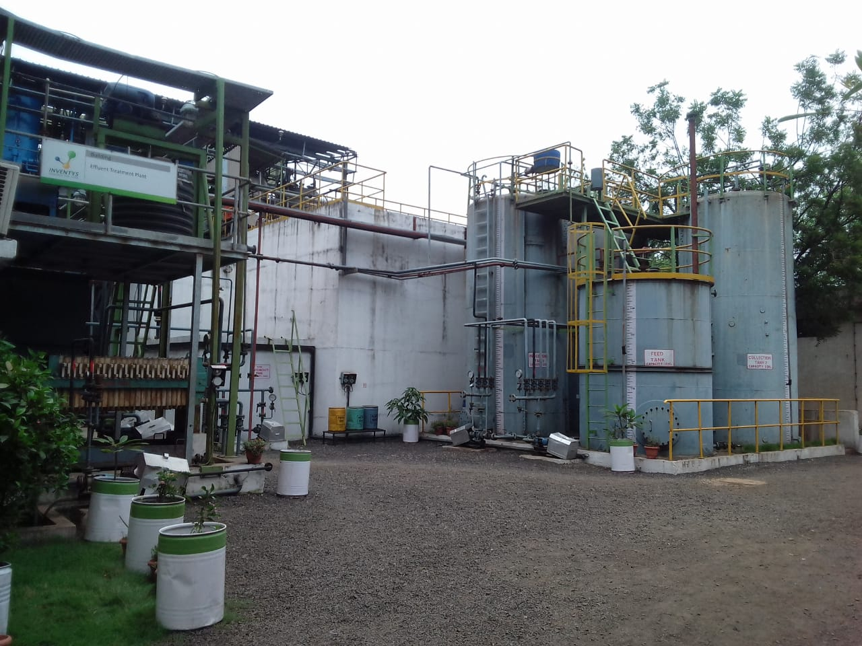
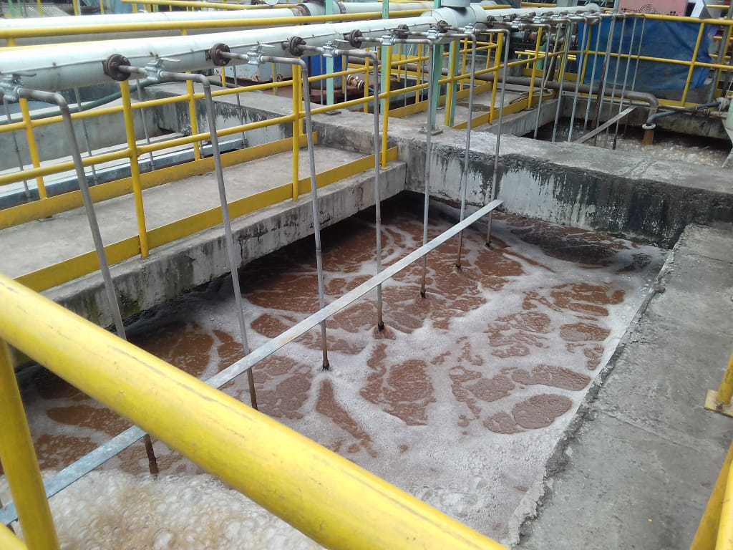
Major Treatment Units of ETP
Preliminary Treatment
  Screening
  Oil and Grease Trap
Primary Treatment
  Equalization / Neutralization Tank
  Flash Mixer- Alum dosing
  Flocculator- Polyelectrolyte dosing
  Primary Settling Tank
Secondary Treatment
  Activated Sludge Process
  Secondary Settling Tank
Tertiary Treatment
  Filtration
  Carbon Filter
  Sand Filter

Slide 41
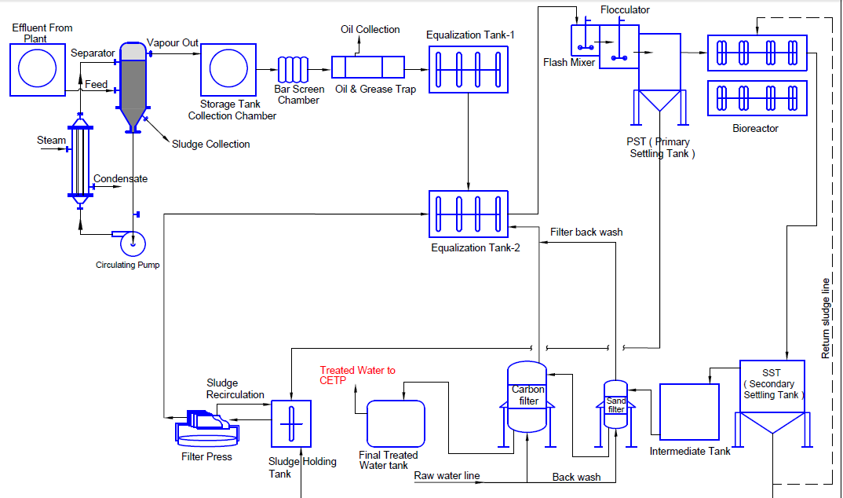
Schematic Flow of ETP

Slide 42
Waste Management
Non-Hazardous Waste Storage and Segregation System:
Type of Waste | Components of Waste | Colour Code
PAPER | Office papers, Labels, Sutli, Packing Materials, Newspapers, Cotton Waste | YELLOW
PLASTIC | Damaged plastic,/ Rubber handgloves, polyethylene liners & damaged HDPE bags | GREY
GASKETS | Used/Damaged Gaskets/Gasket Cuttings | GREEN
GLASS | Lab bottles, Broken pieces, Fused bulbs | ORANGE
SWEEPED DUST | Sweep dusts | RED
METAL | Mild steel, SS, Aluminium waste of small size, Damaged nut bolts | BLUE
FOOD | Left overs of food | WHITE

Slide 43
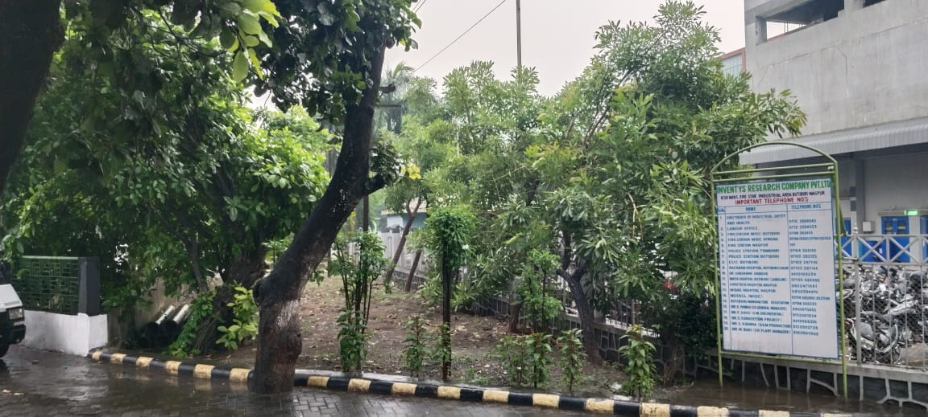
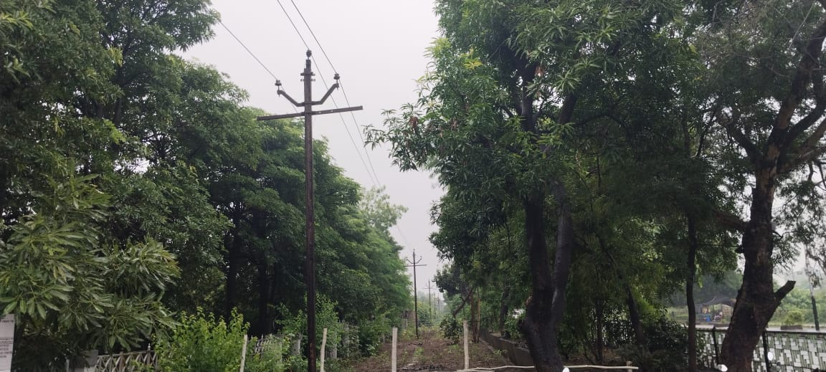
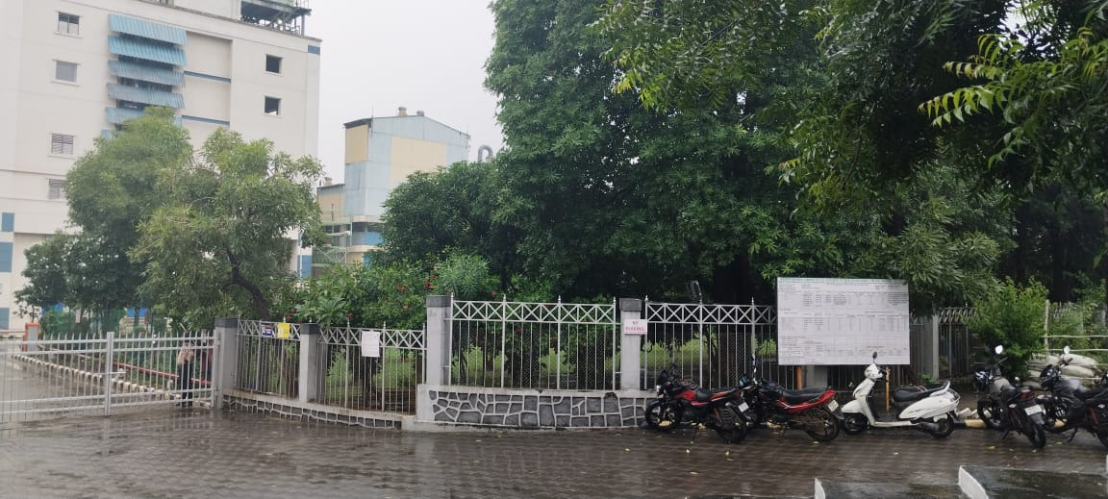
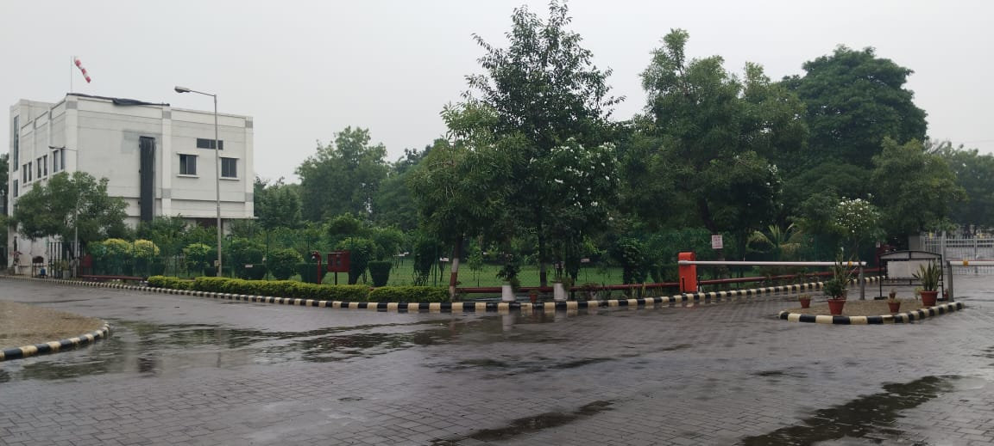
Site 1 Plantation Pictures
Trees & Shrubs :- +2500 Number

Slide 44
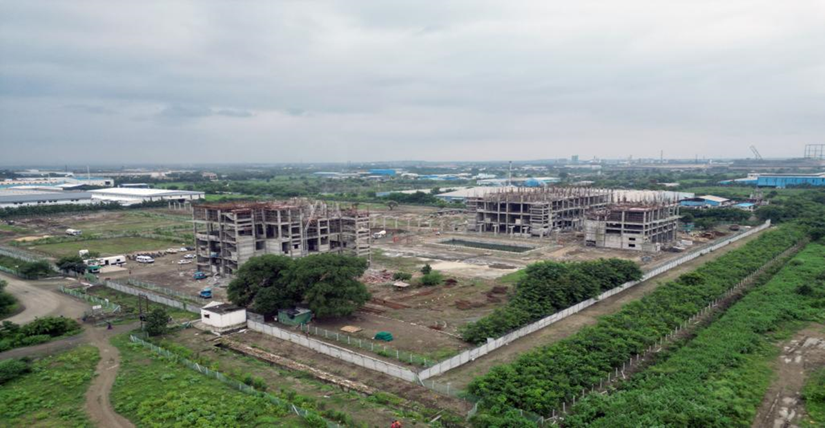
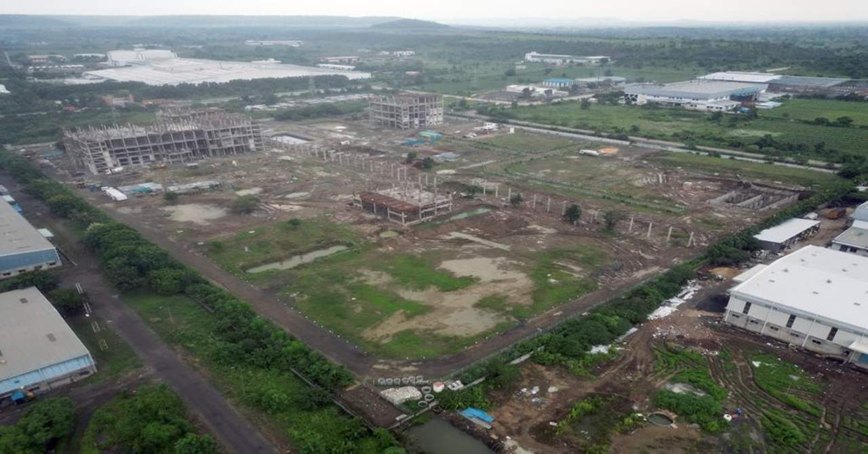
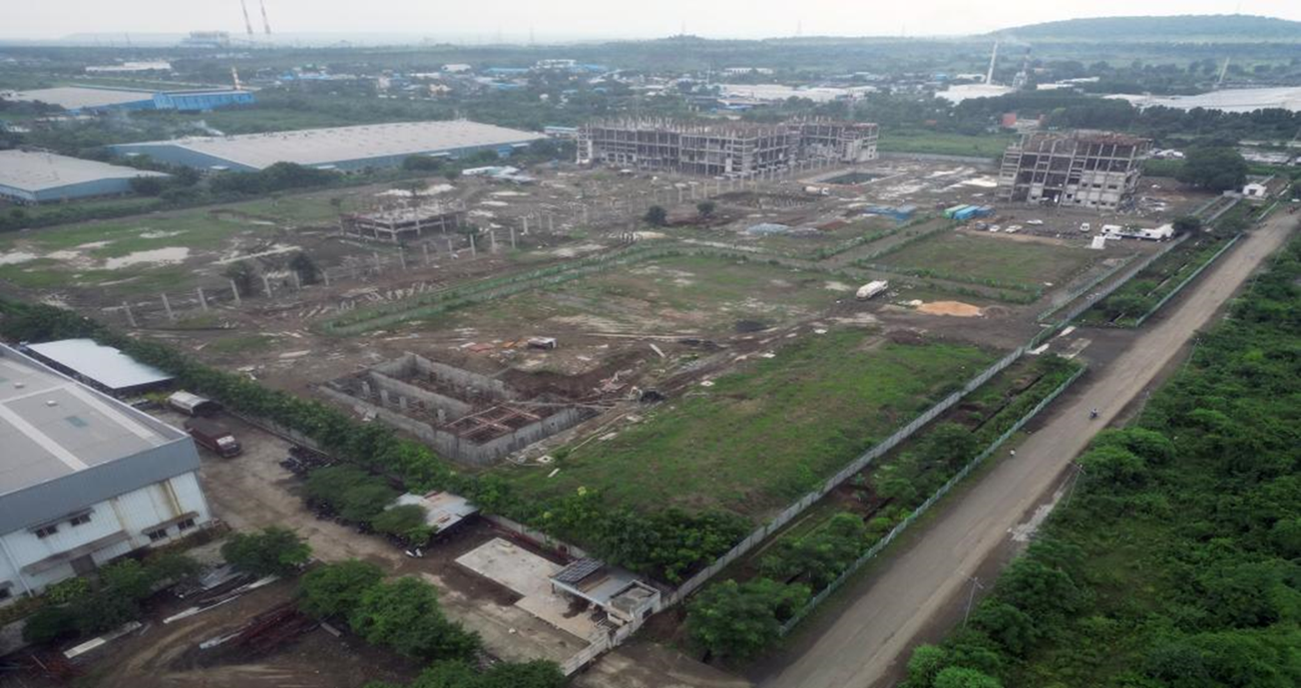
Site 2,3 Plantation Pictures
Miyawaki MD zone (West)
Miyawaki Zone MC-( South)
Miyawaki Zone MA(East) &
Tree zone(North- road side)
Plantation ~16,500 Trees

Slide 45
Site 2,3 Plantation
SZ1415 Summary of Plants
 | Zones
Category of Plants (Tree & Fruit Zone) | TA | TA1 | TB | TB1 | TC+TD | TD1 | TE | Total
Trees | 70 | 28 | 22 | 26 | 62 | 37 | 63 | 308
Shrubs | 359 | 0 | 100 | 0 | 603 | 0 | 639 | 1701
Medicinal Shrubs | 81 | 90 | 62 | 146 | 165 | 217 | 141 | 902
Total | 510 | 118 | 184 | 172 | 830 | 254 | 843 | 2911
Category of Plants (Fruit Zone) | FA | FB | FC | FD | FE
Fruit Plants | 52 | 75 | 44 | 52 | 105 |  |  | 328
Shrubs(Fruit) | 124 | 87 | 92 | 284 | 0 |  |  | 587
Total | 176 | 162 | 136 | 336 | 105 |  |  | 915
Category of Plants (Miyawaki Zone) | MA | MB | MC | MD
Canopy/SubCanopy/Trees/Fruit Trees/ Shrubs/Ground Cover | 1276 | 0 | 4170 | 6936 |  |  |  | 12382
Medicinal Plants | 85 | 20 | 0 | 0 |  |  |  | 105
Total | 1361 | 20 | 4170 | 6936 |  |  |  | 12487
Grand Total | 2047 | 300 | 4490 | 7444 | 935 | 254 | 843 | 16313

