Slide 1
HSE Practices at Inventys
2024 Q1

Slide 2
Outline
Inventys K38 Site 1
Certifications
Management system
ISO 9001: 45001:2018 14001:2015
HSE team and Role and responsibilities
Safety Management system
Management Commitment and committee
KPI and Goals

Slide 3
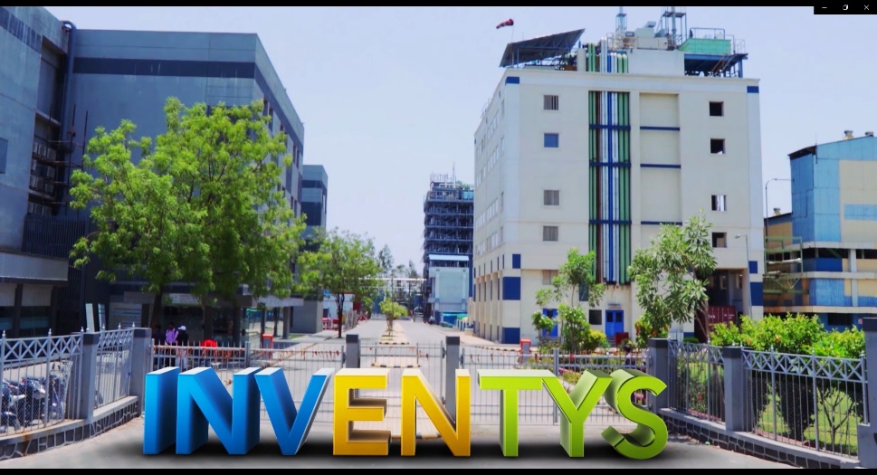
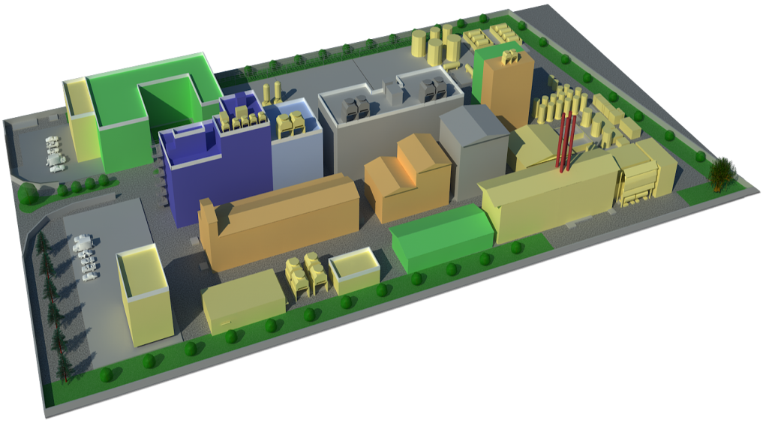
Inventys – Integrated Manufacturing Site 1
Concept → Manufacturing
Synthesis Strategy to Process Development
Scale up to Commercial Production
Continuous Improvement
Quality Assurance & Quality Control
Laboratories
R&D
QC & QA
Kilo Labs & Pilot Plants
APIs & RSMs
Specialties
Advanced Intermediates (GMP & non-GMP)
Bulk Intermediates
Manufacturing Facilities
APIs & RSMs
Specialties
Advanced Intermediates (GMP & non-GMP)
Bulk Intermediates
Effluent Treatment Facilities
500 KL/Day Discharge Permission
https://youtu.be/9rcNlSdsyX8

Slide 4
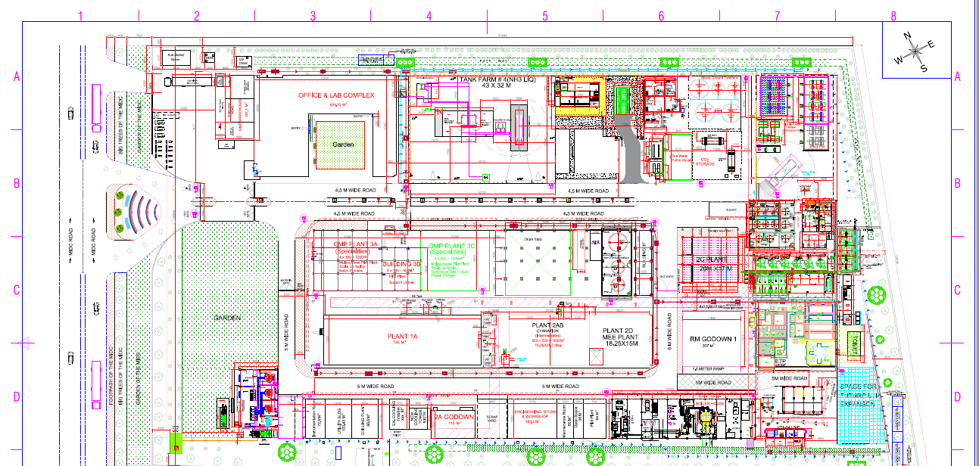
K38 Site Plan

Slide 5
Certification
State License for Manufacturing Healthcare Products 2018
Renewal 2023 April valid up to April 2028
Central WHO certification GMP :- 2020
ISO 9001:2015 IRQS/210100486 Valid 23/03/2024
ISO 14001:2015 IRQS/210300487 Valid 23/03/2024
ISO-45001:2018 IRQS/210400488 Valid 23/03/2024
Validity 5 Years
Manufacturing of Speciality Chemicals, Agro Actives, APIs, & Advanced Intermediates for Pharma & Agro
LICENSE No : 25-MH/102571
State FDA approval 2019
Certificate number 6116113
Validity Yearly
Valid 5/11/2024
Certificate No.: NEW-WHO-GMP/CERT/ND/126239/2023/11/46894
Validity 3 years 2020
Renewal June 2023 Valid Aug 2026
Dosage Form(s) Active Pharmaceutical Ingredients (Bulk Drugs)
Activity(ies) Synthesis, Purification, Packing, Labelling, Quality Control, Quality Assurance
Integrated ISO Certification 2012
EU GMP Certification – Expected by Q3 2024

Slide 6
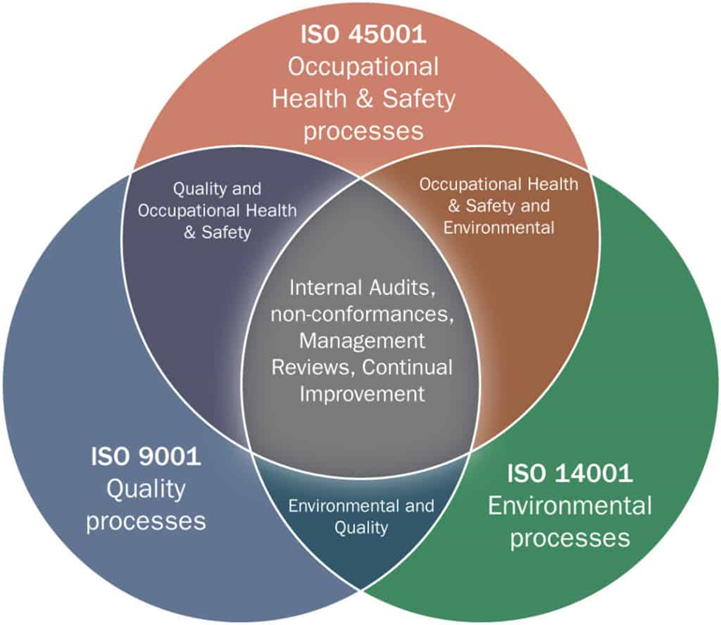
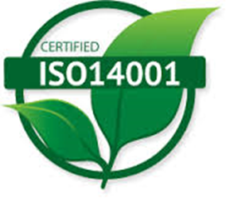
Management System
Policy
Requirement
Standards
Guideline
Standard operating procedure
Inventys is committed to achieve customer satisfaction and meet changing expectations through:
Health & Safety
Continual quality improvement
Adhere up to GMP requirements
Meeting the national and international regulatory requirements
Qualified and fast response to the customers and authorities
Valid till 23rd March 2024.

Slide 7
Inventys QHSE Policy
Safety of a person is the top priority other than any target” is the Quality, Health, Safety and Environment policy of InventyS Research Company
Inventys believes that due to continual improvement in safe working environment through regular learnings, trainings and practicing Quality, Health, Safety and Environment procedures, all incidents, accidents, and environmental incidents brings to near zero.
Inventys is committed to
Carry out all its activities in such a way that it avoids any harm to employees, contractors and to the environment.
Encourage employees and contractors to take care of their occupational health and personal safety.
Enhance continually its environmental practices and performance.
Reduce adverse impact on environment and minimize the risk to the peoples which may arise from its operational activities and transportations.
Manage all energy resources in a responsible way to minimize emissions and reduce waste generation.
Comply all statutory requirements related with Quality, Safety, Health and Environment.
Develop safe working environment through regular learnings, trainings and practicing Quality, Health, Safety and Environment Systems and Procedures among all its employees and contractors.

Slide 8
HSE TEAM PROFILE
Chetan Maih
Director Manufacturing & Compliance
M.Sc. (Organic Chemistry)
34 years of experience
Shrinivas Holennavar
Deputy General Manager
Works
B.Sc. (Chemistry)
Umesh Shirke
Deputy Manager
Safety & Health
B. Tech. Chemical : M. Tech. Environment
13 years of experience
Hoechst : HMR : Aventis : Sanofi : Zentiva
MBA : PGDHRM
44 years of experience
Zenith Ltd. : Metrochem Ltd. : Shreyas Ltd.
Solar Industries : Economic Explosive : Sai Techniques
Advance Diploma in Industrial Safety
Ajay Pandey
Manager ETP
B. Sc.
Morarjee Textiles : Indorama Synthesis
30 years of experience
Diploma in Pollution Control Board
Dishali Hirulkar
Environmental Engineer ETP
M. Tech. Environment
03 years of experience
National Environmental Engineering & Research Institute
Advance Diploma in Industrial Safety
-

Slide 9
Role and Responsibilities -
Hierarchy of HSE Management:
Health:
Dy. General Manager Works
Dy. Manager HR
Officers HR
Safety:
Dy. General Manager Works
Dy. Manager EHS
Safety Officer
Safety Supervisor
Fireman
Environment:
Dy. General Manager Works
Manager Environment
Environment Engineer
Site Supervisor
Operators
Management Level
Site Head
Dy. Manager EHS
Manager HR
Environment Engineer
Dy. General Manager Works
Manager Environment
Safety Officer
Safety Supervisor
Operators
Site Supervisor
Fireman
Observers/ External Auditors
1.Supporting EHS activities programs and site performance
2. Empowered to identify and correct unsafe condition or behaviours and promptly report other potentially hazardous situations.

Slide 10
Safety Management system
Plan
Establish Safety management frame work
Do
Implement planned safety program
Check
Monitor safety performance
Act
Safety awareness
Safety communication
CAPA

Slide 11
HSE Management system
Legal Requirements:
Annual Compliance
Annual Health Checkup (Form 7)
Factory Inspector Returns (Form 27)
Hazardous Waste Returns (Form 4)
E-Waste Annual Returns (Form 3)
Environment Statement (Form V)
Half Yearly Compliance
Certificate to report Maintenance of fire prevention and safety measures (Form B)
Mock Drills (Major)
Testing of Lifting Tool and Tackles (Form 11)
Testing of Pressure Vessels (Form 13)
EC Compliance Report
Quarterly Compliance
Testing of Fire and Safety Equipment’s
Hazardous Waste Disposal
Environment Monitoring
Health
Annual Health Checkup (Form 7)
Testing of Lifting Tool and Tackles & PRV (Form 11& 13)
Testing of SRV
Environment
EC Compliance Report
Hazardous Waste Annual Returns (Form 4)
Environment Statement (Form V)
Safety
Environment Monitoring
External Safety Audit
Testing of Fire and Safety Equipment's
Factory Inspector Annual Returns (Form 27)
Daily Compliance:
Testing of effluent parameters before discharge to CETP
Logbook submission on MPCB Verification Portal
Monitoring of OCEMS System

Slide 12
Management Review
Outcomes of the audits/observations carried out and status of all corrective actions are reviewed in the management review.
The review frequency of such activities are on daily, monthly and quarterly basis
Daily MRM is conducted by all plant managers along with top management to discuss unsafe acts and unsafe conditions and process breakdowns
Top management receives a daily safety report with information on any incidents and observations.
The status of observations and compliances of safety tour, safety survey and safety audits are conveyed to top management on monthly basis through Emails and meetings.
Safety Committee Meeting observations and status of corrective actions are reviewed on quarterly basis
Site Compliance Meeting is conducted quarterly to review the compliance of all the legal requirements of factory operations.
Daily
Safety Report
Management Review Meeting
Monthly
Safety Tour
Safety Survey
Quarterly
Safety Committee
Site Compliance Meeting
Incident/ Accident Report
Safety Audit
Internal Audit

Slide 13
Process safety Management
Hazop study
HIRA 45001 :2018
Environmental14001:2018 Aspect & Impact
P&ID
Recommendation Go to P&ID
Lab Feasibility
Process Optimization
Scale up studies
Pilot trials
Trial Production
Commercial production
Route Scouting
Evaluation of selected routes
Hazards identification & listing
Isolation of characterization of intermediates
Screening of reaction parameters
Process sensitivity studies
Process hold up studies and stability studies
DSC studies for reaction mass, intermediates, distillation residue
Reporting of reaction exothermicity – dose dependency
Critical process parameter identifications
Reaction profile at kilo scale
Reaction & impurity profiling
Calculation of dimensionless numbers
Listing of process requirements – Equipments & utilities
Stability studies
Finalization of cleaning protocol
Solvent recovery & reuse; if required
Reaction profile at scale
Throughput calculation
Utility requirement
Selection of reactor and downstream equipment
Finalization of RM, Intermediate and FG handling and storage protocol
Validation of cleaning protocol
Process validation
Finalization of reactor and equipment for commercial scale
Stability studies
Analytical method development
Production planning
Basic engineering package preparation
Production efficiency improvement
Energy conservation
Quality monitoring
Quality monitoring
HAZOP studies
HAZOP studies
Finalization of Engineering & administrative controls
Defining LoP
BMR preparation
Training
PSSR

Slide 14
Management Commitment
Management actively participates in the EHS program to keep direct knowledge of the effectiveness of the programme
Various activities conducted under EHS Program :
National Safety Week
Celebrated annually on 4th March to 10th March
Conducts various competitions like firefighting competition, Running with Fire Extinguisher, quiz competition, safety slogans, safety poem & essay competition
Prize distribution to winners to encourage more participation
Mock Drills
Monthly mock drills conducted on various scenarios like gas leakage, solvent fire, acid & caustic spillage, Electrocution etc. during day and silent hours
As per statutory requirement major mock drills are conducted half yearly on different scenarios
Trainings
Trainings are conducted on-job, classroom,
departmental, cross functional, external etc.
Daily tool box talk to contract & company
employees on work safety is conducted in all
shifts
Safety Week
Mock Drill
Tree Plantation
Blood Donation Camp
4th to 10th March every year
Monthly Small Drills
Half Yearly Major drills
World Environment Day
During Monsoons
Every Year

Slide 15
Management Committee
Safety Committee is formed for HSE Management
Committee consists of equal number of representatives of workers and management to promote co-operation between the workers and the management in maintaining proper safety and health at work
The meeting is conducted every quarter to review periodically the measures taken in that behalf
Total 24 Members consisting Managers of production, Maintenance, Instrument, Electrical
Operators of Production, ETP, RM, Technicians of Electrical and Instrumentation, workers
Officers of Production, Utility and other members of the organization
Safety Committee organogram
Chairman
(DGM Production)
Secretary
(Dy. Manager EHS)
Managers
Manager Production
Manager Maintenance
Manager HR
Manager R&D
Officers
Officers Production
Engineer Utility
Engineer Environment
Site Supervisor
Operators
Operator Production
Operator ETP
Operator RM
Technician
Instrument
Technician Electrical
Workers

Slide 16
Management KPI and Goals
Goals
To protect workers from job-related injuries and illnesses
Identify and mitigate physical, chemical and biological hazards in the workplace
Improving training and communications that clearly explain the company objectives for promoting a safe and healthy work Environment
Manage organizations approach to sourcing clean energy, reducing energy costs and reducing negative environmental impacts such as spills and leaks.
Manage the health of your workers to prevent illness, injury and chronic disability while maintaining productive operations.
Manage your work environment and processes to identify safety hazards and prevent workplace incidents, accidents and injuries.
KPI
Reduction of Accident and incident frequency
Reduce Accident Severity & Near Miss
Implementation of corrective actions
Measure the number of safety violations fines that an organization has paid
Tracking average employee overtime hours
Providing regular training and communication with all the employees
Spread awareness about the impact of industrial activities on the environment
Water Conservation, Energy Conservation, Prevention of air pollution and hazardous waste generation

Slide 17
Management KPI and Goals
Regular Tool Box Talk
Regular Tool Box Talk
Engineering and Administrative Controls
Identify Potential Risk
Identify Potential Risk
Zero Incident
Identify Unsafe Act and Unsafe Condition
Elimination and substitution of potential hazard at R&D level
Identify Unsafe Act and Unsafe Condition
Occupational Health
Use of PPE’s
Specific training by experts
Resource Conservation
On-job and classroom trainings
Environment Protection
Process Control
Counselling and Training
Safety Signages and Posters
Creating Awareness among people

