Slide 1
Process hazard analysis for Safe Manufacturing
Case Studies @Inventys
2024 Jan 10

Slide 2
P527 Insecticide
Process Tech-pack Replication
Process Improvement
Pilot Production for Scale up Studies
Trial Production
Commercial Production

Slide 3
P527 Intermediate – Chlorination + Work-Up
Hazards suspected (preliminary review)
  Chemical Incompatibility → SOCl₂ with Water, Base
  Corrosivity → SOCl₂ + Byproducts (SO₂ + HCl)
  Release of Non-Condensable Gases (Pressure) → SO₂ + HCl
    Addressed through incorporation of engineering design measures
  Potential Product Decomposition → Side reaction of ‘carbonyl’ or ‘carbonyl-adjacent’ and acidic species (at higher temperature → potential for autocatalytic decomposition)
    Further characterization required

Slide 4
Identified Hazards
- Process and Engineering Design Safety Measures
Chemical Incompatibility → SOCl₂ with Water, Base
  Secondary (indirect) cooling system installed for reactor and condenser
    Dowtherm-J used as utility fluid → chemically inert to SOCl₂ and other process species
    Temperature of utility regulated in separate reactors
Corrosivity → SOCl₂ + Byproducts (SO₂ + HCl)
  Glass-Lined Reactor
  MS-PTFE Hollow Column & Piping
  All-Glass Condenser
    (+ Relief Valve into Dump Tank)
Release of Gases (Pressure) → SO₂ + HCl
  Automated Control Loop for SOCl₂ addition operation
    Addition Rate linked to Reactor Temperature, Pressure
      Gas evolution rate controlled by reaction rate → controlled by addition rate of SOCl₂ + reaction temperature
    Lab Optimization (Addition Rate, Reaction Temperature)
      Prevent accumulation (avoid runaway → Minimize Reaction Temperature → Maximize throughput → address expected peak gas flow rate vs. line/scrubber capacity
  Emergency Measures
    Pressure Relief Valve into Dump Tank (@ 0.75 bar)
    Rupture Disk (@ 1.0 bar)

Slide 5
Further characterization (DSC Analysis)
- Potential autocatalytic decomposition
In order to further understand the thermal stability of the reaction system, DSC Analysis was conducted
  PRE-REACTION
    Solution of KRM, Thionyl Chloride Solvent, Catalyst (before reaction)
      To evaluate potential for autocatalytic decomposition (RMs, intermediates) caused by runaway reaction
  POST-REACTION (mid work-up)
    Reaction mass after completion of reaction and removal of Thionyl Chloride, partial removal of Toluene
      To evaluate stability of reaction mass at increased temperatures

Slide 6
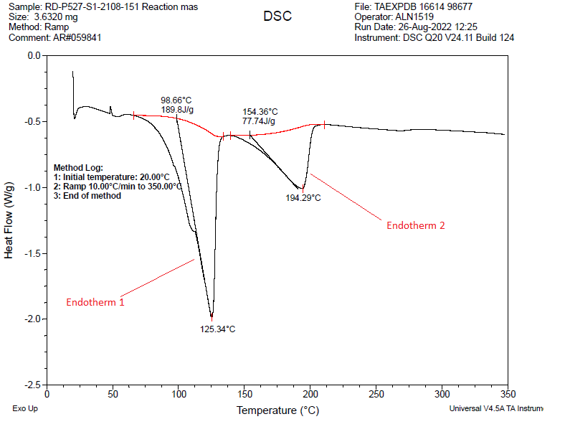
DSC Analysis – PRE-REACTION
Endotherm 1
  ~65ºC → 125.34ºC
  Energy intake of 189.8 J/g
  Evaporation of Thionyl Chloride, Toluene
  Possible Endothermic Decomposition
Endotherm 2
  ~140ºC → 194.29ºC
  Energy intake of 77.74 J/g
  Sublimation or Endothermic Decomposition
No exothermic decomposition detected

Slide 7
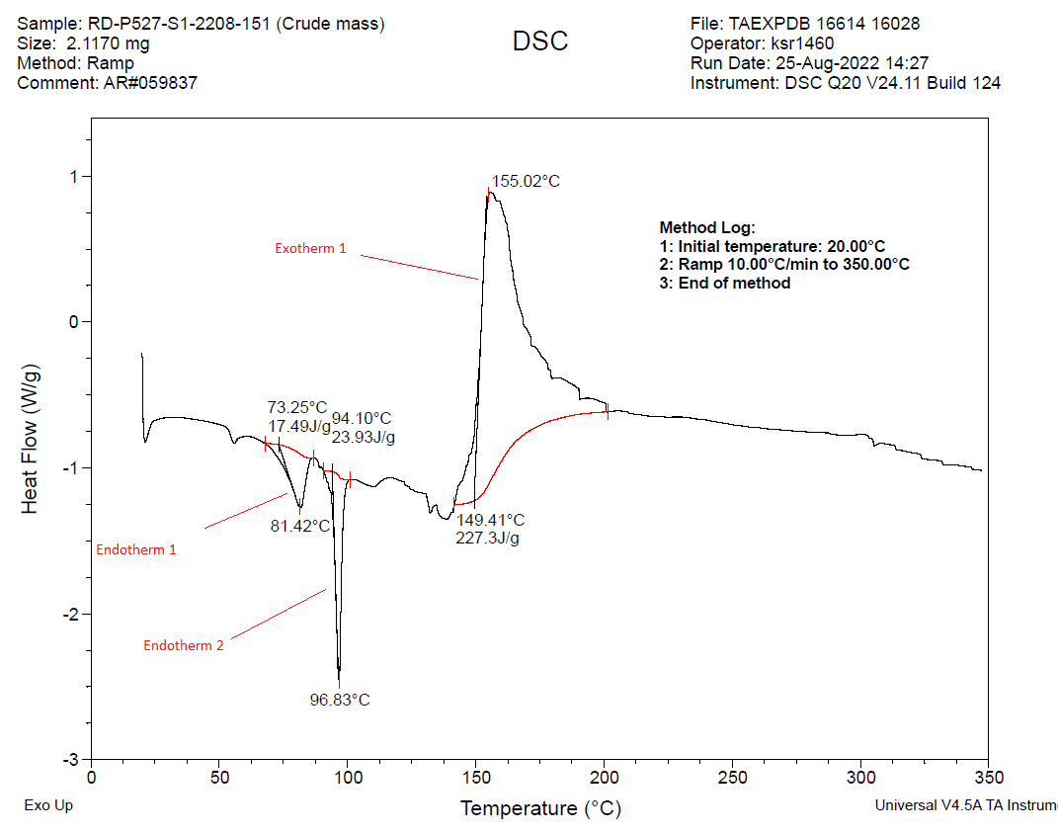
DSC Analysis – POST-REACTION
Endotherm 1 & 2
  Similar temperature ranges to endotherms detected in PRE-REACTION DSC
  Evaporation of Thionyl Chloride, Toluene (reduced quantities)
Exotherm 1
  147.5ºC → 155.02ºC
  Maxima at 155.02ºC (peak energy release of 227 J/g)
Indicative of autocatalytic decomposition of reaction species
  → may lead to rapid pressurization of vessel

Slide 8
Addressing detected Thermal Instability of POST-REACTION system
Measured Onset Temperature (T_{onset}) = ~147.5ºC
Objective → Minimize operating temperature (as far away from T_{onset})
  T_{reaction} = <60ºC
  T_{concentration} = 110ºC – 115ºC (lab trials)
    Preliminary lab trials (g-scale) → concentration operation was conducted at atmospheric pressure
    ΔT (onset – concentration) = 147.5ºC – 115ºC = 32.5ºC
      Unacceptably low safety margin in operating temperature if concentration operation conducted under atmospheric conditions
Process modified to conduct concentration at reduced pressure (vacuum) to reduce operating temperature
  P_{concentration,revised} = 52 mmHg
    (vs. 732 mmHg before)
  T_{concentration,revised} = 45-50ºC
  ΔT (onset – concentration) = 97.5ºC
    Temperature safety margin substantially increased
    Preferred safety margin > 80ºC (for critical reactions)

Slide 9
P527 Material Hazards

Slide 10
P527 Process Hazards

Slide 11
Further Process Modifications / Analysis
Accurate quantification of reaction heat → RC studies
  To understand whether the ~100ºC safety margin provide is adequate
  Observed reaction heat (cumulative) vs. C_{p,composite} → How much temperature increase is possible
Optimize (increase) Toluene loading to reduce the overall specific heat of the reaction mass (C_{p, composite})
  To increase the amount of heat the can be adsorbed by the reaction mass to incite a temperature increase.

Slide 12
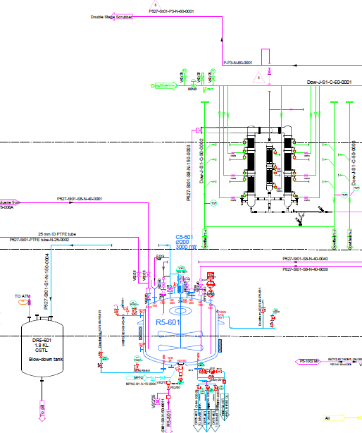
P527 – Product Decomposition & Rapid Pressurization
Hazard
  Process decomposition at high temp → Solvent evaporation → Rapid increase pressure
    Toluene BP 112°C.
    Reaction mass decomposition at 150° C
Source
  DSC
  MSDS
  Lab Experiments
Solution Approach
  Engineering control
  Distillation under vacuum
Solution Implemented
  Rupture Disk (Burst Pressure 1.0Kg/cm2) followed by dump tank provided.
  Solvent distillation under vacuum at lower temp (<50 °C)

Slide 13
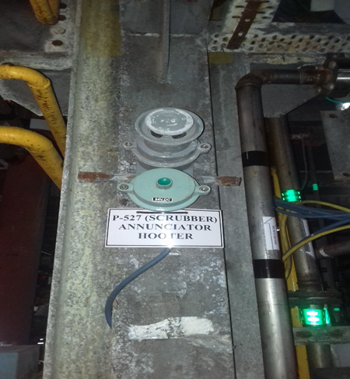
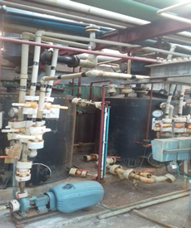
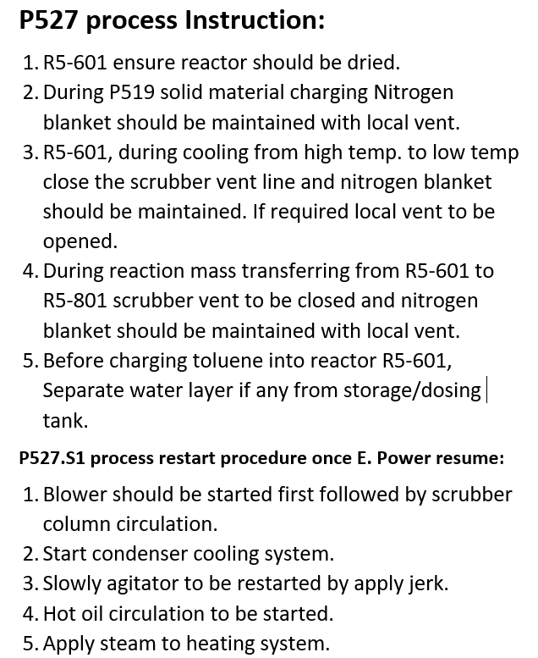
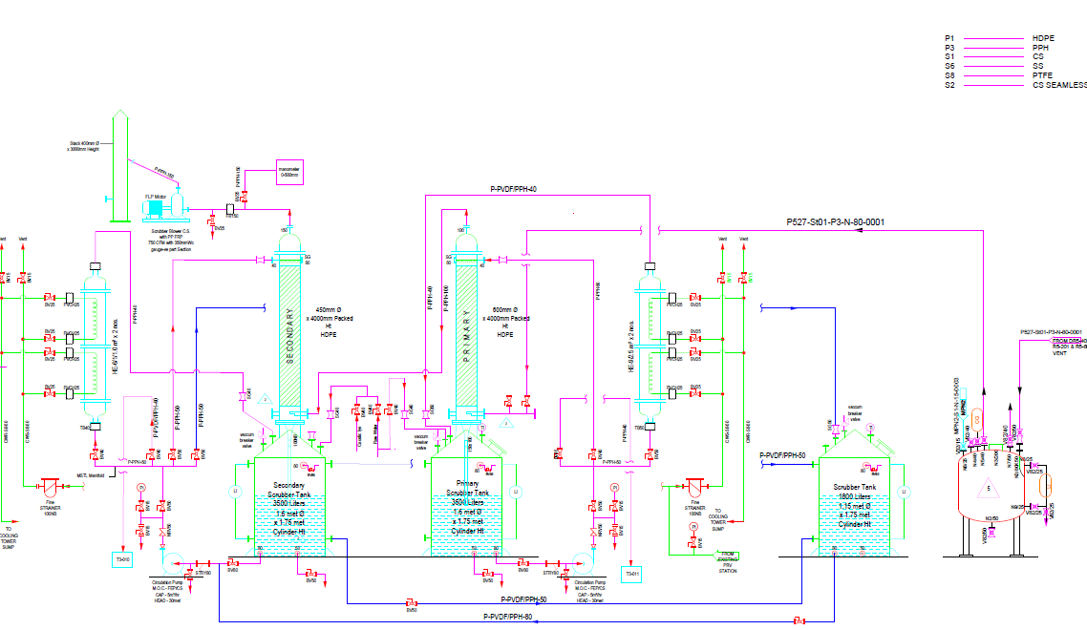
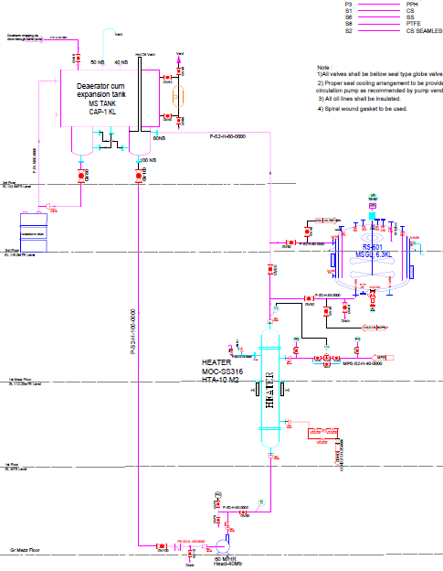
P527 – Water Sensitivity
Hooter alarm for Blower at shop floor
Hazard
  Thionyl Chloride solvent → High water sensitivity
Source
  MSDS & Existing Knowledge
Solution Approach
  Engineering /Administrative control
  Water ingress to be prevented
Solution Implemented
  Rupture Disk with Safety relief valve followed by dump tank provided.
  Single fluid utility (DowTherm-J synthetic oil)compatible with process.
  Trap provide between Multistage scrubber and process reactors.
  Hooter alarm provided for Blower failure.
  “U” loop vent with liquid seal provided in scrubber tank.
  Process instruction/SOP displayed for power failure.
Multistage scrubber with trap
Dump tank with RD
Single fluid utility system
Process instruction /SOP

Slide 14
P518 Pharma n-1 KRM
Process Development & Optimization
Pilot Production for Scale up Studies
Supply for Clinical Trials
US-FDA to be obtained

Slide 15
P518 Nitration – PHA Summary
Hazards Identified
  Thermal Hazard of Reaction – heat of reaction & runway
  Thermal Hazard of Materials – exothermic decomposition of product
PHA Conclusions
  Reaction Heat Estimate → Potential adiabatic temperature rise
    Customer input
    Verified by Calculations
    RC Planned
  DSC/TSU → Decomposition Details, Onset temperature
    Isolated product
      Endotherm due to melting and evaporation of product
  Reaction Screening Trials → Profile and Magnitude of Exotherm
  (before RC is conducted)
    Amount of Nitrating mixture Vs rise in reaction temperature
      Addition rate 6.0 Lit /hr Vs temp rise 1 to 5 °C
    Amount of Nitrating mixture added Vs conversion of RM Vs time to reach contest conversion
      Required time to consume Nitrating mixture and reach constant conversion after lot addition was up to 45 min

Slide 16
P518 Nitration – Process Design & Operations
Set Operating Temperature (vs. Onset Temperature vs. Potential Adiabatic Temperature Rise)
  Addition Rate 6.0 ± 0.2 Lit / Hr in 8 lots
  Reaction temperature -5 ± 5 °C
To avoid accumulation of Nitrating mixture; reaction mass should send for HPLC analysis
  Expect RM conversion ~ 12 to 13 % A per lot of Nitrating mixture
Manual Control
  During Nitrating mixture charging; addition pot should not contain quantity more than 6 Kg
  Expecting maximum temperature if 6.0 Kg gets in ~ 10 to 14 °C
    Reaction performed in lab at 25 °C to observed any possible runway
Operator Training
  Be aware that reaction is exothermic
    Stop Nitrating mixture addition if reaction temp crosses 5 °C
  Incremental conversion of RM per lot of Nitrating mixture in reaction mass
    If less than 10.0% then stop addition and wait till its more than 10.0%
  Accidental spillage of Nitrating mixture
    Confine spillage and treat with sand and soda ash

Slide 17
P518 Material Hazards

Slide 18
P518 Process Hazards

Slide 19
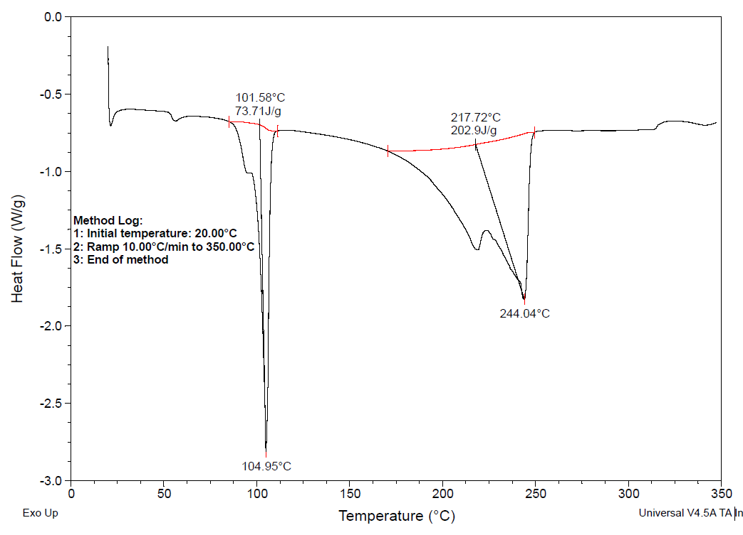
P518 DSC Data – Isolated product
No Exothermic event; endotherm due to Endotherm due to Melting and evaporation product

Slide 20
P518 Aryl diazonium Tetrafluoroborate salt
Hazard identified
  Stability of aryldiazonium tetrafluoroborate salt
    Spontaneous decomposition leads to liberation of Nitrogen and Boron trifluoride gas
  Contact with metal may triggers decomposition
Source
  Literature data – DSC / in general compatibility understanding
Solution
  Recommended not use metallic equipment to handle semi dry and dry powder of Aryl tertrafluoroborate salt
  Recommended storage temperature less than 40 °C (source literature –DSC decomposition temperature onset ~ 140 °C)
  Ensure free nitrous acid content less than 20 ppm (Test –quantitative NO2 detection strips; to be tested on Mother liquor) else wash with excess water
  Mechanical bromine charging facility – to minimize human exposure
  Pressure suite for operator
Implementation
  Dedicated bromine handling and charging room
  Multiple suction point along with elephant suction trunk provided
  Cooling bath provide to pre-cool bromine bottles
  Bromine compatible pressure suits were provided to operator
  Emergency response kit for bromine spillage provided

Slide 21
P518 DSC Aryl diazonium Tetrafluoroborate salt

Slide 22
P533 – RSM for Herbicide
Process Development for Reducing Environmental Impact
Pilot Production for Scale up Studies
Registration Underway
Trial Production - Awaited
Commercial Production - Awaited

Slide 23
P533 Oxidation – PHA Summary
Hazards Identified
  Thermal Hazard of Reaction – due to accumulation of hydrogen peroxide in reaction
    Literature Study & Calculations with Experimental Confirmation
  Thermal Hazard of Materials – product itself
    DSC
  Fire hazards of Oxygen generated - due decomposition of Hydrogen peroxide
    Literature Studies
PHA Conclusions
  Reaction Heat Estimate → Potential adiabatic temperature rise
    Heat of reaction (Estimated) 3747.3 KJ/Lg
      Expected Temp rise of reaction Mass ~ 5.33 °C
    Due to H2O2 decomposition
      Expected temperature rise due to decomposition of unreacted H2O2 (Not more than 1.0% w/w) ~ 10.01°C
    Expected Maximum Process temperature ~ 80 (operating temp) + 10.01 ( due to H2O2 decomposition) + 5.33°C ( heat of reaction) = 95.34 °C
      Calculation are based on Estimated Heat of reaction & Cp value of reaction mass
  Thus Expected temperature rise is less than Boiling point of water
    Will be verified by RC
  DSC/TSU → Decomposition Details, Onset temperature
    Reaction mass - > endotherm due to water evaporation observed at 105°C; no exothermic event
    Isolated wet product -> major endotherm due to melting of product and second endotherm may be due to evaporation
  Reaction Screening Trials → Profile and Magnitude of Exotherm (before RC is conducted)
    Amount of H2O2 add Vs rise in reaction temperature
      Addition rate 0.07 kg /hr Vs temp rise 1 to 5 °C
    Amount of H2O2 added Vs time to consume H2O2 below 1.0 % w/w (wrt total reaction mass)
      Required time to consume H2O2 after lot addition was upto 30 min
    Amount of H2O2 added Vs Oxygen liberated (to be release with Nitrogen stream; maintaining oxygen concentration less than 2.0%)

Slide 24
P533 Oxidation – Process Design & Operations
Conclusions → Design & Operations
  Set Operating Temperature (vs. Onset Temperature vs. Potential Adiabatic Temperature Rise)
    Addition Rate 0.07 ± 0.01 Kg / Hr in three lots
    Reaction temperature 80 ± 5 °C
  To avoid accumulation of H2O2; it’s content in reaction mass should be less than 1.0% wrt total reaction mass
    Sample to be sent for H2O2 content analysis after 30 min of H2O2 lot addition
  Manual Control
    During H2O2 charging; addition pot should not contain quantity more than 3.5 Kg
    Expecting maximum temperature if 3.5 Kg gets in ~ 100 °C
    Ensure vent is open and always monitored for Oxygen content
  Operator Training
    Be aware that reaction is exothermic
      Stop H2O2 addition if reaction temp crosses 85 °C
    Accidental spillage of H2O2
      Confine spillage and treat with 15% solution of sodium bisulfite
    Residual H2O2 content in reaction mass
      If more than 1.0% then stop addition and wait till it reduced to below 1.0%
    Monitor Oxygen content of vent stream; should be less than 2.0%; If more than 2.0%
      Adjust rate of H2O2 addition ( specifically for lot 3)
      Adjust the flow rate of nitrogen

Slide 25
P533 Material Hazards

Slide 26
P533 Process Hazards

Slide 27
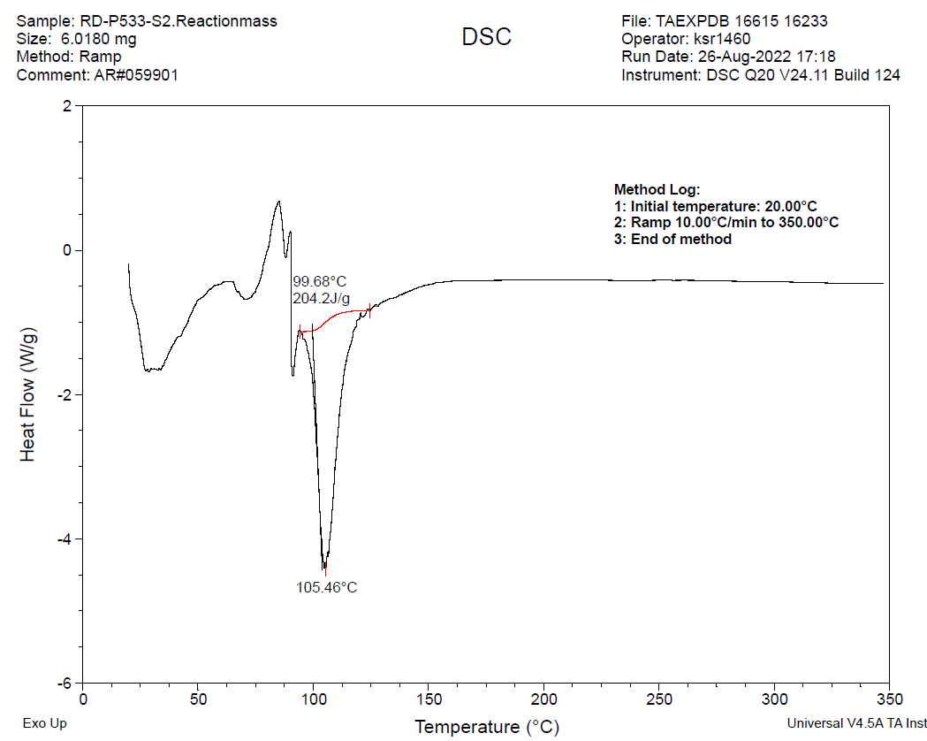
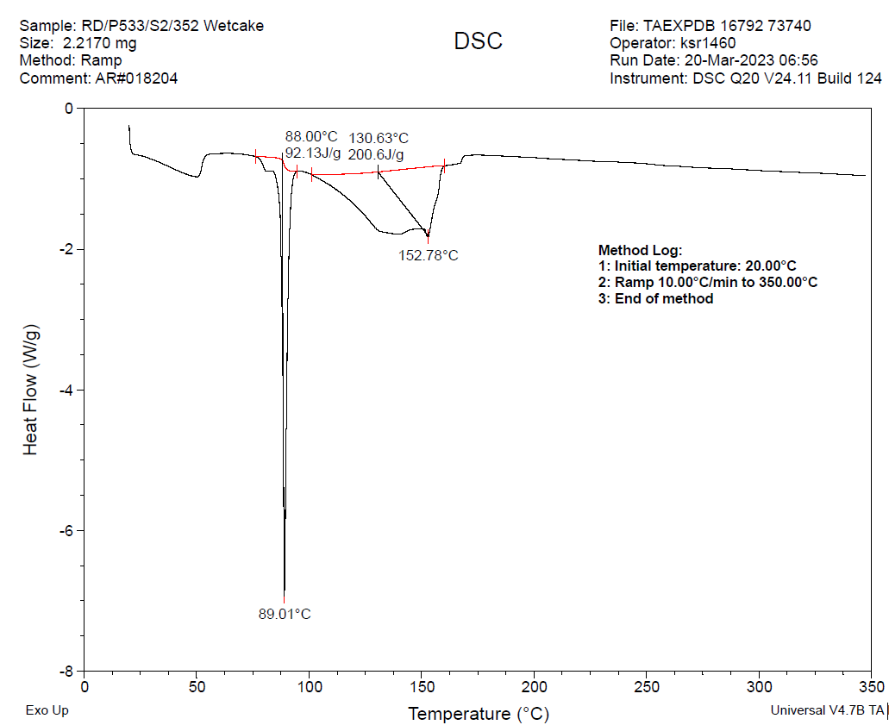
P533 DSC Data – Oxidation reaction & isolated product
No exothermic event observed, endotherm was due to evaporation of solvent (water) in reaction mass and melting point endotherm due to melting of product

Slide 28
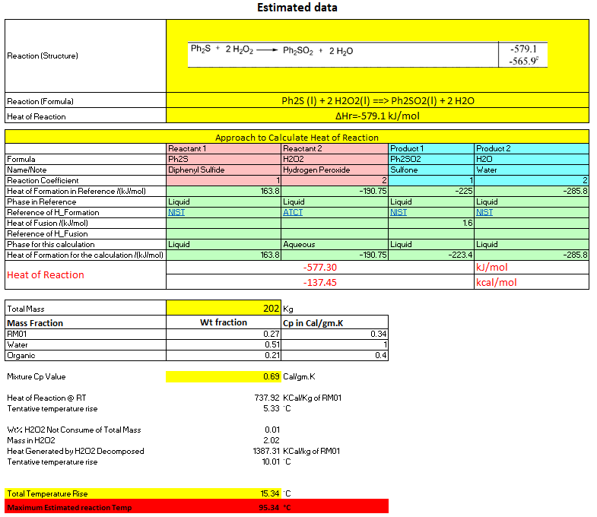
P533 Estimated Heat of reaction at RT (2nd Order analogue)

Slide 29
P487 – Advanced Intermediate Insecticide
Process Tech-pack Replication
Process Improvement
Pilot Production for Scale up Studies
Trial Production
Commercial Production

Slide 30
P487 Hydrogenation – PHA, Design, & Operations
Hazards Identified
  Thermal Hazard of Reaction – heat of reaction
    Literature Study & Calculations with Experimental Confirmation
  Fire Hazard of Materials – Hydrogen venting; Handling of raney Nickel
    Literature Studies
Evaluation Process → Conclusions
  Reaction Heat Estimate → Potential adiabatic temperature rise
    Heat of reaction (Estimated) 233.37 KJ/Lg
      Expected Temp rise of reaction Mass ~ 0.03 °C
    Expected Maximum Process temperature ~ 80 (operating temp) + 0.03°C ( heat of reaction) = 80.03 °C
      Calculation are based on Estimated Heat of reaction & Cp value of reaction mass
  Thus Expected temperature rise is not significant
  DSC/TSU → Decomposition Details, Onset temperature
    Does not shows any exothermic event; observed endotherm may be due to boiling point of Product
  Reaction Screening Trials → Profile and Magnitude of Exotherm
    Not required ; exotherm not observed
Conclusions → Design & Operations
  Set Operating Temperature
    Hydrogen pressure 17 to 20 kg/Cm2
    Reaction temperature – 80 ± 5°C
  Automation
    Hydrogen pressure (inversely) & cooling water (proportionately) Vs Reaction temperature - controlled loop required
  Operator Training
    Handling Raney Nickel -Pyrophoric in nature
      Always keep wet or under water
      Catch fire when get dry and in contact with air
    Ensure oxygen content in reactor less than 0.5%

Slide 31
P487 Material Hazards

Slide 32
P487 Process Hazards

Slide 33
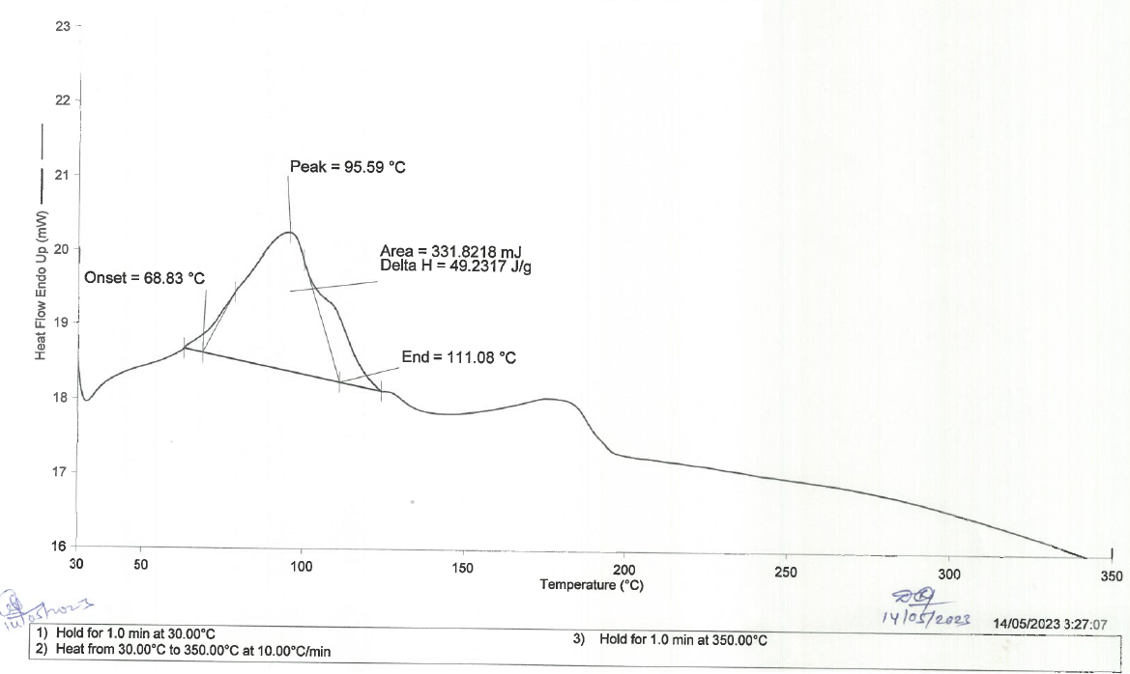
P487 DSC Data
No Exothermic event; endotherm due to boiling point of product

Slide 34
P487 Estimated Heat of reaction at RT (2nd Order analogue)

Slide 35



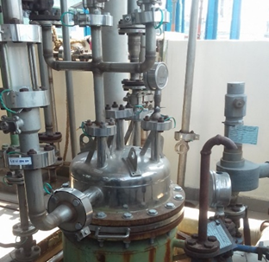
P487 – Pyrophoric Catalyst
Hazard
  Presence of Pyrophoric Raney Nickel in Hydrogenation filtration
Source
  MSDS
Solution Approach
  Engineering control
  Closed filtration system
  Nitrogen blanketing
Solution Implemented
  Candle filter when catalyst is to be reloaded in to the reactor
  PNF when catalyst is to be discharged
  Nitrogen Blanketing

Slide 36


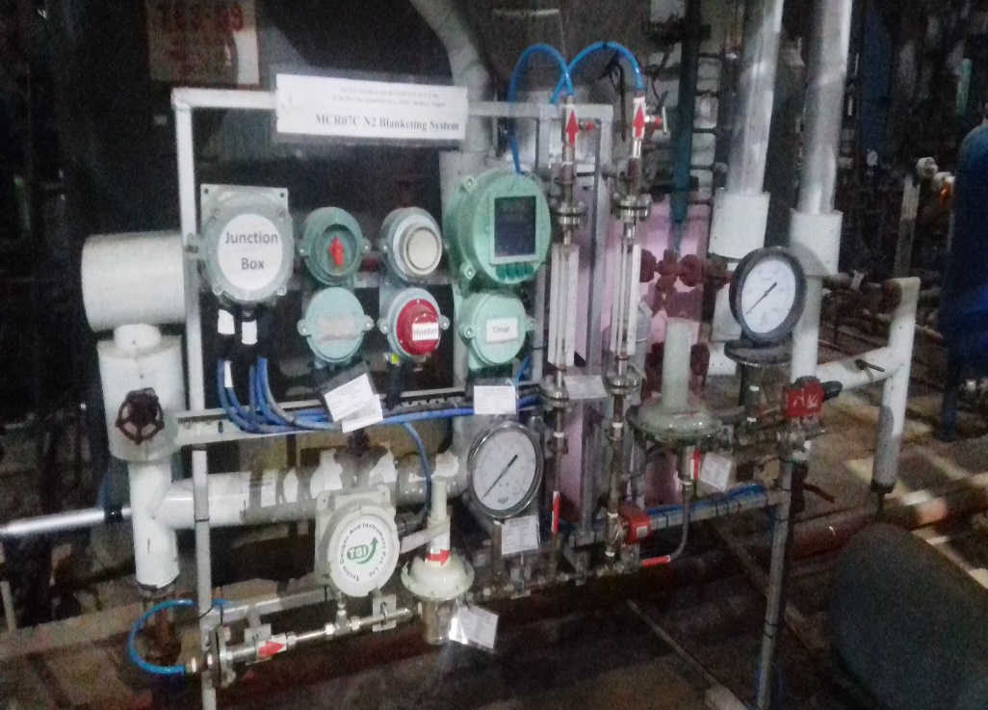
P487 – Fire & Asphyxiation
Hazard
  Flammable vapor of Toluene
    LEL of Toluene is 1.1%
    UEL of Toluene-7.1%
    Flash point of Toluene- 4°C
  Asphyxiation by Nitrogen while opening and unloading the centrifuge
Source
  MSDS & Laboratory Studies
Solution Approach
  Engineering controls & SOP
  Closed system for filtration with grounding
  Nitrogen blanketing & CFG opening SOP
Solution Implemented
  Automatic Nitrogen blanketing system implemented with interlocks
    Centrifuge will not start till nitrogen switch is on.
    80 Second Timer provide for replacing oxygen
  200mmWC Nitrogen pressure maintained in the centrifuge and Sump tank
  Interlock provided with centrifuge lid and N2 blanketing system
Hooter on low pressure of nitrogen
Organization control
Hazard/risk communication part of BMR, Training

Slide 37
P440 – Advanced Intermediate Insecticide
Process Development Batch
Process Optimization
Conversion to Flow Chemistry
Pilot Production for Scale up Studies
Trial Production
Commercial Production

Slide 38
P440.S1 Chlorination
Hazards Identified
  Slow rate of reaction & more chlorine liberation
    Lab experimental data
  Gas liberation HCl – release of chlorine gas and HCl gas
    Lab experimental data
Evaluation Process → Conclusions
  Reaction Heat Estimate → Not estimated
    Observed endothermic reaction
  DSC/TSU → Decomposition Details, Onset temperature
    Reaction mass
      No exothermic event observed
      Endotherm observed at 107.9°C; might be due to boiling of acetic acid
      No exothermic decomposition observed
  Reaction Screening Trials → Profile and Magnitude of Exotherm
    At lower temperature (~ 50 to 60 °C ) observed lower rate of conversion
      Liberating more unreacted chlorine gas
    At higher temperature (90 to 95 °C) formation of unwanted product observed
      Liberating more HCl gas
Conclusions → Design & Operations
  Set Operating Temperature
  Addition Rate 25 Kg /Hr
  Reaction temperature – 80 ± °C
  Automation
    Chlorine purging rate (Inversely) Vs Scrubber pH
  Operator Training
    Do not start purging of chlorine at temperature less than 70°C
    Monitor scrubber temperature and pH

Slide 39
P440 Material Hazards

Slide 40
P440 Process Hazards

Slide 41
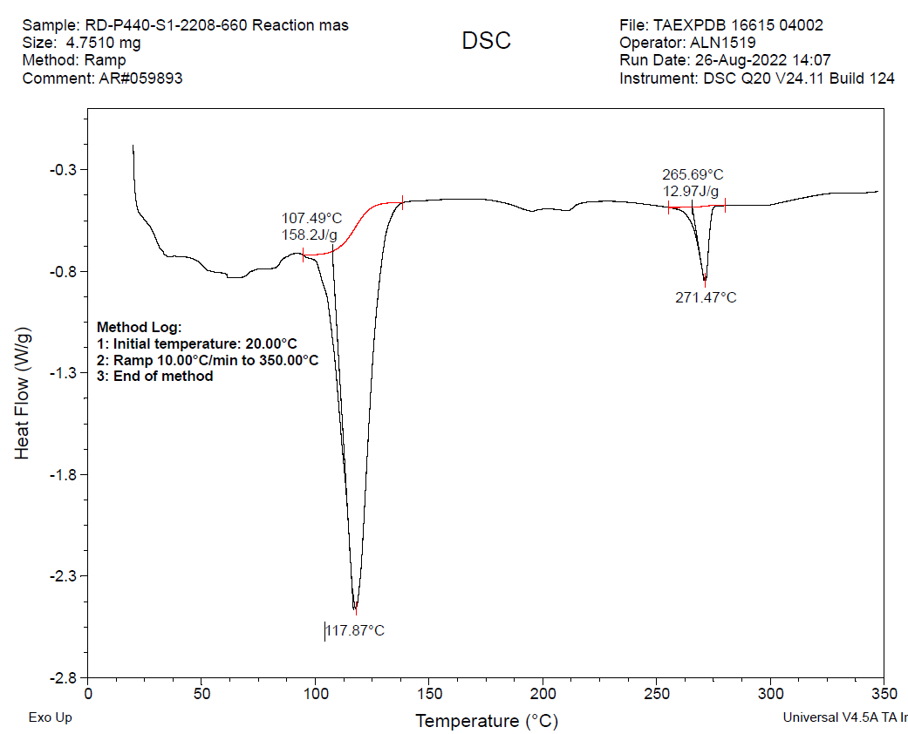
P440 DSC Chlorination
No exothermic event observed; endotherm may be due to boiling point of reaction media acetic acid

Slide 42
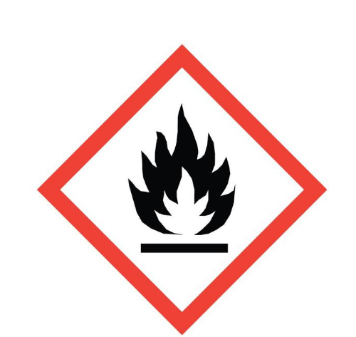


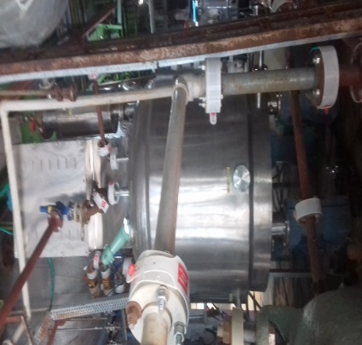
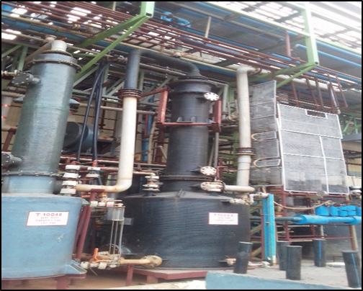
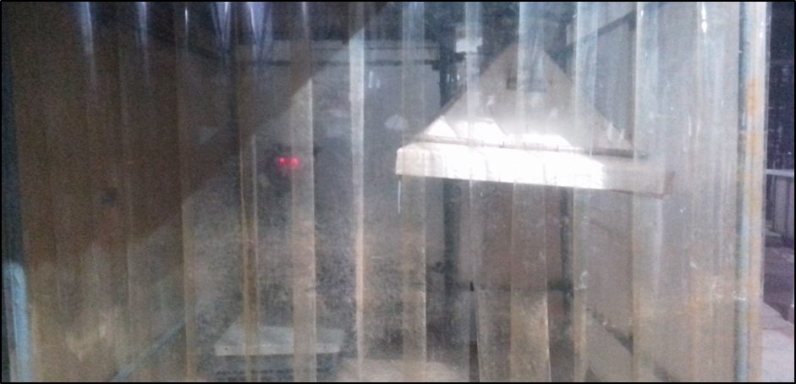
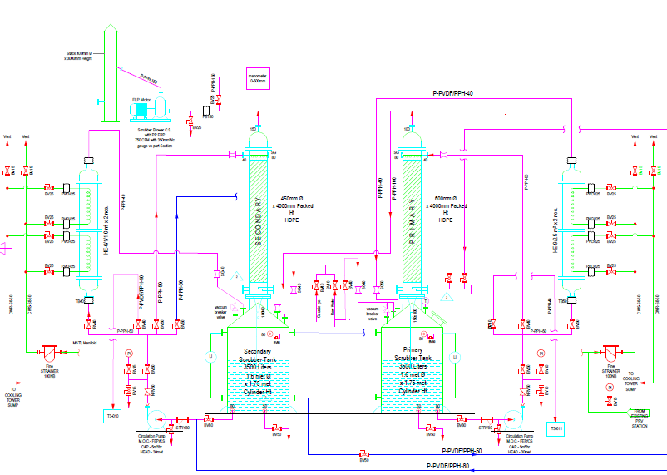
P440 – Exposure to Lachrymators & to Chlorine
Hazard
  Exposure to Lachrymators
  Exposure to Chlorine
Source
  MSDS & Lab Studies
Solution Approach
  Engineering Controls & SOPs
  Isolate people from Hazard
  Closed type filtration
  Vapor contact/Exposure to be avoided
  Suction in filtration system
Solution Implemented
  Full body Suite with breathing air supply provided
  ANFD used to avoid vapor exposure and ensure effective washing
  Multistage scrubber provided for suction in ANFD
  Suction hood provided for material handling
  The filtration area was enclosed to avoid exposure to other people in the plant
ANFD
Suction hood & area enclosure for material handling
P&ID for Multistage scrubber

Slide 43
P149 - Solvent
Process Development Batch
Conversion to Continuous Process
Continuous Process Optimization
Pilot Production for Scale up Studies (Dedicated Plant)
Commercial Production

Slide 44
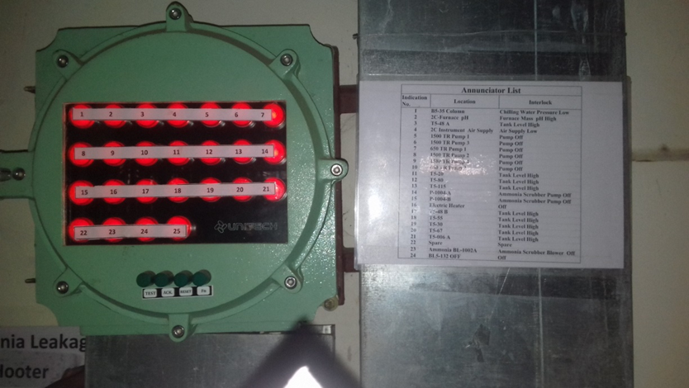
P149 – Fire by inflammable gases
Hazards
  Leakage of flammable vapours and liquids
  Utility failure
  High level of tank
  Scrubber blower and pump failure
Source
  HAZOP, MSDS
Solution Approach
  Engineering control
  Process Automation
  Alarms
Solution Implemented
  Process Automation Interlocks with alarm on DCS
  Annunciator panel installed for immediate response to utility failure, tank levels and scrubber blower and pump

Slide 45
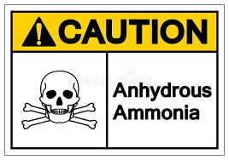
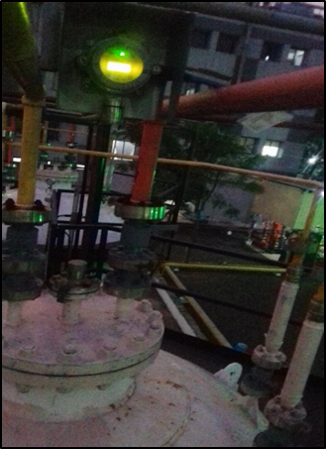
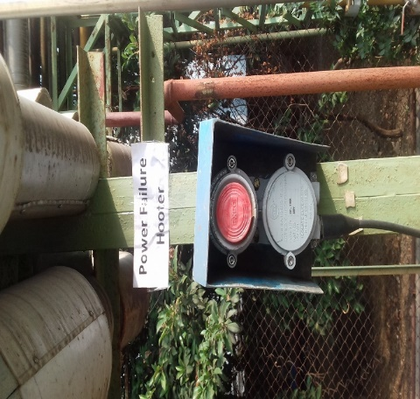
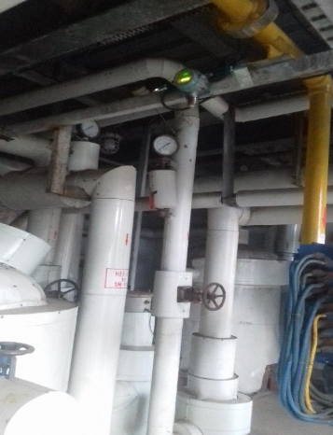
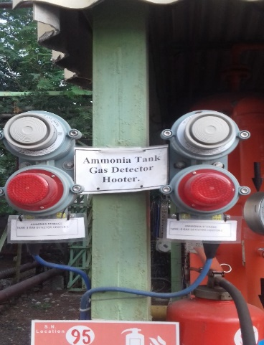
P149 – Hazardous Gas Leakage
Hazard
  Leakage of ammonia from Storage tank and process area
Source
  Explosives Department Regulations
  Environment Impact Analysis
  3 D Modeling and Consequences Analysis Study Report
  Life Cycle Assessment
Solution Approach
  Engineering control
  Alarm, Sprinkler, etc
Solution Implemented
  Ammonia gas detector with alarm system implemented
  Sprinkler and Scrubber system implemented
  Alarm provided for power failure
Organization control
Hazard/risk communication part of Training
Ammonia gas detector in storage tank area
Ammonia gas detector in reaction section
Ammonia gas detector hooter
Alarm for power failure

Slide 46
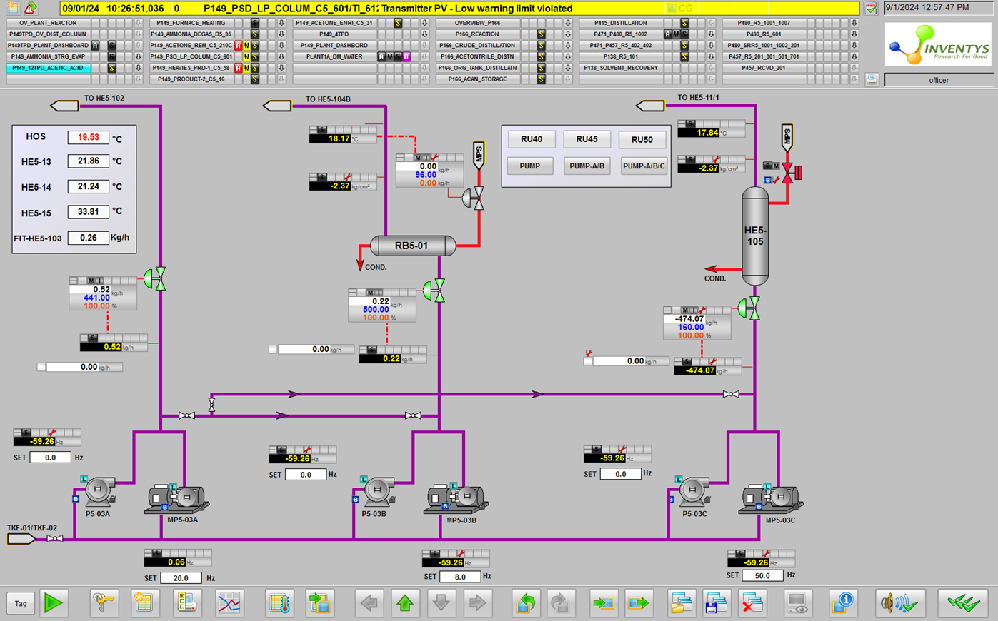
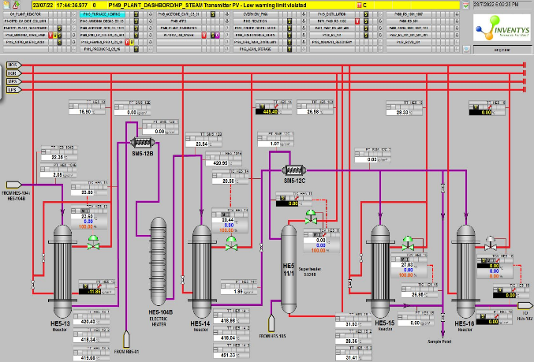
P149 – Fire & Yield Loss – Plant Start-up / Ramp-up
Hazard
  Ammonia Leakage
  Fire due to leakage of very high temperature flammable vapours and liquids
Source
  MSDS, Reaction literature, HAZOP
Solution Approach
  Engineering controls and SOP
  Fully Automated Startup and Ramp-up procedure
  Alarm and sprinkler
  Closed system
Solution Implemented
  Stepwise Automated Process Start-up & Ramp-up Protocol
    Nitrogen flushing & Reactor Heating
    Ammonia startup →Acetic Acid pump 1 start up → Acetic Acid pump2 startup →Acetic Acid pump 3 startup
    Ammonia ramp up → Acetic Acid pump 1 ramp up → Acetic Acid pump2 ramp up →Acetic Acid pump 3 ramp up
    Ammonia ramp up → Acetic Acid pump 1 ramp up → Acetic Acid pump2 ramp up →Acetic Acid pump 3 ramp up
  Proportionate control valve, mass flow meter, field instruments, metering pumps
  Gas detectors alarm system, Alarm for utility failure and tank levels
  24x7 DCS monitoring station at plant (in addition to the central control room)
P-149 reaction section acetic acid / ammonia ratio splitting scheme
P-149 reaction section acetic acid / ammonia ratio splitting scheme
Step 1: Press Start
Step 2: select sequence RU40, RU45, RU50
Step 3: Start-up pump cycle time lag.
List of process interlocks

Slide 47
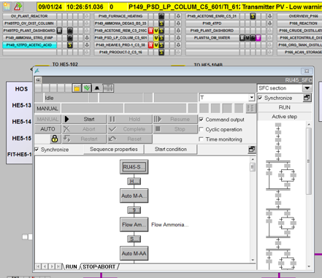
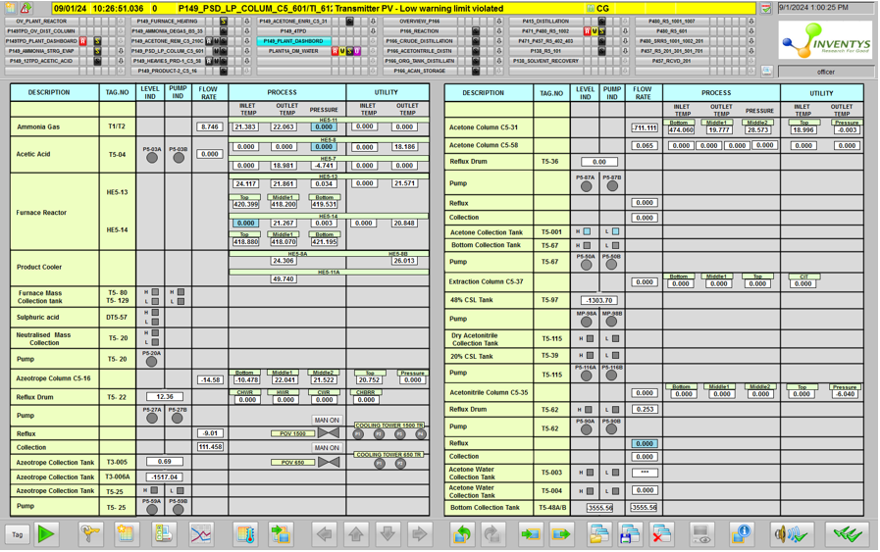
P149 – Fire & Catalyst Fouling – Plant Shutdown
Hazard
  Ammonia Leakage
  Fire due to leakage of very high temperature flammable vapours and liquids
Source
  MSDS, Reaction literature, HAZOP
Solution Approach
  Engineering control and SOP
  Process Automation
  Alarm and sprinkler
  Closed system
Solution Implemented
  Fully Automated Shutdown Protocol
    Acetic Acid pump 3 ramp down →Acetic acid pump 2 ramp down →Acetic Acid pump1 ramp down
    Ammonia rate ramp down →Acetic Acid pump 3 ramp down →Acetic acid pump 2 ramp down →Acetic Acid pump1 ramp down
    Ammonia rate ramp down →Acetic Acid pump 3 ramp down →Acetic acid pump 2 ramp down →Acetic Acid pump1 ramp down
    Ammonia rate ramp down →Acetic Acid pump 3 shut down →Acetic acid pump 2 shut down →Acetic Acid pump1 shut down
    Ammonia shut down →Nitrogen flushing
  Proportionate control valve, mass flow meter, field instruments, metering pumps
  Gas detectors alarm system, Alarm for utility failure and tank levels
  24x7 DCS monitoring station at plant (in addition to the central control room)
Shut down SOP
Shut down sequence in DCS
Process and utility dashboard

Slide 48
P471 – Electronic Chemical
Process Development Batch
Process Optimization
Pilot Production for Scale up Studies
Commercial Production

Slide 49
P471 Hydrolysis Exothermic Reaction
Hazard identified
  Exothermic reaction above 220 °C
    Rapid rise in reaction temperature upto 260 °C
  Heating media Thermic fluid; immediate cooling not possible
  Evaporation of starting material
Source
  Lab experiments and literature
Solution
  Recommended process temperature 175±5 °C
  Recommended small batch size ~ 200 Kg
  Direct reaction mass cooling with water injection
    Water is compatible with reaction mass and part of workup procedure
Implementation
  Ensured reactor Oxygen content in reactor less than 1.0%
  Water injection pump interlocked with reaction temperature installed
  Large vent line (12” dia) connected to dump tank
    Vent of dump tank connected to water tank

Slide 50
P471 Bromine Spillage & human exposure
Hazard identified
  Bromine Spillage hazard
    Human hazard
  Exposure to bromine vapor
Source
  MSDS and literature
Solution
  Recommended Bromine Charging in confined area with scrubber (Sodium bisulfite solution)
  Pre-cooling facility for bromine bottles to avoid vapor
  Mechanical bromine charging facility – to minimize human exposure
  Pressure suite for operator
Implementation
  Dedicated bromine handling and charging room
  Multiple suction point along with elephant suction trunk provided
  Cooling bath provide to pre-cool bromine bottles
  Bromine compatible pressure suits were provided to operator
  Emergency response kit for bromine spillage provided

Slide 51
P522 – Advanced Intermediate for AI under Development (CRO)
Process Development Batch
Process Optimization
Conversion to Flow Chemistry
Lab Produced Material Supplied
Awaiting further development

Slide 52
P532 – Advanced Intermediate for Pharma etc
Process Development Batch
Process Optimization
Conversion to Flow Chemistry
Pilot Production for Scale up Studies
Commercial Production Planned

Slide 53
P522/P532 Aryl diazonium salt storage Stability
Hazard identified
  Stability of aryldiazonium salt as solution
    Spontaneous decomposition with rise in temperature (10 to 80 °C in 2-5 min) leads to liberation of Nitrogen
Source
  Lab studies and Literature data
Solution
  Recommended not prepare and store diazonium salt solution
  Develop continuous process for preparation of Diazonium salt from Amines
    Use continuous reactor PFR and CSTR
Implementation
  Developed continuous manufacturing process for diazonium salt
    PFR for P522
    CSTR for P532
  On demand basis preparation diazonium salt and cascade further processing
  Completely avoiding storage of diazonium salt

Slide 54
Miscellaneous Examples
Storage
Harmful Dust and Vapor

Slide 55
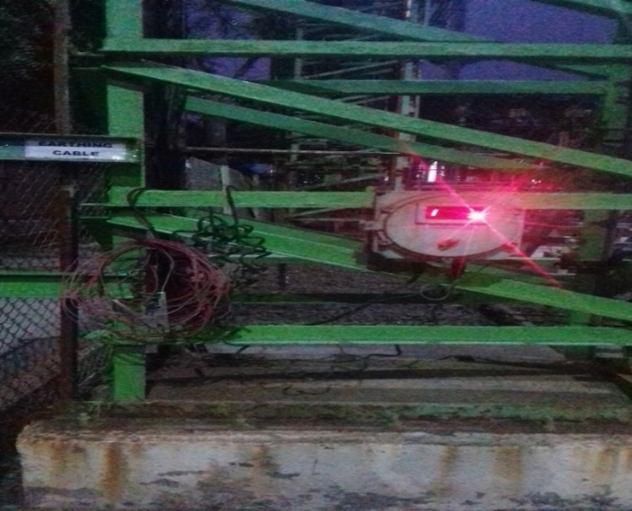

Petroleum Class A Storage – Fire
Hazard
  Fire during loading and unloading of tankers
Source
  MSDS & Literature Studies & HAZOP
Solution Approach
  Engineering Control for Static Charge detection
  SOP
Solution Implemented
  Earth rite system installed
  Permit system implemented for tanker loading and unloading activity
    Tanker tailpipe smoke arrestor
Indication for proper connectivity

Slide 56


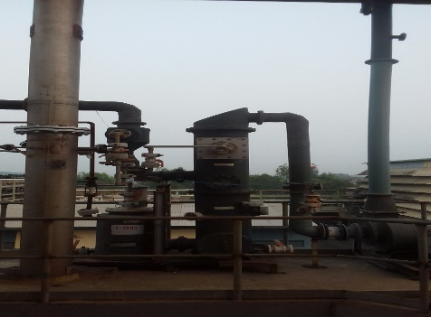
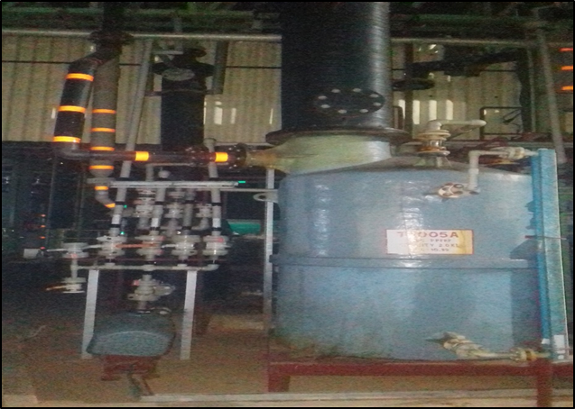
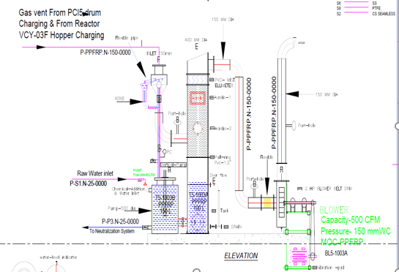
P485 – Hamrful Dust & Vapor
Hazard
  PCl5 dust exposure during charging
  HCl Vapor liberation during PCl5 charging
Source
  MSDS, Lab Studies
Solution Approach
  Engineering & Administrative controls
  Suction at charging point & reactor
Solution Implemented
  Suction hood provided for charging hopper
  Dedicated scrubber system arranged for PCl5 charging point
  Multistage scrubber provided for Reactors with ?mm vacuum
Dedicated scrubber for PCl5 handling
Multistage scrubber for Reactors
P&ID of Dedicated scrubber for PCl5 handling

