Slide 1
Inventys Sites
Site 1 – Healthcare & Specialty
Site 2 - Actives & Specialty
Site 3 - Herbicides

Slide 2
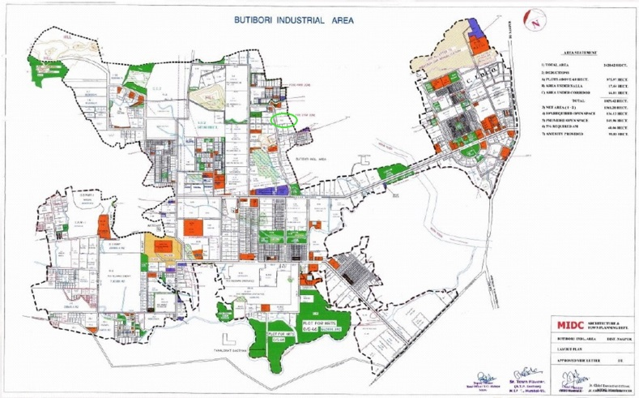
Locations

Slide 3
Inventys Manufacturing Sites
Site 1 | Site 2 | Site 3 | Site 4
7 Acres | 14 Acres |  | 9 Acres
Healthcare & Specialty Integrated Manufacturing | Crop Protection Manufacturing Site |  | Healthcare Manufacturing Site
Pharma KSMs, Advanced Intermediates, Specialties | Crop Protection Actives, RSMs, Advanced Intermediates, Specialties | Crop Protection Herbicides | Pharma KSMs & Advanced Intermediates
60 Batch Reactors (+30 future) Other Supporting Equipment Utilities | 250+ Batch & Flow Reactors Other Supporting Equipment Utilities |  | 60 Batch & Flow Reactors Other Supporting Equipment Utilities
12 Products | 45 Products |  | To be decided
6 Production Blocks R&D, Pilot Plant, ADL / QC / Safety / Microbiology / ETP Laboratories | ~15 Production Blocks Quality Control Various Utilities | 5 Production Blocks Quality Control Various Utilities | 6 Production Blocks, Microbiology / ADL / QC Laboratories Various Utilities
Process Engineering Center CRO | Project Management | Project Management | RA CRO
Operating Since 2008 | 2024 Q1 | 2024 Q1 | 2026
150 KL Discharge Permissions | 750 KL Discharge Permission |  | 150 KL Discharge Permissions
Necessary Permissions in Place | Necessary Permissions in Place |  | Necessary Permissions in Place

Slide 4
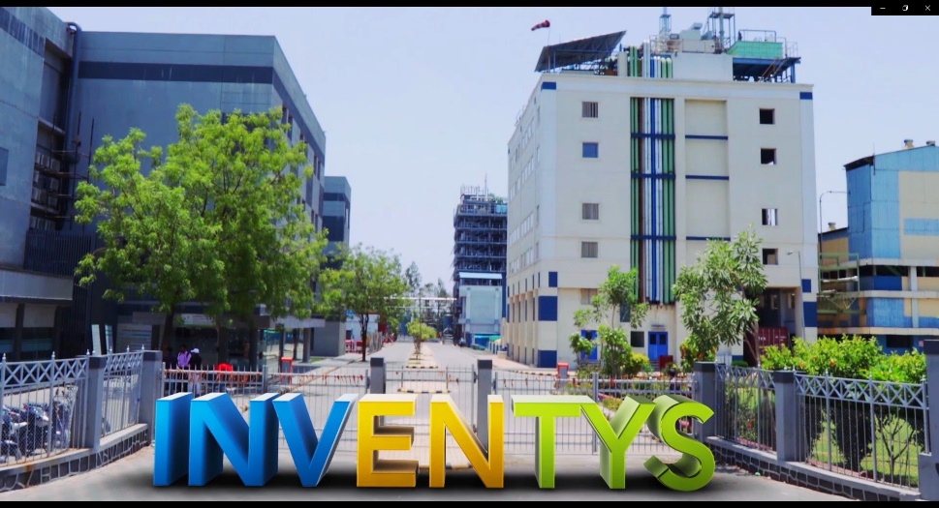
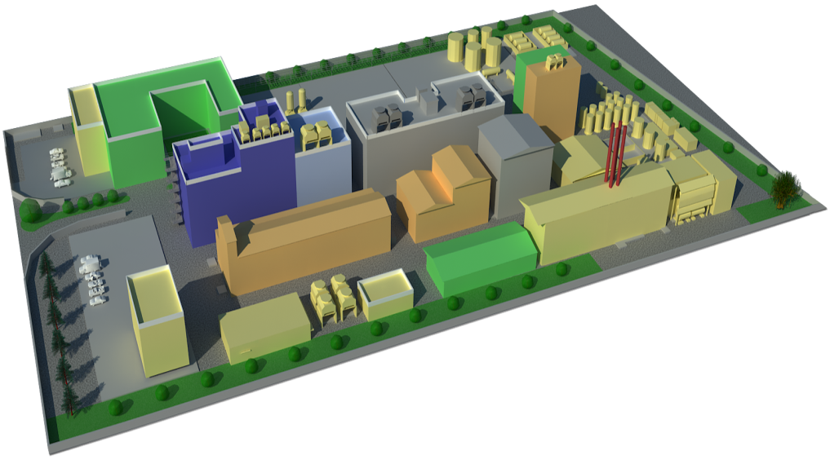
Inventys – Integrated Manufacturing Site 1
Concept → Manufacturing
Synthesis Strategy to Process Development
Scale up to Commercial Production
Continuous Improvement
Quality Assurance & Quality Control
Laboratories
  R&D
  QC & QA
Kilo Labs & Pilot Plants
  APIs & RSMs
  Specialties
  Advanced Intermediates (GMP & non-GMP)
  Bulk Intermediates
Manufacturing Facilities
  APIs & RSMs
  Specialties
  Advanced Intermediates (GMP & non-GMP)
  Bulk Intermediates
  Effluent Treatment Facilities
  300 KL/Day Discharge Permission
https://youtu.be/9rcNlSdsyX8

Slide 5
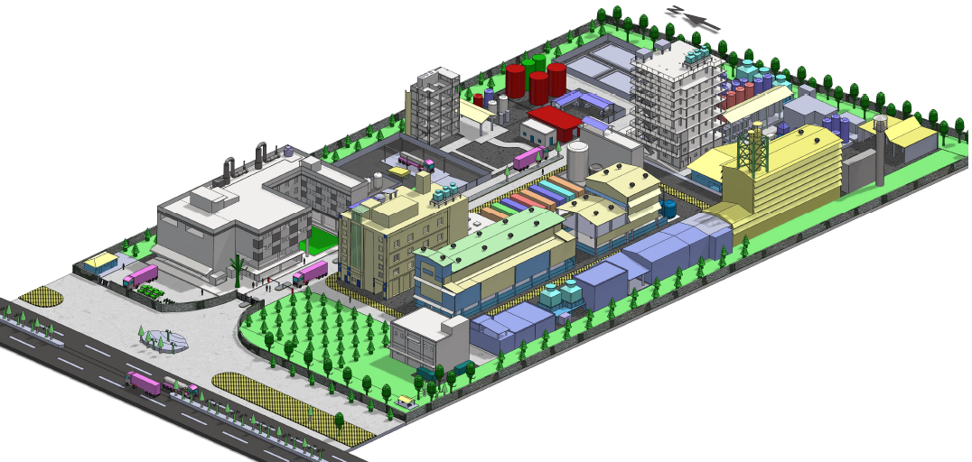
Inventys – Integrated Manufacturing Site 1

Slide 6
Production Blocks @ Site 1
6 Plants / 15 Sections
  Multi Purpose
  State of the Art Facilities
  Automated (DCS/PLC)
  Recipe Management System
  WHO-GMP / ISO 9001:2015/ 14001:2015/ OHSAS 18001:2018
Dedication
  For Intermediates & Advanced Intermediates
    10 Sections Constructed & In Operation & Ready to Use
  For GMP Requirements & Advanced Intermediates
    1 GMP Plant Constructed & In Operation & Ready to Use
Expansion opportunities 3 Plants / 9 Sections
  For Intermediates & Advanced Intermediates
Existing wide frame permit

Slide 7
Inventys New Site 2 – Production Capacities
Actives (Fungicides & Insecticides)
  3 Production Blocks
  6 Production Lines
  36 Reactors (Batch/Flow)
  Plus other supporting equipment including Various Filters & Dryers, Powder Processing Equipment, Pumps, Heat Exchangers, Scrubbers, Solvent Recovery Equipment, Primary Effluent Treatment & Byproduct Recovery Equipment, etc
Registered Starting Materials / Advanced Intermediates / Specialty Chemicals
  6 Production Blocks
  150 Reactors (Batch/Flow)
  Plus other supporting equipment including Various Filters & Dryers, Powder Processing Equipment, Pumps, Heat Exchangers, Scrubbers, Solvent Recovery Equipment, Primary Effluent Treatment & Byproduct Recovery Equipment, etc
Hydrogenation
  1 Production Block
  6 Reactors (Batch/Flow)
Halogenation (HF/KF/etc)
  1 Production Block
  10 Reactors (Batch/Flow)
Fermentation Products
  1 Production Blocks
  To be decided

Slide 8
Inventys New Site 3 – Production Capacities
Herbicides
5 Production Blocks
  50 Reactors (Batch + Flow)
  Plus, other supporting equipment including Various Filters & Dryers, Powder Processing Equipment, Pumps, Heat Exchangers, Scrubbers, Solvent Recovery Equipment, Primary Effluent Treatment & Byproduct Recovery Equipment, etc.
Dedicated
  Quality Control
  Quality Assurance
  Warehouses
  Primary Effluent Treatment
  Byproduct Recovery
  Employee Facilities
  Entrance & Exit
  Parking

Slide 9
Sites 1 – Guided Tour
Plant 3AB
Pilot Plant
Hydrogenation Plant
Plant 2C
Plant 2A / 2B / A

Slide 10
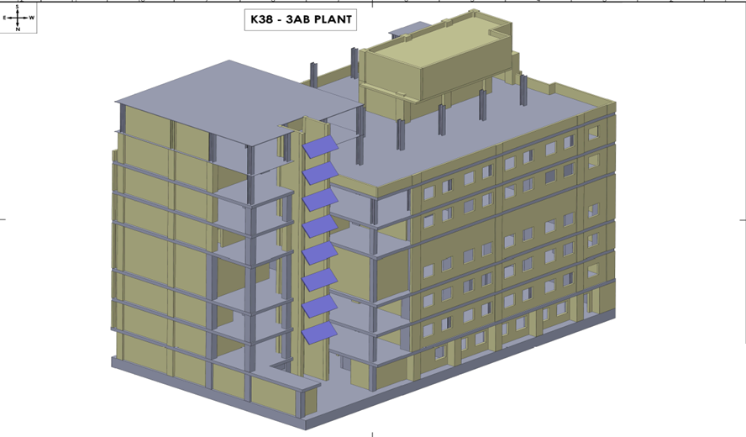
Production Block 3AB

Slide 11
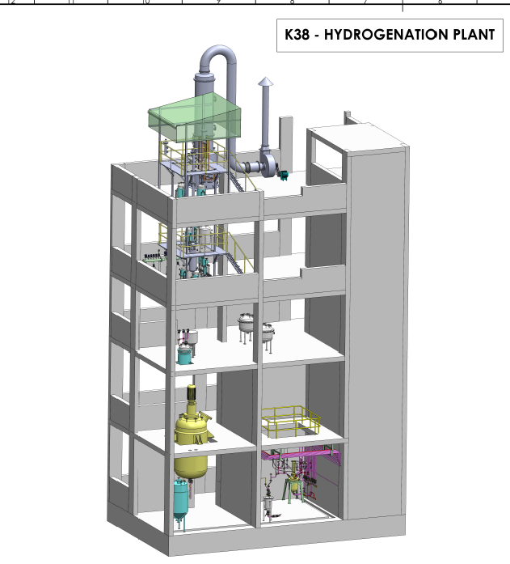
Production Block Hydrogenation

Slide 12
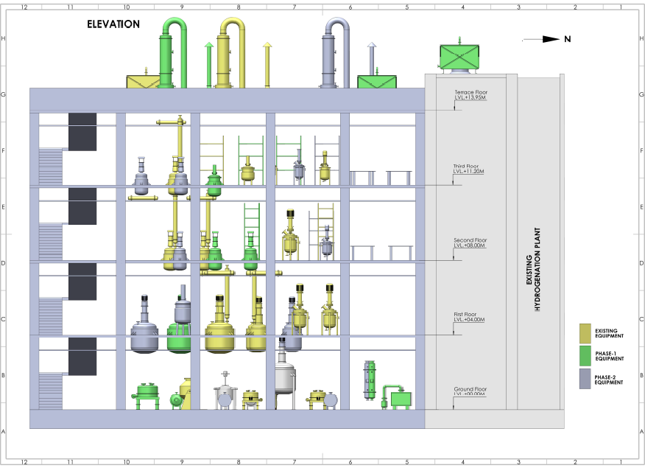
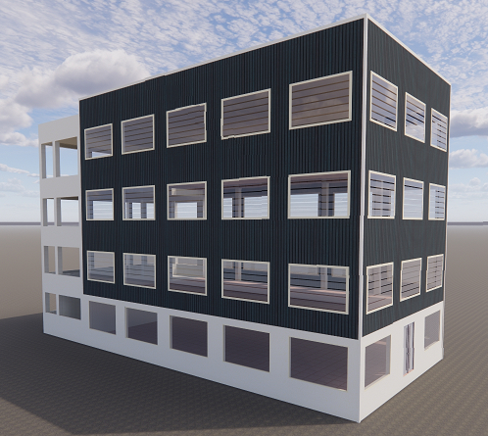
New Pilot Plant Facility

Slide 13
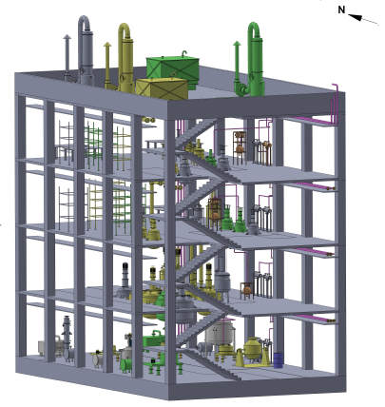
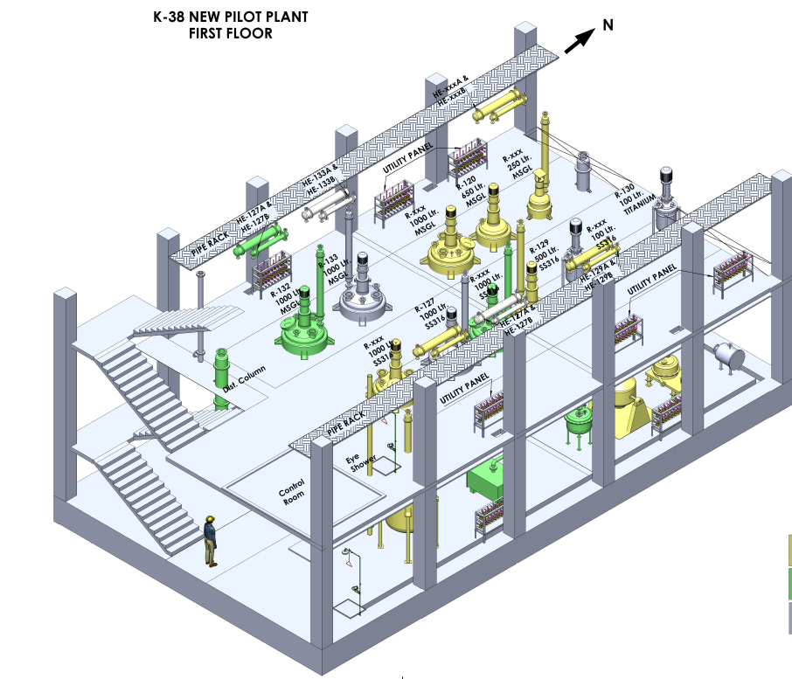
New Pilot Plant Facility
The new pilot plant facility will be ready by Oct-2023

Slide 14
Pilot Plant – Oct 2023
Three ranges of capacities
  20-30 lit
  200-300 lit
  500-1,000 lit
MOCs
  SS316L
  MSGL
  All Glass
  Hastelloy
  Inconel
  Titanium
Batch Reactors
Flow Reactors
Catalytic Reactors
FFE
ATFD
WFE
Vacuum Tray Dryers
ANFDs
Thermosyphon Distillation
Continuous Extractors
Molecular Sieves
Dry vacuum pumps

Slide 15
Major Equipment
Stainless steel Reactors
  ~40
  Reaction Volume
    ~250 KL
Glass lined Reactors
  ~15
  Reaction Volumes
    ~75 KL
Flow Reactors
  5 Commercial Scale
  6 Laboratory setups
Autoclaves
  ~04
  Reaction Volumes
    ~10 KL
Distillation Systems
  Batch or Continuous
  ~20
Centrifuges
  15
Rota Cone Vacuum Dryers
  5
Agitated Nutsche Filter Dryer
  SS316- 2 number
  Hastelloy C-22- 1 number
Vacuum Tray Dryer
  3
LLE System
  2
PSD System (LP & HP)
  2
Blender & Miller
  1 each

Slide 16
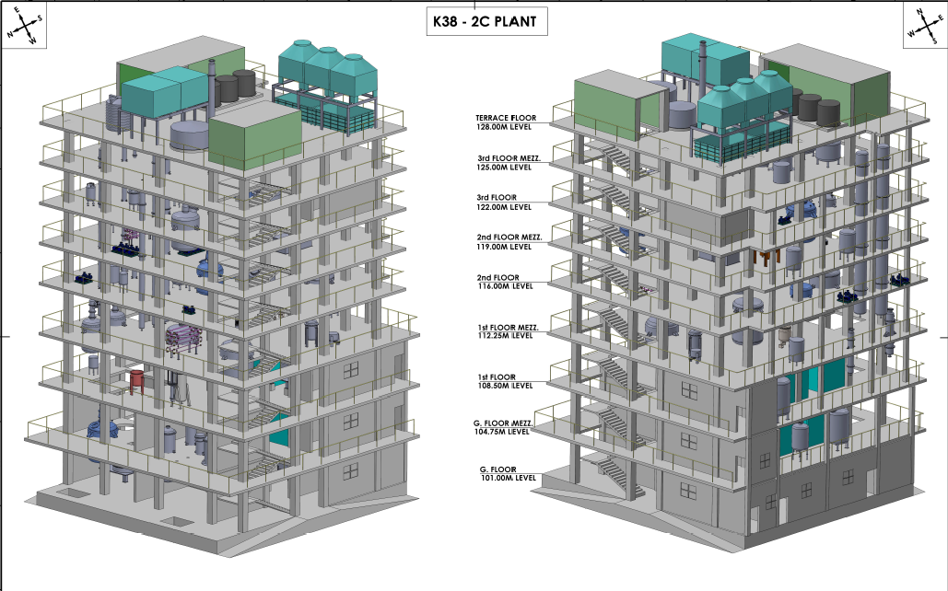
Production Block 2C

Slide 17
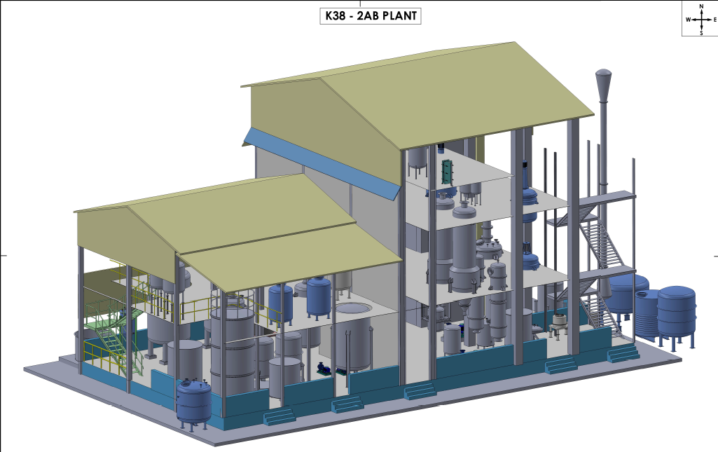
Production Block 2AB

Slide 18
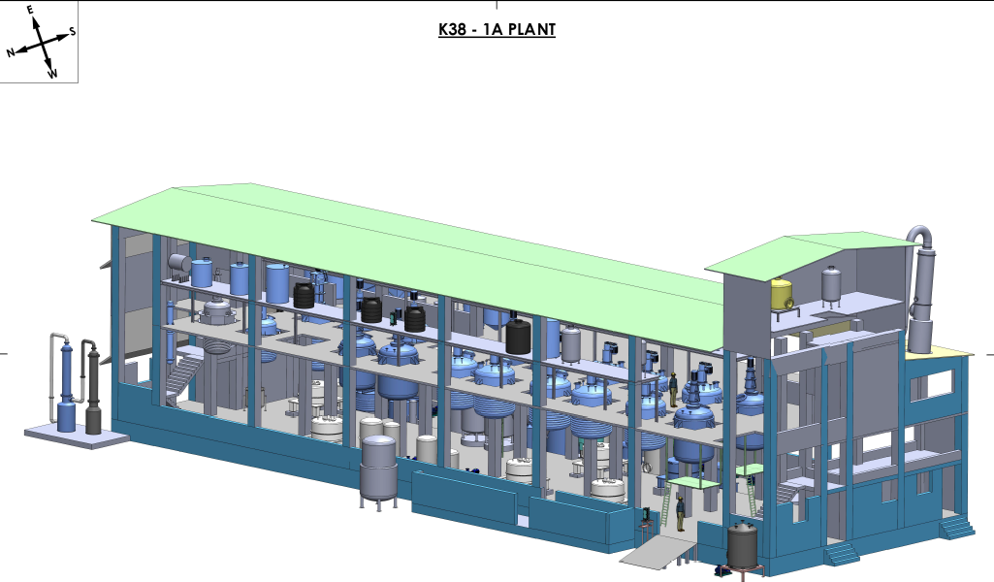
Production Block 1A

Slide 19
Site RM to FG

Slide 20
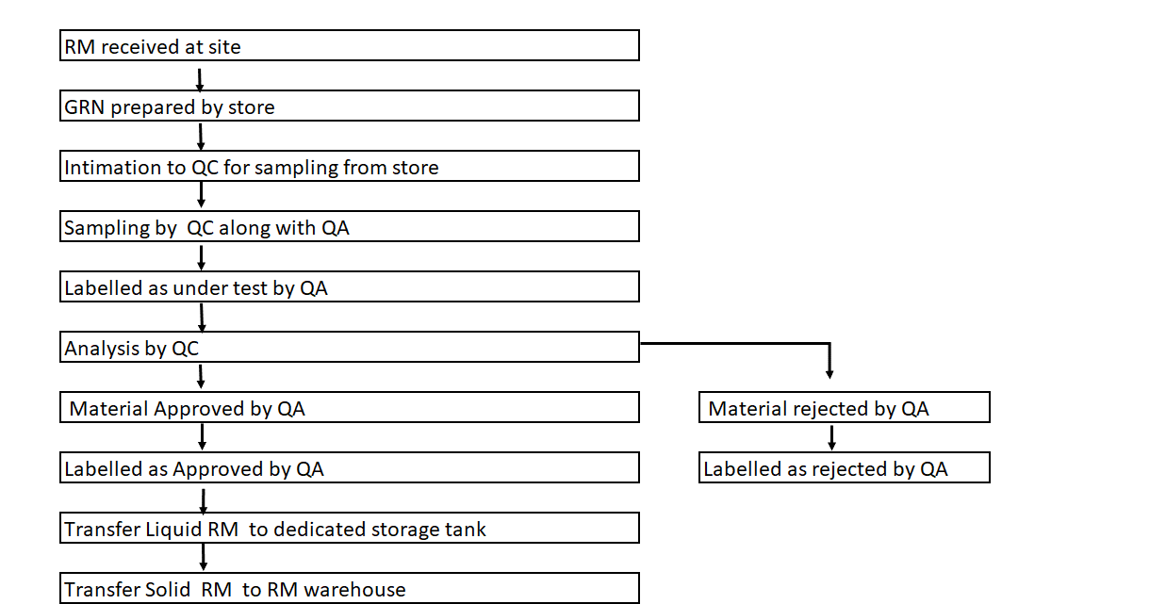
Material Movement - RM and FG

Slide 21
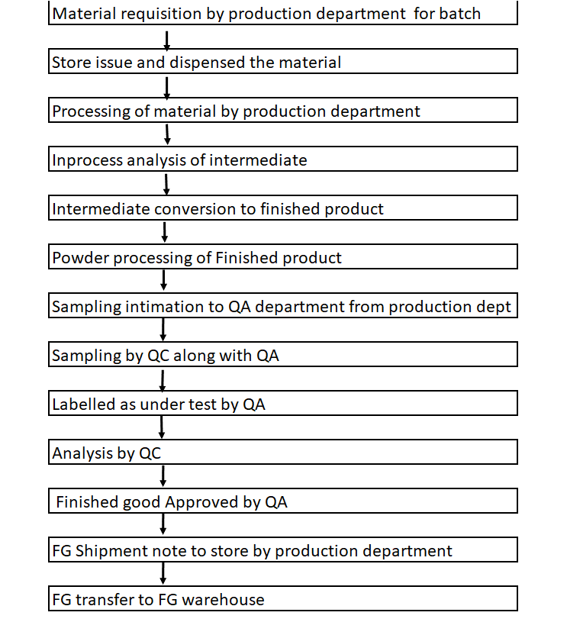
Material Movement - RM and FG

Slide 22
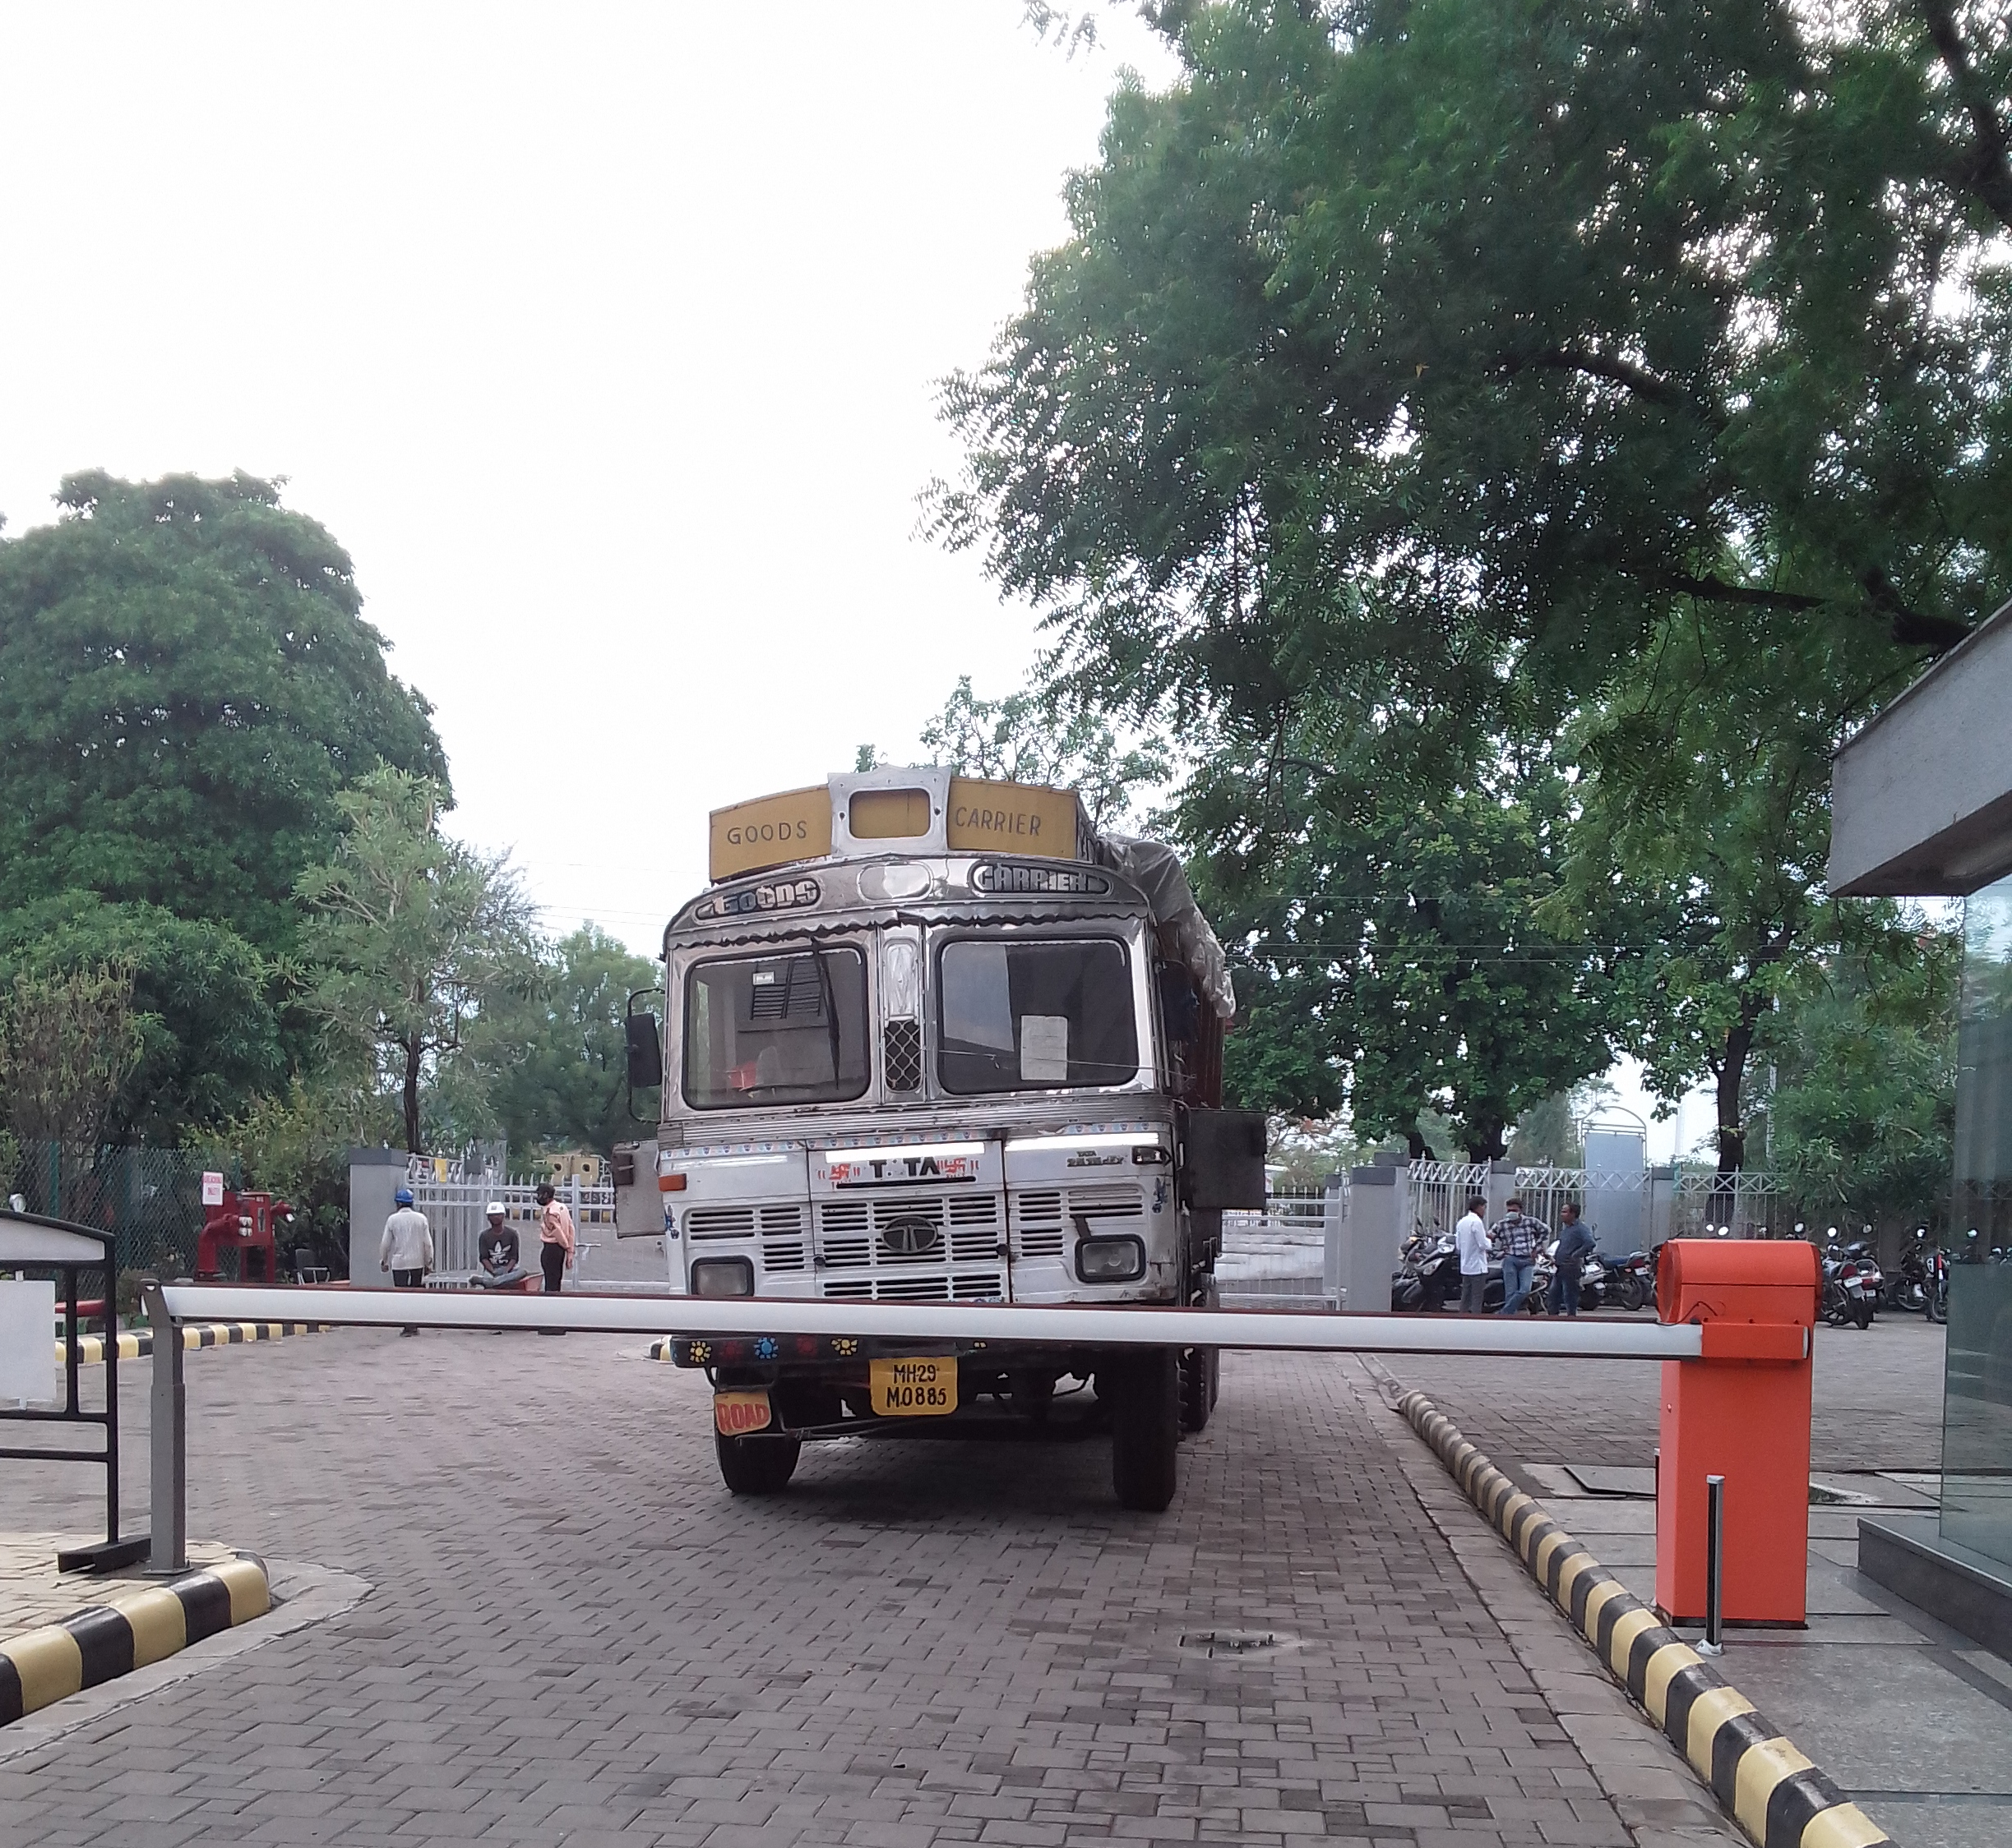
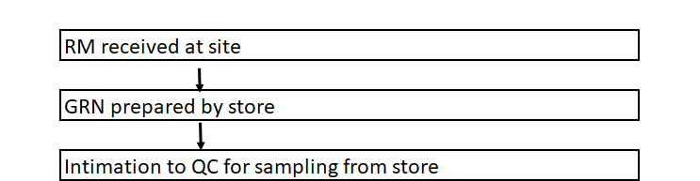
Raw material entry

Slide 23
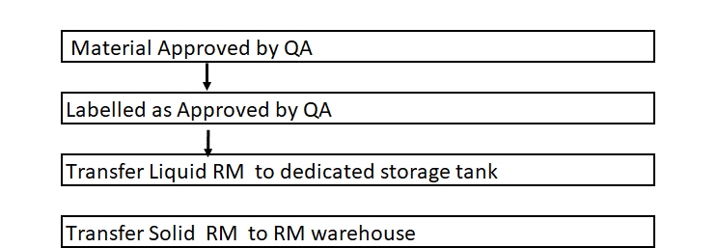
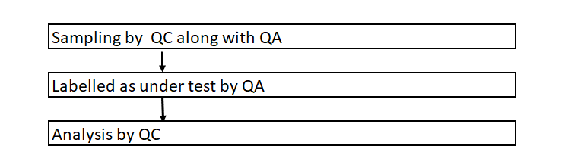
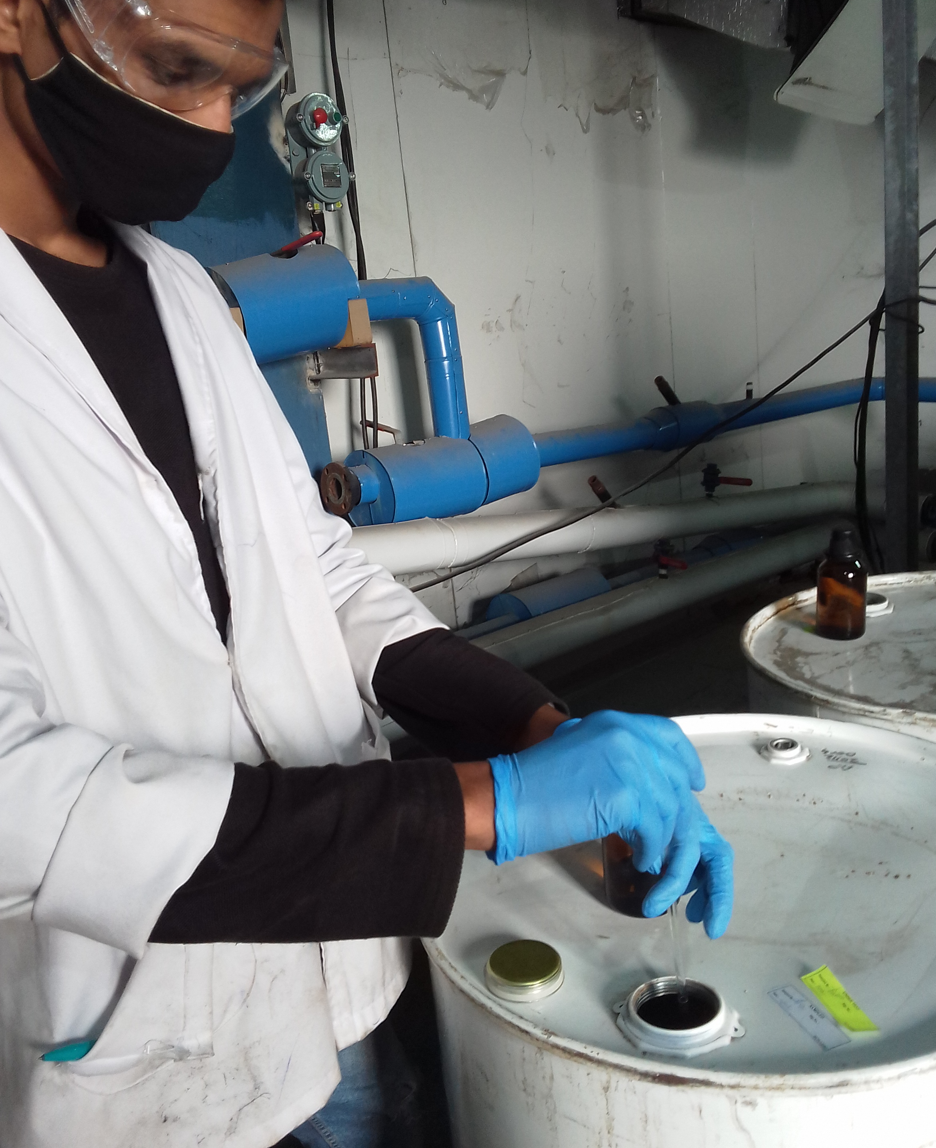
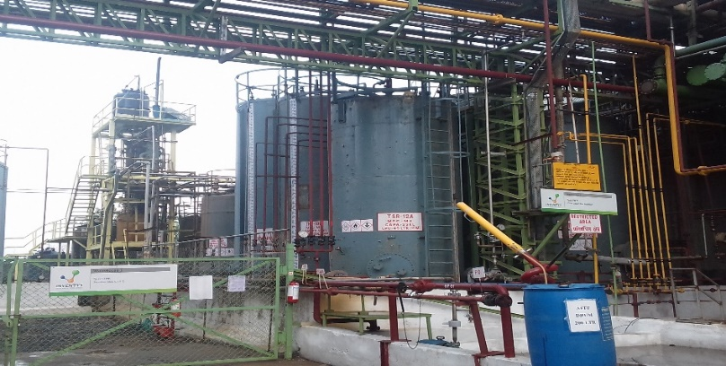
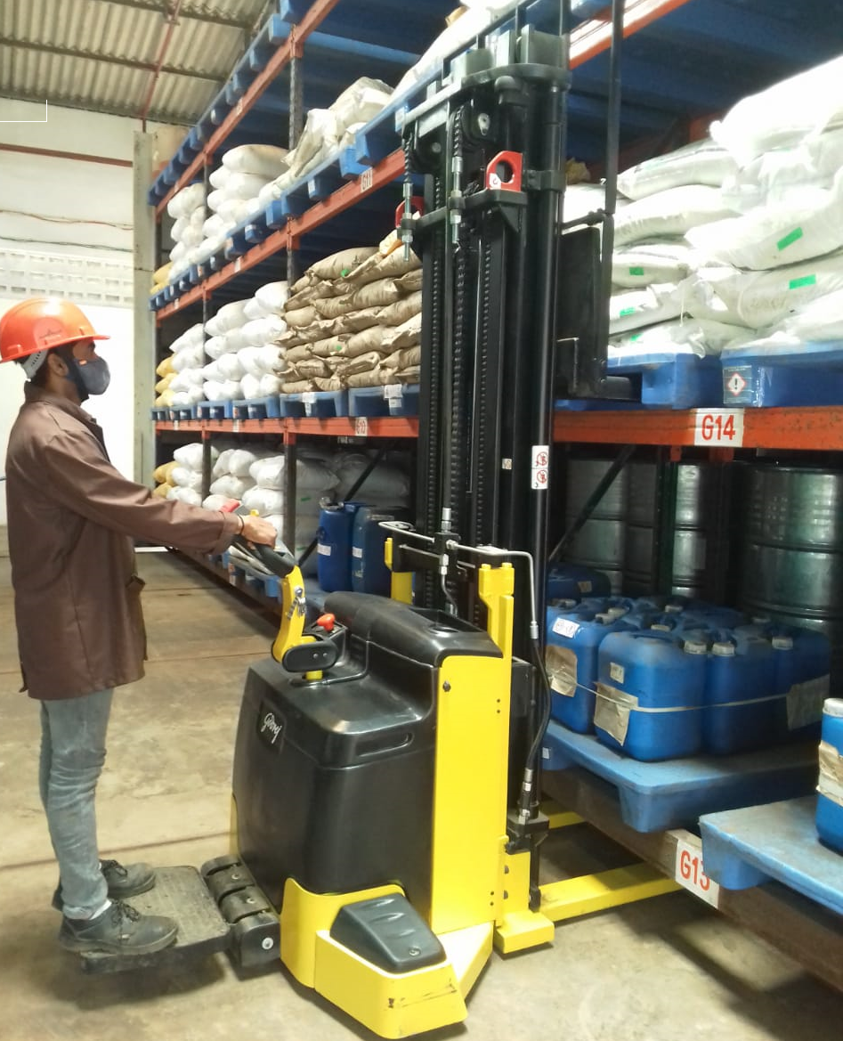
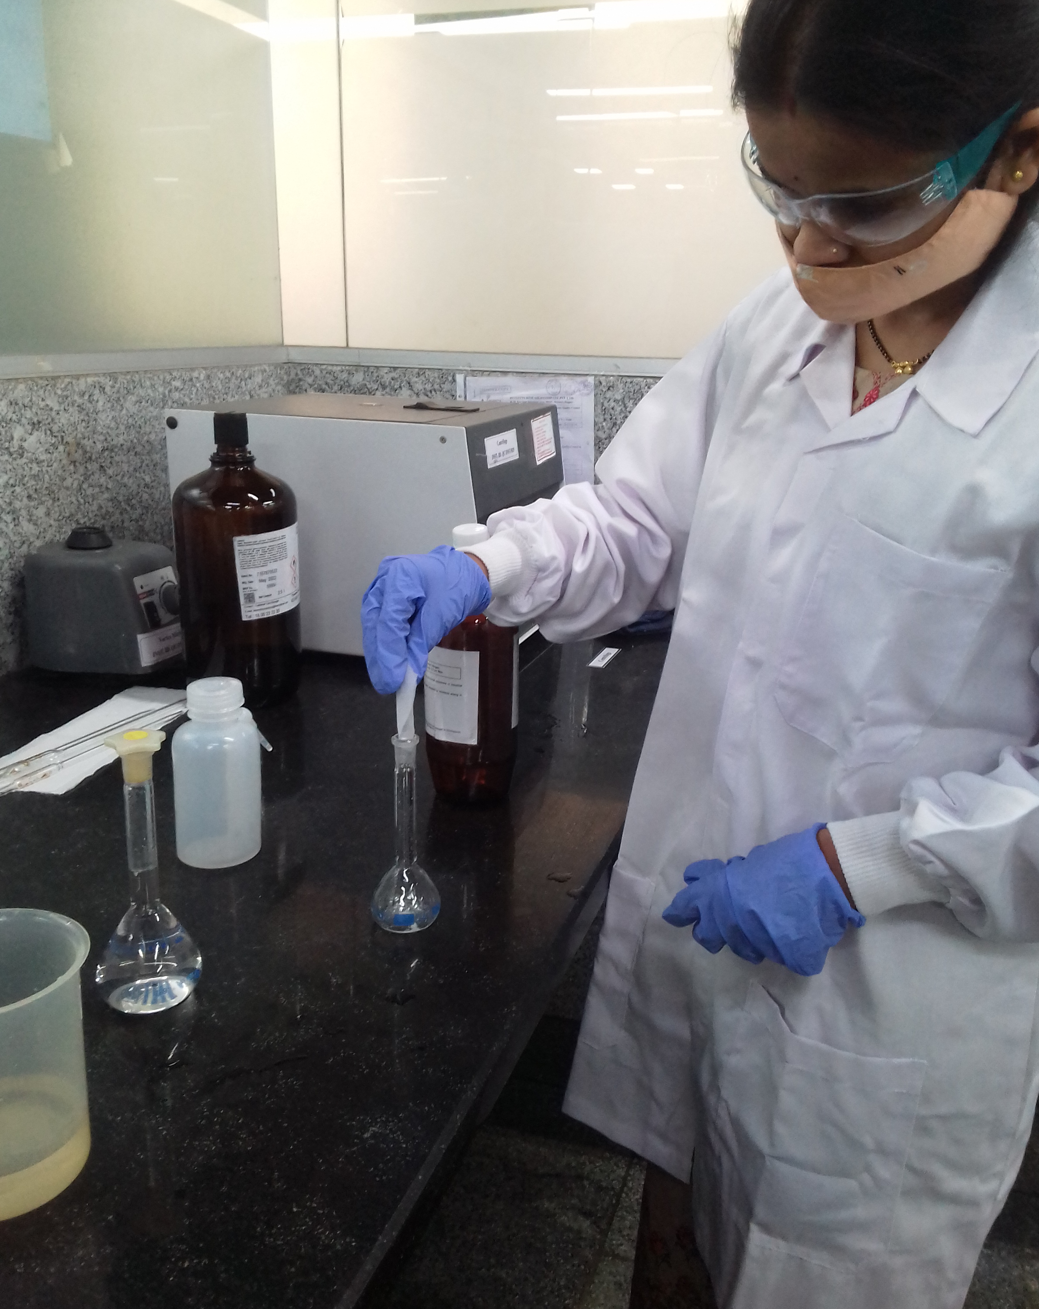
Raw Material Sampling, Approval & Storage

Slide 24
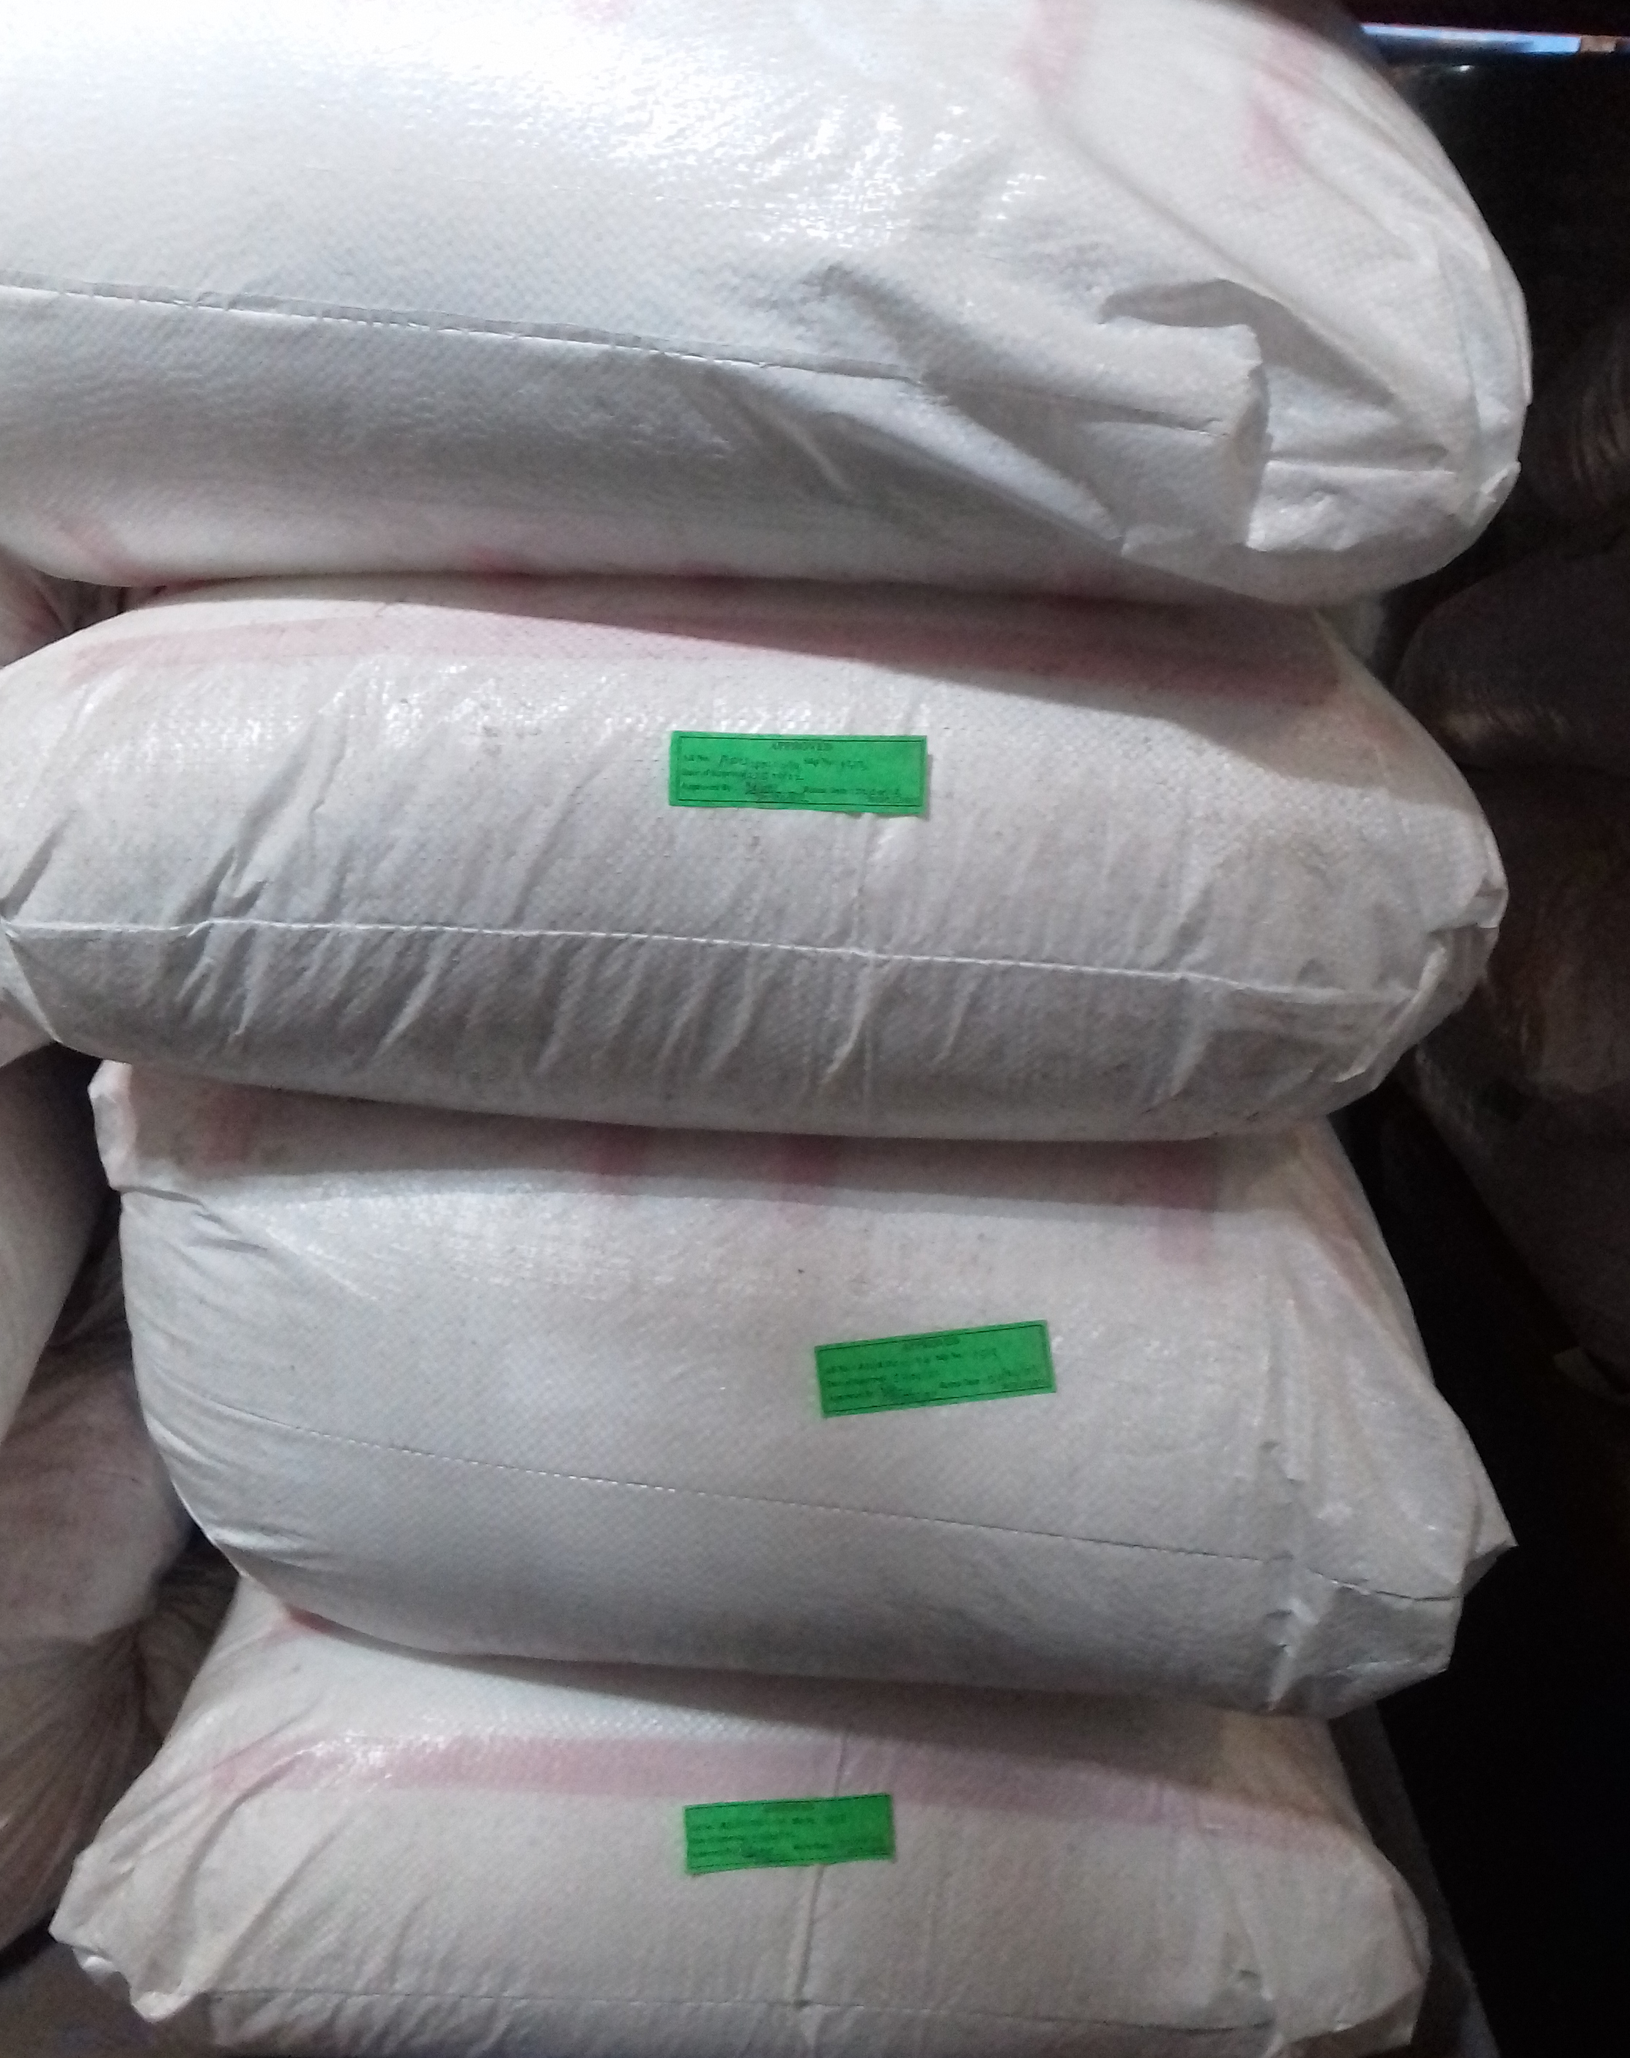
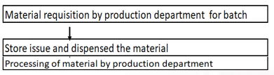
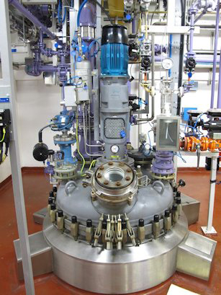
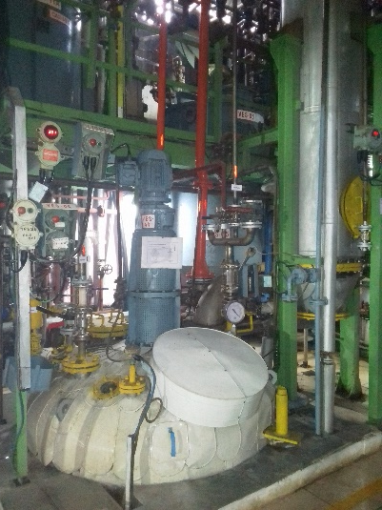
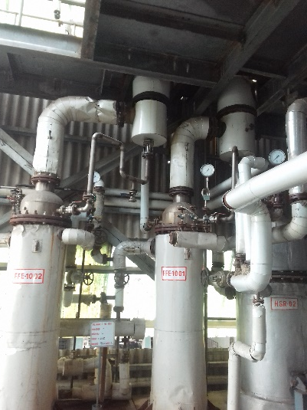
Production – Processing

Slide 25
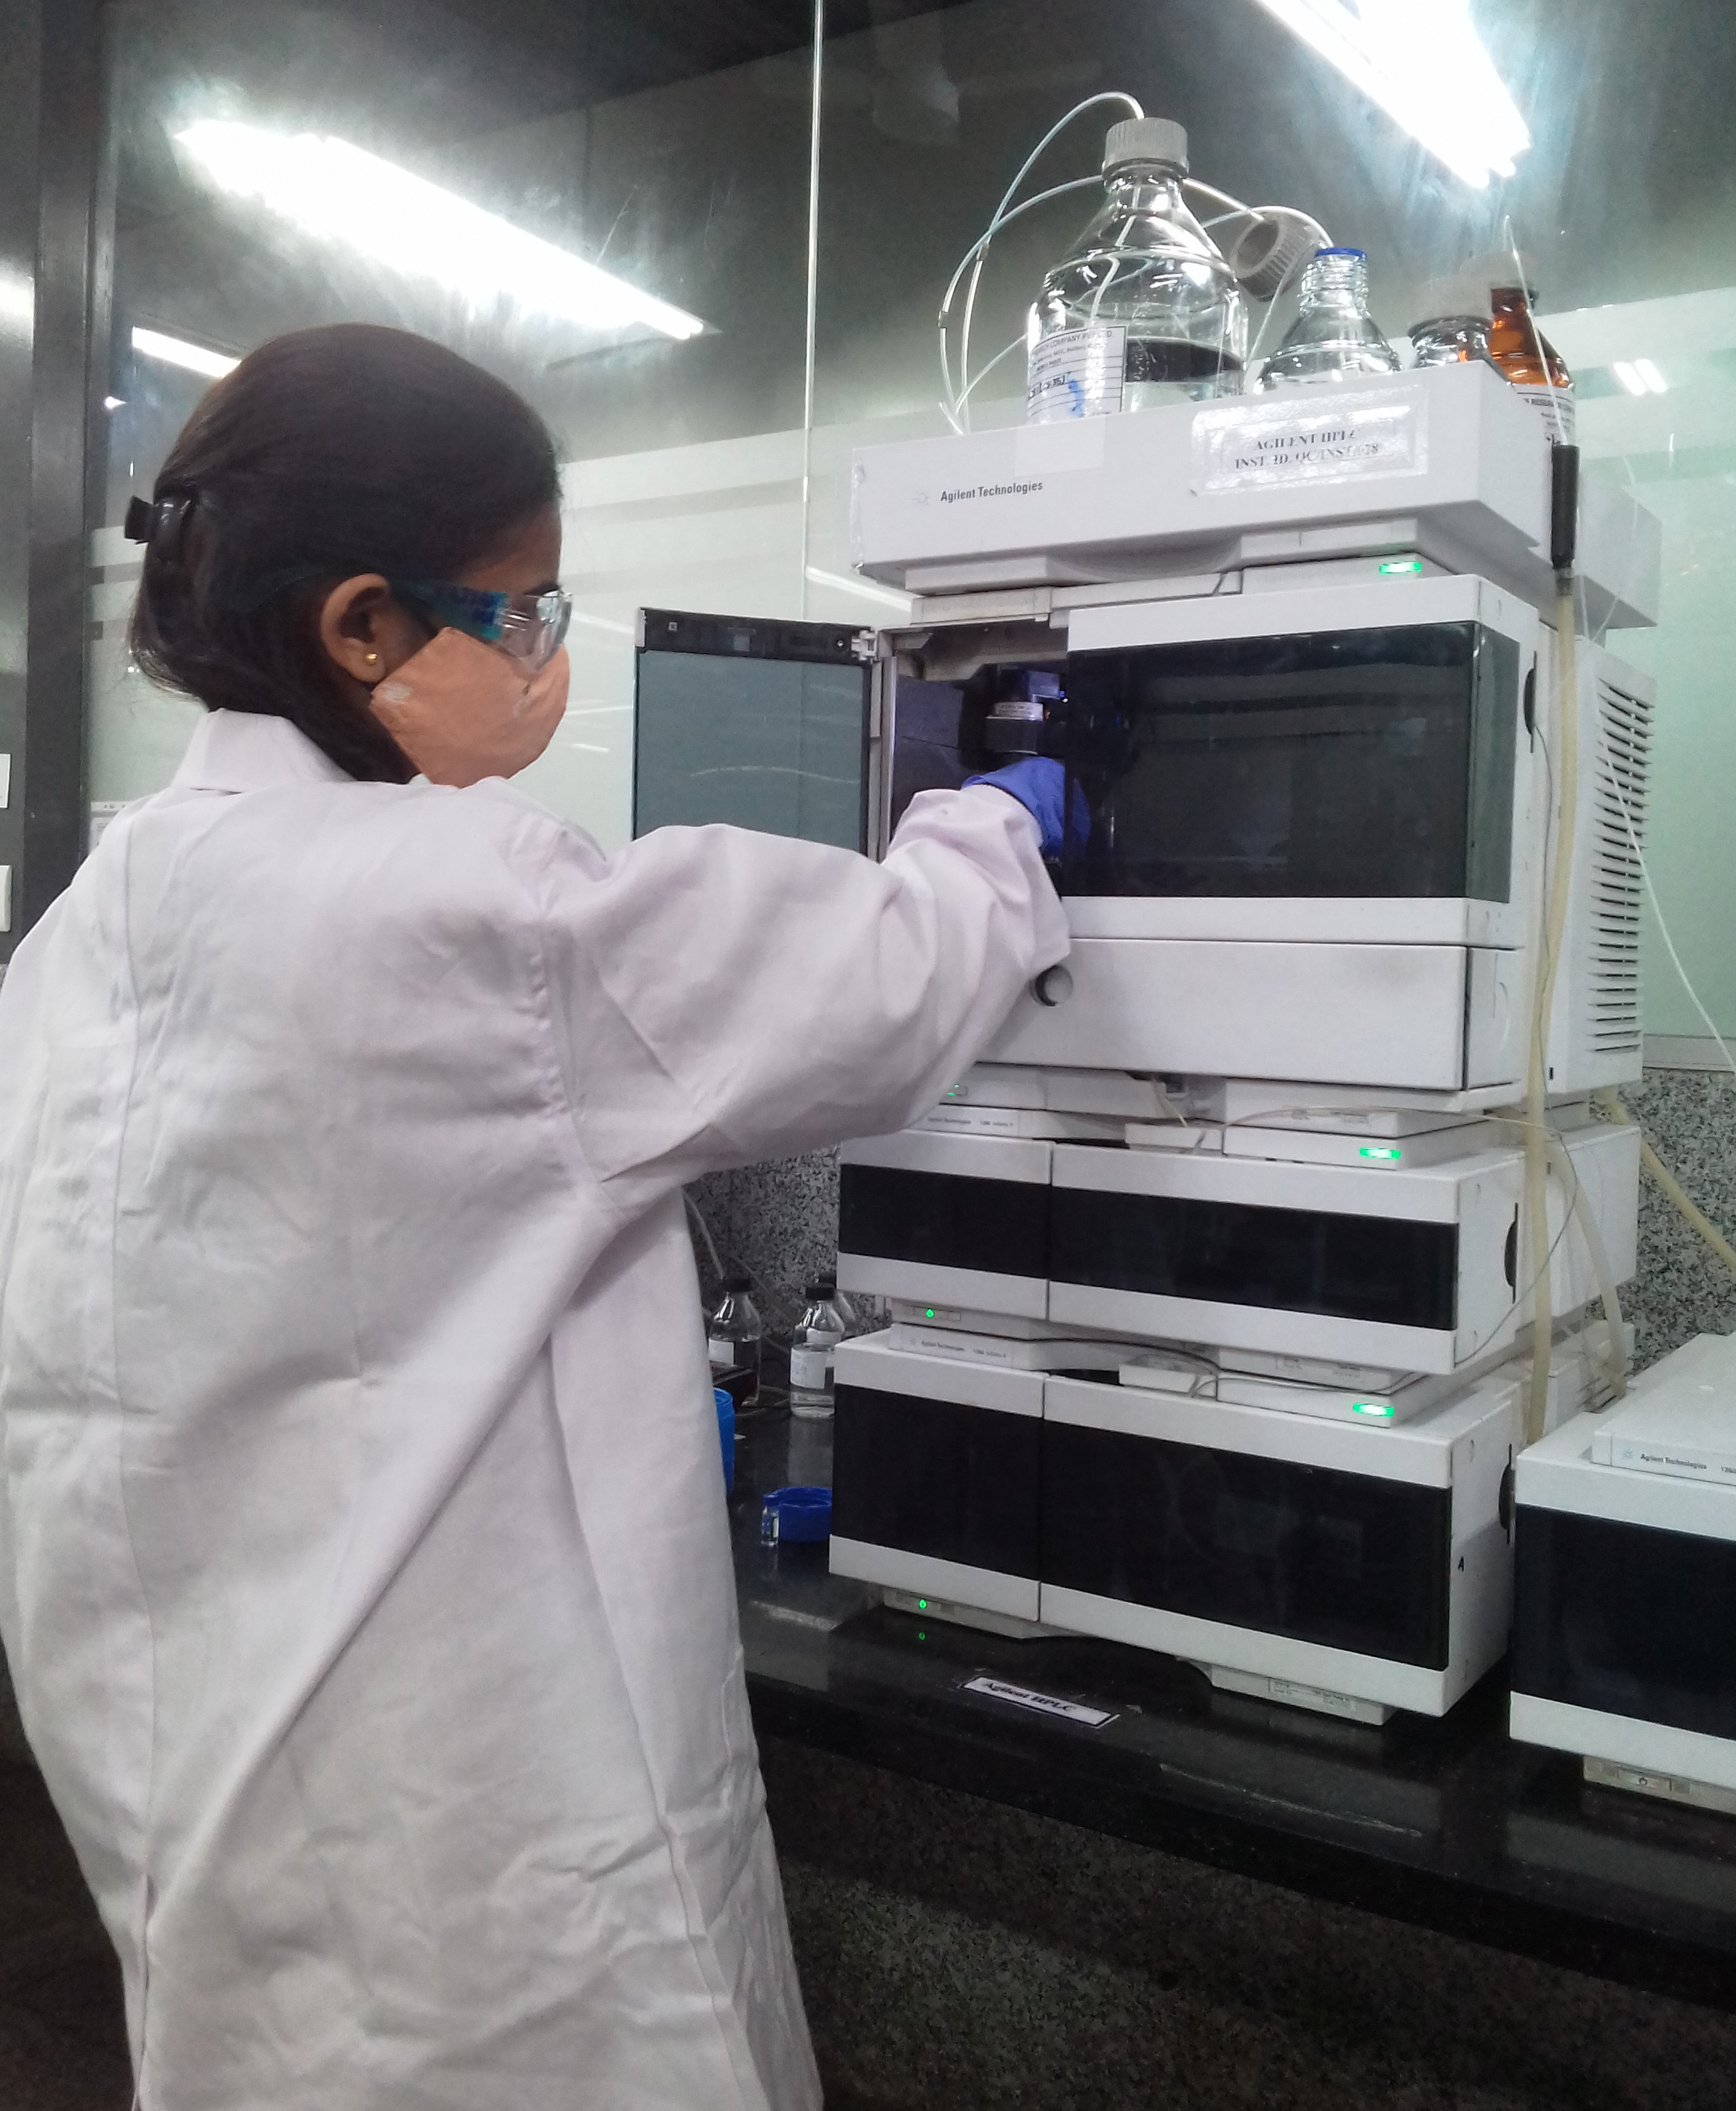
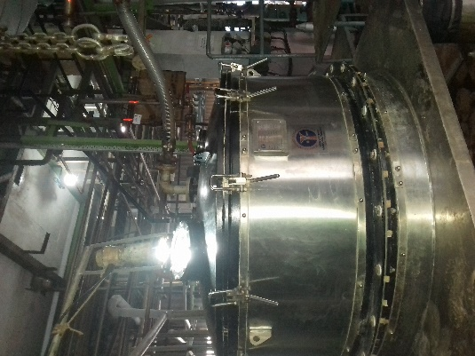

Production In-process Analysis

Slide 26
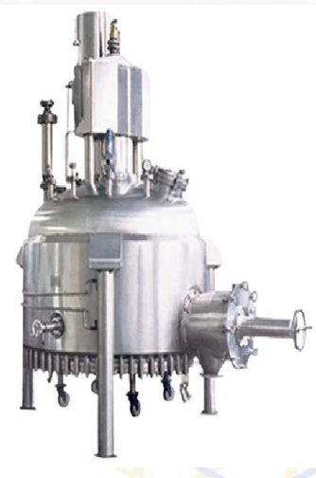
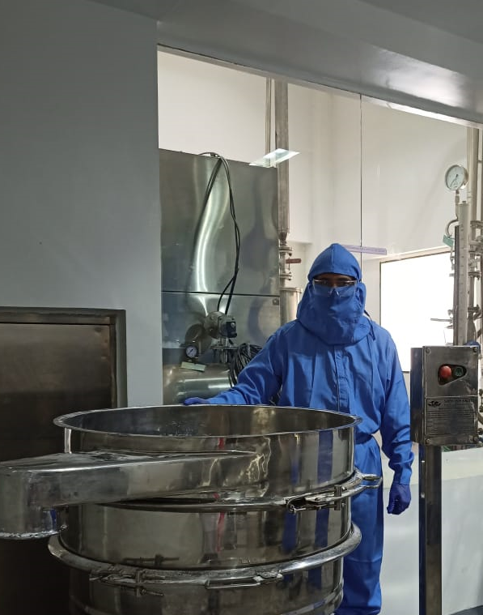
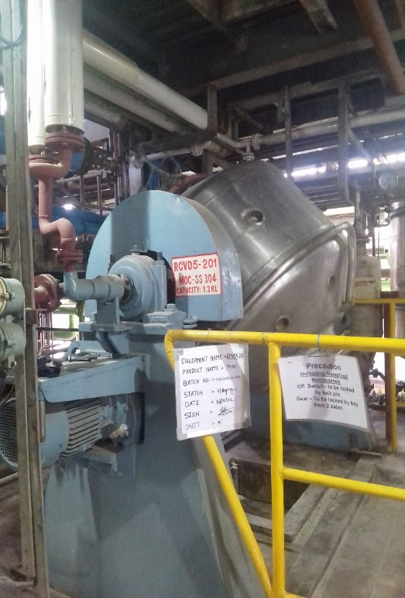
Production –Powder Processing

Slide 27
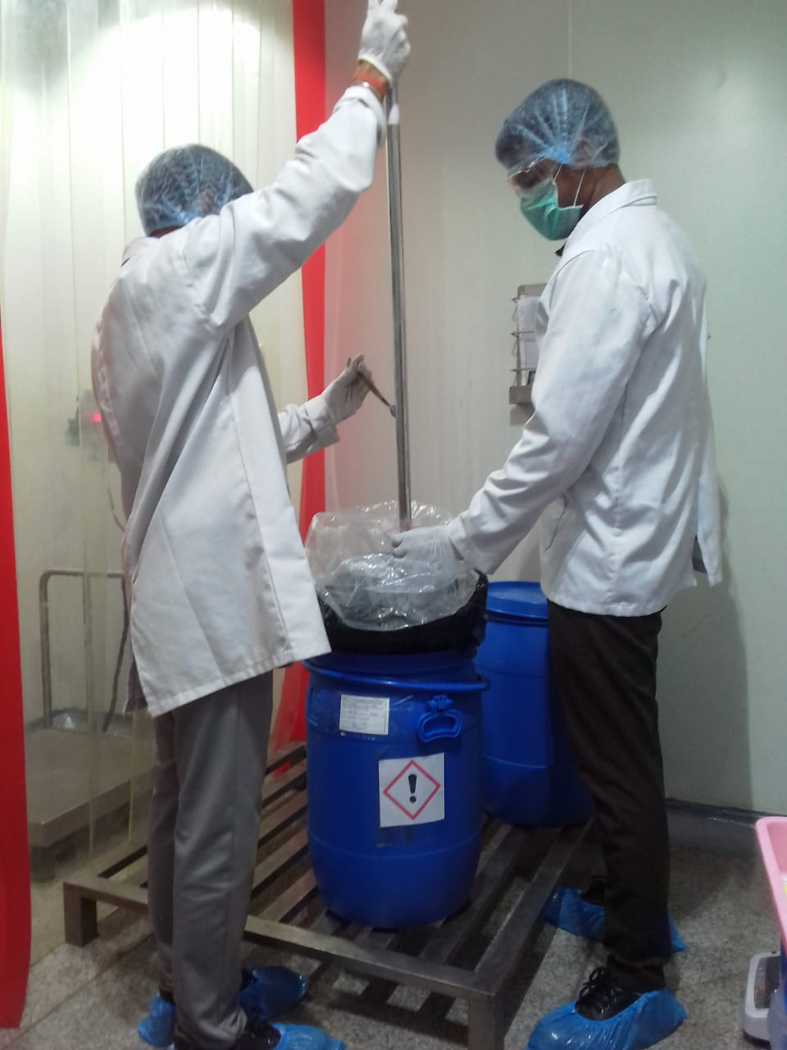
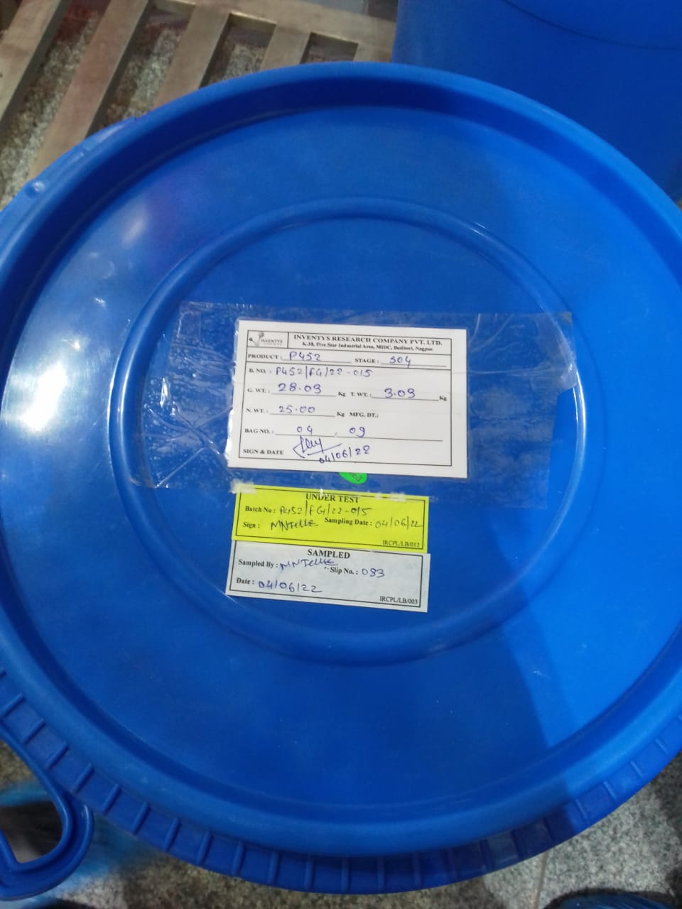
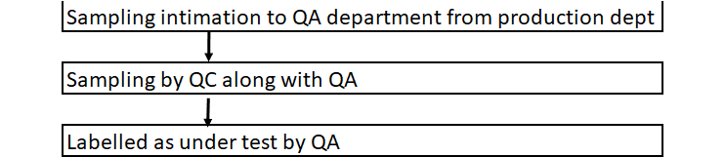
Production –Intermediate Sampling

Slide 28
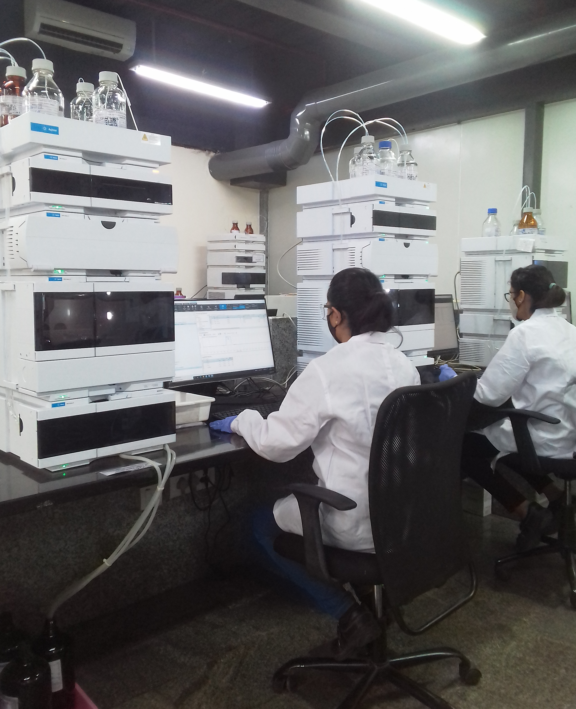
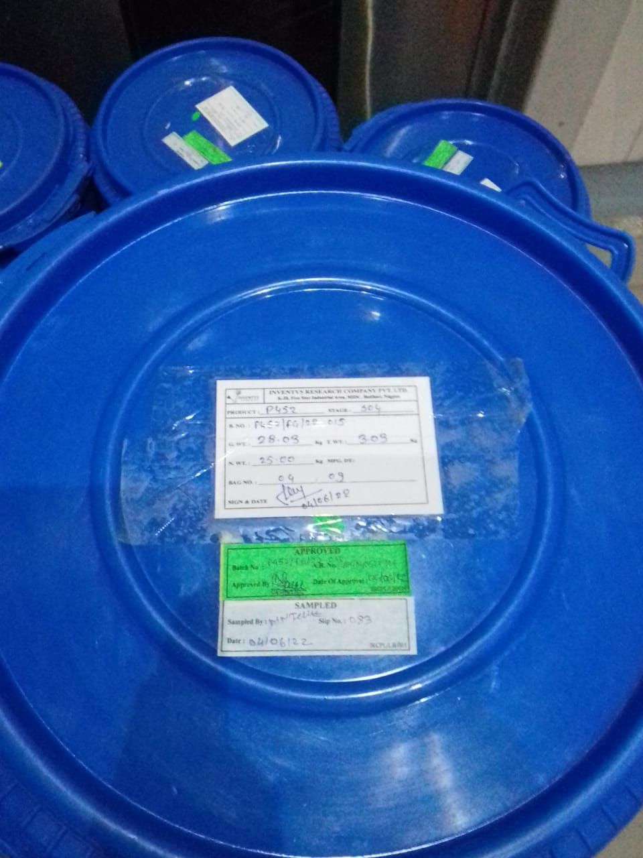

Finished Goods – Analysis & Approved

Slide 29
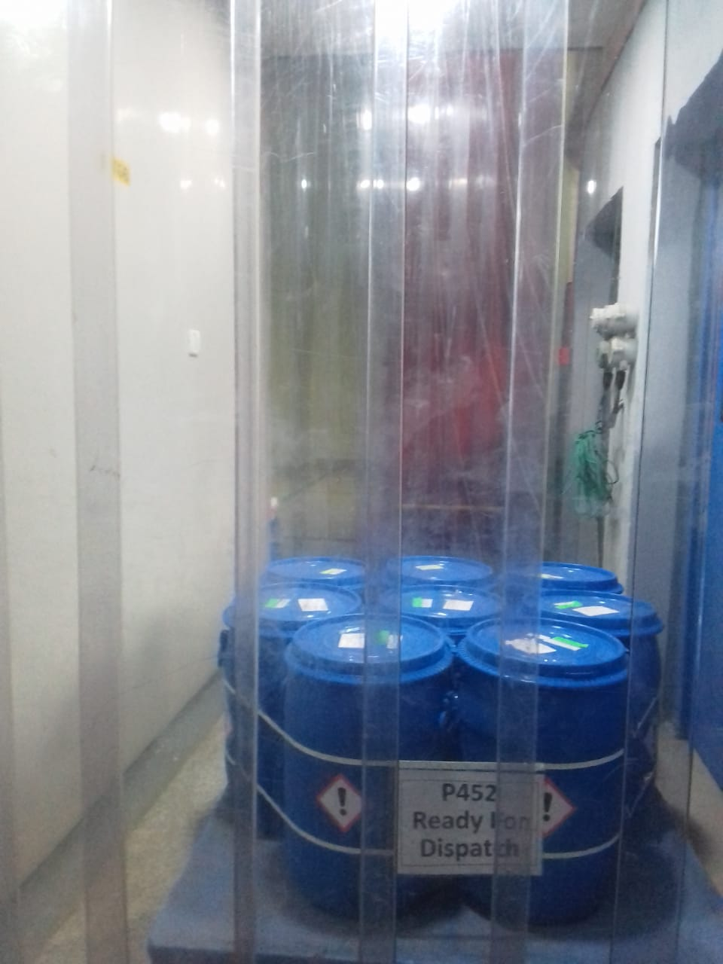

Finished Goods – FG Storage

Slide 30
Inventys New Sites – 2024Q2

Slide 31
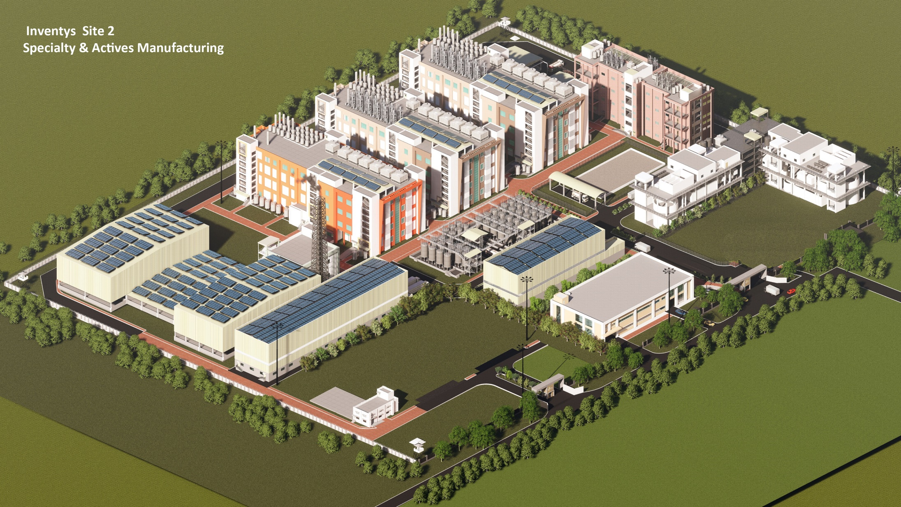
Inventys Site 2

Slide 32
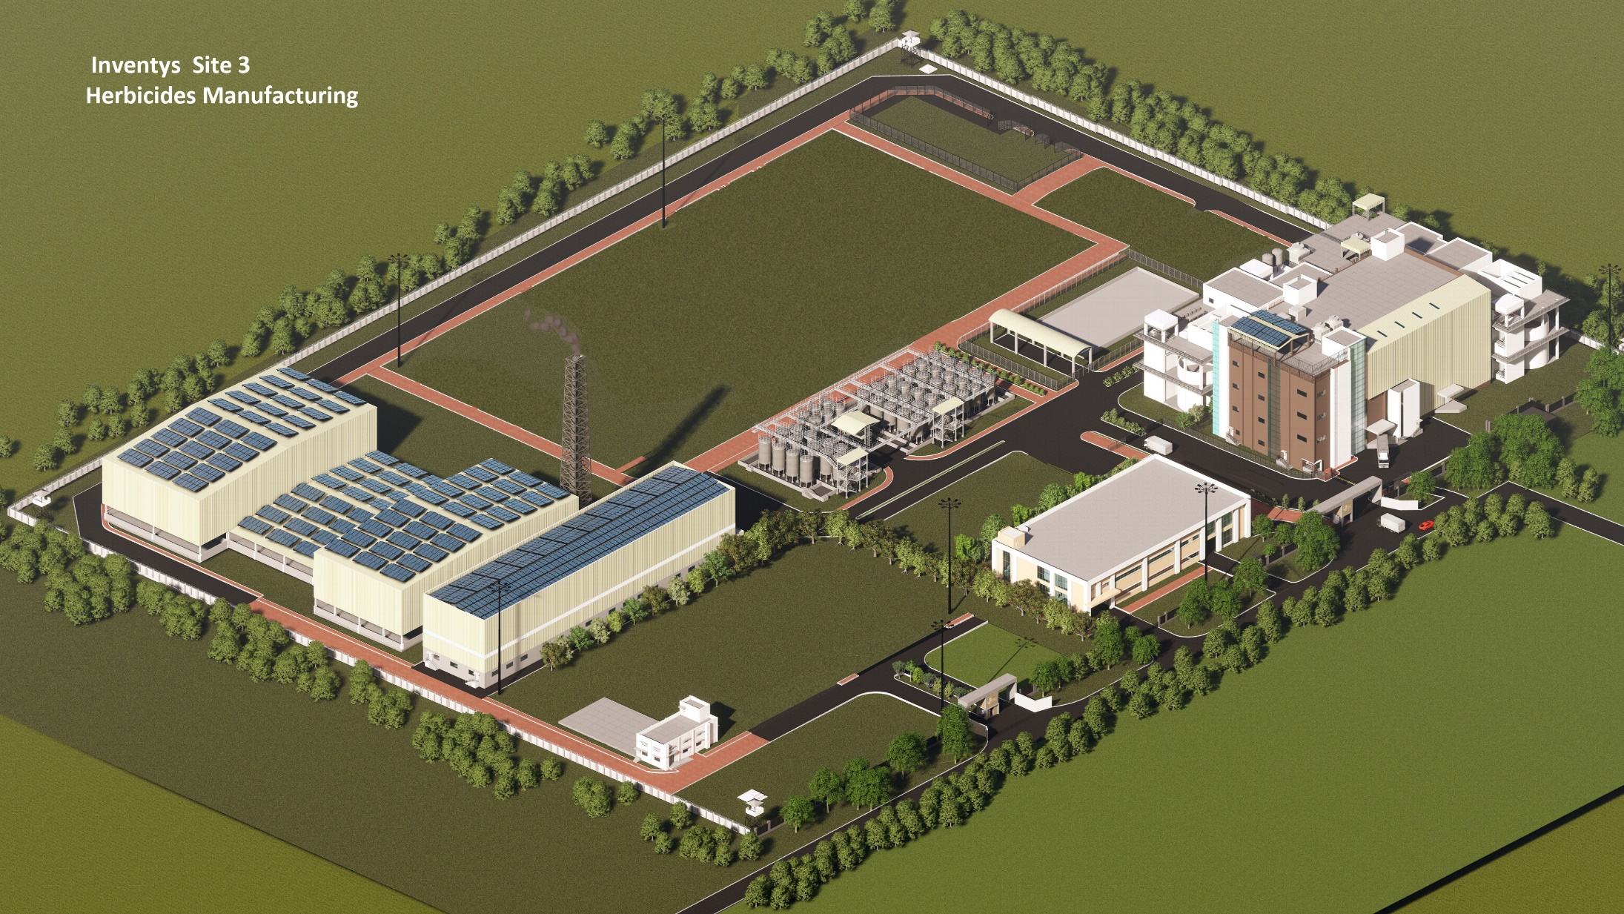
Inventys Site 3

Slide 33
Next Steps

Slide 34
Site 2,3 Plantation
SZ1415 Summary of Plants
 | Zones
Category of Plants (Tree & Fruit Zone) | TA | TA1 | TB | TB1 | TC+TD | TD1 | TE | Total
Trees | 70 | 28 | 22 | 26 | 62 | 37 | 63 | 308
Shrubs | 359 | 0 | 100 | 0 | 603 | 0 | 639 | 1701
Medicinal Shrubs | 81 | 90 | 62 | 146 | 165 | 217 | 141 | 902
Total | 510 | 118 | 184 | 172 | 830 | 254 | 843 | 2911
Category of Plants (Fruit Zone) | FA | FB | FC | FD | FE
Fruit Plants | 52 | 75 | 44 | 52 | 105 |  |  | 328
Shrubs(Fruit) | 124 | 87 | 92 | 284 | 0 |  |  | 587
Total | 176 | 162 | 136 | 336 | 105 |  |  | 915
Category of Plants (Miyawaki Zone) | MA | MB | MC | MD
Canopy/SubCanopy/Trees/Fruit Trees/ Shrubs/Ground Cover | 1276 | 0 | 4170 | 6936 |  |  |  | 12382
Medicinal Plants | 85 | 20 | 0 | 0 |  |  |  | 105
Total | 1361 | 20 | 4170 | 6936 |  |  |  | 12487
Grand Total | 2047 | 300 | 4490 | 7444 | 935 | 254 | 843 | 16313

