Slide 1
Inventys - Sept 2024 Recent Developments
Sustainable Reliable Product Supply & Safe Manufacturing Processes

Slide 2
Inventys – Services & Products
Exclusive Synthesis Manufacturing Services for Global Innovators
Process Development & Manufacturing
One molecule – One Customer
Actives & Advances Intermediates
COMPLETE IP protection and exclusivity commitment
Process Development / Improvement Services to Innovators
Batch Process to Flow Chemistry & Process Intensification
Higher selectivity → lower waste
Significantly lower solvent usage & energy consumption → Smaller footprint
Safe operations
Scaleup services & Gm / Kg material supply synthesis for trials & development work
Raw Material & Intermediates Supply to Pharmaceutical / Electronics Industry
Alternative to critical dependency on unreliable supplier base
Focused on Complex Challenging Manufacturing
Inventys own products with Inventys technology

Slide 3
Updates & Recent Achievement - Capacities - Commercial Scale Chemistry - Developments at Pilot & Lab Scale - Contracts & Agreements – Pharma & Agro - Inventys Strengths
Updates & Recent Achievement at Inventys
Last ~12 months

Slide 4
Safety & Sustainability
Culture
Systems
Hardware
Training
Safe
Manufacturing
Decade+ long demonstrated commitment excellence in Safe Manufacturing & Sustainable Practices
> 51% of the total energy add NETZERO Carbon
Using renewable resources
Since 2012
89
Notes:
We are an also established practitioner of Circularity. Inventys has converted more than 50% of its energy - to be derived from non-depletable resources, since as early as 2012. We have also enthusiastically adopted of the principles of Green Chemistry.

Slide 5
New Capacities
Site 2 – Intermediates & Actives
Site 3 - Herbicides
New Pilot Scale Up Studies
New Kilo Plant for CDMO Services

Slide 6
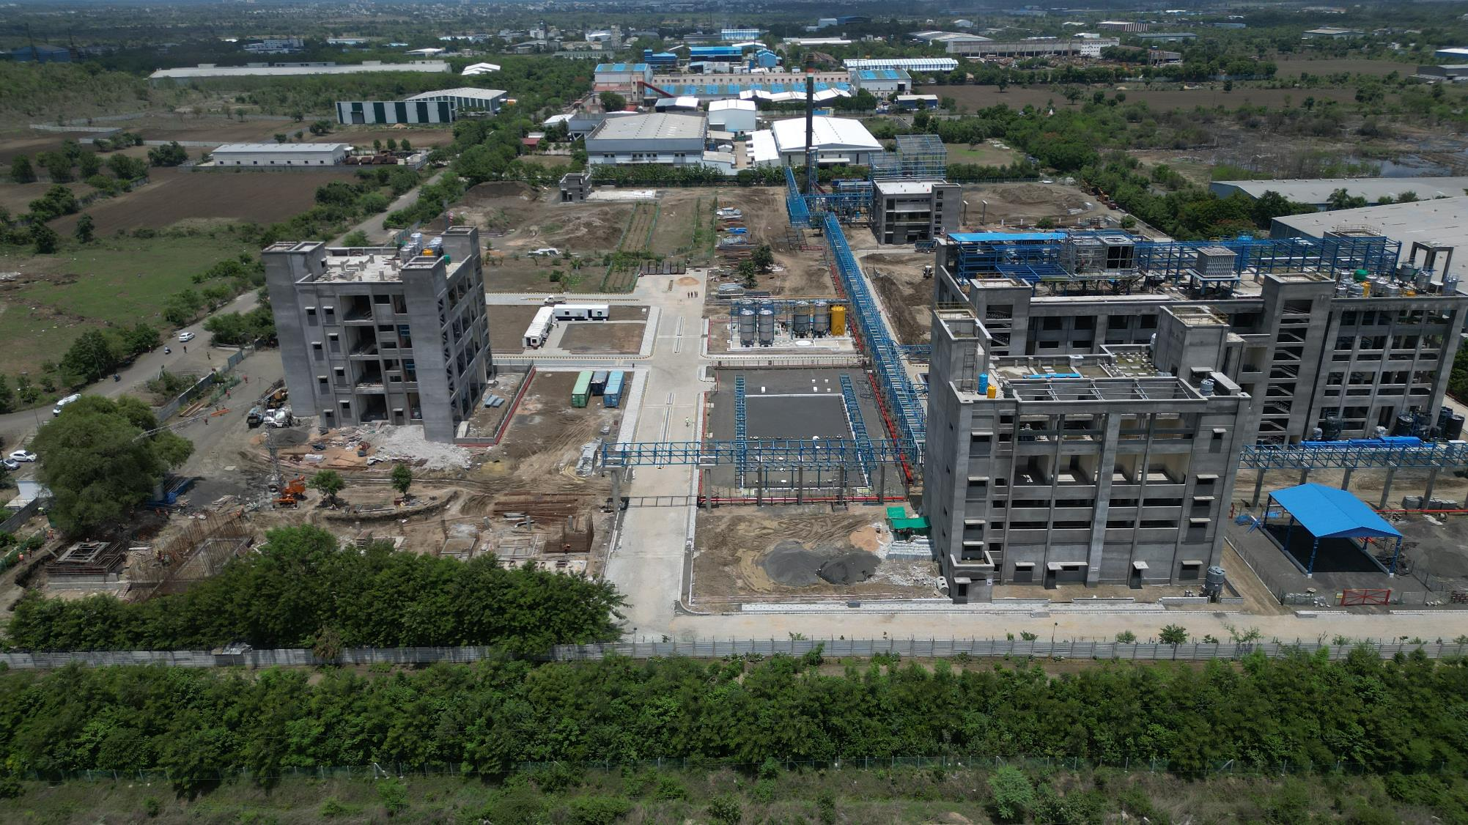
Inventys New Sites 2 & 3
June 2024
Copyright © 2005-2024 Inventys Research Company, All Rights Reserved.
6

Slide 7
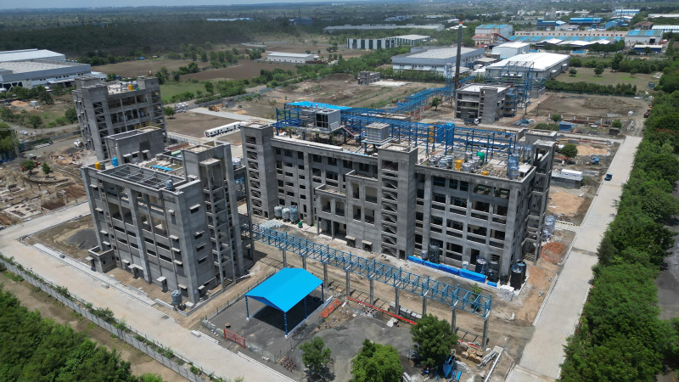
Inventys New Site 2 – Intermediates & Actives
June 2024
Copyright © 2005-2024 Inventys Research Company, All Rights Reserved.
7

Slide 8
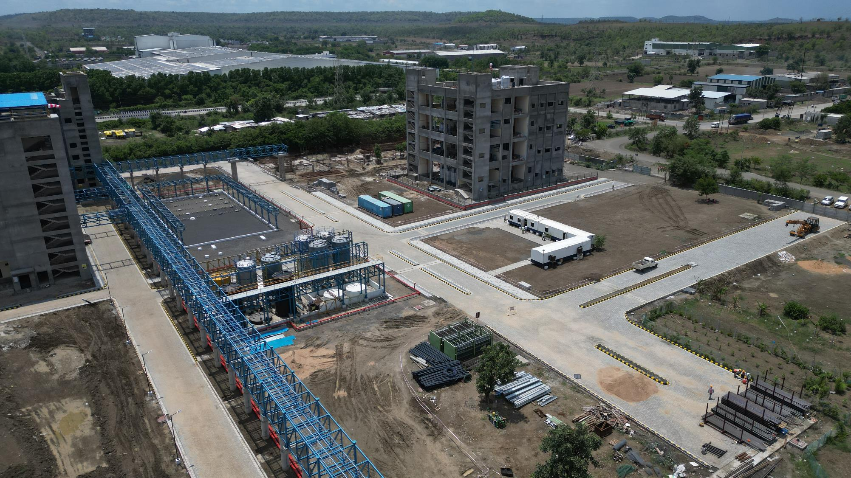
Inventys New Site 3 - Herbicides
June 2024
Copyright © 2005-2024 Inventys Research Company, All Rights Reserved.
8

Slide 9
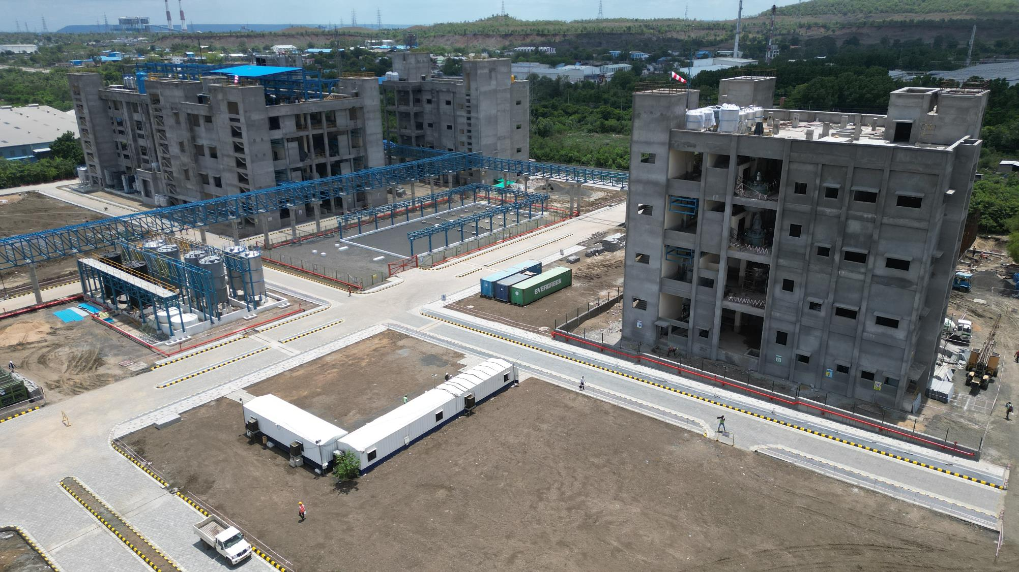
Inventys New Sites 2 & 3 – Production Blocks, Tank Farms, etc
June 2024
Copyright © 2005-2024 Inventys Research Company, All Rights Reserved.
9

Slide 10
New Site 2 – Production Capacities (33% in 2024)
Actives (Fungicides & Insecticides)
3 Production Blocks (6 Production Lines)
36 Reactors (Batch/Flow) – 200+ KL
Plus other supporting equipment
Registered Starting Materials / Adv Intermediates / Specialty Chemicals
6 Production Blocks
150 Reactors (Batch/Flow) – 900+ KL
Plus other supporting equipment
Hydrogenation
1 Production Block
6 Reactors (Batch/Flow) – 50+ KL
Halogenation (HF/KF/etc)
1 Production Block
10 Reactors (Batch/Flow) – 50+ KL
Fermentation Products
1 Production Block
To be decided
Notes:
The greenfield Site - two is designed for the production of various advanced intermediates, specialty chemicals, and actives. This manufacturing site will also have dedicated production blocks for hydrogenation, halogenation, and fermentation. Fluorination by HF gas and by KF as well as by Fluoroborate salts will be implemented on this site. Hydrogenation as well as Fluorination will be conducted in batch as well as in flow manufacturing mode.

Slide 11
New Site 3 – Production Capacities (40% in 2024)
Herbicides
5 Production Blocks
45 Reactors (Batch/Flow) – ~500+ KL
Plus, other supporting equipment
Quality Control
Quality Assurance
Warehouses
Primary Effluent Treatment
Byproduct Recovery
Parking
Notes:
Inventys Site three is designed for herbicides production. This site will contain five independent production blocks. To ensure adequate containment, all the support facilities – including the final product warehouses will be located within this Site three.

Slide 12
New Pilot Plant & Kilo Plants 22 Reactors installed + 23 in future
Reaction – Flow & Batch
~30 lit
~ 200 lit
~ 500-1000 lit Production Blocks
Separation
Distillation
Filtration
Solvent Extraction
ATFDs
Falling Film Evaporators
etc
Various MoCs
SS 316 L
Glass
MSGL
Titanium
Hastelloy
Extensive SCADA, Parameter control, & Safety Interlocks

Slide 13
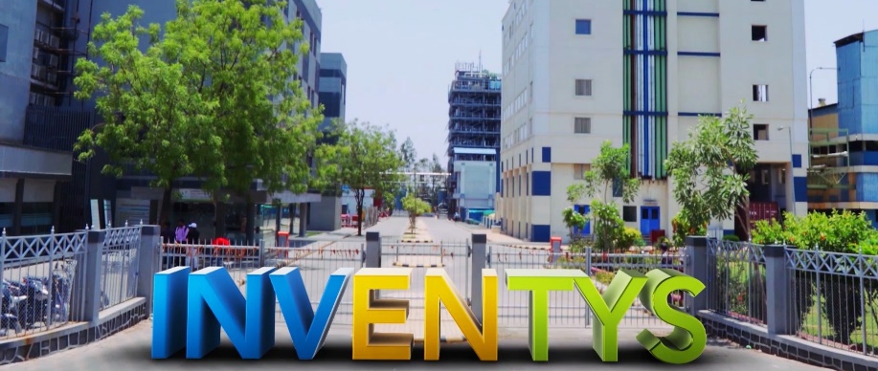
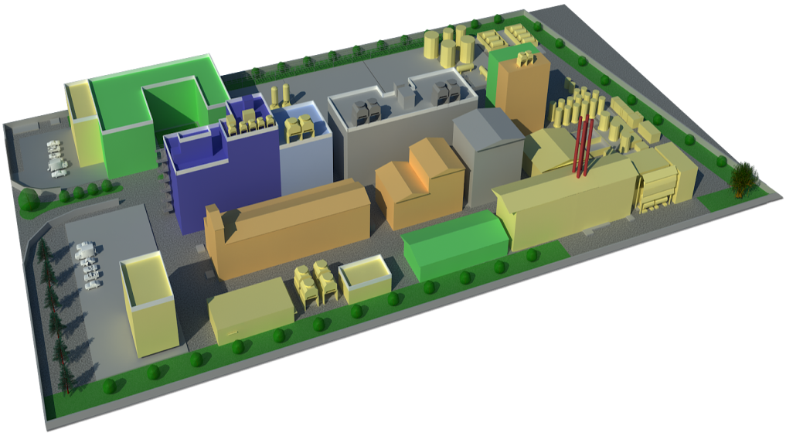
Integrated Manufacturing Site 1 – Pharma & Specialty Chemicals
WHO GMP
ISO 9001, ISO 14001, ISO 45000
Concept
Manufacturing
Synthesis Strategy to Process Development
Scale up to Commercial Production
Continuous Improvement
Quality Assurance & Quality Control
Laboratories
Manufacturing Facilities
R&D (Batch/Flow) & ADL
Process Safety & Hazards, Effluent Treatment,
QC, QA, & Microbiology
APIs & RSMs
Specialties
Advanced Intermediates (GMP & non-GMP)
Bulk Intermediates
Kilo Labs & Pilot Plants
Scale up Studies (12 reactors)
Small Lot Mfg (29 reactors)
Total 41 reactors
30 – 300 – 1000 lit
Effluent Treatment Facilities
500 KL/Day Discharge Permission
5 min Virtual Tour
https://youtu.be/9rcNlSdsyX8
Notes:
Inventys integrated manufacturing site number 1 has been operating since 2008. It houses more than 45 reactors up to 15,000 liters in size, another 45 reactors will be added. Additionally, our new pilot plant has more than 40 reactors. 30 liters, 200 liters, and 500 liters. Scaling up a product from laboratory stage to Metric Ton scale production, is a complex task. This happens to be one of the core strengths of Inventys. Inventys is WHO GMP, ISO 9001, ISO 14001, and ISO 45000 certified.
The Knowledge Center houses quality, safety, analytical, flow chemistry, as well as research & product development laboratories as well as Process Design & Engineering, and the Projects department. You may virtually visit this site for 5 short minutes on YouTube, using the link provided.

Slide 14
Inventys Manufacturing Infrastructure
SITE I
SITE II
SITE III
SITE IV (FUTURE)
7 Acres
12 Acres
5 Acres
Healthcare & Specialty Integrated Manufacturing
Crop Protection & Specialty Chemicals Manufacturing
Healthcare Manufacturing& Development
Pharma KSMs, Advanced Intermediates, Specialties
Crop Protection Actives, RSMs, Advanced Intermediates, Specialties
Crop Protection Herbicides
Healthcare CDMO CRO
22 small reactors AND 50+ large Batch/Flow Reactors+ANFDs/Cfg./Dryers/etc & Utilities
250+ large Batch/Flow Reactors+ANFDs/Cfg./Dryers/etc & Utilities
To be installed in three phases
60+ midsize & small Batch/Flow Reactors+ANFDs/Cfg./Dryers/etc & Utilities
R&D/ADL/QC/Safety/Microbio/Eff.Treat. Labs
~50 products could be made simultaneously
To be Decided
6 Prod Blocks (3,000 to 15,000 lit reactors) +
Pilot Plant & Kilo Plant for Scale Up & Small Lot Manufacturing (30/300/1000 lit reactors)
16 Production Blocks
(8,000 / 10.000 / 12,000 lit reactors)
Small Kilo Plant + Quality Control
5 Production Blocks
(8,000 / 10.000 / 12,000 lit reactors)
Small Kilo Plant + Quality Control
6 Production Blocks,
Microbiology / ADL / QC Laboratories
Various Utilities
300+ KL Reaction Capacity
2100+ KL Reaction Capacity
~500 KL Reaction Capacity
To be Decided
Operating Since 2008
33% capacity in 2025
40% capacity in 2025
2027
Inventys manufacturing capacity expected increase ~9x in next ~6 years
Necessary permissions in place
DEBT FREE
Notes:
In order to serve our customers better, Inventys manufacturing capacity is poised to grow significantly. Site 2, is dedicated to specialty chemicals, advanced intermediates, and crop protection actives. This site will have a up to 14 production blocks, Whereas the site 3, is dedicated to herbicides production. This site will contain 5 independently operating production blocks. First phase of expansion will be commissioned in early 2024.
From the current capacity of about 45 batch reactors at the Integrated Manufacturing Site 1, Inventys will add more than 300 batch and flow reactors at these 3 new sites

Slide 15
New Chemistry
Commercial Scale
Lab / Pilot Scale
Analysis Capabilities

Slide 16
New Chemistry @ Commercial Scale
FLOW
Telescopic Pyrimidine Synthesis + Nitrosation
Telescopic Diazotization + Hydrolysis (to Phenol)
Nitration

Slide 17
New Chemistry @ Lab/Pilot Scale
BATCH
Isocyanide Synthesis (TOSMIC)
Van-Leusen Imidazole Synthesis
Dichloro- cyclopropanation (Carbene Chemistry)
Dechlorination
Thioetherification
Cat. Oxidation of Sulfide to Sulfone
Indole Synthesis (Leimgruber-Batcho)
FLOW
Fluorination by Halex
Chlorination
Hydrogenation
Grignard Reaction (+ Reagent Formation)
Lithiation
Azidation
Nitration
Tetrazole Synthesis
Acyl Hydrazide Synthesis
Cat. Oxidation of Sulfide to Sulfone
Enolate Alkylation
N-Alkylation
Claisen Condensation
Photochlorination (initial stages)

Slide 18
Wide range of Chemistry / Hazardous Materials
Wide range of plant scale implemented chemistry
Defragment your supply chain & hence more robust
Notes:
Today, we can handle many hazardous chemicals at commercial scale. For example, we have been consuming one ton per day Sodium Cyanide & Hydrazine Hydrate for many years. In our new upcoming production plants, we will use HF gas for continuous fluorination. We have already commercialized several products that use KF and fluoroborate salts. Our mastery of numerous complex chemistries and our ability to handle multiple hazardous chemicals – safely in a consistent manner – enables us to help you defragment your supply chain using our backward integration capabilities.

Slide 19
New Analytical Equipment
Benchtop NMR
TSU
DSC
DTA
Automatic Flash Chromatography System
Four additional HPLCs
Two additional GCs

Slide 20
New Business
Exclusive Synthesis
(70%-75% revenue)
Agrochemical Innovators
(All Exports)
CDMO Services
(~5% revenue)
Primarily for Pharma
(Mostly Exports)
Inventys Chemicals
(20%-25% revenue)
Pharma Manufacturers
(All within India)

Slide 21
New Business in last 15 months Exclusive Synthesis + CDMO (42 more molecules in pipeline)
Customer | Products | $MM /yr | Status
Specialty Chemicals – Large innovator | Three molecules | $ 23 MM/yr x 6 | Commercial Supply - Six year contract (up to $97 MM total)
Pharma – Small innovator | Advanced Intermediate | $ 0.7 MM/yr x 5 | Commercial Supply started
Agro – Midsize innovator | Active + Advanced Intermediate | $ 3.3 MM/yr x 5 | Commercial Supply started
Agro – Reputed innovator | Three intermediates | $ 2.25 MM/yr x 5 | Commercial Supply started
Agro – Reputed innovator | New Active (Recently launched) + Advanced Intermediate | $20 MM/yr x 5 | Pilot Studies & Inventys as new Source Registration (currently internally produced)
Agro – Reputed innovator | Active to be launched + 2 Advanced Intermediates + 1 Intermediate | $10 MM/yr x 5 | Scaleup & New Active Registration using Inventys Material
Agro – Reputed innovator | An old Active | $1.5 MM/yr x 5 | Pilot Studies & Inventys as 2nd Source Registration
Revenue finalized or at an advanced stage |  | $65.75 MM/yr | Exclusive Synthesis
Customer | Products | $MM /yr | Status
Pharma – Large CDMOs | Five advanced intermediate | $ 4.5 MM/yr | Product Development
Pharma – Small Innovators / CMOs | Several molecules | $ 3.0 MM/yr x 5 | Product Development
Revenue Expected |  | $7.5 MM/yr | CDMO Services
Customer | Products | $MM /yr | Status
Pharma – Reputed Global innovator | API + 2 Advanced Intermediates 18 steps synthesis in total | $180 MM/yr x 10 | New Potential Project. Laboratory Development underway.

Slide 22
New Business in 2023 Inventys Chemicals
Six new products launched
Pharma Intermediates
5 of 6 price competitive in the current market!
Alternative to critical dependence on single country sourcing
Eleven new products developed in lab
Pharma Intermediates & Specialty Chemicals
All are price competitive as of now
Advanced intermediates for under patent drugs

Slide 23
Inventys Proposition Process Development & Exclusive Synthesis
Safer Sustainable Supply Chain
Stable Raw Material Supply

Slide 24
Inventys Strengths
Safe State of the Art manufacturing – 3 sites
Process Hazard Analysis established part of Process Development & Plant Design - Safe Manufacturing
DCS Controlled Multipurpose Plants
Product Development
120 Product Development team
64 products developed 6 years
Up to 14 steps synthesis
~290 out of 360
engineers / scientists
Large Capacities
<2022 – 50 reactors
2024 – 90 reactors + 22 reactors
2025 – 135 reactors + 22 reactors
<2030 – 300 reactors + 45 reactors
~3 MM Lit of Reaction Capacity
Top 5 in Indian (Spec Chem)
Stable Supply Chain
Deep Backward Integration
Large debt free capacity
Wide Chemistry Expertise
Complex Multistep Synthesis
80%+ sourcing within India
Flow Chemistry Leader
5 products - Commercial scale
15 products – Under Scaleup
Selective & Safe Manufacturing
Significant Reduction in Waste Generation & Solvent Usage
Privately Held
>86% held in family
<14% by Private Equity

