Slide 1
Inventys Sites Tour
2024 July
Butibori MIDC Nagpur

Slide 2
Outline
Inventys Manufacturing Facilities
Facilities Overview
Inventys Material Flow – RM to FG

Slide 3
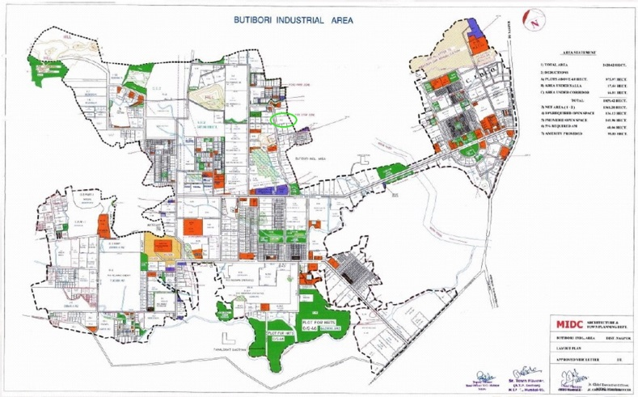
Locations

Slide 4
Inventys Manufacturing Infrastructure
SITE I
SITE II
SITE III
SITE IV (FUTURE)
7 Acres
12 Acres
5 Acres
Healthcare & Specialty Integrated Manufacturing
Crop Protection Manufacturing Site
Healthcare Manufacturing Site
Pharma KSMs, Advanced Intermediates, Specialties
Crop Protection Actives, RSMs, Advanced Intermediates, Specialties
Crop Protection Herbicides
Healthcare CDMO CRO
50+ Batch Reactors (& 45 in future) + Cfg. /Dryers/Dist. etc & Utilities – 5 Prod Blocks
250+ Batch & Flow Reactors Other Supporting Equipment & Utilities
In 16 Production Blocks
60 Batch & Flow Reactors
Other Supporting Equipment Utilities
R&D/ADL/QC/Safety/Microbiology/EffTreat Labs
45 Products
To be Decided
Pilot Plant for Scale Up studies – 12 reactors
Small Lot Manufacturing – 29 reactors
(30 lit / 300 lit / 1000 lit)
~11 Production Blocks
Quality Control
Various Utilities
5 Production Blocks
Quality Control
Various Utilities
3 Production Blocks,
Microbiology / ADL / QC Laboratories
Various Utilities
300+ KL Reaction Capacity
2100+ KL Reaction Capacity
~500 KL Reaction Capacity
To be Decided
Operating Since 2008
33% in 2024
40% in 2024
2026
Inventys manufacturing capacity will increase 9x in next 5 years
Necessary permissions in place
Phase 1 expansion DEBT FREE
Notes:
In order to serve our customers better, Inventys manufacturing capacity is poised to grow significantly. Site 2, is dedicated to specialty chemicals, advanced intermediates, and crop protection actives. This site will have a up to 14 production blocks, Whereas the site 3, is dedicated to herbicides production. This site will contain 5 independently operating production blocks. First phase of expansion will be commissioned in early 2024.
From the current capacity of about 45 batch reactors at the Integrated Manufacturing Site 1, Inventys will add more than 300 batch and flow reactors at these 3 new sites

Slide 5
Inventys Sites
Facilities OVERVIEW
Site 1 – Healthcare & Specialty
Site 2 - Actives & Specialty
Site 3 - Herbicides
Site 4 – Future

Slide 6
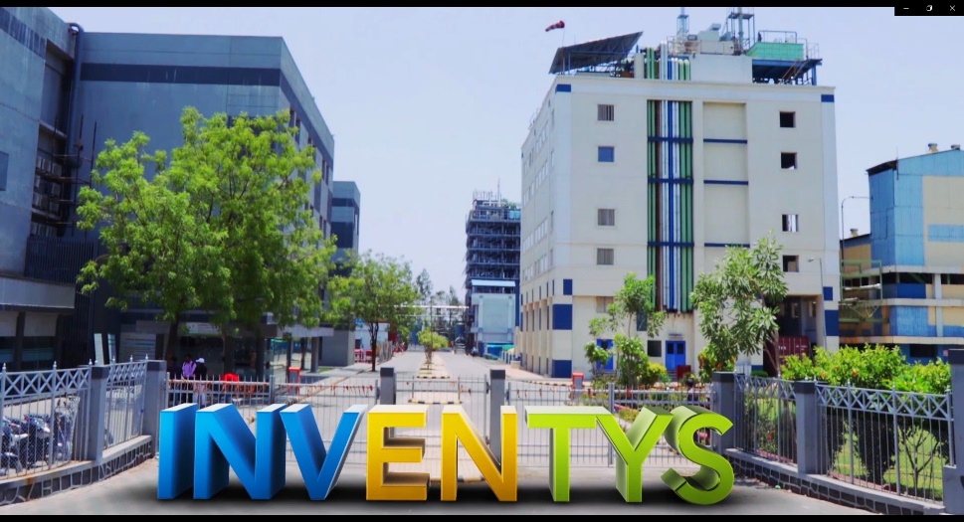
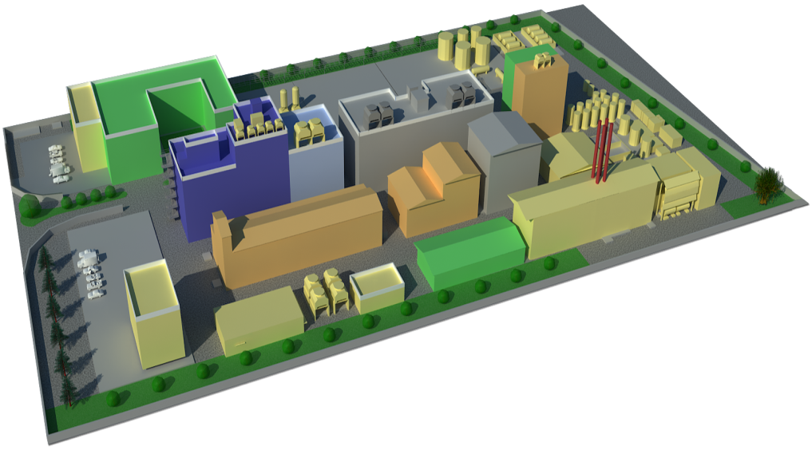
Inventys – Integrated Manufacturing Site 1
Concept → Manufacturing
Synthesis Strategy to Process Development
Scale up to Commercial Production
Continuous Improvement
Quality Assurance & Quality Control
Laboratories
  R&D
  QC & QA
Kilo Labs & Pilot Plants
  APIs & RSMs
  Specialties
  Advanced Intermediates (GMP & non-GMP)
  Bulk Intermediates
Manufacturing Facilities
  APIs & RSMs
  Specialties
  Advanced Intermediates (GMP & non-GMP)
  Bulk Intermediates
  Effluent Treatment Facilities
  300 KL/Day Discharge Permission
https://youtu.be/9rcNlSdsyX8

Slide 7
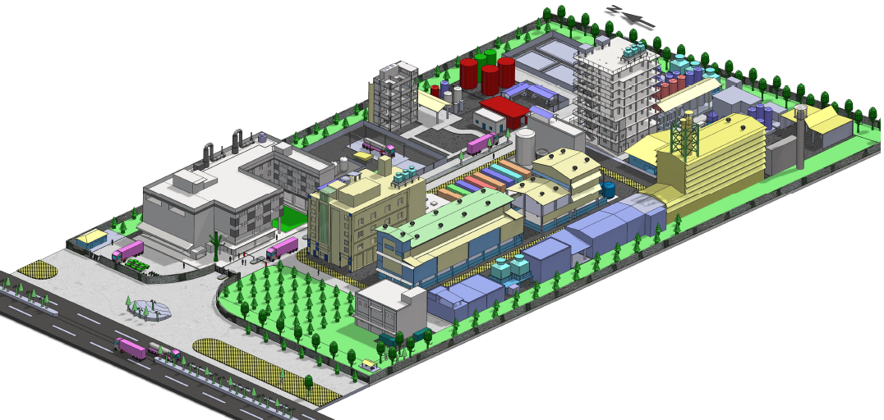
Inventys – Integrated Manufacturing Site 1

Slide 8
Production Blocks @ Site 1
6 Plants / 15 Sections
  Multi Purpose
  State of the Art Facilities
  Automated (DCS/PLC)
  Recipe Management System
  WHO-GMP / ISO 9001:2015/ 14001:2015/ OHSAS 18001:2018
Dedication
  For Intermediates & Advanced Intermediates
    10 Sections Constructed & In Operation & Ready to Use
  For GMP Requirements & Advanced Intermediates
    1 GMP Plant Constructed & In Operation & Ready to Use
Expansion opportunities 3 Plants / 9 Sections
  For Intermediates & Advanced Intermediates
Existing wide frame permit

Slide 9
Inventys New Site 2 – Production Capacities
Actives (Fungicides & Insecticides)
  3 Production Blocks
  6 Production Lines
  36 Reactors (Batch/Flow)
  Plus other supporting equipment including Various Filters & Dryers, Powder Processing Equipment, Pumps, Heat Exchangers, Scrubbers, Solvent Recovery Equipment, Primary Effluent Treatment & Byproduct Recovery Equipment, etc
Registered Starting Materials / Advanced Intermediates / Specialty Chemicals
  6 Production Blocks
  150 Reactors (Batch/Flow)
  Plus other supporting equipment including Various Filters & Dryers, Powder Processing Equipment, Pumps, Heat Exchangers, Scrubbers, Solvent Recovery Equipment, Primary Effluent Treatment & Byproduct Recovery Equipment, etc
Hydrogenation
  1 Production Block
  6 Reactors (Batch/Flow)
Halogenation (HF/KF/etc)
  1 Production Block
  10 Reactors (Batch/Flow)
Fermentation Products
  1 Production Blocks
  To be decided

Slide 10
Inventys New Site 3 – Production Capacities
Herbicides
5 Production Blocks
  50 Reactors (Batch + Flow)
  Plus, other supporting equipment including Various Filters & Dryers, Powder Processing Equipment, Pumps, Heat Exchangers, Scrubbers, Solvent Recovery Equipment, Primary Effluent Treatment & Byproduct Recovery Equipment, etc.
Dedicated
  Quality Control
  Quality Assurance
  Warehouses
  Primary Effluent Treatment
  Byproduct Recovery
  Employee Facilities
  Entrance & Exit
  Parking

Slide 11
Sites 1 – Guided Tour
Plant 3AB
Pilot Plant
Hydrogenation Plant
Plant 2C
Plant 2A / 2B / A

Slide 12
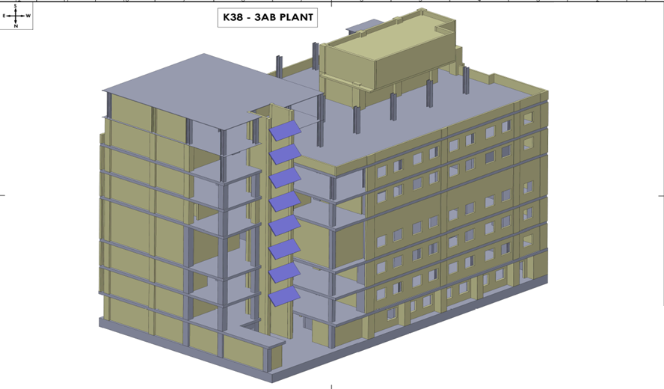
Production Block 3AB

Slide 13
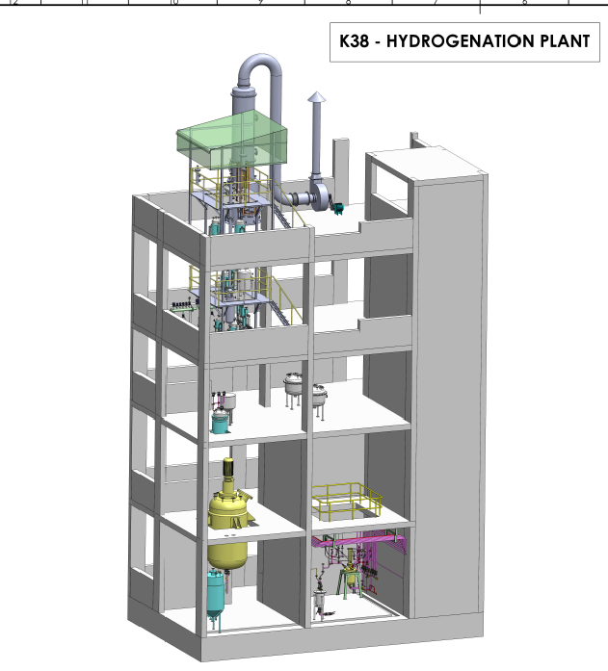
Production Block Hydrogenation

Slide 14
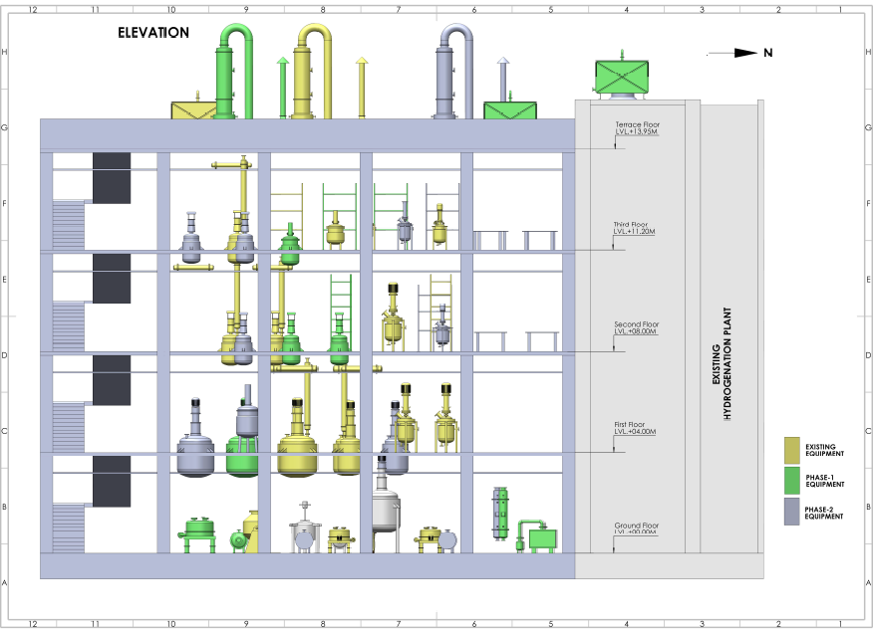
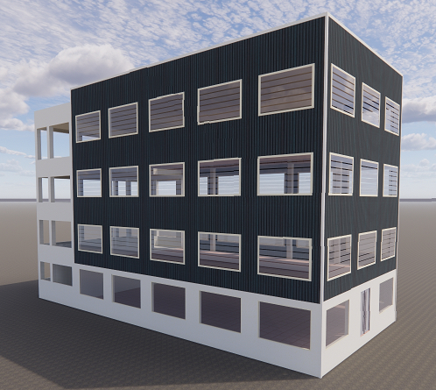
New Pilot Plant Facility

Slide 15
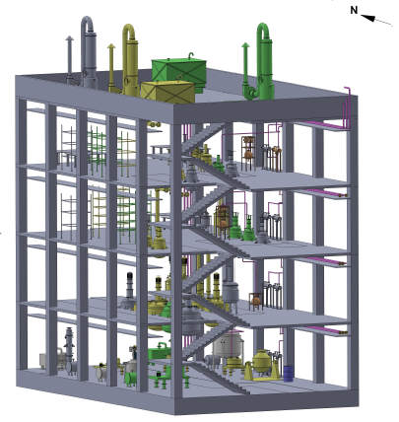
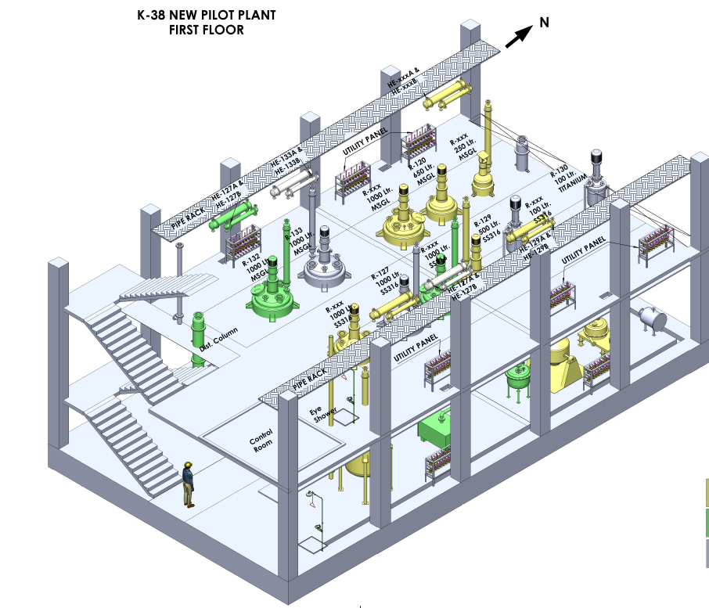
New Pilot Plant Facility
The new pilot plant facility will be ready by Oct-2023

Slide 16
Pilot Plant – Oct 2023
Three ranges of capacities
  20-30 lit
  200-300 lit
  500-1,000 lit
MOCs
  SS316L
  MSGL
  All Glass
  Hastelloy
  Inconel
  Titanium
Batch Reactors
Flow Reactors
Catalytic Reactors
FFE
ATFD
WFE
Vacuum Tray Dryers
ANFDs
Thermosyphon Distillation
Continuous Extractors
Molecular Sieves
Dry vacuum pumps

Slide 17
Major Equipment
Stainless steel Reactors
  ~40
  Reaction Volume
    ~250 KL
Glass lined Reactors
  ~15
  Reaction Volumes
    ~75 KL
Flow Reactors
  5 Commercial Scale
  6 Laboratory setups
Autoclaves
  ~04
  Reaction Volumes
    ~10 KL
Distillation Systems
  Batch or Continuous
  ~20
Centrifuges
  15
Rota Cone Vacuum Dryers
  5
Agitated Nutsche Filter Dryer
  SS316- 2 number
  Hastelloy C-22- 1 number
Vacuum Tray Dryer
  3
LLE System
  2
PSD System (LP & HP)
  2
Blender & Miller
  1 each

Slide 18
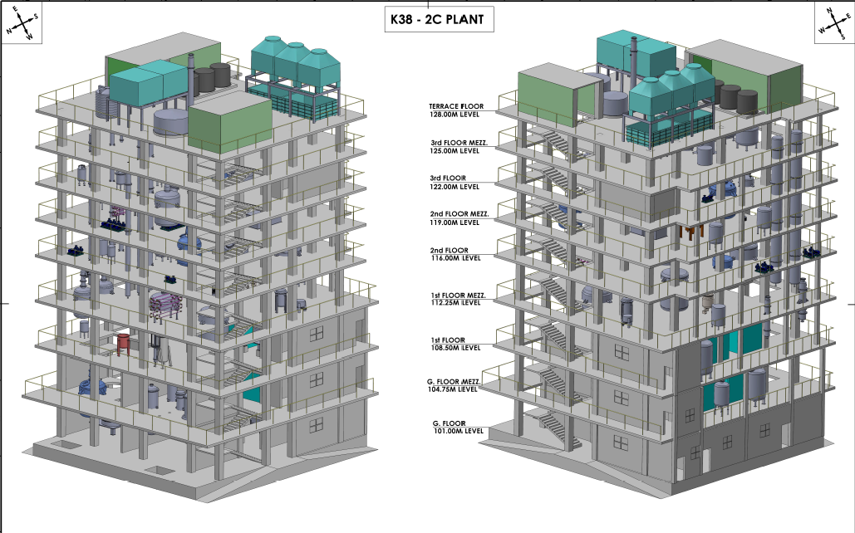
Production Block 2C

Slide 19
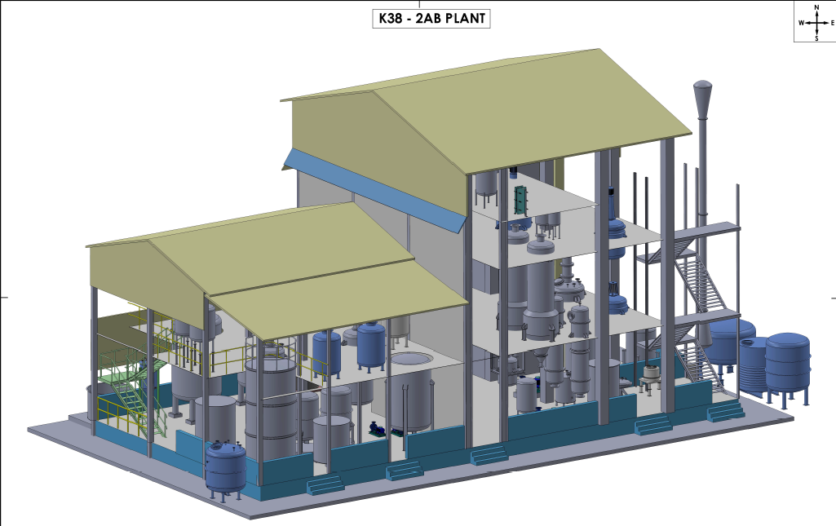
Production Block 2AB

Slide 20
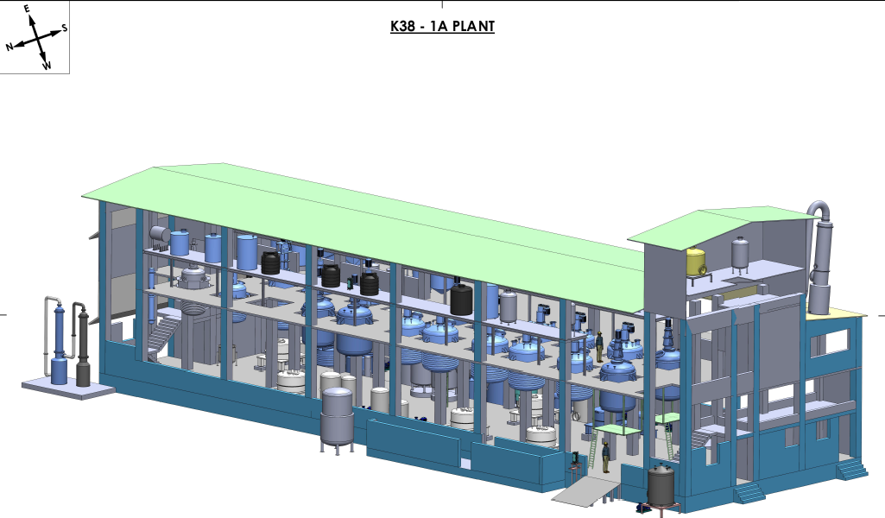
Production Block 1A

Slide 21
Inventys New Sites 2 & 3
2024 June

Slide 22
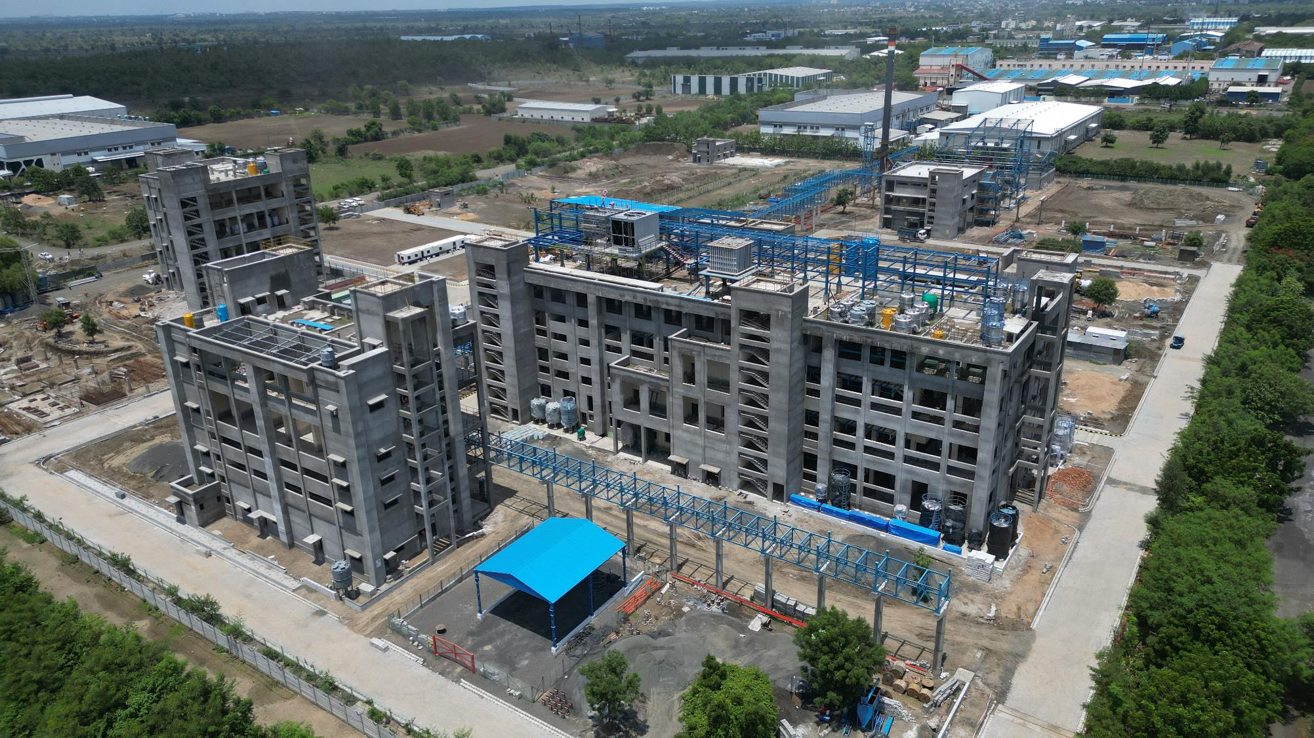

Slide 23
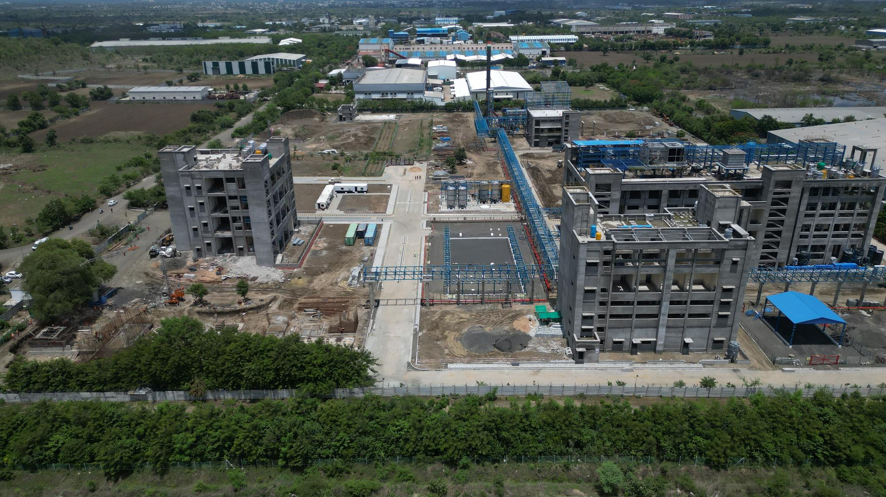

Slide 24
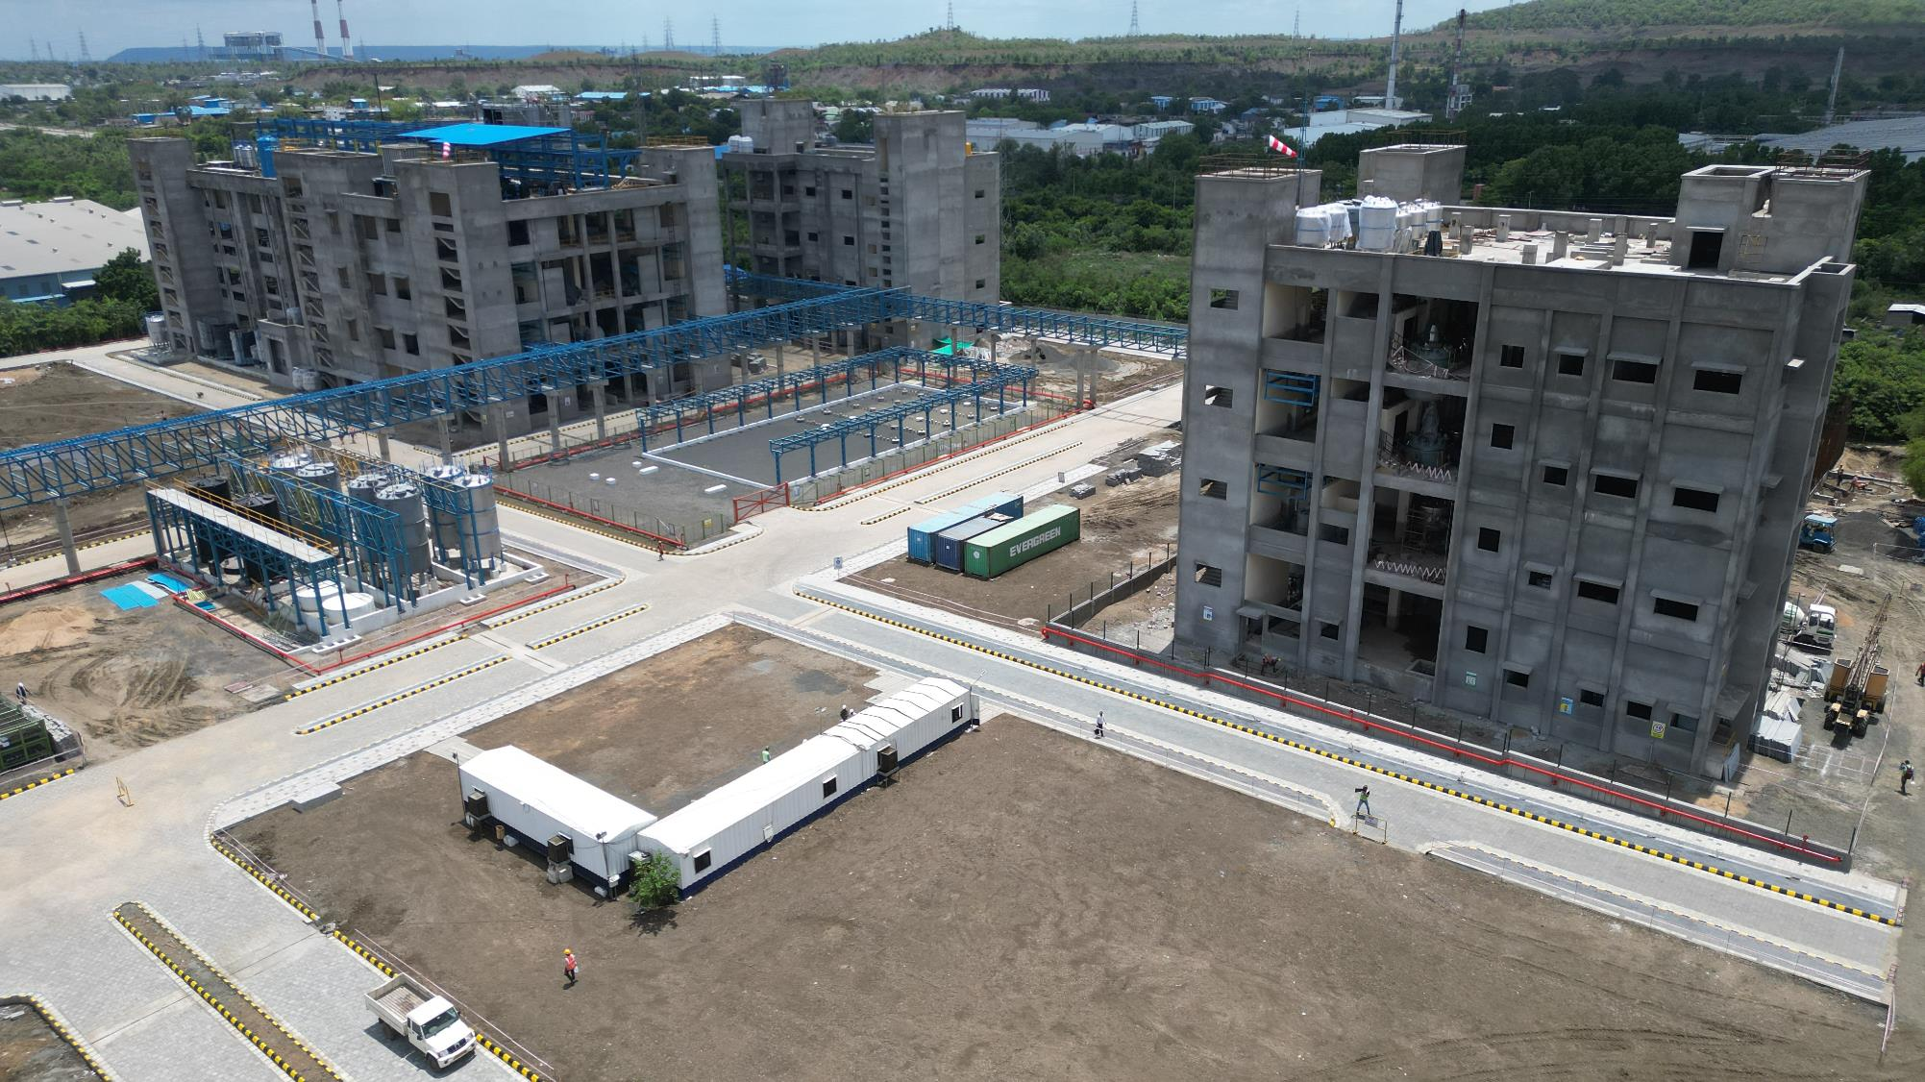

Slide 25
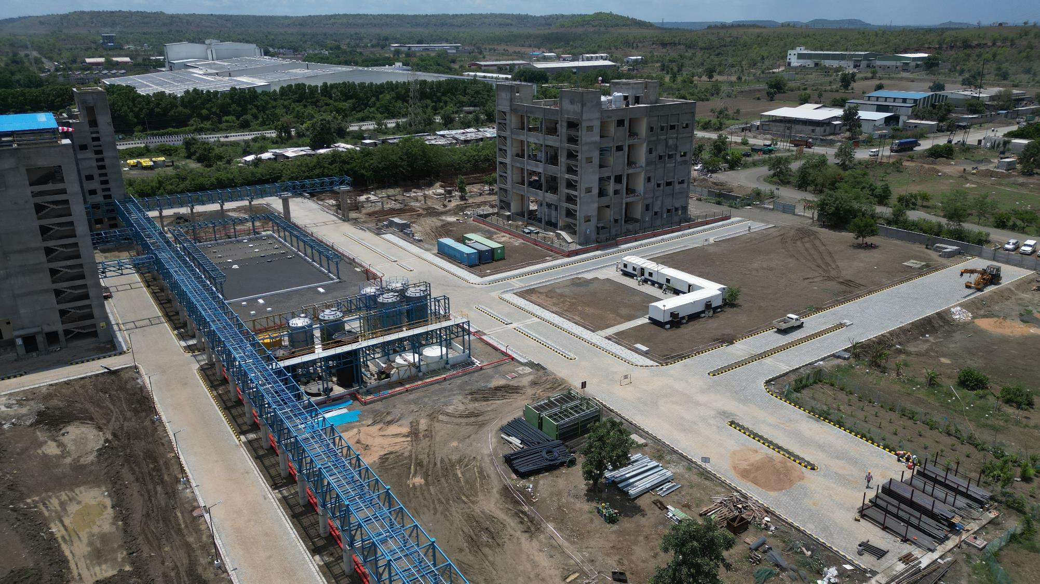

Slide 26
Site 2,3 Plantation
SZ1415 Summary of Plants
 | Zones
Category of Plants (Tree & Fruit Zone) | TA | TA1 | TB | TB1 | TC+TD | TD1 | TE | Total
Trees | 70 | 28 | 22 | 26 | 62 | 37 | 63 | 308
Shrubs | 359 | 0 | 100 | 0 | 603 | 0 | 639 | 1701
Medicinal Shrubs | 81 | 90 | 62 | 146 | 165 | 217 | 141 | 902
Total | 510 | 118 | 184 | 172 | 830 | 254 | 843 | 2911
Category of Plants (Fruit Zone) | FA | FB | FC | FD | FE
Fruit Plants | 52 | 75 | 44 | 52 | 105 |  |  | 328
Shrubs(Fruit) | 124 | 87 | 92 | 284 | 0 |  |  | 587
Total | 176 | 162 | 136 | 336 | 105 |  |  | 915
Category of Plants (Miyawaki Zone) | MA | MB | MC | MD
Canopy/SubCanopy/Trees/Fruit Trees/ Shrubs/Ground Cover | 1276 | 0 | 4170 | 6936 |  |  |  | 12382
Medicinal Plants | 85 | 20 | 0 | 0 |  |  |  | 105
Total | 1361 | 20 | 4170 | 6936 |  |  |  | 12487
Grand Total | 2047 | 300 | 4490 | 7444 | 935 | 254 | 843 | 16313

Slide 27
Inventys Material Flow
RM to FG
2024 Q1
Butibori Nagpur

Slide 28
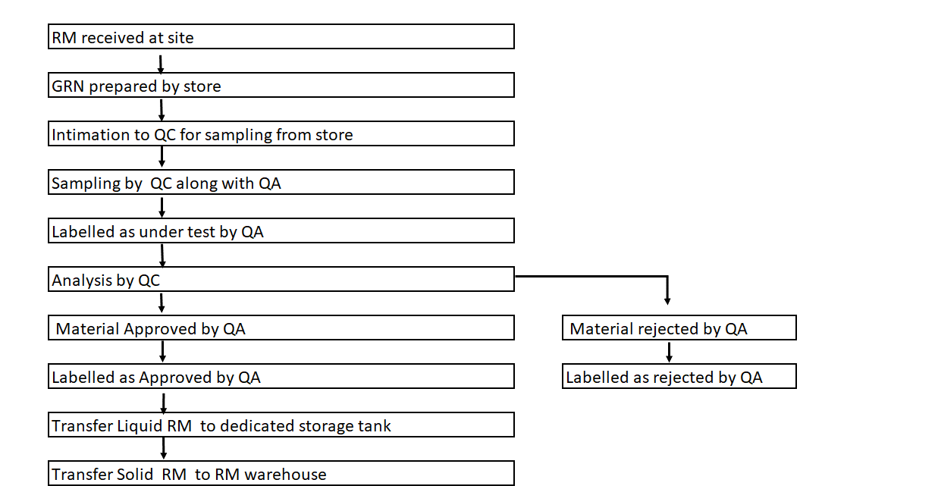
Material Movement - RM and FG

Slide 29
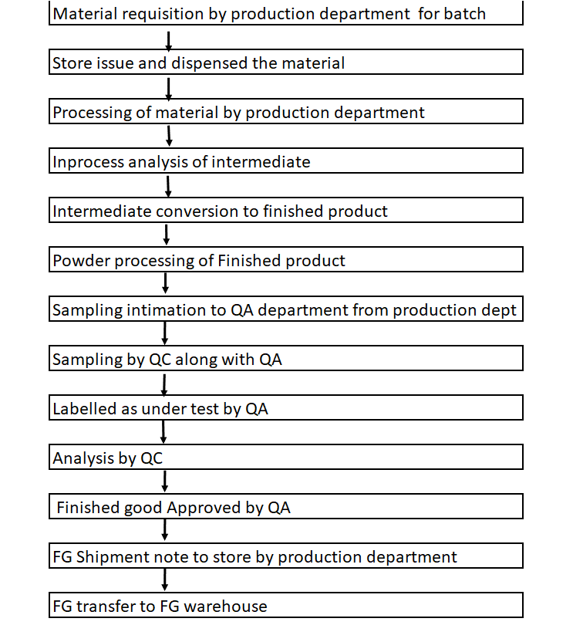
Material Movement - RM and FG

Slide 30
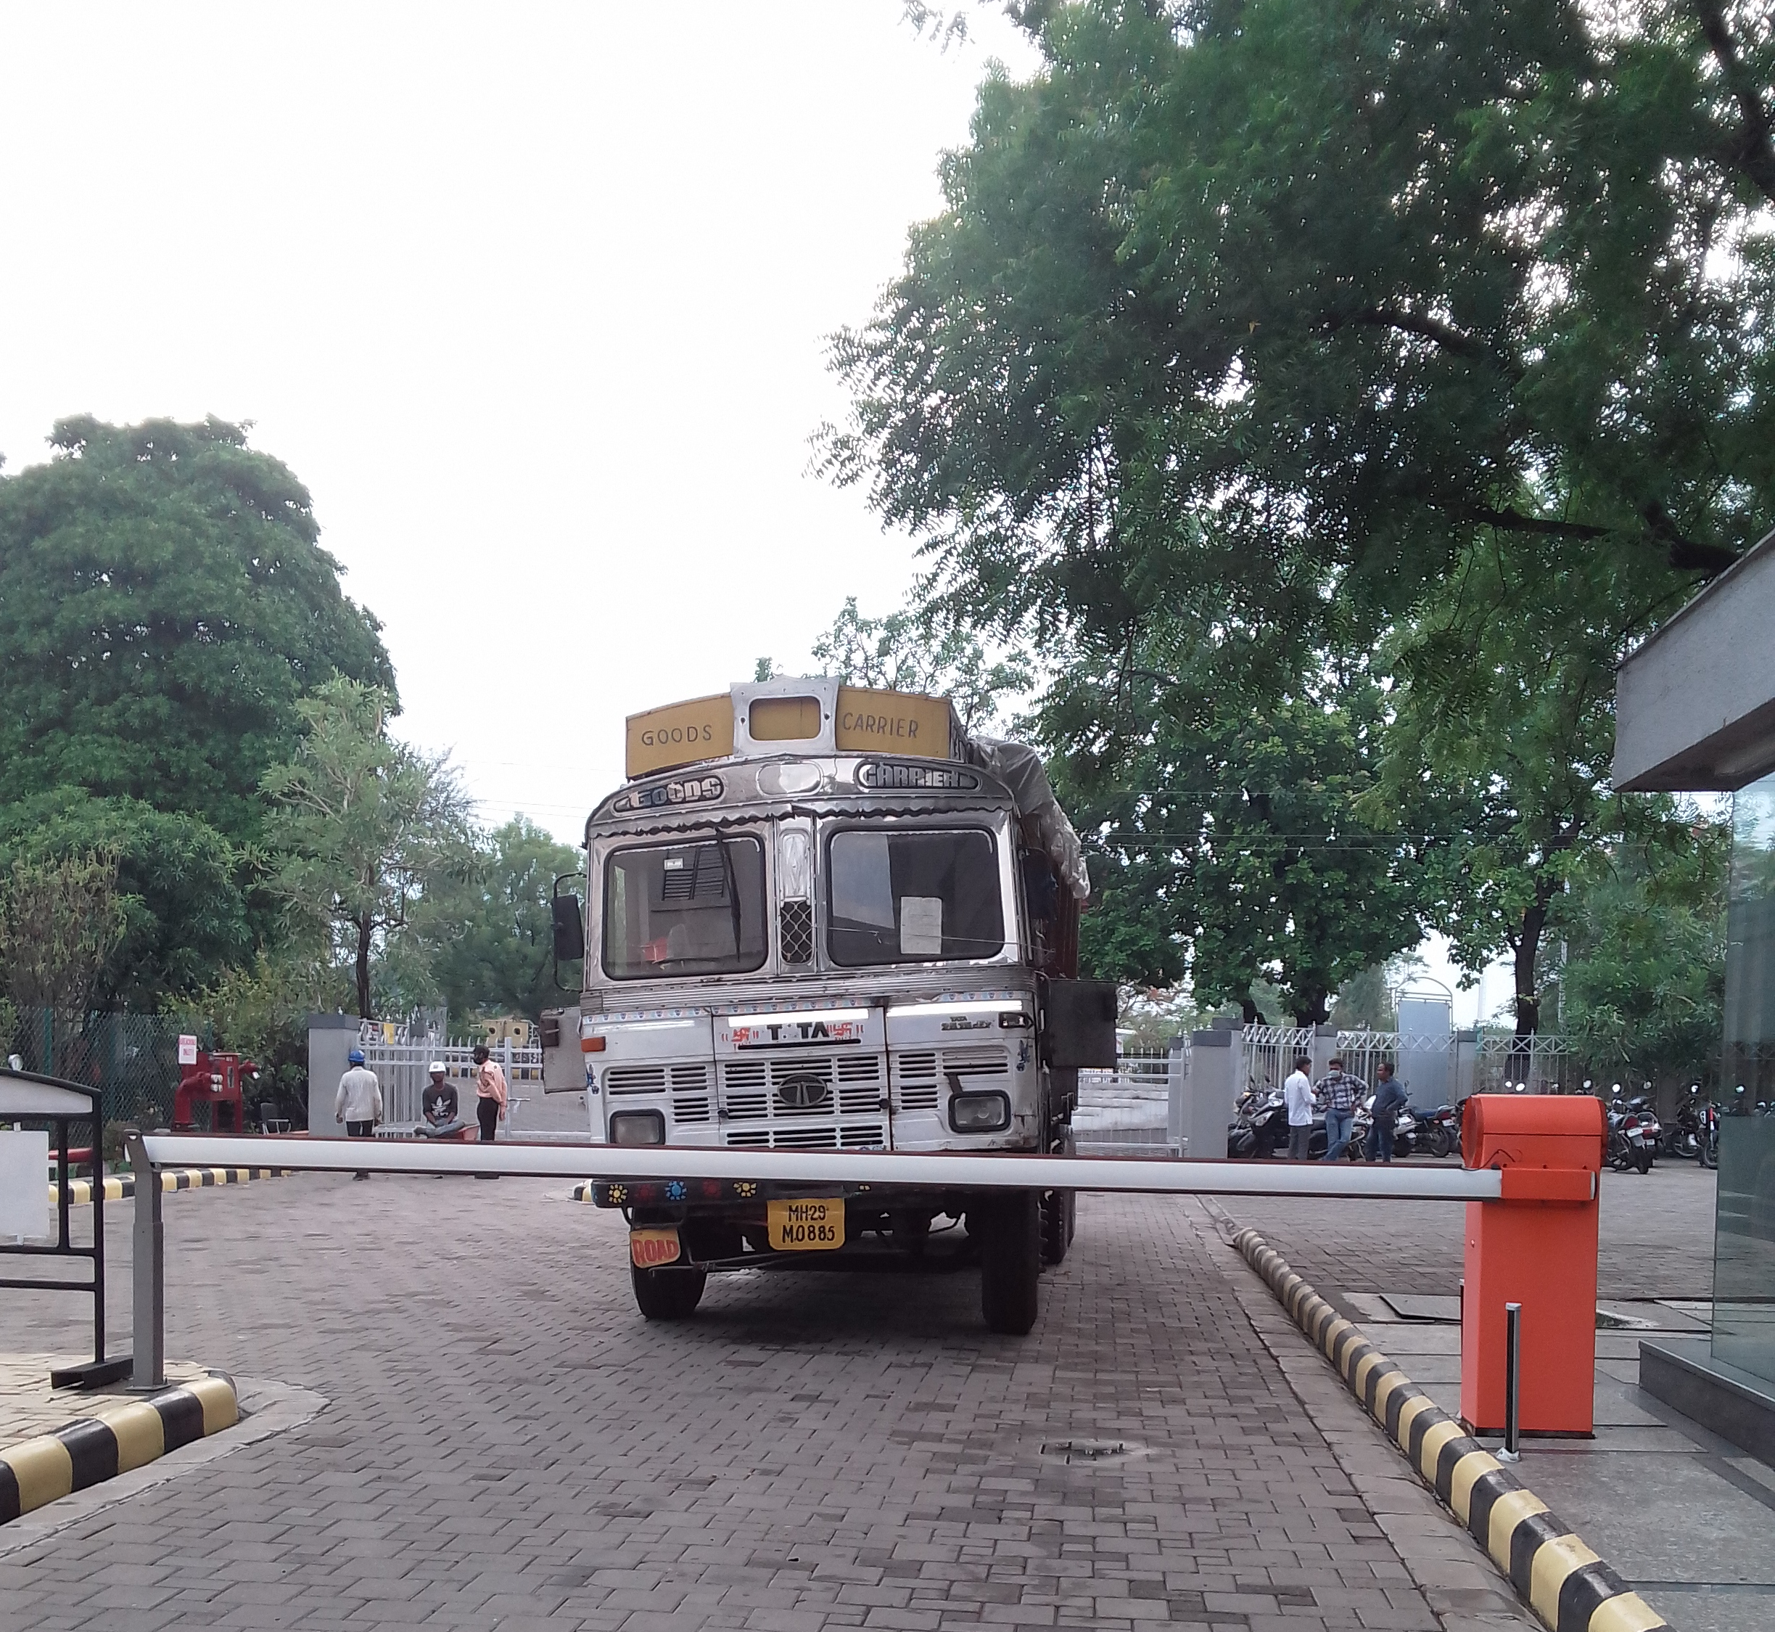
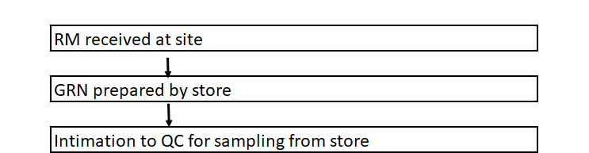
Raw material entry

Slide 31
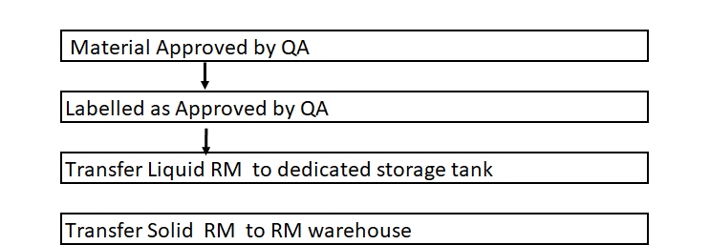
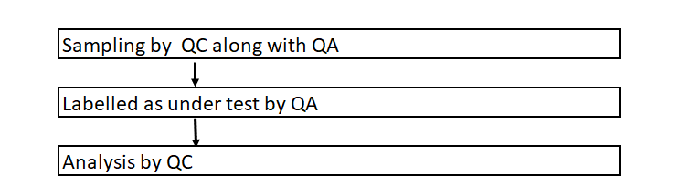
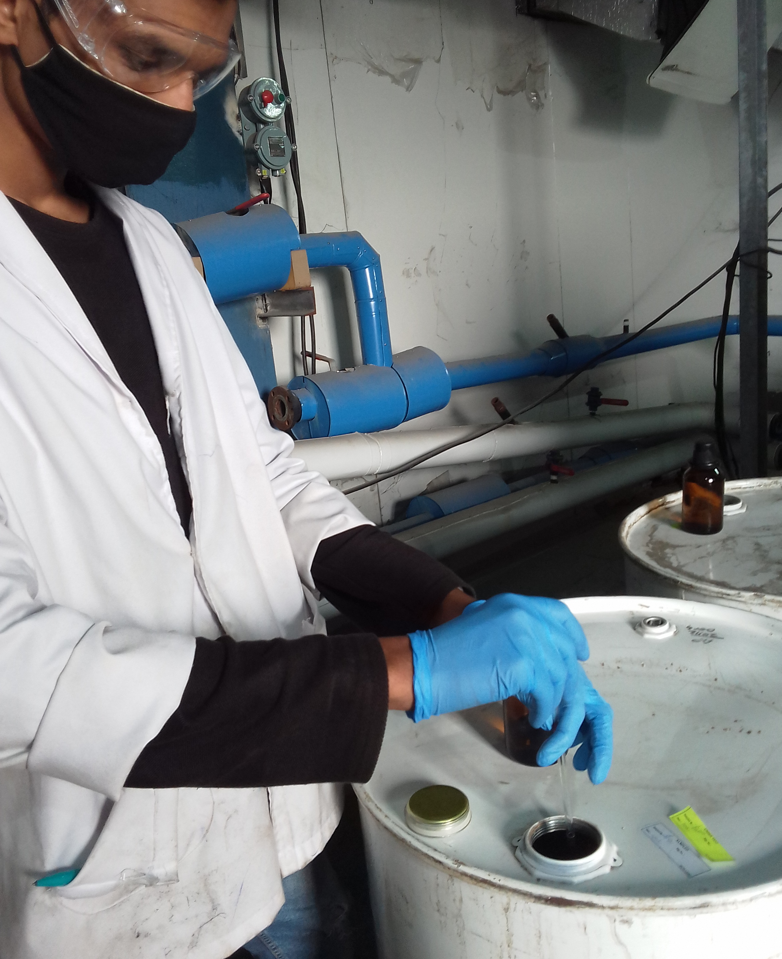
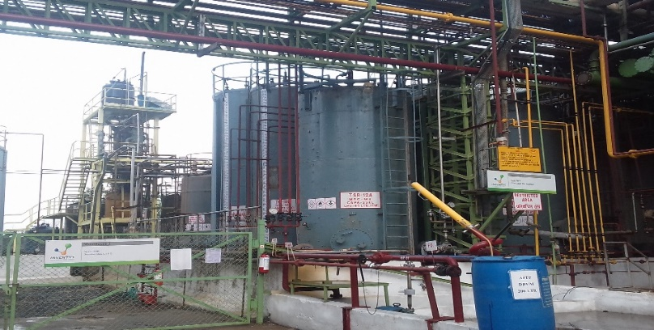
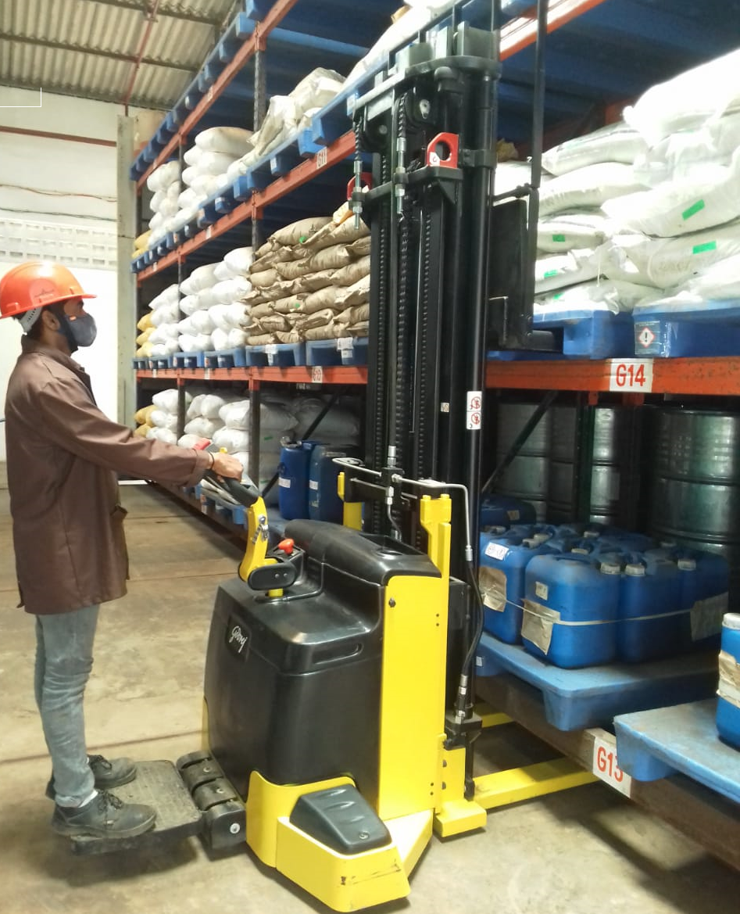
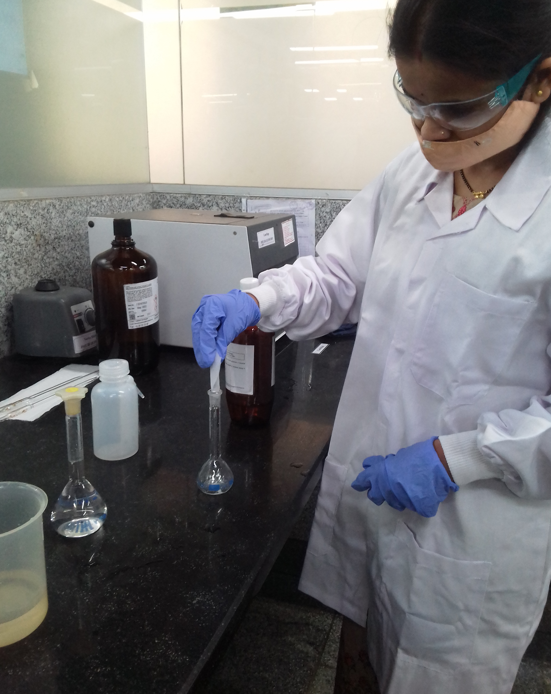
Raw Material Sampling, Approval & Storage

Slide 32
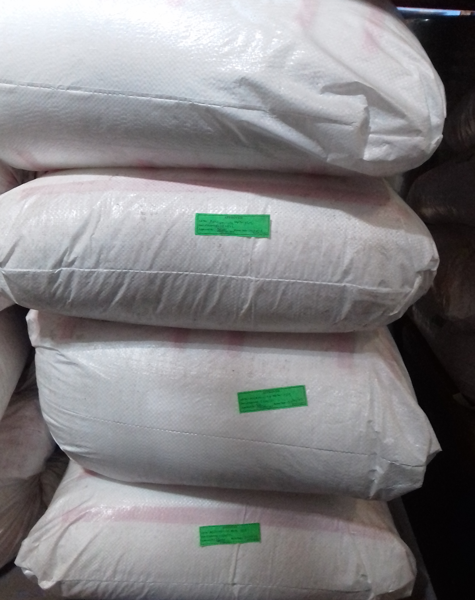
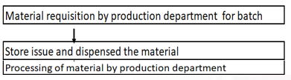
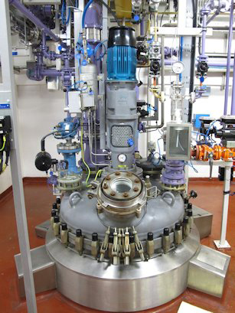
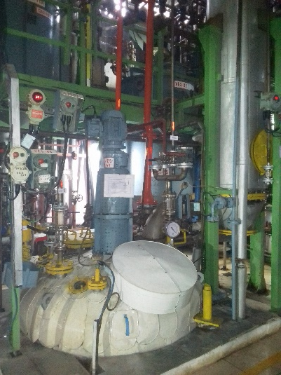
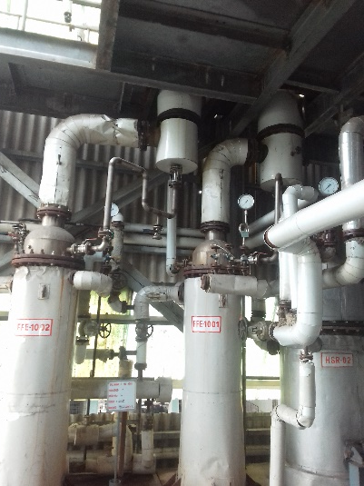
Production – Processing

Slide 33
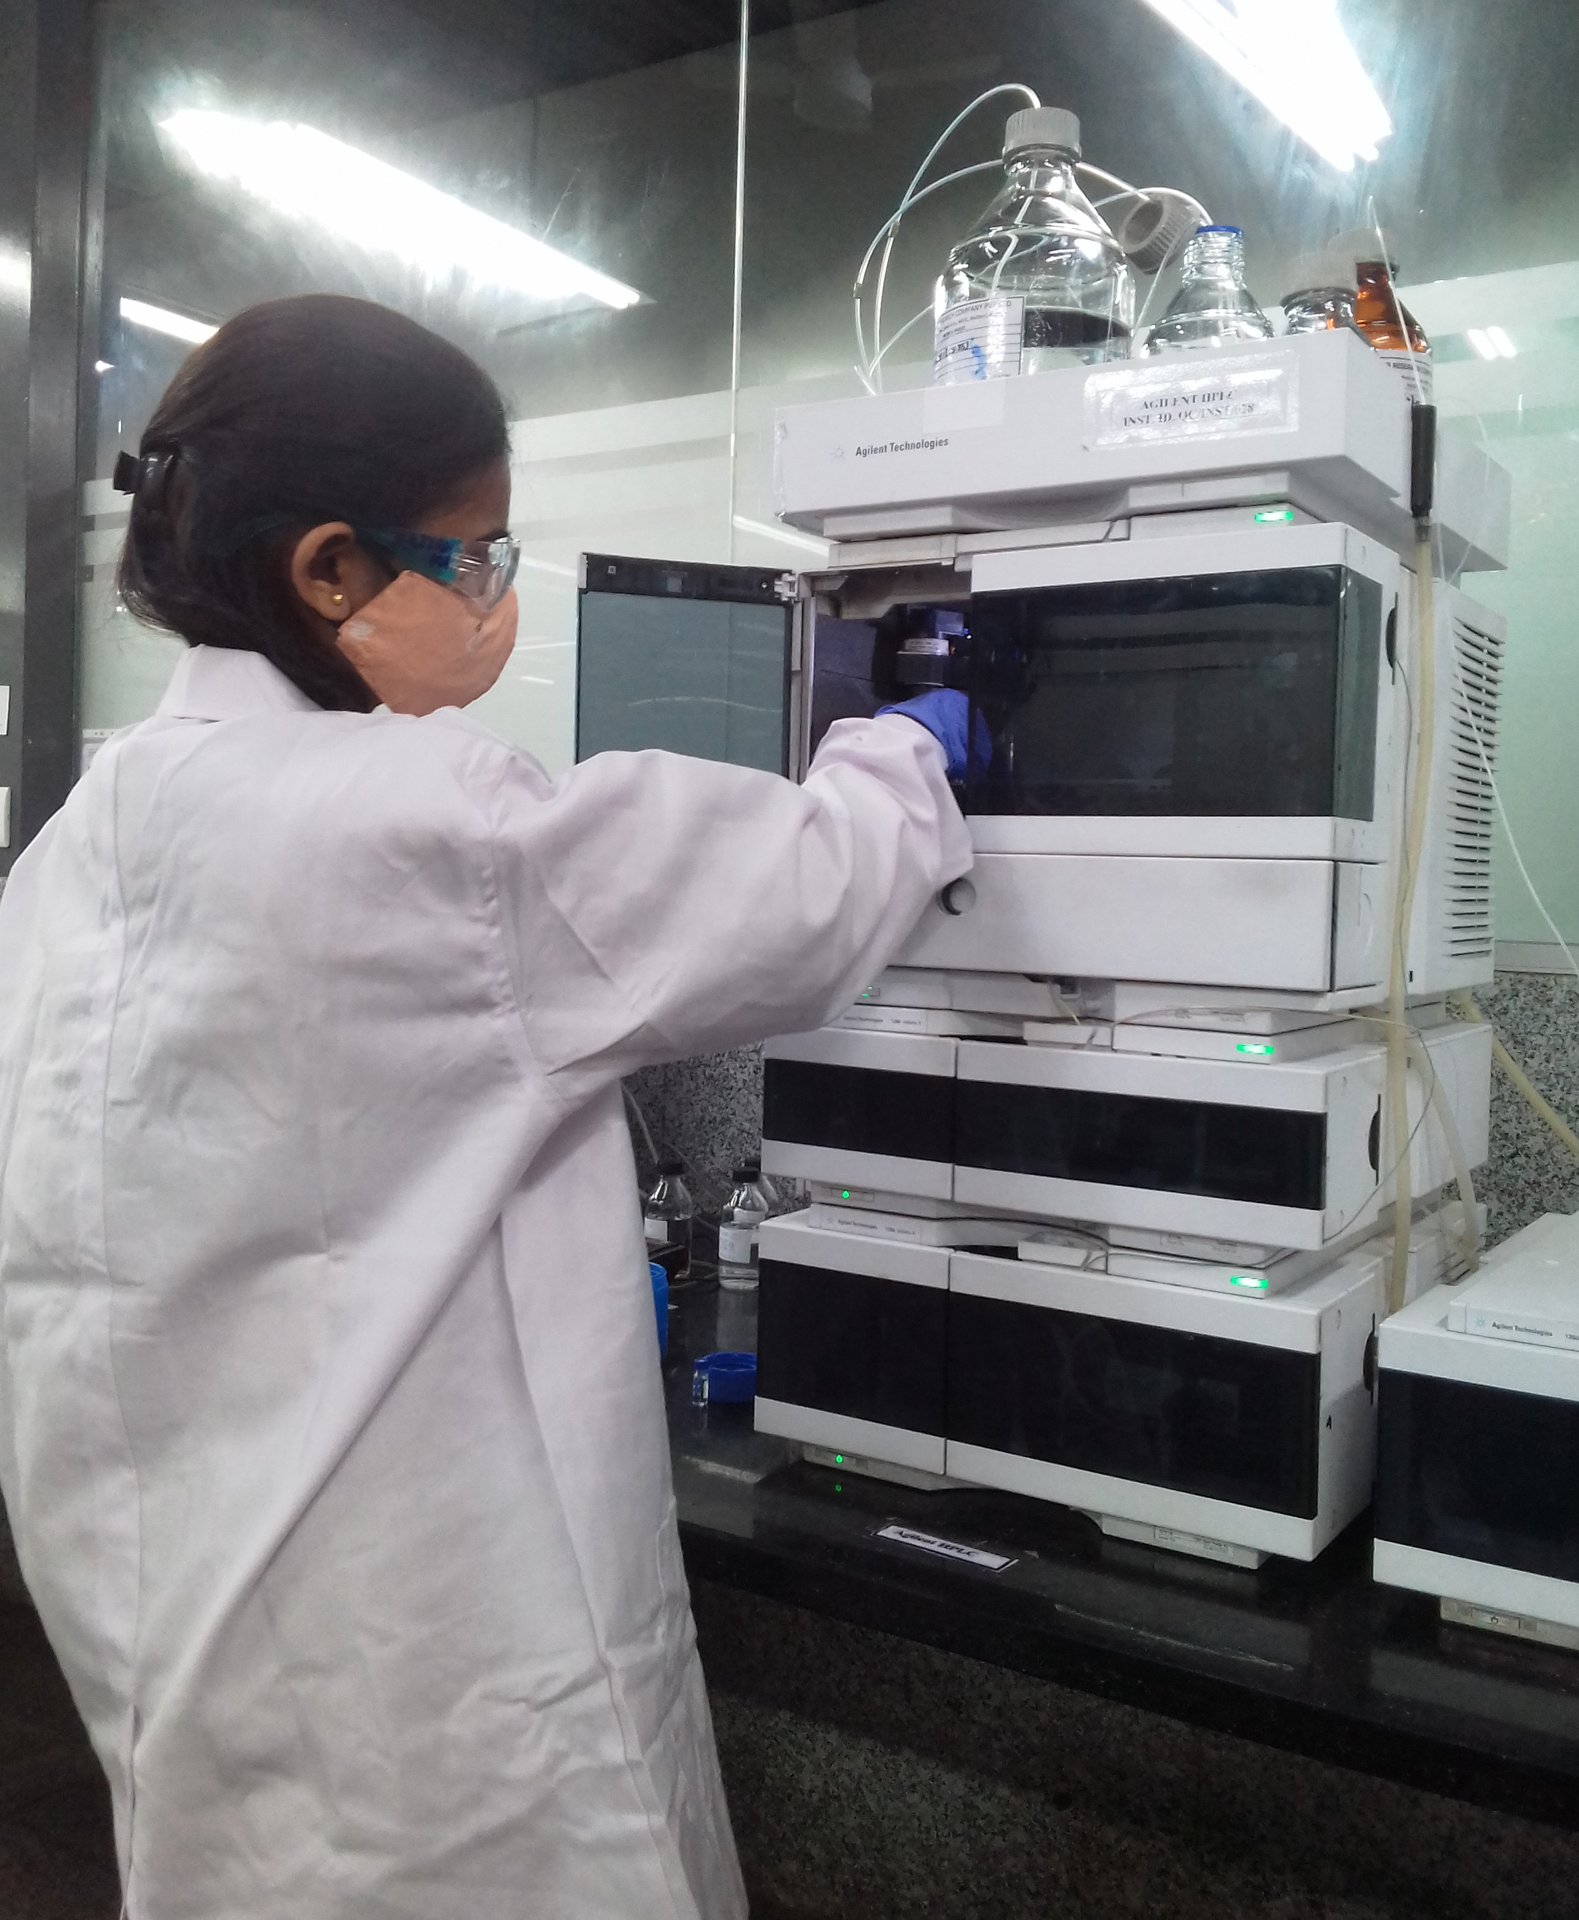
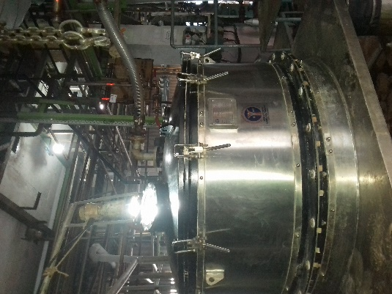

Production In-process Analysis

Slide 34
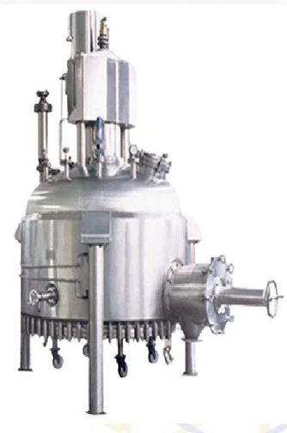
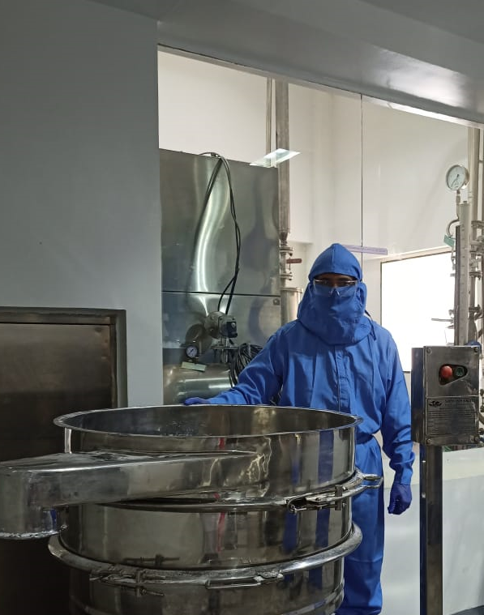
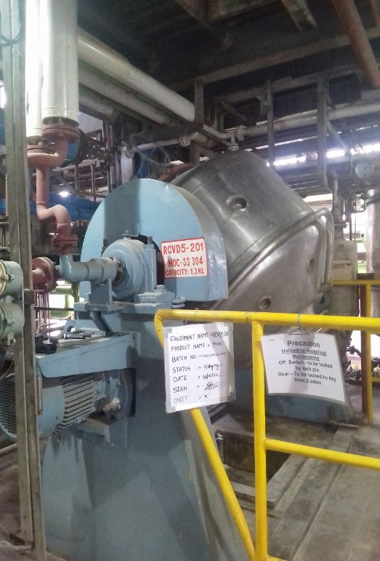
Production –Powder Processing

Slide 35
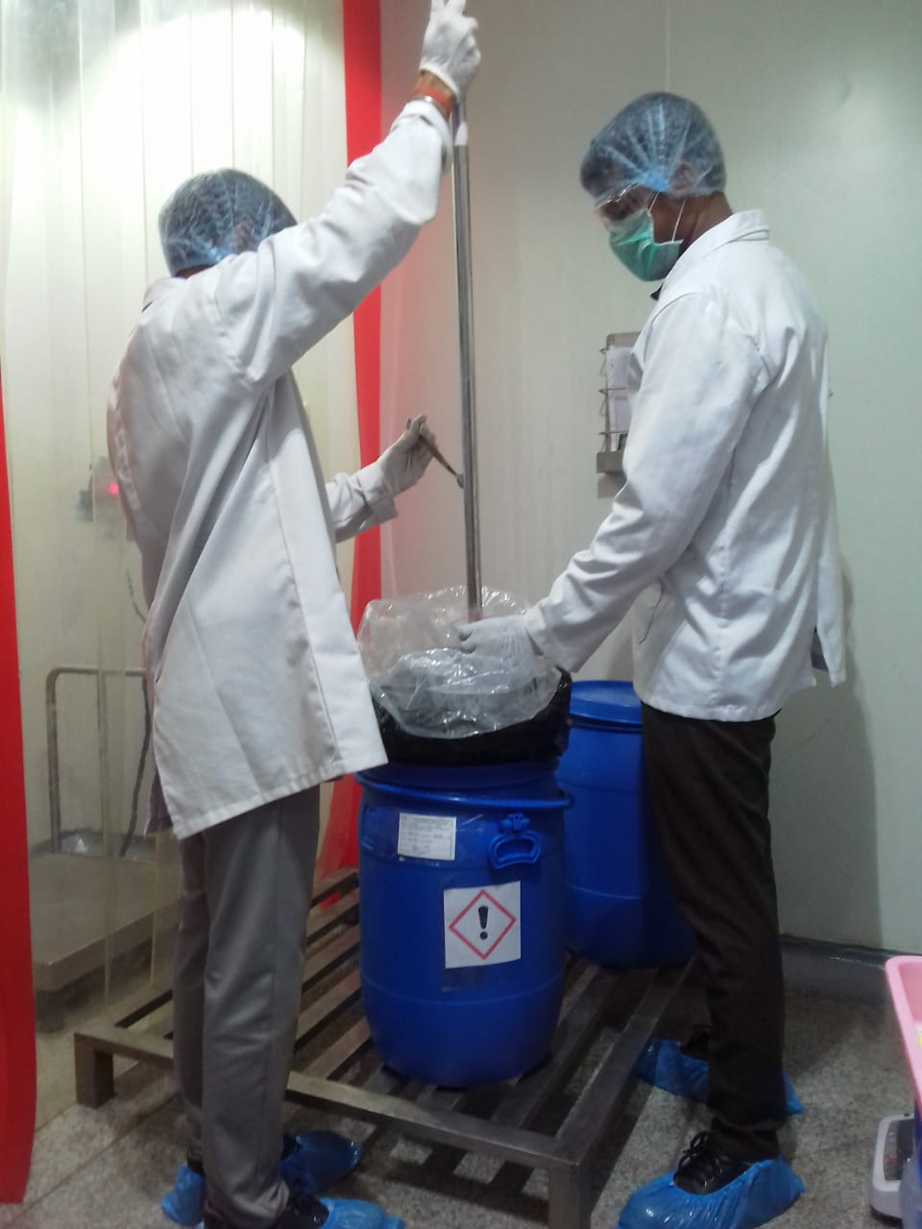
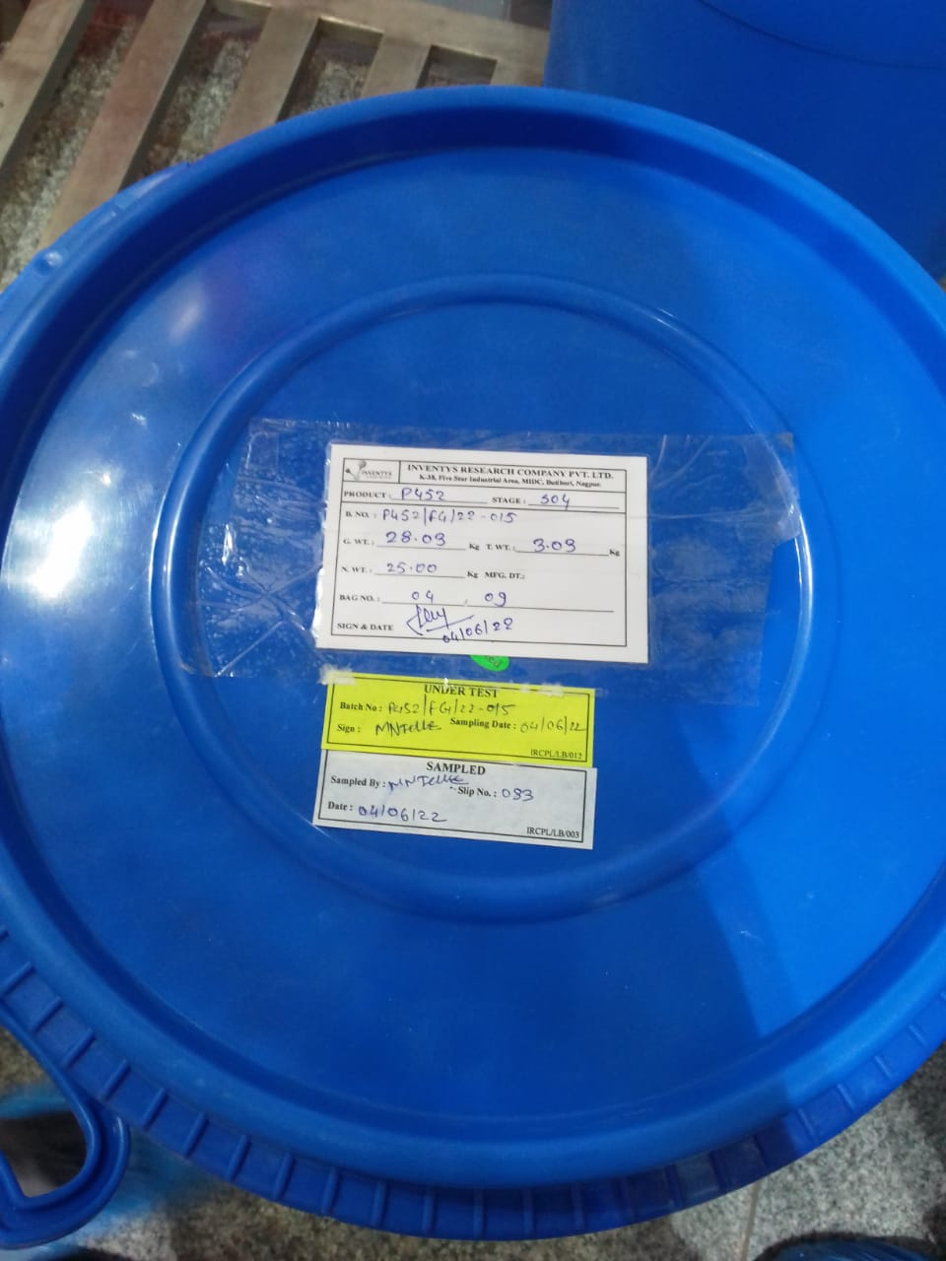
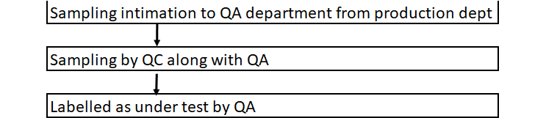
Production –Intermediate Sampling

Slide 36
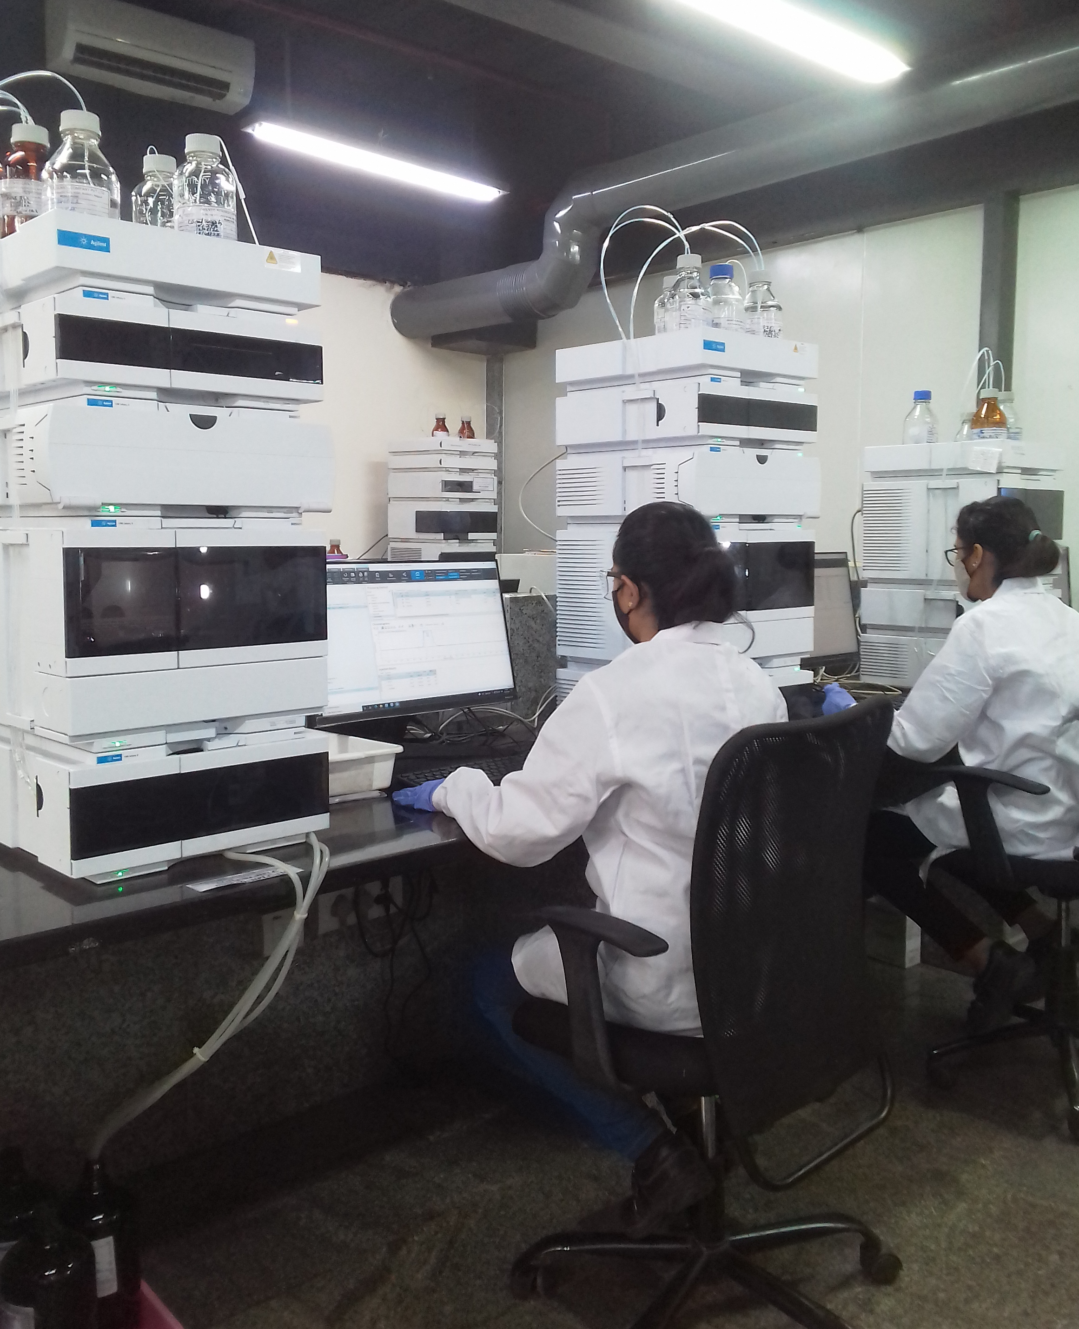
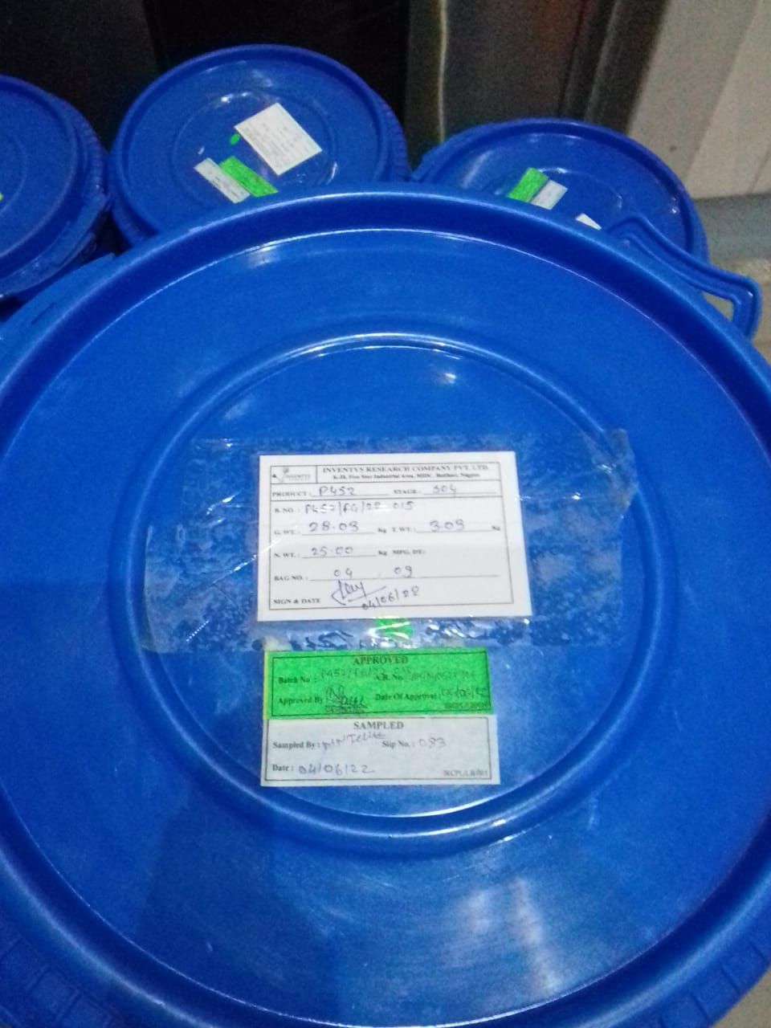

Finished Goods – Analysis & Approved

Slide 37
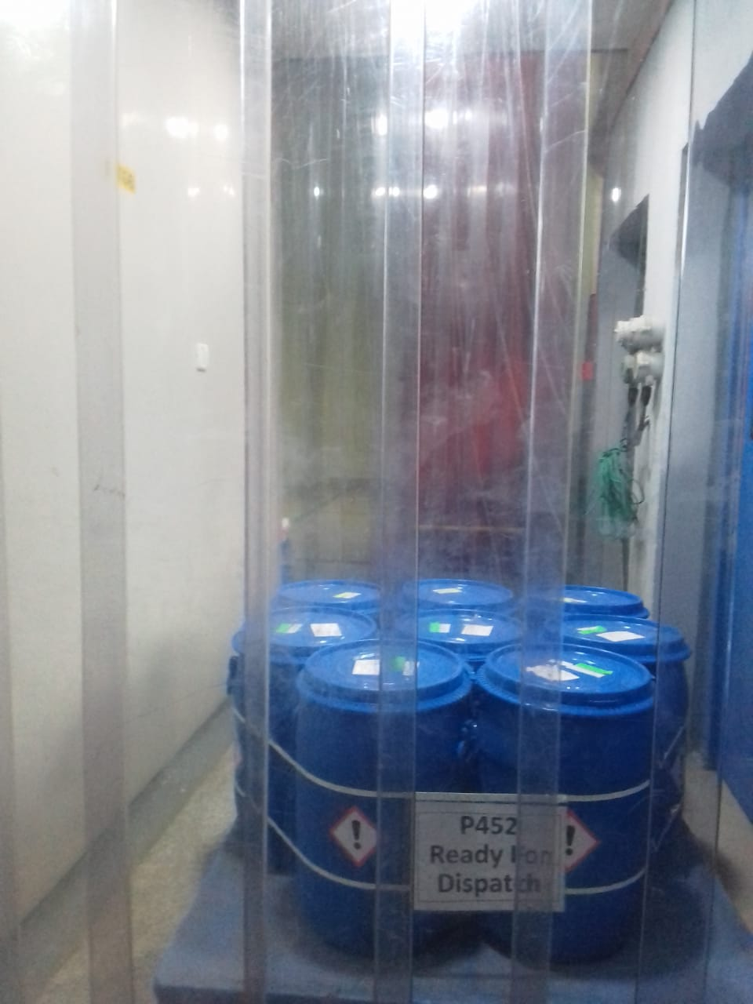

Finished Goods – FG Storage

Slide 38
Inventys Proposition
Process Development & Exclusive Synthesis
Safer Sustainable Supply Chain
Stable Raw Material Supply

Slide 39

Inventys
Strengths
Safe State of the Art manufacturing
Process Hazard Analysis established part of Process Development & Plant Design - Safe Manufacturing
DCS Controlled Plants
Multiple sites
Product Development
110 Product Development team
54 products developed 5 years
    3 to 14 steps each
~290 out of 360
    engineers / scientists
Large Capacities
<2022 – 50 reactors
2024 – 90 reactors + 22 reactors
2025 – 135 reactors + 45 reactors
~2030 – 300 reactors + 45 reactors
~3 MM Lit of Reaction Capacity
Top 5 in Indian Spec Chem (~2030)
Stable Supply Chain
Deep Backward Integration
    Large debt free capacity
    Wide Chemistry Expertise
    Complex Multistep Synthesis
80%+ sourcing within India
Flow Chemistry
Early Adopters
15 Chemistry Transformation
Safety & Selectivity ➔ Sustainability
Privately Held
>86% held in family
<14% by Private Equity

