Slide 1
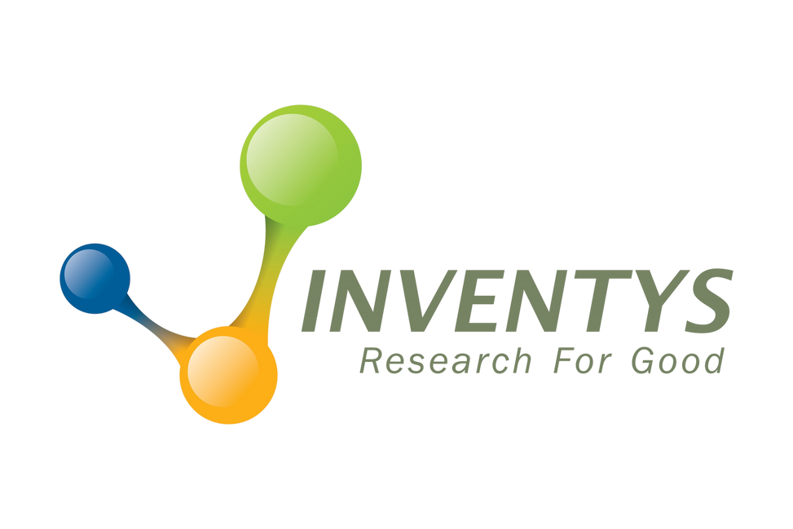




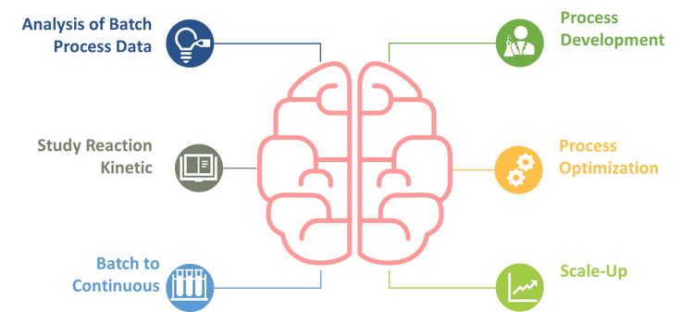
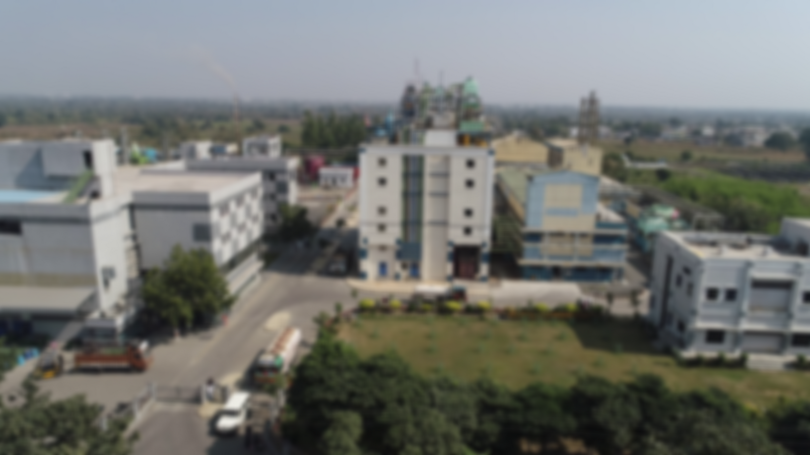


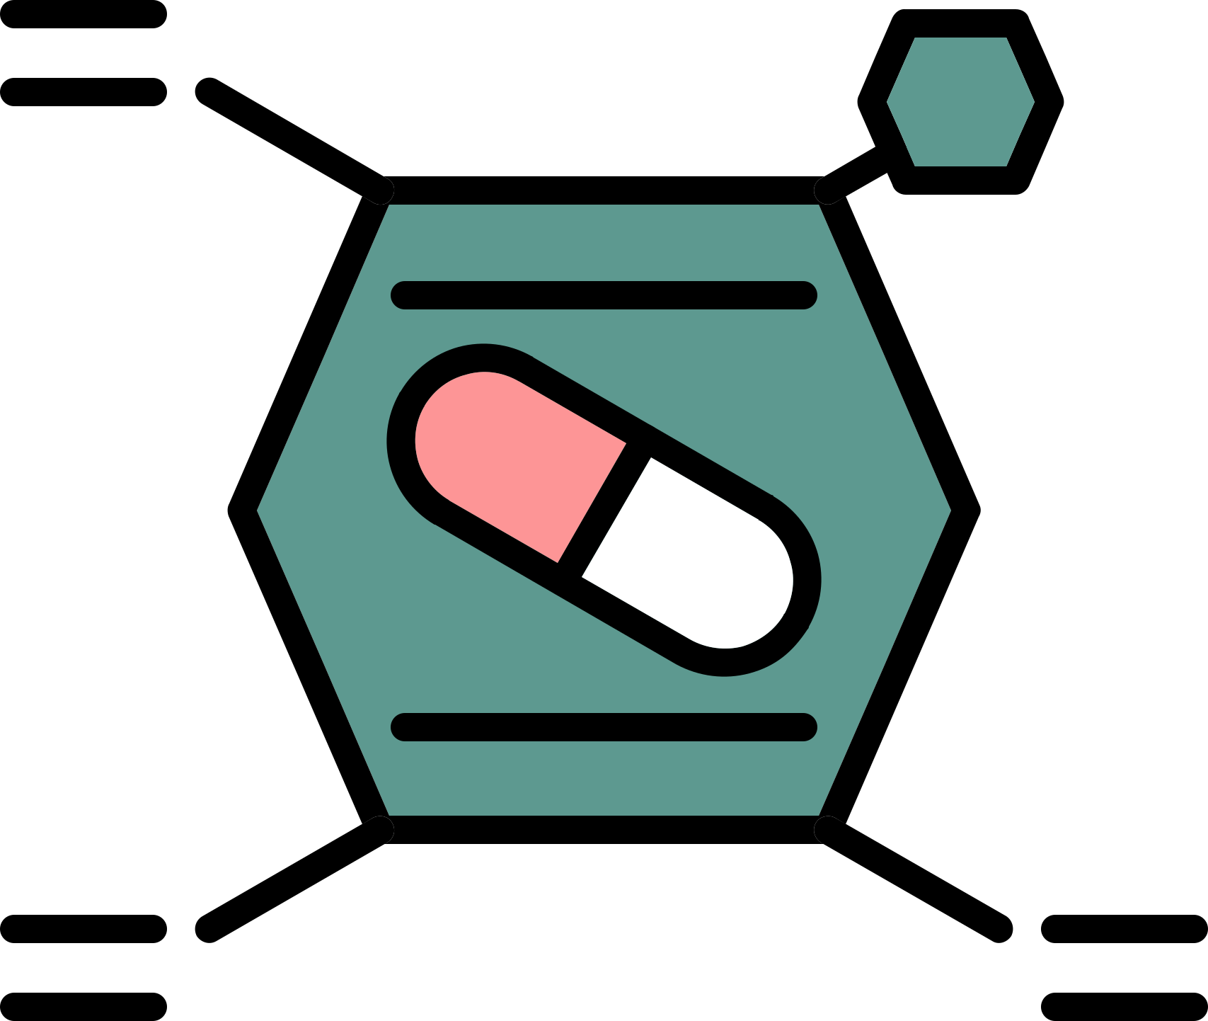
Flow Chemistry by INVENTYS
CASE STUDIES
INVENTYS ADVANTAGE
Inventys specialises in creating safer & more efficient manufacturing plants and process implementations. Thereby meaningfully reducing the environmental impact. Inventys has documented case studies showcasing exceptional results:
Inventys is well qualified to deliver stable supply enabled by
  Deep backward integration
  With a large number of chemistry implemented at commercial scale
  Large DCS controlled multipurpose manufacturing capacity.
Growing from 300 KL (in 2023) to 1,200 KL (in 2025) to eventually to more than 3,000 KL.
  Inventys leadership in Flow Chemistry at commercial scale
(as little 1 MT/month -10 MT/month - 250 MT/month)
  90% reduction in solvent usage
  91% reduction in energy consumption
  170 times increased throughput
  900+ times reduction in reactor sizes
89
Inventys TFS (togetrher for sustainability) score today stands at 89.
Renewable energy usage more than 51% - since 2012!
Recipient of Best Green Process award by FICCI (Federation of Indian Chamber of Commerce and Industry).
248th Fastest Growing Company AsiaPacific 2023 (Financial Times London)
Best Green Process
by FICCI, 2022
58th India's Growth Champions 2023 (Economic Times Mumbai)
INVENTYS APPROACH
Advanced Chemical Rxn Tools
HAZOP Study
Thermal Management Systems
TSU
Heat Exchangers
Safety Monitoring System
Toolkit
Process Simulation System Optimization
Flow Reactors
Pilot Plant facilities
Environmental & Compliance
  Pressure Relief Systems
  Real Time Monitoring
  Automated Temp. Control
ABOUT US
Inventys Research Company provides Exclusive Manufacturing & CDMO services to innovators in the life sciences domain (Crop Protection, Pharmaceutical, & other Specialty chemicals – including Electronic Chemicals). Inventys is reputed to be a reliable & trustworthy manufacturing partner. Mastery over a large number of chemistries implemented at commercial scale, coupled with a track record of responsible behaviour has enabled such a distinction.
Exclusive Manufacturing
CDMO Services
Speciality Chemicals

Slide 2
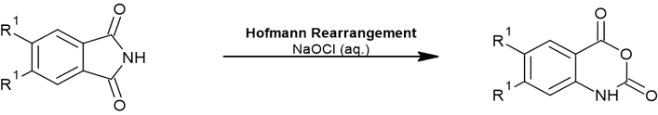




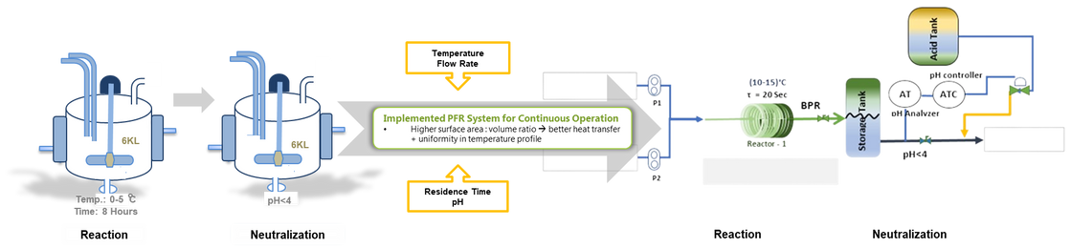


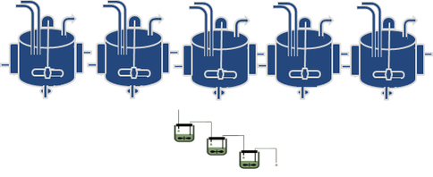










HOFMANN REARRANGEMENT (200 MT/yr)
Flow Chemistry by INVENTYS
CHALLENGES
Exothermic reaction with
run-away reaction hazard
Difficult to scale-up
operations
Stabilizing the process to plant scale
INVENTYS FLOW CHEMISTRY SOLUTION
Implemented PFR System for reaction followed by inline quench system for work-up.
INVENTYS ADVANTAGE
Batch Reaction
Flow Reaction
Reduced reactor volume requirement by factor of 170
Reducing residence time 80%
With minimal capex; could meet demand
Throughput increased
15 times
Finer control of temperature profile makes process inherently safe
Due to higher surface area, volume ratio; reduced energy consumption by 110 times

Slide 3
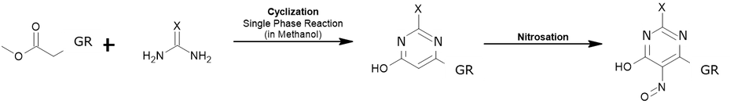
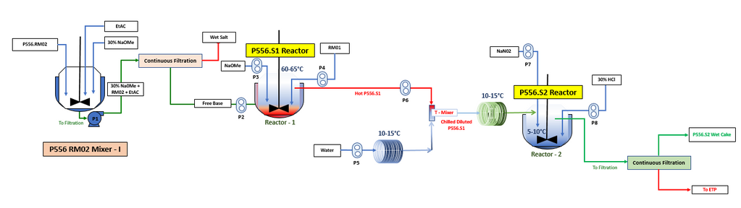
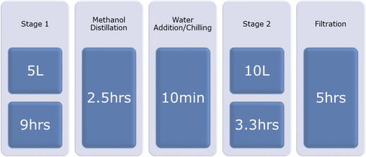

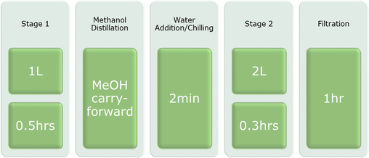
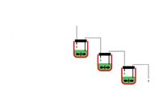
CYCLIZATION +NITROSATION (200 MT/YR)
Flow Chemistry by INVENTYS
CHALLENGES
  High Through-Put required to compete with Current Market Demand.
  High Through-put requires large reactor volume for Batch Reaction.
INVENTYS’ FLOW CHEMISTRY SOLUTION
Implemented Combination of CSTR and PFR systems for telescopic production
INVENTYS ADVANTAGE
Batch Reaction
Flow Reaction
25 Lit=5x5 Lit
x11
3 Lit=3x1 Lit
Comparison of LAB Scale for
600 gm Batch
Reduced processing time by 91%
Reactor volume reduced by ≈90%
Increased throughput by 11 times

Slide 4
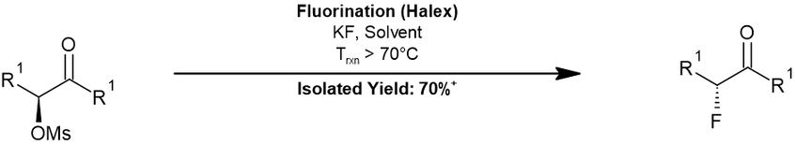

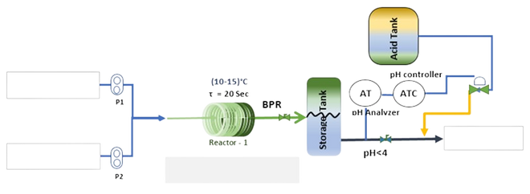
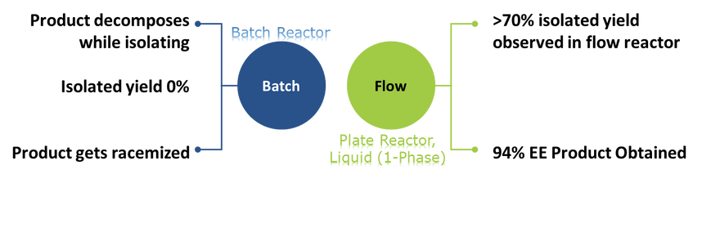
FLUORINATION (100MT/yr)
Flow Chemistry by INVENTYS
CHALLENGES
  Batch operation resulted in transient formation of product, but subsequent decomposition in-situ; resulting in complete loss of product
  Longer batch time resulted in racemization of product
INVENTYS’ FLOW CHEMISTRY SOLUTION
Implemented PFR (1Phase Reaction)
Implemented PFR (1Phase Reaction)
  Promote removal of product from reaction conditions substantially mitigated racemization
  Isolated yield increased significantly
For
Isolation
  Implemented PFR system for Halex reaction
INVENTYS ADVATAGE
The flow reactor consistently achieves an isolated yield of over 70%.
Batch reactor
Flow reactor

Slide 5
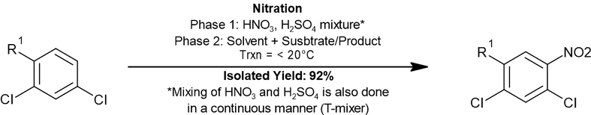
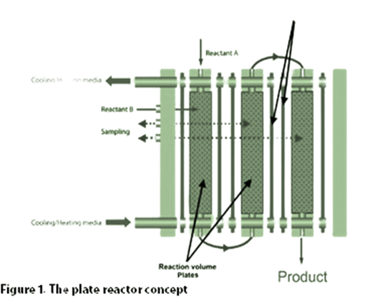
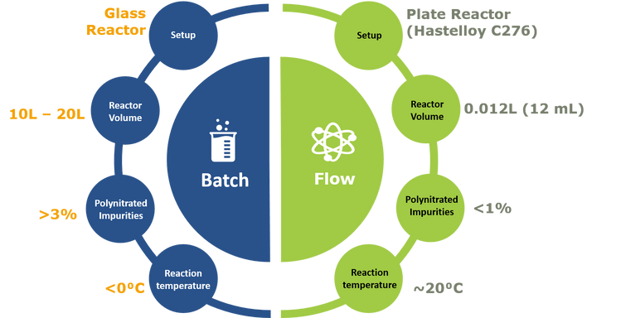
NITRATION (300MT/YR)
Flow Chemistry by INVENTYS
CHALLENGES
  Formation of Polynitrated impurities
  Exotherm & possible runaway
INVENTYS’ FLOW CHEMISTRY SOLUTION
Implemented process in Plate Reactor (2-Phase Reaction; Liquid-Liquid)
  Formation of di/tri-nitro impurities largely mitigated
  Better reaction temperature control
  Higher rate of reaction
  Lower utility load
INVENTYS ADVANTAGE
Lower polynitrates formation,
hence safer.
Safer because of significantly smaller volume.
Higher Purity Product.
25%-30% Lower Chilling Cost.
Batch Reaction
Flow Reaction
Lower Capital Expenditure.

Slide 6
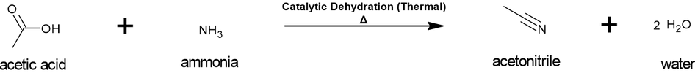

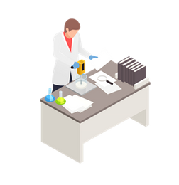

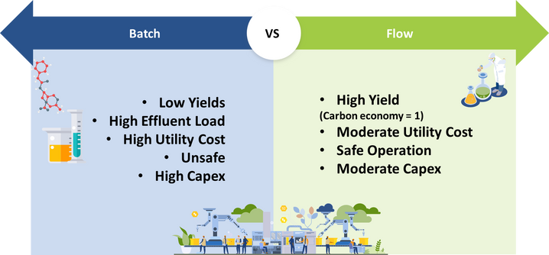
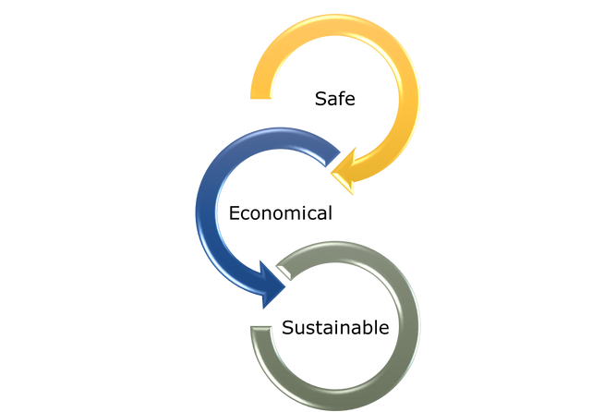
CATALYTIC DEHYDRATION (3300 MT/yr)
Flow Chemistry by INVENTYS
CHALLENGES
  Low Selectivity, results in low yield & high effluent load.
  Very high operating temperature leading to higher utility costs.
  Very High Capex
INVENTYS’ FLOW CHEMISTRY SOLUTION
Implemented series of fixed bed, catalytic tubular reactors in continuous operation
INVENTYS ADVANTAGE
  Conversion > 98% & Selectivity > 95%
  Minimal by-product formation < 2.0%
  Consistent quality and inherent safe operations

Slide 7
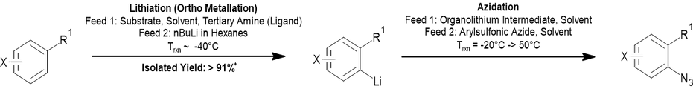
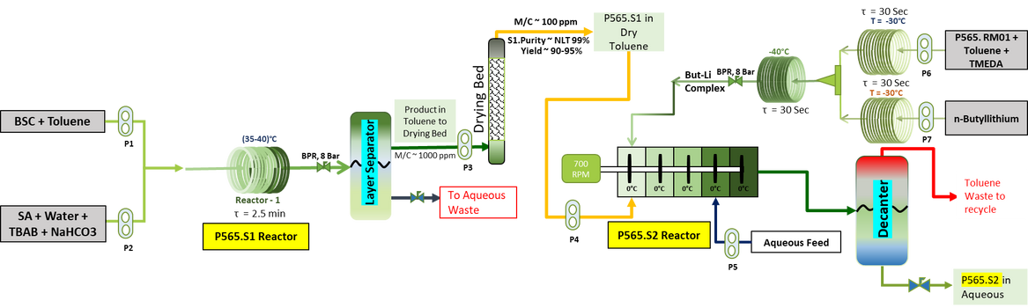
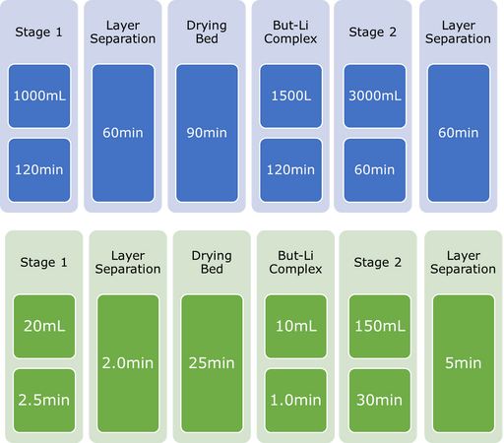
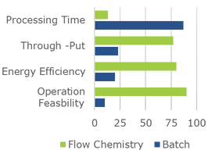
LITHIATION & AZIDATION (200MT/yr)
Flow Chemistry by INVENTYS
CHALLENGES
  High utility cost reaction temperature ~ “- 78.0°C” – butyl lithium reaction
  Preparation, drying and handling of azides – liberation and accumulation of hydrazoic acid in reactor empty space
  Stability issue of intermediates resulted in inconsistent quality and quantity
INVENTYS’ FLOW CHEMISTRY SOLUTION
Implemented end to end continuous process, consist of reactors (PFR & CSTR), continuous extractor, in-line layer separator, in-line drying bed
INVENTYS ADVANTAGE
Batch Reaction
Flow Reaction
Key Achievement
Enhanced
Reaction Control
In-line
Phase
Separator
In-line
Drying
Bed
Very High
Through-
put
More
Safe
  Higher temperature of Operation feasible (-40°C in flow vs. <-78°C in batch) resulting in lower energy cost.
  Due closed loos system accumulation of hydrozoic acid is avoided, resulting is inherently safe system
  Due to end to end operation; hazardous organic azides prepared and consumed without isolation
  A Higher energy efficiency, easier operations are achieved
  Higher overall yield ~ 85% over 3 steps achieved

