Slide 1
Flow Chemistry @ Inventys
Commercialized Applications & Under Development / Scaleup
Q4 2024

Slide 2
Continuous Chemistry at Inventys
Commercialized (MT-Scale) | Pilot Completed (Kg-Scale) | Under Development (g-Scale)
Catalytic, Thermal Dehydration (Carboxylic Acid → Nitrile) | Halogenation (Chlorination) | Catalytic Oxidation – Hydrogen peroxide
Oxidative Rearrangement (Amide → Amine) | Fluorination (Substitution, with KF) | Catalytic Hydrogenation
Diazotization & Hydrolysis (Diazonium → Phenol) | Lithiation / Ortho Metalation (using BuLi) | Grignard Reaction including Grignard Reagent Preparation
Mattox Rearrangement & Acetal Formation | Azidation | Photochemical Halogenation
 | Nitration | Pyrazoles Synthesis (with various hydrazines)
 | Pyrimidine Synthesis | Tetrazole Synthesis
 | Solvent Recovery | Azide Reduction
 |  | Sulphonyl Azide Transfer
 |  | Protection / Deprotection of Ketones & Aldehydes
 |  | Acyl Hydrazide Synthesis

Slide 3
Flow Chemistry – At Commercial Scale

Slide 4
Catalytic Thermal Dehydration – 3,000MT/yr
Low yielding, equipment heavy process (very high CapEx) in batch
  High temperature operation with moderately acidic process species
  Batch process suffers from low selectivity and limited conversion
  Completely infeasible in batch
Implemented series of fixed bed, catalytic tubular reactors in continuous operation
  Using in-house engineering design and automation capabilities
System | Continuous
Setup | Four proprietary fixed bed catalytic tubular reactors
Conversion (AcOH) | 96%+
Sustainability | - Carbon Economy = 1 - Only major effluent = Water - Powered by renewable fuel (biomass)
Throughput | 10 MT/day
Temperature | 360ºC
Work-Up / Isolation | 5 Continuous Distillation Columns (in series) - Operated in fully automated manner

Slide 5
Catalytic Thermal Dehydration – 3,000MT/yr
Nitrile Synthesis
Plant 2C
  Fixed Bed Catalytic Reactors in Series
    HE5-13, HE5-14, HE5-15, HE5-16
    SS316L
    Catalyst Volume 3,600 lit
    Up to 360°C
    Up to 2.0Kg/cm²
  5 Continuous Distillation Systems
    C5-210C, C5-601, C5-602, C5-58, C5-20
    Up to 140°C
    Pressure 1 to 4 Kg/cm²
  DCS controlled
    Start up
    Shut down
    Continuous Operations
Development Timeline
  3 months
    Process Feasibility
  3 months
    Lab process optimization
  1 year
    Dedicated Pilot Scale up
  2 years
    Commercialization
      3 MT/day – 6 months
      6 MT/day – 6 months
      10 MT/day – 12 months

Slide 6
Oxidative Rearrangement – 360MT/yr
Highly exothermic reaction
  Batch operation required large volume of solvent as heat sink
  Non-uniform temperature profile in reactor resulted in impurity formation
Implemented PFR system for continuous operation
  Higher surface area:volume ratio → better heat transfer + uniformity in temperature profile
System | Batch | Continuous
Setup | 2 x 6000L MSGL Reactors (12000L total) | 34L Plug Flow Reactor (Shell & Tube heat exchanger)
Reactor Volume | Reduced by factor of 170
Utility Consumption | Reduced by factor of 110 (utility flow, utility type, solvent recovery costs)
Throughput | Increased by factor of 15 (reduced reaction time, work-up time)
Operating Temperature | 0-5ºC | 15-20ºC (easier operation)
Product Purity | 92% | 99%+

Slide 7
Oxidative Rearrangement – 360MT/yr
Hoffmann reaction
Plant 1A
  Plug Flow Reactor
    PFRHE-10
    VCR-01B, VCR-01C, VCR-01D
    SS316L
    34 Lit
    Operating range
    -5°C to 100°C
    Up to 2.0Kg/cm²
Development Timeline
  1 month
    Process Feasibility
  1 month
    Process Optimization
  1 month
    Pilot Scale up
  3 months
    Commercialization

Slide 8
Diazotization & Hydrolysis – 150 MT/yr
Product highly prone to side reactions in Hydrolysis reaction medium
  Batch operation required large volume of solvent to dilute reaction medium and reduce rate of side reactions
    Ether formation, C-X bond hydrolysis, Nitration
Implemented cascade of CSTRs for both reactions and work-up
  Prompt removal of product from reaction system reduced side reactions and increased yield
  Reduced solvent requirement → Increased throughput + reduced utility load
System | Batch | Continuous
Setup | 8 individual reactors (MSGL, SS316L) | PFR (Graphite Shell & Tube Heat Ex.) & Reactive Distillation (MSGL)
Reactor Volumes | 4000L - 12000L | 100L - 500L
Utility Consumption | Reduced by factor of 2
Reaction Throughput | Increased by factor of 5
Yield (isolated) | <60% | 92-94%

Slide 9
Diazotization & Hydrolysis – 150 MT/yr
Aniline → Phenol
Pilot Plant
  PFR for Diazotization
    RHEP-105
    Graphite
    30 lit
    -5 to 30°C
    Up to 2.0Kg/cm²
  Continuous Reactive Distillation
    RK-101
    MSGL
    650 Lit
    100 to 150°C
    Atmospheric
Development Timeline
  1 month
    Process Feasibility
  3 month
    Process Optimization
  3 month
    Pilot Scale up
  6 months
    Commercialization

Slide 10
Mattox Rearrangement + Acetal Formation – 240MT/yr
Lower selectivity observed towards product in Batch mode of operation
  System is highly sensitive towards MeOH:Water ratio during reaction
    This can be problematic as water is generated as a byproduct during the reaction (which is under pressure)
  Product is prone to impurity formation (either by hydrolysis or over-reaction with Methanol) to form several impurities
    Removal of these impurities is possible – but requires additional operations; which reduces the overall throughput and yield of the process
Implemented PFR (Fixed Bed Reactor with acidic immobilized catalyst)
  Enabled finer control of MeOH:Water concentration along reaction coordinate
  Increased selectivity towards product (and hence, yield) and removed the need for downstream purifications
System | Batch | Continuous
Setup | 2 Nickel Cladded Autoclaves | Fixed Bed Catalytic Reactor (SS316L) & Batch Distillation (SS316L)
Reactor Volumes | 3000-5000 L | 250 Lit
Reaction Throughput | Increased by factor of 4
Yield (isolated) | <60% | > 80%

Slide 11
Mattox Rearrangement + Acetal Formation – 240MT/yr
Triol → Acetal
Plant 2C
  Fixed Bed reactor
    HE-15
    SS316L
    Catalyst Volume 250 lit
    Up to 360°C
    Up to 2.0Kg/cm²
  Batch Distillation
    SSR5-1001
    SS316L
    3 KL
    Up to 120 C
Development Timeline
  1 month
    Process Feasibility
  1 month
    Process Optimization
  1 month
    Pilot Scale up
  3 months
    Commercialization

Slide 12
Flow Chemistry – At Pilot Scale

Slide 13
Fluorination by Substitution – 10 MT/yr (Pilot)
Batch operation resulted in transient formation of product, but subsequent racemization in-situ
  0% Isolated Yield in batch
Implemented Plug Flow Reactor (1-Phase Reaction
  Prompt removal of product from reaction conditions substantially mitigated racemization
  Isolated yield increased substantially
System | Batch | Continuous
Setup | Glass Reactor | Plug Flow Reactor (SS316)
Isolated Yield | 0% | 70%+
Enantiomeric Excess (EE) | N/A | 94%+

Slide 14
Fluorination by Substitution – 10 MT/yr (Pilot)
Mesylate → Alkyl Fluoride
Pilot Plant
  PFR
    PFRP-101
    Hastelloy
    0.25 Lit
    -30 to 200°C
    Up to 50 Kg/cm²
  Batch Extraction & Distillation
    RP-103
    MSGL
    1,000 lit
Development Timeline
  2 month
    Process Feasibility
  4 month
    Process Optimization
  2 month
    Pilot Scale up
  3-6 months expected
    Commercialization

Slide 15
Azidation + Lithiation – 5 MT/yr (Pilot)
Lithiation (Ortho-Metallation) + Azidation
  System Details: Two PFRs in Series, Liquid (1 Phase)
  Performance Improvements
    Higher temperature of operation feasible (-40ºC vs. <-78ºC in batch) → higher energy efficiency, easier operation

Slide 16
Azidation + Lithiation – 5 MT/yr (Pilot)
Telescopic orthometallation + Azidation
Pilot Plant
  PFR for Azidation
    PFRP-101
    Hastelloy
    0.25 Lit
    -30 to 200°C
    Up to 50 Kg/cm²
  Pinched Tube Reactor for Lithiation
    RD/EQ/TRF/001
    Hastelloy
    0.1 Lit
    -30 to 200°C
    Up to 50 Kg/cm²
  Multiple Steps in Batch
    500 lit
Development Timeline
  2 month
    Process Feasibility
  4 month
    Process Optimization
  2 month
    Pilot Scale up
  3-6 months in 2026
    Commercialization

Slide 17
Nitration – 5 MT/yr (Pilot)
Batch operation resulted in formation of poly-nitrated impurities (yield, safety)
  Higher volumes of operation also presented safety concerns
Implemented process in Plate Reactor (2-Phase Reaction; Liquid-Liquid)
  Formation of di/tri-nitro impurities largely mitigated
  Reaction temperature → higher rate of reaction and lower utility load
System | Batch | Continuous
Setup | Glass Reactor | Proprietary PFR (Hastelloy C276)
Reactor Volume | 10L-20L | 0.25 Lit
Polynitrated Impurities | >3% | <1%
Reaction temperature | <0ºC | ~20ºC

Slide 18
Nitration – 5 MT/yr (Pilot)
Pilot Plant
  PFR
    PFRP-101
    Hastelloy
    0.25 Lit
    -30 to 200°C
    Up to 50 Kg/cm²
  Workup & Filtration
    RK-101, RP-102
    MSGL
    650 lit to 1,000 lit
Development Timeline
  1 month
    Process Feasibility
  3 month
    Process Optimization
  3 month
    Pilot Scale up
  6-9 months expected
    Commercialization

Slide 19
Pyrimidine Synthesis
Telescopic Cyclization + Nitrosation – 10 MT/yr (Pilot)
Cyclization & Nitrosation processes exhibited undesirably low throughput
  Several intermediary operations (cooling, heating, addition, concentration, isolation) resulted in long process cycle times
Implemented cascade of CSTRs for both reactions and work-up
  Process / reaction setup adapted to eliminate as many of these operations as possible (telescopic)
  No changes in reaction conditions
System | Batch | Continuous
Setup | 5 Individual Reactors | 3 CSTR Cascade (Glass)
Reactor Volumes | 6,000 Lit to 10,000 Lit | 250 L
Reaction Throughput | Increased by factor of 11

Slide 20
Pyrimidine Synthesis
Telescopic Cyclization + Nitrosation – 10 MT/yr (Pilot)
Pilot Plant
  CSTR x 3
    Glass
    1.0 Lit
    -30 to 200°C
    Atmospheric Pressure
  Workup & Filtration
    -
Development Timeline
  1 month
    Process Feasibility
  3 month
    Process Optimization
  3 month
    Pilot Scale up
  6-9 months expected
    Commercialization

Slide 21
Halogenation – 25 MT/yr (Pilot)
Chlorination in batch had poor selectivity towards desired product, and required additional protection/deprotection steps to improve selectivity
  Several intermediary operations (cooling, heating, addition, concentration, isolation) resulted in long process cycle times
Implemented PFR for chlorination process
  Flow approach increased selectivity towards desired product (by reducing time spent by product in reactor + over-reaction)
    Eliminated the need for protection/deprotection steps (increased throughput and time)
    Eliminated the need for high solvent loading (to mitigate impurity formation)
  PFR system enabled easier use of Cl₂ gas under pressure and higher temperature → faster reaction, higher throughput

Slide 22
Halogenation – 25 MT/yr (Pilot)
Chlorination of aniline derivatives
Pilot Plant
  PFR
    PFRP-101
    Hastelloy
    0.25 Lit
    -30 to 200°C
    Up to 50 Kg/cm²
  Batch Reactions (multiple)
    RK-101, RP-102
    MSGL
    650 lit to 1,000 lit
Development Timeline
  1 month
    Process Feasibility
  3 month
    Process Optimization
  3 month
    Pilot Scale up
  6-9 months expected
    Commercialization

Slide 23
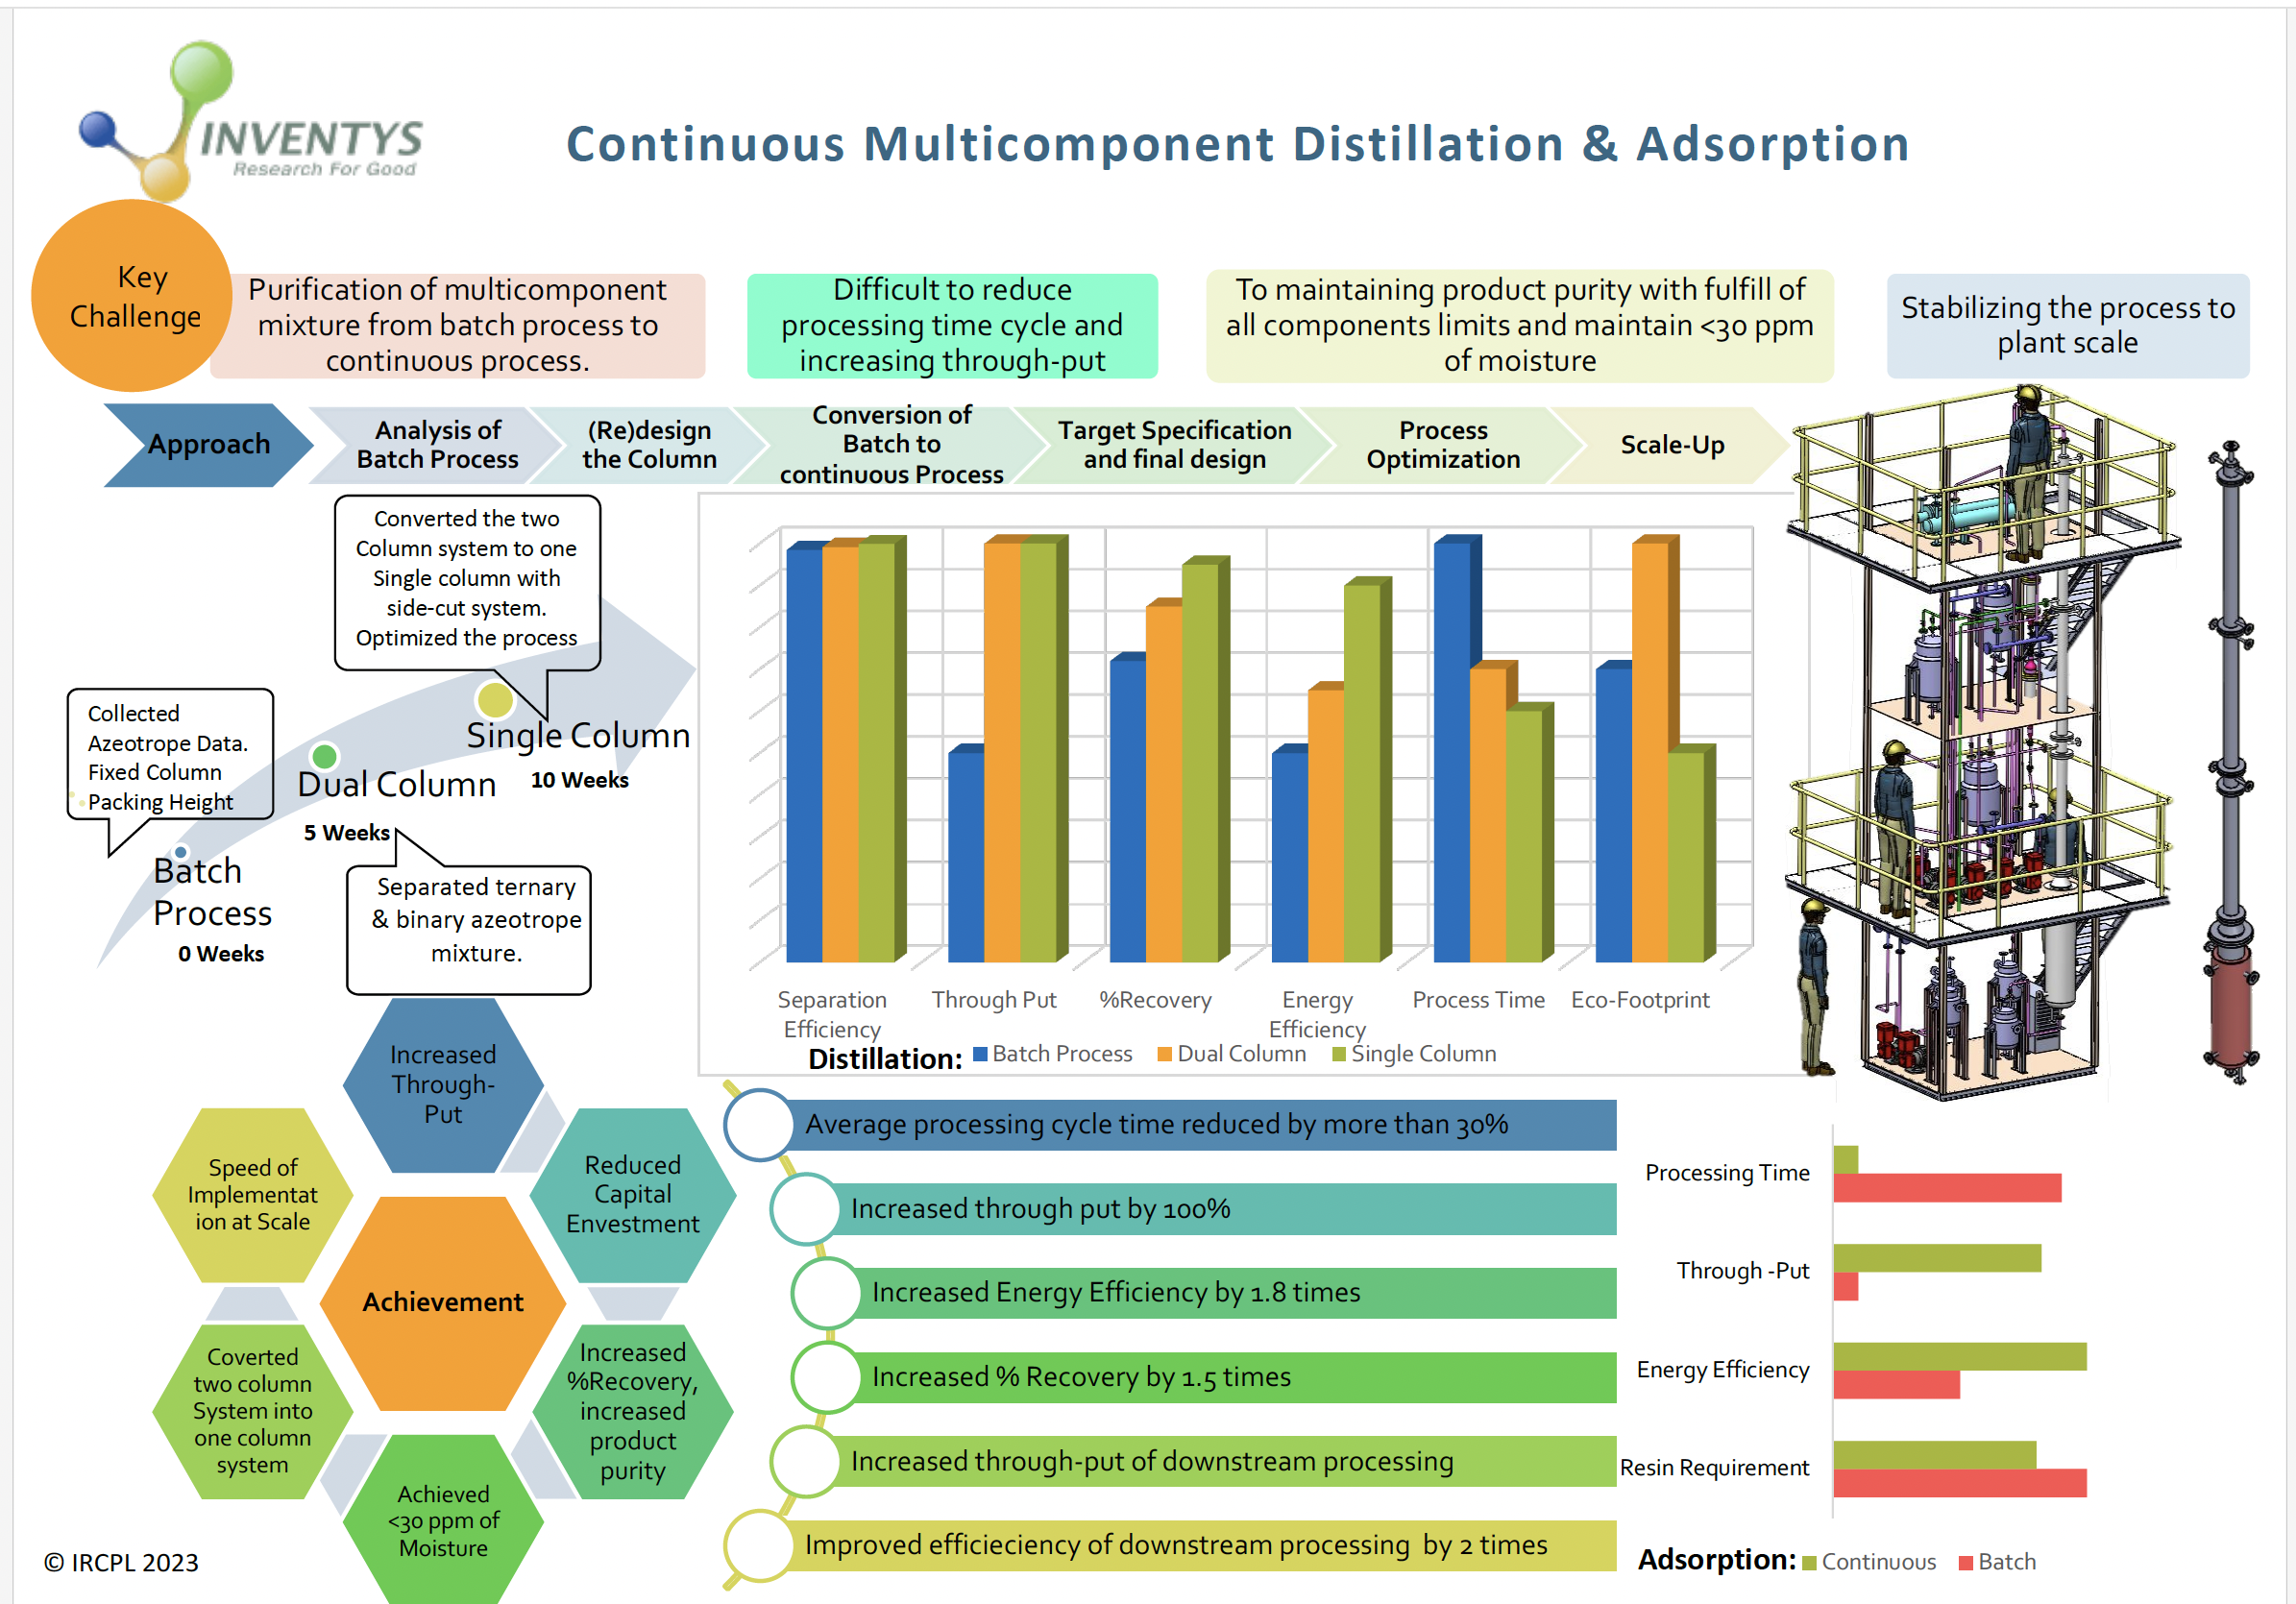

Slide 24
Solvent Recovery System – 50 MT/yr
Application Recovery of acetonitrile
Pilot Plant
  Continuous Multi Component Fractional Distillation
    C-101
    SS316L
    3 met tall packed bed
    Up to 110°C
    Up to 2 Kg/cm²
  Multiple Continuous Adsorption Columns
  (Base Removal, Drying, Iodine Removal)
    AC-101, AC-102, AC-103
    SS316L
    1 met tall packed bed
Development Timeline
  4 month
    Process Feasibility
  6 month
    Process Optimization
  6 month
    Pilot Scale up
  Awaited
    Commercialization

Slide 25
Flow Chemistry – At Laboratory Scale

Slide 26
Future Development Plan
- Telescopic Synthesis of (un)substituted 1,2,3-Triazoles
1,2,3-Triazoles are energetic species – commercial-scale batch processing involving handling large quantities is not preferable
  Also involves handling of (un)substituted hydrazines (as raw materials) – which are also energetic in nature
Synthesis typically involves cyclization (or oxidative cyclization) at elevated temperatures (50ºC)
Continuous manufacturing approach is preferrable
  Reaction media for ALL steps can be single phase (easy-to-pump/handle)
  Higher heat transfer area for easier management of reaction heat and reaction temperature
  Smaller reactor volume ensures less quantity of energetic species in reaction zone, at a time
  Enables safe synthesis of substituted triazoles, without the need to use expensive Pd-Catalysis

Slide 27
Future Development Plan
- Telescopic Synthesis of various Pyridazines
Pyridazine synthesis involves the handling of hydrazine hydrate or (un)substituted hydrazines
Entire synthesis – from amine precursor to pyridazine derivative) – can be done in FLOW
  Diazotization + reduction can be a fully aqueous system
  Diazotization + downstream chemistry has already been implemented in FLOW at a commercial-scale by Inventys
Continuous manufacturing approach is preferred because
  Reaction media for ALL steps can be single phase (easy-to-pump/handle)
  Higher heat transfer area for easier management of reaction heat and reaction temperature
  Smaller reactor volume ensures less quantity of Hydrazines in reaction zone (elevated temperature), at a time

Slide 28
Flow Chemistry Equipment – Lab Scale
Plate Microreactor
  High heat transfer area → for highly endo/exothermic reactions
  Liquid or Liquid-Liquid reactions
  Limited Flowrate
Slurry Flow Reactor
  Liquid-Solid reactions
    With high solid content (>30%)
    Fast-settling suspensions are amenable to operation
  Axial utility temperature control (along reaction coordinate)
  Limited heat transfer area
Pinched Tube Reactor
  Liquid, Liquid-Liquid, Liquid-Solid reactions
    With low solid content (<10%)
    Uniform, slow-setting settling suspension required
  Mass-transfer limited reactions → divots (pinch) in tube design increase turbulence/mixing
Continuous Hydrogenator (Fixed Bed Reactor)
  Gas-Solid, Gas-Liquid-Solid reactions
PFR specially designed
  Liquid – solid reaction
  Liquid – Gas reaction
  Liquid – liquid biphasic reaction
Several self-fabricated flow reactors
  SS PFR
  PFA PFR
Pump Types Available (for a range of flow rates)
  10 µL – 10 mL/min
    Syringe Pump
      Pressure Rating = Atmospheric
  0 – 30 mL/min
    Reciprocating Pump
      Pressure Rating = 5 kg/cm2
      MOC = PTFE
  0 - 50 mL/min
    Reciprocating Pump
      Pressure Rating = 100 kg/cm2
      MOC = Hastelloy
  0 – 100 mL/min
    Reciprocating Pump
      Pressure Rating = 100 kg/cm2
      MOC = Hastelloy
  0 – 1000 mL/min
    Peristaltic Pump
      Pressure Rating = Atmospheric
Utility Systems
  Maximum Temperature = 500ºC (electric)
  Maximum Temperature = 160ºC (fluid)
  Minimum Temperature = -40ºC (fluid)

Slide 29
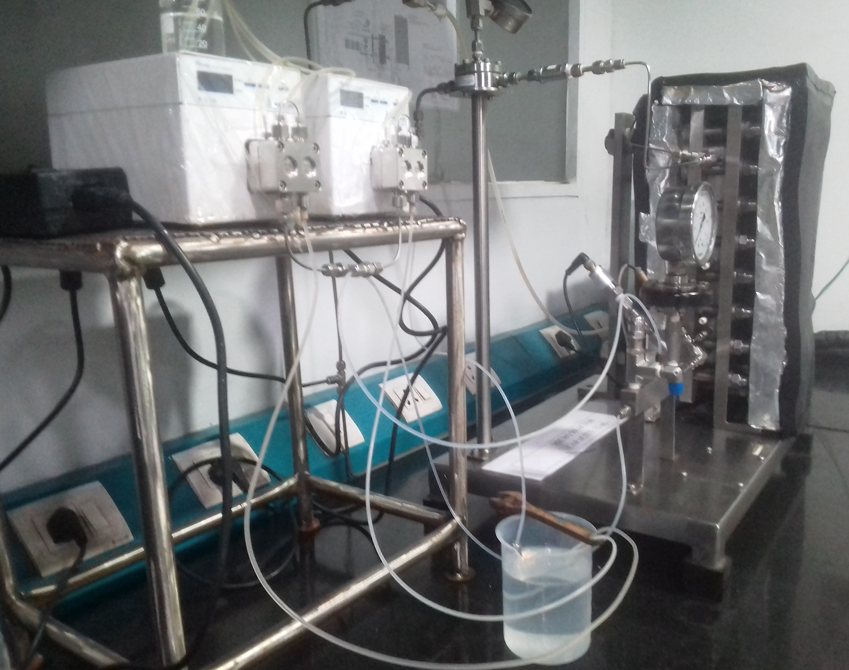
Plate Microreactor - Lab scale
Chemistry done so far
  Aromatic Nitration
  Sulfonyl azide preparation / Azide transfer reagents
  Halex reaction
  Hydrazide preparation
Equipment details
  MOC- Hastelloy
  Large Heat transfer area
    Fine control of process temperature
  Enhanced Mixing
    No limitation of mass transfer
  Volume- 12ml
  Operating Range
    -30°C to 200 °C.
    Pressure up to 20bar.
Output-0.006 to 0.5 Kg/Hr.
Preferred for highly energetic or mass transfer limited process
Location – R&D Lab

Slide 30
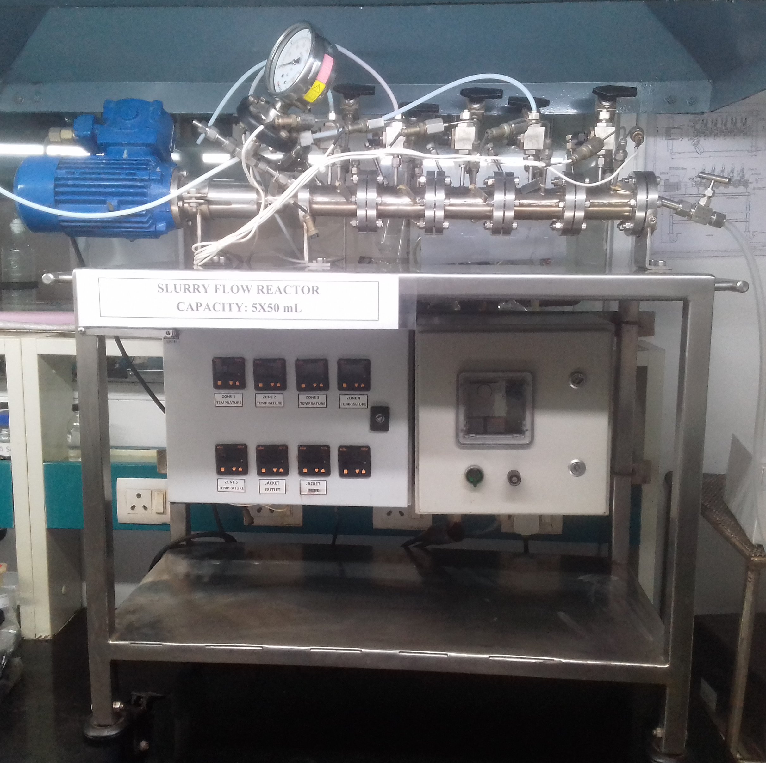
Slurry Flow reactor – Lab scale
Chemistry done so far
  Diazotization reaction
  Mesylation reaction
  Nitrosation
  Pyrimidine synthesis
Equipment Details
  MOC- Hastelloy
  Volume- 50ml X 5 cell
  Operating Range
    -20°C to 200 °C.
    Pressure up to 20 bar.
Output-0.06 to 25 Kg/Hr.
Preferred for solid formation during reaction or in feed
Location – R&D Lab

Slide 31
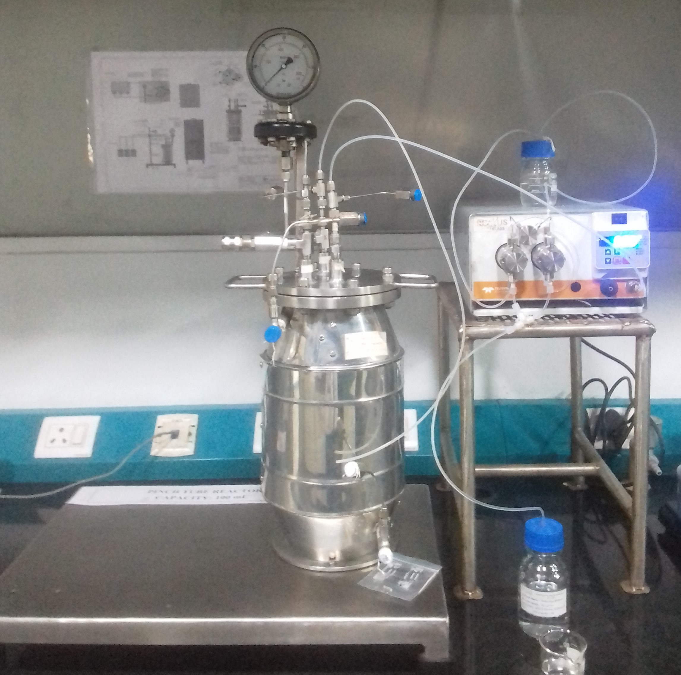
Pinch Tube Reactor – Lab scale or kilo scale
Chemistry Done So far
  Halex reaction scale up
  Sulfonyl azide scale up
  Tetrazole synthesis
  Oxidation using Hydrogen peroxide or sodium hypochlorite
  Reduction Nitro/azide using sulphide reagents
  Butyl lithium reaction
Equipment Details
  MOC- Hastelloy
  Volume- 100ml
  Enhanced Mixing
    No limitation of mass transfer
  Operating Range
    -40°C to 250 °C.
    Pressure up to 50bar.
Preferred for biphasic reactions liquid-liquid and Liquid-gas
Location – R&D Lab

Slide 32
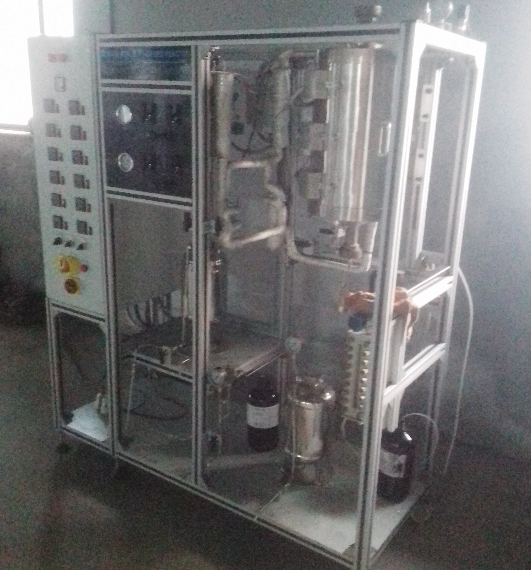
Fixed Bed Reactor – Lab Scale or Kilo scale
Chemistry Done So far
  Hydrogenation
  Nitrile synthesis by thermal dehydration
  Amidation
Equipment details
  MOC- Inconel
  Volume- 500ml (catalyst cavity)
  Operating Range
  35°C to 500 °C.
  Pressure up to 50 bar.
Output- 0.1 to 3.0 Kg/Hr.
Preferred for Liquid-gas; Gas-gas high temperature reaction
Location – R&D Terrace

Slide 33
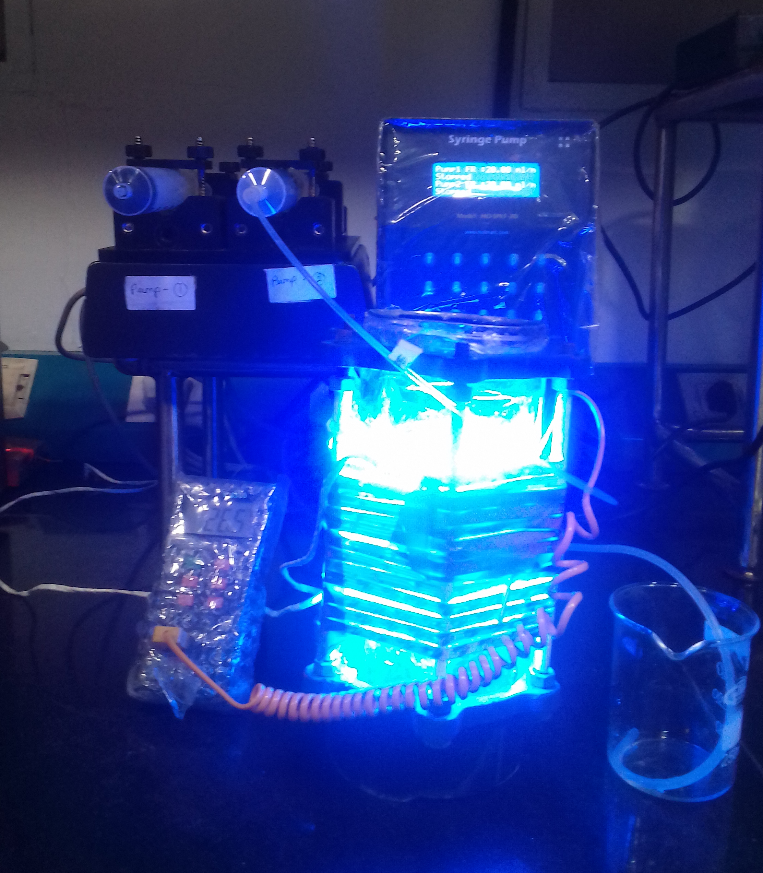
Photo Chemical PFR – lab scale
Chemistry Done so far
  Bromination
  Chlorination
Equipment Details
  MOC- PFA and SS
  Volume- 2 to 10ml
  Operating Range
  RT°C to 80 °C.
  Pressure up to 10 bar.
Output- 0.02 to 0.6 Ltr/Hr.
Preferred for Photo-chemical reactions
Location – R&D Lab

Slide 34
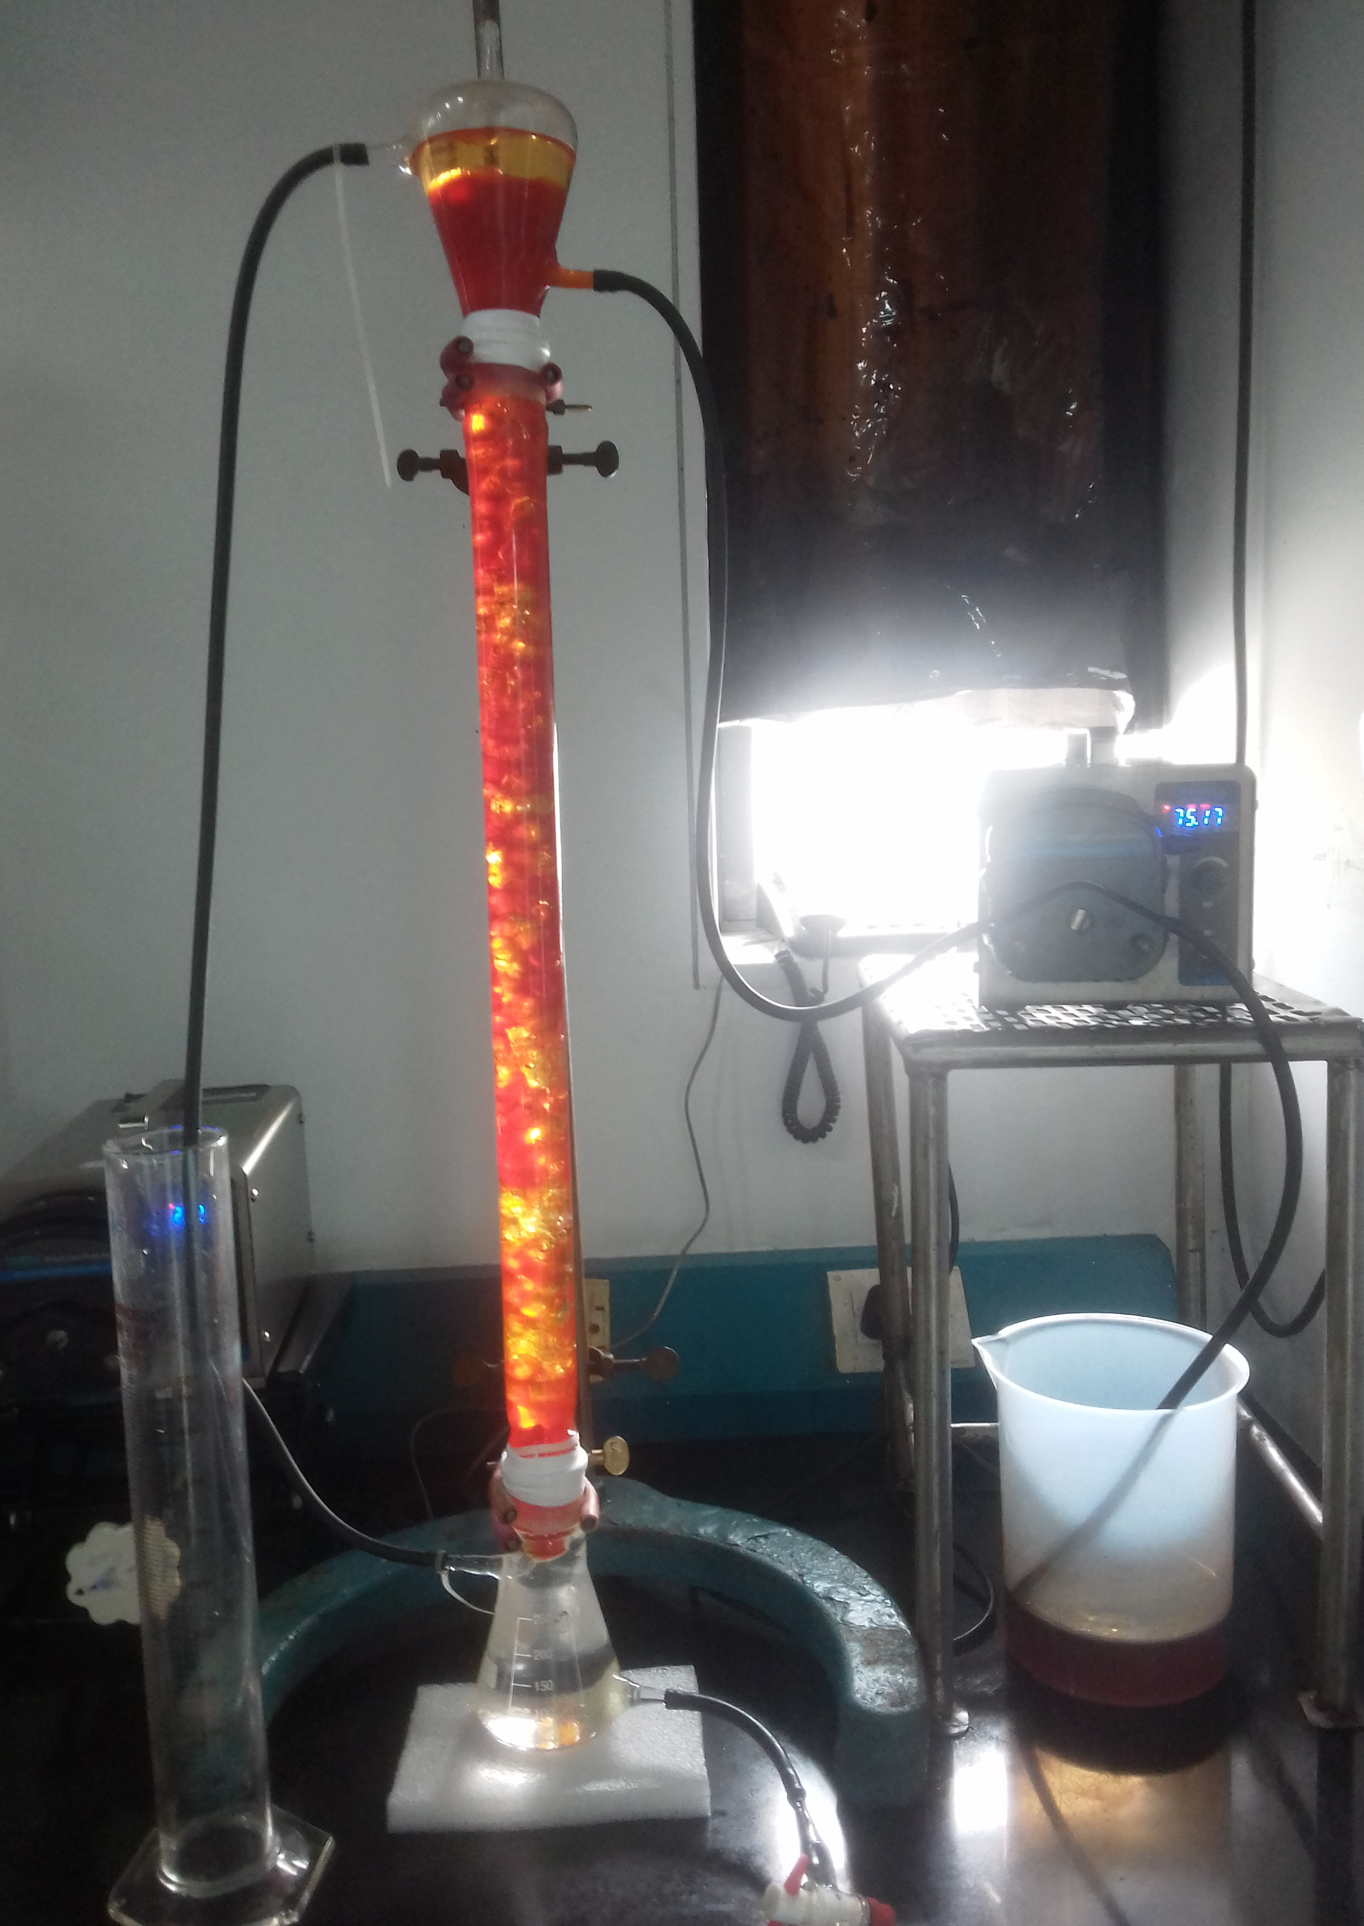
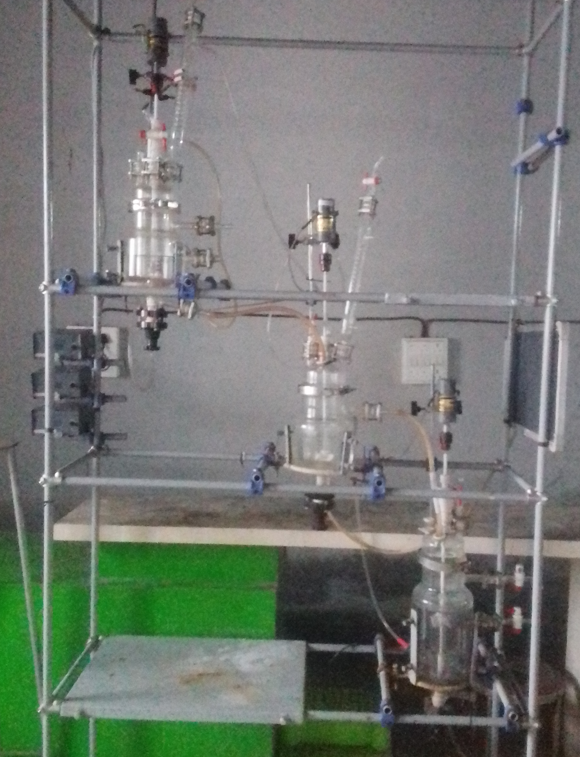
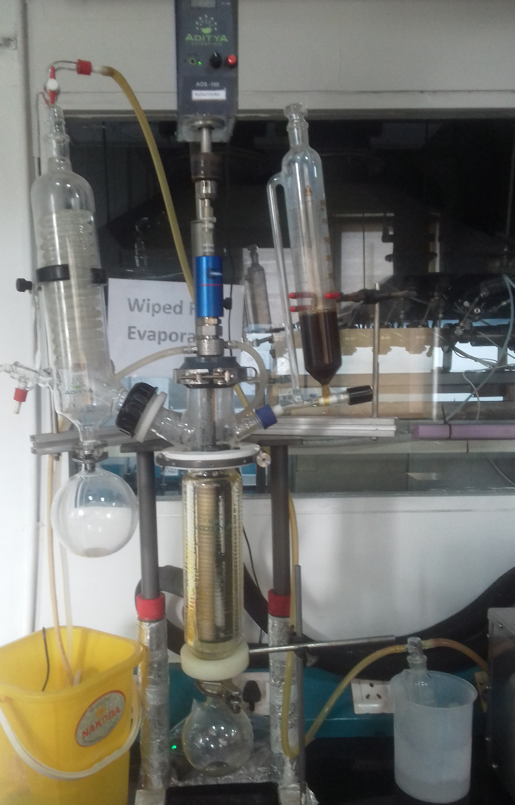
Miscellaneous Reactor / equipment (s)
Extraction Column
CSTR Cascade
ATFE

Slide 35
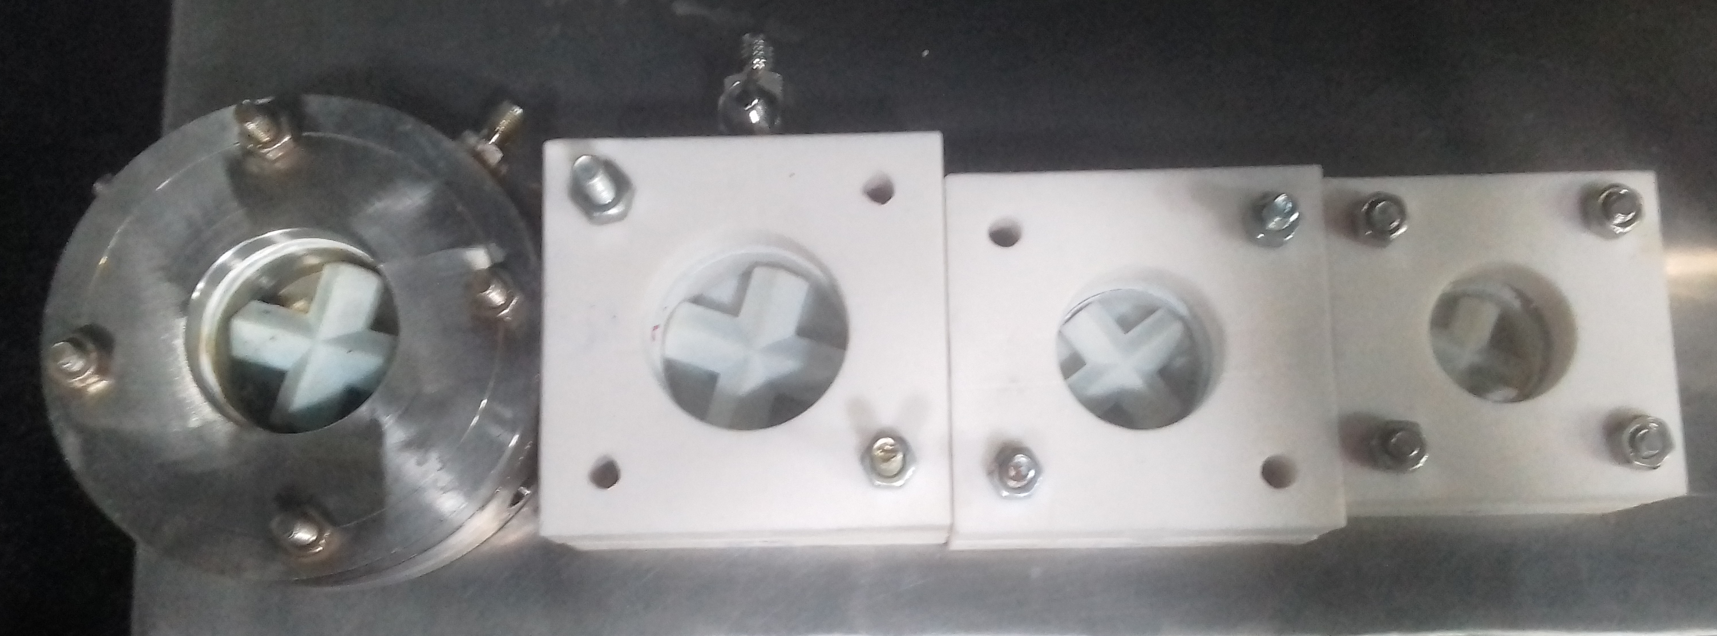
In-house designed & Fabricated CSTR’s

Slide 36
Timeline & Scaleup – Piloting / Flow Chemistry adoption
We recommend that we always start production using Multipurpose capacity
  Say for two years
  To understand the intricacies of the process
  Some cases we could also directly start with flow chemistry
In parallel, work on converting selected operations to the flow process and to dedicated capacities
Typical timeline for flow chemistry
  Lab adoption: 2-4 months
    Conversion to Flow: additional 2-4 months (wherever applicable)
  Pilot Scale up: 3-9 months (depending on hardware requirements)
  Commercialization: 3-15 months (depending on hardware requirements)
We can run 3-6 flow chemistry & 12 batch chemistry projects in parallel

