Slide 1
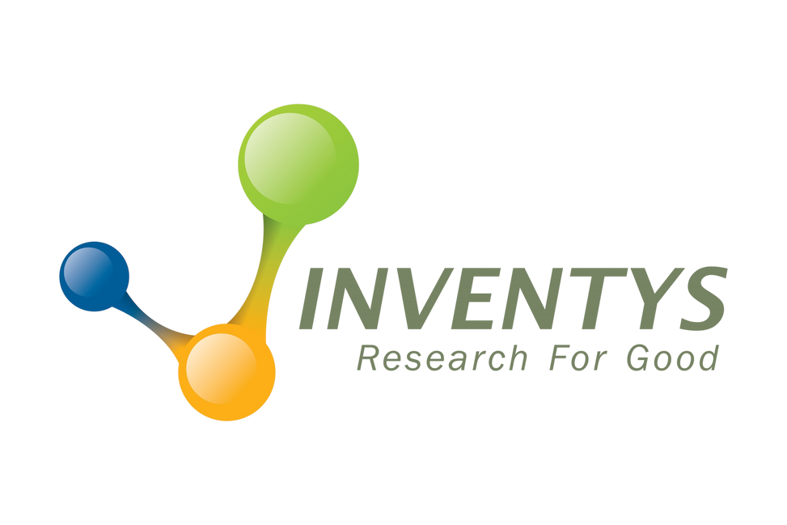
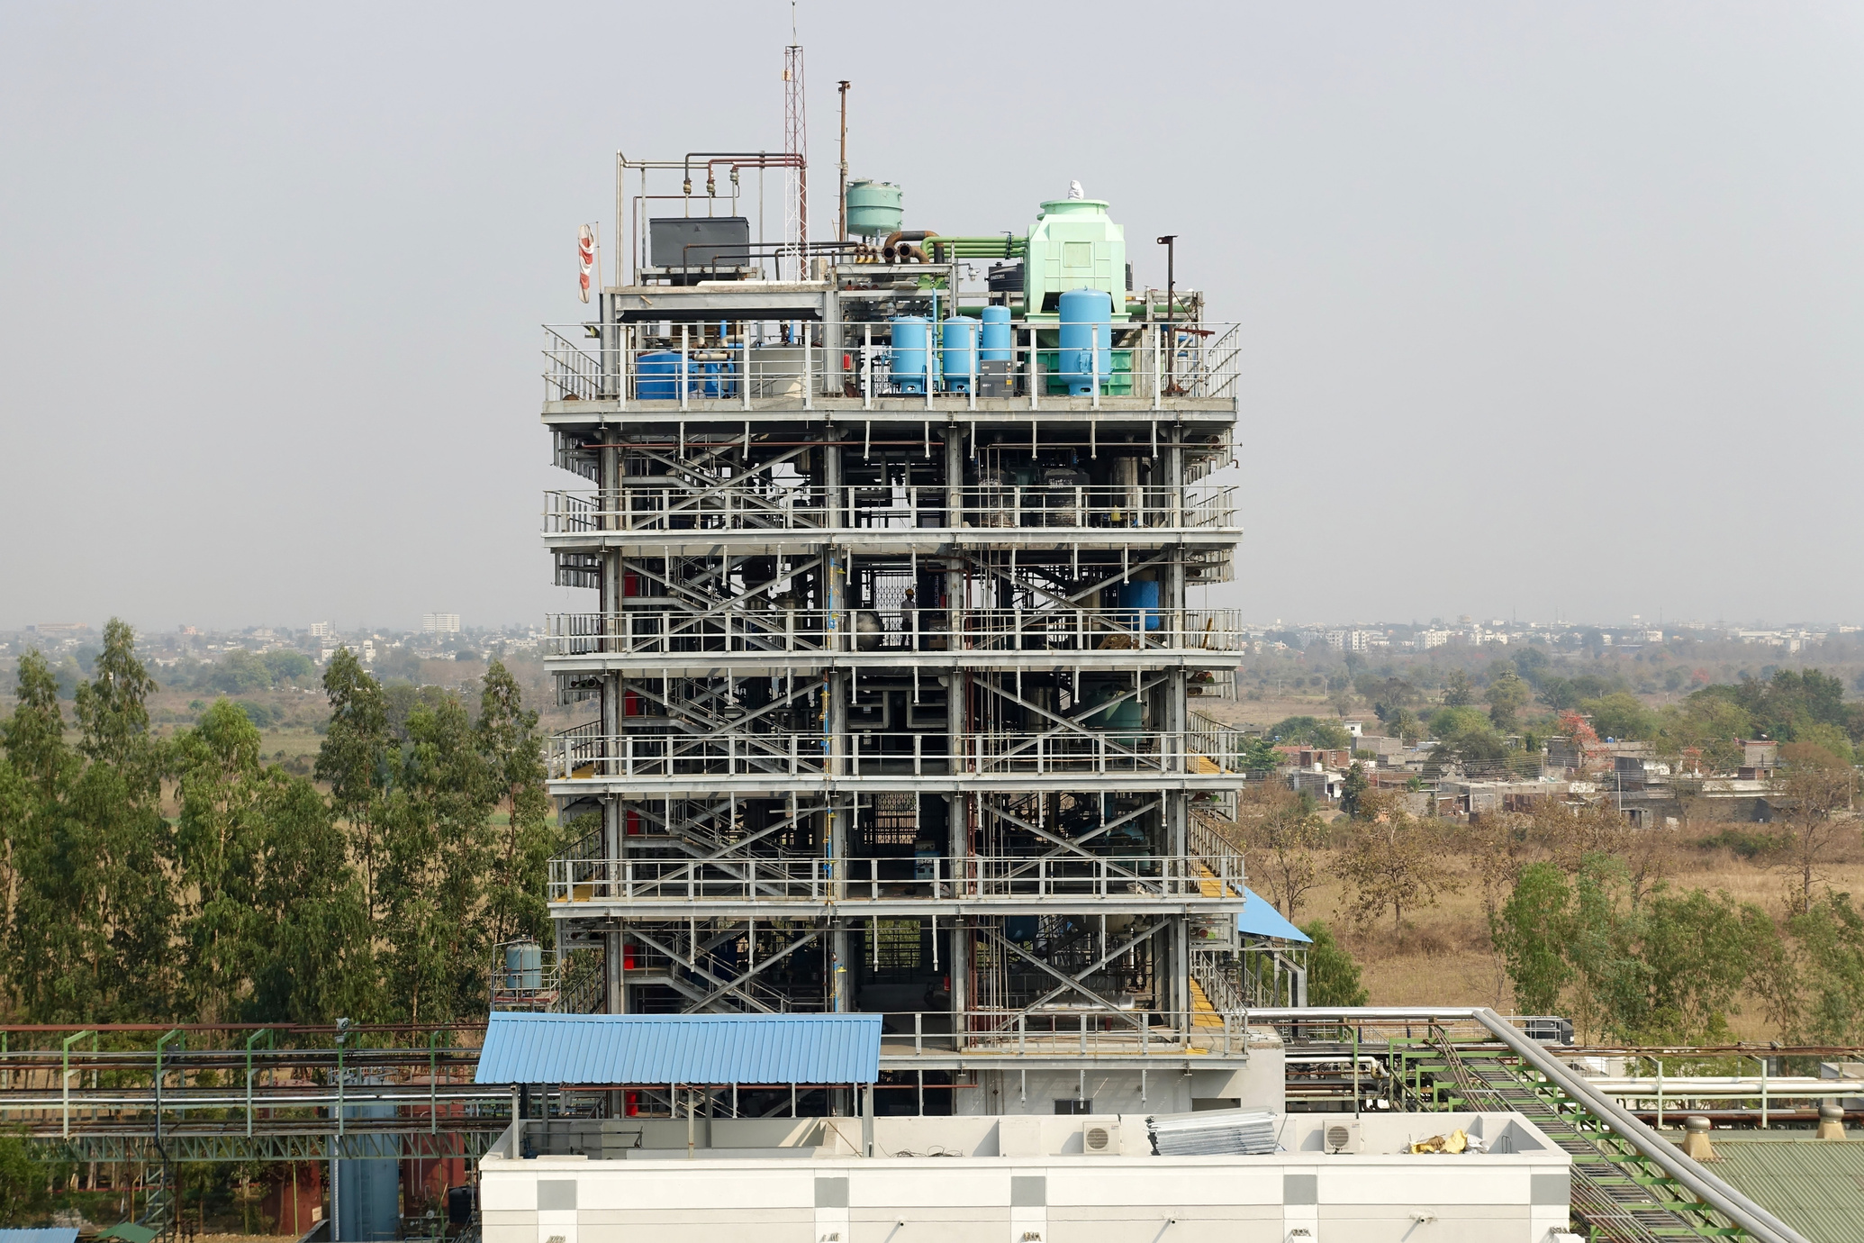



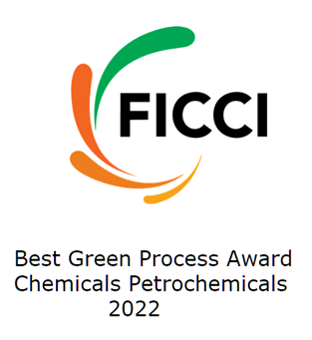
THE
GREEN ACETONITRILE FROM INVENTYS
89
COMPANY CONFIDENTIAL
2025
1

Slide 2
VALUE PROPOSITION FOR GREEN ACETONITRILE
> 51% of energy used is derived from non depletable/ renewable resources with NET ZERO CARBON addition
  TFS score of 89
  Sustainable, Responsible behavior
Zero effluent generation
  Best green process award (Nov 2022) – From FICCI (Federation of Indian chamber of commerce & industry)
  Green route of synthesis
Other advantages
  Synthetic route
  Independent of Acrylonitrile production quantities
  Independent of other supply chain dynamics
COMPANY CONFIDENTIAL
2025
2

Slide 3
  100% Green route - produced from Acetic Acid
  Various Grades for Pharma & other specialty applications
    Availability of customized grades
  No waste, only water as by-product
  GUARANTEED
    ZERO ppm HCN (Hydrogen Cyanide)
    Allyl alcohol
    Benzene
    Inherent Process Advantage
  Less than 500 ppm moisture content
  Less than 5 ppm Acetone content
  Guaranteed Quality
INVENTYS SUPERIOR QUALITY
COMPANY CONFIDENTIAL
2025
3

Slide 4
INVENTYS
VALUES
Reliability & Trustworthyness
Deep Domain Experties
Responsive & Transparent
Zero Critical Dependence On Unreliable Entities
Responsible Behavior Towards Society, Employees, IPR, Environment & Suppliers.
Sound Financials
Safety
Compliance
Quality
COMPANY CONFIDENTIAL
2025
4

Slide 5
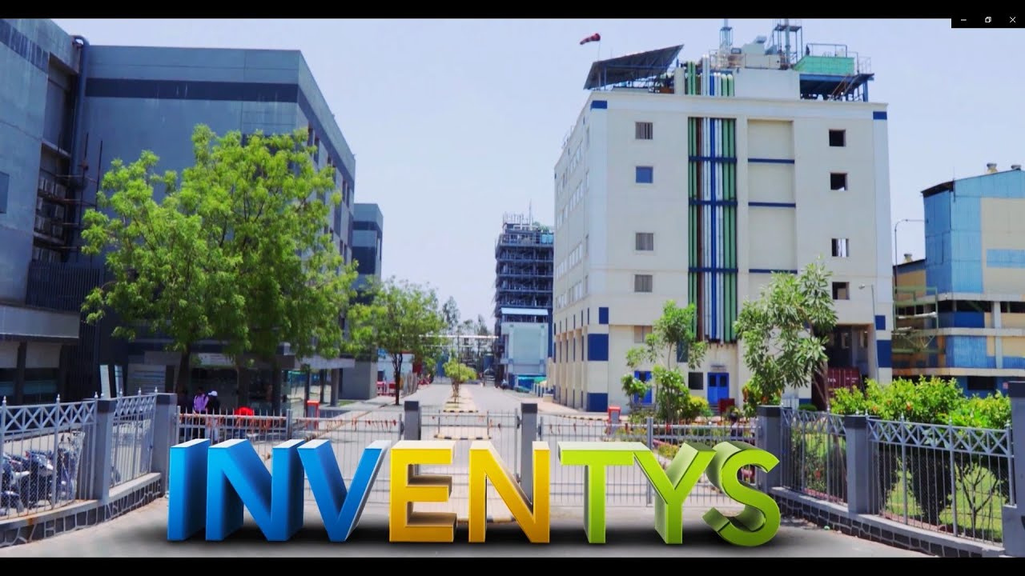

CDMO Services
  Discovery (gm to Kg scale)
  Process Research and Development
  Rapid scale up (1kg to 100kg)
  Regulatory support
EXCLUSIVE SYNTHESIS
&
CDMO
SERVICES
CMO Services
  Manufacturing Services
  Up to few 100MT/yr
  Pharma APIs
  Specialty Chemicals
  Electronic chemicals
COMPANY CONFIDENTIAL
2025
5

Slide 6
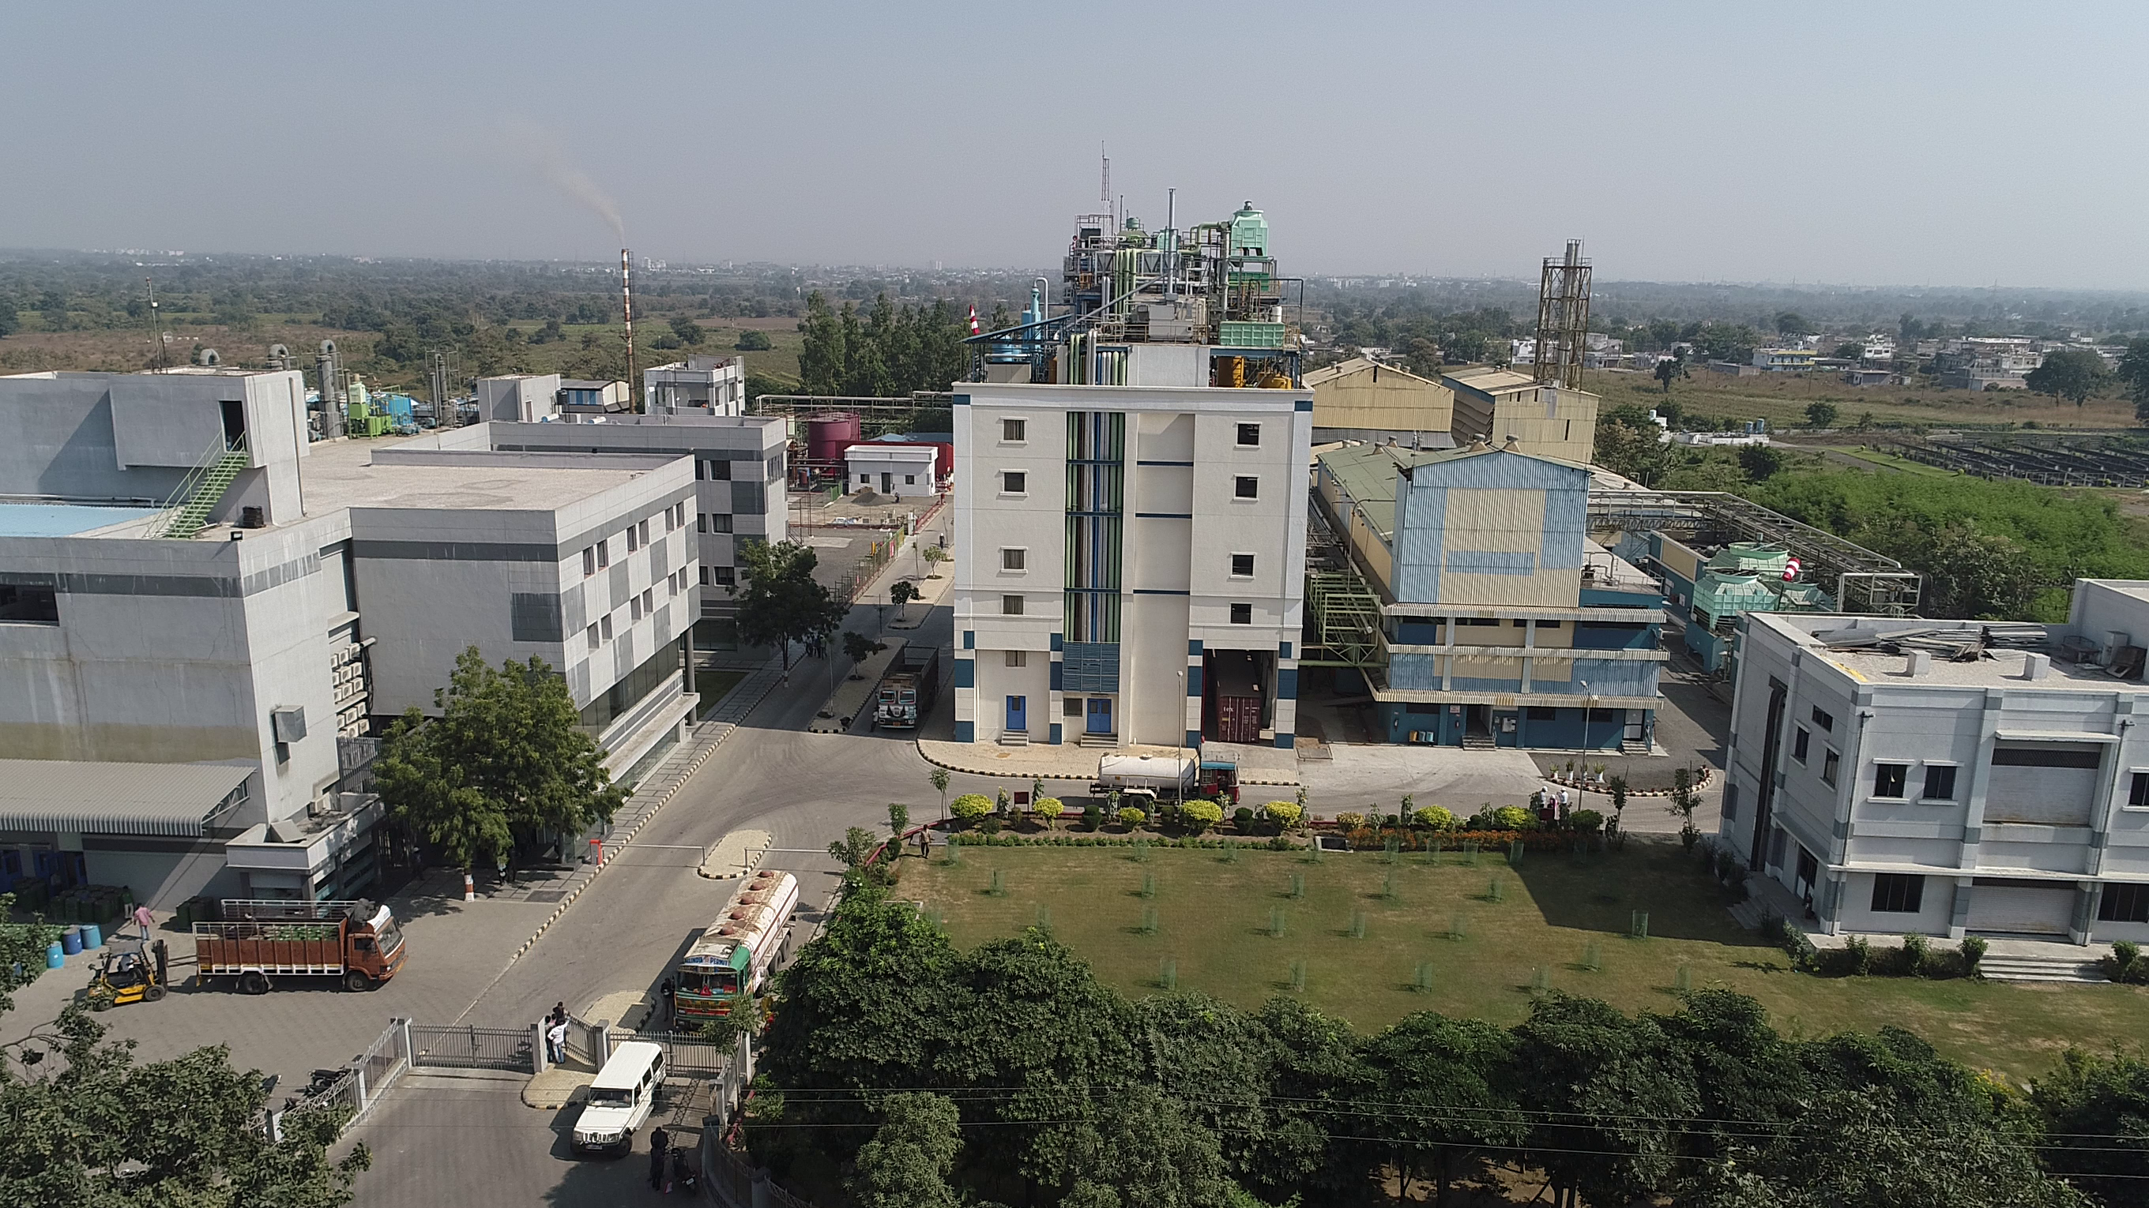

SAFETY & SUSTAINABILITY
  Manufacturing Services
  Up to few 100MT/yr
  Pharma APIs
  Specialty Chemicals
  Electronic chemicals
Safe
Manufacturing
89
>51% of the total energy from Renewable Resources
with Net Zero Carbon since 2012
COMPANY CONFIDENTIAL
2025
6

Slide 7
INVENTYS PROCESS SAFETY SYSTEMS
Hazard Identification & Characterization
  Literature
  TSU / DSC analysis for ALL steps, ALL RMs/Intermediates,
  ALL Products, ALL Waste RC - when required
Process Safety Analysis
  Identify Onset Temperatures, Rate, Profile of Temperature and Pressure Increase
  HAZOP - Three times
Hazards Addressal
  Process Improvements / Modifications
  SOP and Education
  Continuous Training (out of 1,400 training sessions in 2023 - 450 on safety)
COMPANY CONFIDENTIAL
2025
7

Slide 8
One major product (3000 MTs/Yr)
Generates ZERO effluent
12
1
Inherently Safer Chemistry
for Accident
Prevention
11
Pollution
Prevention
2
Inventys Acetonitrile Process received
BEST GREEN PROCESS AWARD
by FICCI
Real-Time Analysis for
Pollution Prevention
Atom
Economy
TECHNOLOGY: GREEN CHEMISTRY
10
Designed
for
Degradation
3
Flow Chemistry
THE 12 PRINCIPLES OF GREEN CHEMISTRY
>50% of energy is derived from renewable resources.
Design Safer Chemical Processes
9
Catalysis
4
Reduces
Derivatives
Safer Solvent & Auxiliaries
NET ZERO carbon footprint
8
Use
Renewable
Feedstocks
Design for
Energy
Efficiency
5
7
6
30%+ revenue derived from processes adhering to the Principles of Green Chemistry
COMPANY CONFIDENTIAL
2025
8

Slide 9
INVENTYS
SUSTAINABLE, SAFE AND RELIABLE
Demonstrated track Record of sustainable and safe practices
  11+ years of highly sustainable practices
  15 + years of High quality reliable supply and safe practicesconsistently
  Strong financials
Large state-of-the-art automated facility
  ~3000 KL of reactor capacity (2024-2027)
  One of top 10 in India
Exclusive synthesis/CMO/CDMO for large innovator supply chains
Proffessional management team with well funded 5 year business plan
Complex broad range of chemistries and Superior Engineerin
  Stable backward integrated supplychain and Flow Chemistry expertise
Financial times (London) and STATISTA (Germany) rated Inventys as one of TOP 250 fasted growing companies in Asia pacific
COMPANY CONFIDENTIAL
2025
9

